Slide 1




DevOps Practice: Effective Data Distribution on Kafka Cluster to attain Low latency and High throughput in Data streaming Use cases
By
Suganya Srinivasan
Senior BigData Engineer
Tata Consultancy Services
Chennai
27,28 June 2020
Ruban Kumar
BigData Engineer
Tata Consultancy Services
Chennai

Slide 2
Agenda
Kafka, its place in Bigdata family!
Problem Statement
Role of Zookeeper in Kafka
Kafka Cluster is AWS
Configuration Management - Ansible
Performance aspects(Low latency and High Throughput)
Partition Reassignment – Kafka
Keys to consideration.

Slide 3
Kafka Basics
Brokers holds topic partitions
Brokers receive and serve data
Brokers are the unit of Parallelism of a Kafka Cluster
Brokers are the essence of the “distributed” aspect of Kafka
Producers are the publisher of messages to one or more Kafka topics. Producers send data to Kafka brokers
Consumers read data from brokers. Consumers subscribes to one or more topics

Slide 4
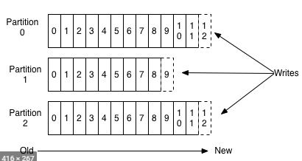
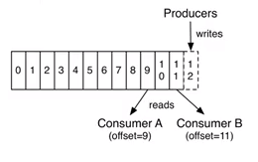
Anatomy of a Kafka Topic
Kafka topics are divided into several partitions
Partitions allow you to parallelize a topic by splitting the data in a topic across multiple brokers
Each partition can be placed on a separate machine to allow for multiple consumers to read from a topic in parallel

Slide 5
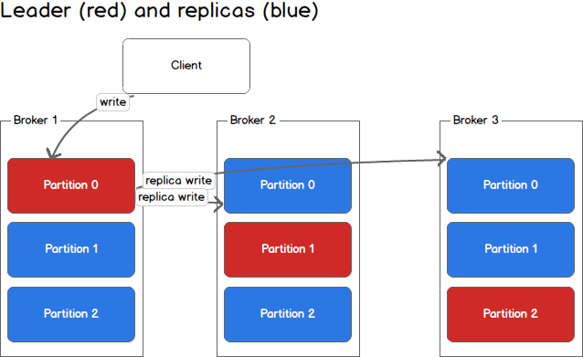
Kafka Consistency and Failover
Each node in the Cluster called Kafka Broker
Each Partition can be replicated across multiple brokers to tolerate node failures
One of the partition replicas is chosen as leader. And the leader handles all read and writes of messages in the partition
On leader failures, one of the in-sync replicas is chosen as the new leader

Slide 6
Problem Statement
Partition reassignment – kafka
Kafka-reassign-partitions has 2 flaws:
It is not aware of partitions size
Does not limit partition migration between brokers
Thus it does not generate a deterministic plan, so we should not trust it

Slide 7
Role of Zookeeper in Kafka
Brokers registration with heartbeat mechanism to keep the list current
Maintaining a list of Topics alongside
Their configuration(partitions, replication factor, other configurations)
The list of ISR(in sync replicas) for partitions
Performing leader election in case any brokers down
Storing the Cluster ID
Storing ACLs if security is enabled
Quotas configurations if enabled

Slide 8
Zookeeper Performance - Kafka
Latency is key for Zookeeper and any of these variables will affect it.
Fast Disk(SSD)
No RAM Swap
Separate Disk for snapshot and logs
High Performance Network(low latency)
Reasonable number of Zookeepers
Isolation of Zookeeper instances from other processes

Slide 9
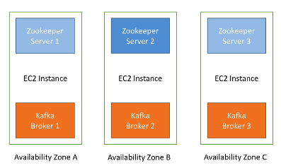
Kafka Cluster Set-up

Slide 10
Kafka Configuration
Latency is key for Zookeeper and any of these variables will affect it.
Kafka Configuration in Production is an ART
It requires Good Understanding of:
Operating Systems Architecture
Servers Architecture
Distributed Computing
CPU Operations
Network Operations
Disk I/O
RAM and Heap Size
Page Cache
Kafka and Zookeeper

Slide 11
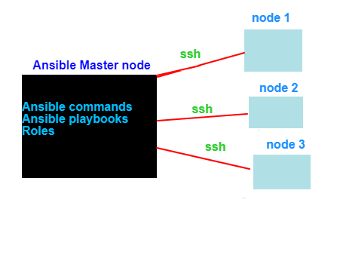
Configuration Management - Ansible
Uses ssh to connect servers
Client only
Modules only (free to download)
Idempotent
Linux friendly

Slide 12
Kafka Performance – Low Latency & High Throughput
More partitions allow greater parallelism for consumption, but this will also result in more files across the brokers
After quite a time, uneven partitions and unbalanced brokers can make headache where partition reassignment is required
An unbalanced cluster can generate unnecessary disk, CPU problems or even the need to add another broker to handle unexpected traffic

Slide 13
How to determine the number of partitions each of your Kafka topics requires
Partitions = max(N_{P}, N_{C})
where:
N_{P} is the number of required producers determined by calculating: T_{T}/T_{P}
N_{C} is the number of required consumers determined by calculating: T_{T}/T_{C}
T_{T} is the total expected throughput for our system
T_{P} is the max throughput of a single producer to a single partition
T_{C} is the max throughput of a single consumer from a single partition

Slide 14

Kafka-reassign-partitions
This tool uses two JSON files for input. One is created by the user and another one will be created by tool as a proposed plan.
Topics-to-Move JSON
Reassignment Configuration JSON

Slide 15
Ongoing POC
“Topicmappr” by DATADOG is a drop-in replacement for the kafka kafka-reassign-partitions.sh script --generate function with a few additional features:
Deterministic Output.
Minimal movement broker replacements
Configurable, rack-aware partition placement
Replication factor updates
Clear action summaries.

Slide 16
Reference
https://docs.cloudera.com/runtime/7.1.1/kafka-managing/topics/kafka-manage-cli-reassign-overview.html
https://www.datadoghq.com/blog/engineering/introducing-kafka-kit-tools-for-scaling-kafka/

Slide 17
Thank you
https://www.linkedin.com/in/suganya-srinivasan-952ab6b5/
https://www.linkedin.com/in/ruban-kumar-e-h-b18844157

