Slide 1
HTML 5
Course Level – Intermediate

Slide 2
About the Course Creators
Course Name | HTML 5
Course Author Name : | Valan Arasu M & Logeshwaran M
About the Author : | Senior Technical Trainer L&D
Date of Creation | 18-Aug-2023

Slide 3
After completing this course, the participants will be able:
to understand the usage of HTML in web page creation.
to understand how to use various HTML tags to create the web page.
Course Learning Objectives

Slide 4
What is a web page?
How to create a web page using HTML?
What are the various tags are available in HTML?
How create various layout in a web page?
Do You Know?

Slide 5
Pre-Test
S.No | Question | Answer Options
1 | What does the abbreviation HTML stand for? | a)HyperText Markup Language. b) HighText Markup Language. c) HyperText Markdown Language. d) None of the above.
2 | How many sizes of headers are available in HTML? | a) 5 b) 6 c) 4 d) 7

Slide 6
Pre-Test
S.No | Question | Answer Options
3 | What is the smallest header in HTML by default? | a) h6 b) h1 c) h2 d) h5
4 | What are the types of lists available in HTML? | a) Ordered and Unordered List. b) Numbered and Bulleted List. c) Named and Unnamed List. d) None of the above.

Slide 7
HTML - Overview

Slide 8
HTML stands for HyperText Markup Language.
HTML is used to create web pages and web applications.
HTML is widely used language on the web.
We can create a static website by using HTML.
Technically, HTML is a Markup language rather than a programming language.
Introduction to HTML.

Slide 9
HTML is an acronym which stands for Hyper Text Markup Language which is used for creating web pages and web applications.
Hyper Text: HyperText simply means "Text within Text." A text has a link within it, is a hypertext. Whenever you click on a link which brings you to a new webpage, you have clicked on a hypertext. HyperText is a way to link two or more web pages (HTML documents) with each other.
What is HTML?

Slide 10
Markup language: A markup language is a computer language that is used to apply layout and formatting conventions to a text document.
Web Page: A web page is a document which is commonly written in HTML and translated by a web browser. A web page can be identified by entering an URL. A Web page can be of the static or dynamic type. With the help of HTM, we can create static web pages.
What is HTML?

Slide 11
<html>
<head>
<title>Web page title</title>
</head>
<body>
<h1>Write Your First Heading</h1>
<p>Write Your First Paragraph.</p>
</body>
</html>
HTML Structure.

Slide 12
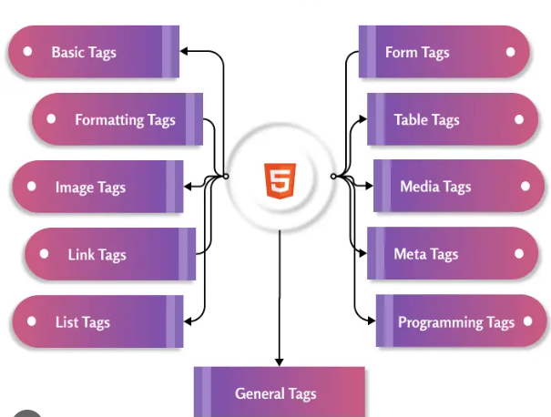
HTML Tags

Slide 13
HTML - Basic Tags

Slide 14
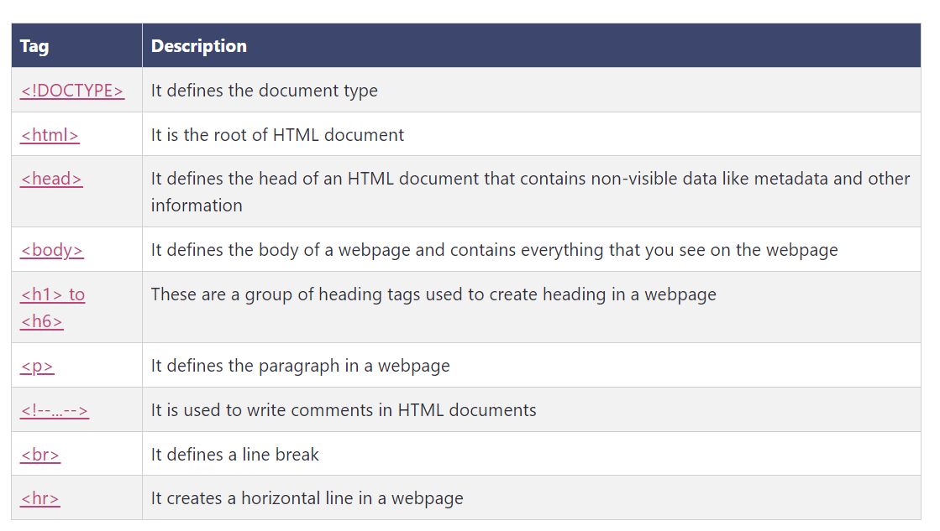
HTML Basic Tags

Slide 15
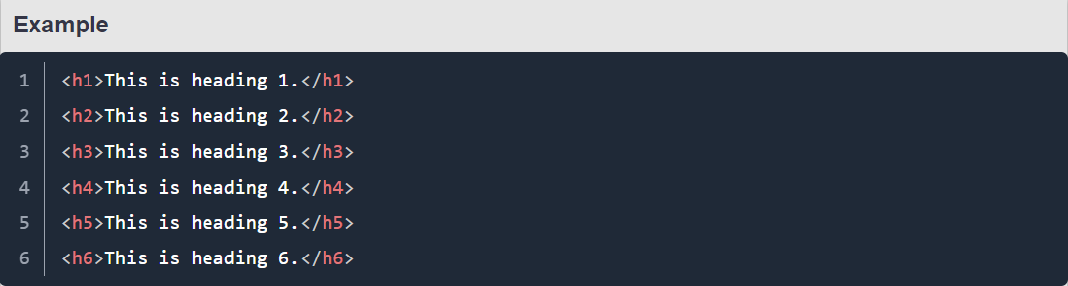
Heading Tags

Slide 16
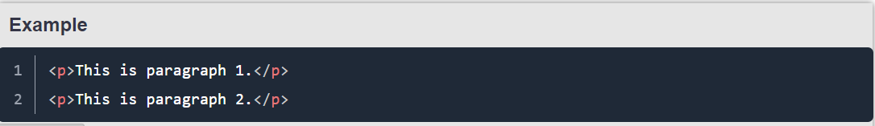
<p> Tag

Slide 17
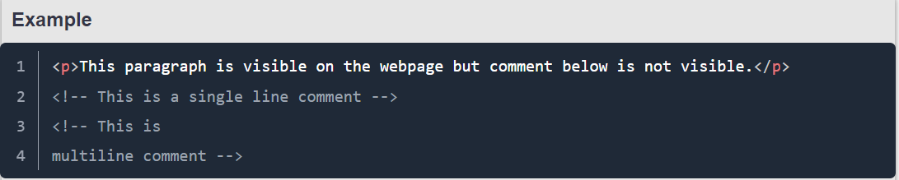
Comment Tag

Slide 18
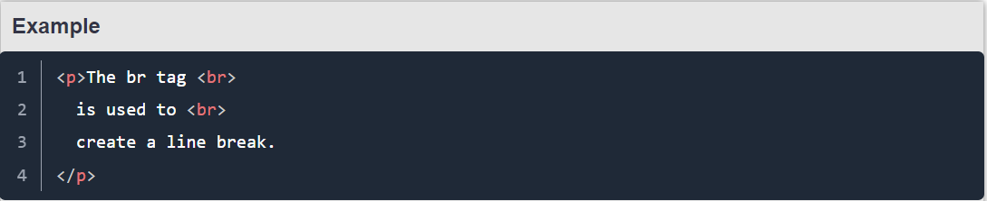
<br> Tag

Slide 19
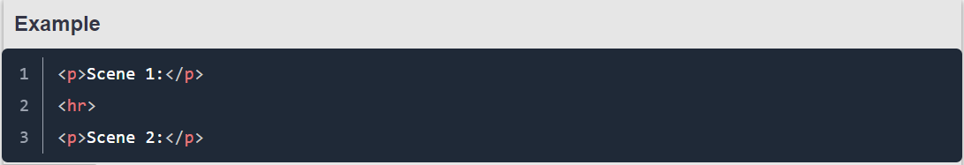
<hr> Tag

Slide 20
HTML - Elements & Attributes

Slide 21
An HTML element is defined by a starting tag. If the element contains other content, it ends with a closing tag, where the element name is preceded by a forward slash as shown below with few tags.
HTML Elements
Start Tag | Content | End Tag
<p> | This is paragraph content. | </p>
<h1> | This is heading content. | </h1>
<div> | This is division content. | </div>

Slide 22
We have seen few HTML tags and their usage like heading tags <h1>, <h2>, paragraph tag <p> and other tags. We used them so far in their simplest form, but most of the HTML tags can also have attributes, which are extra bits of information.
An attribute is used to define the characteristics of an HTML element and is placed inside the element's opening tag. All attributes are made up of two parts − a name and a value.
Example:
<p align = "left">This is left aligned</p>
<p align = "center">This is center aligned</p>
<p align = "right">This is right aligned</p>
HTML Attributes

Slide 23
HTML - Formatting

Slide 24
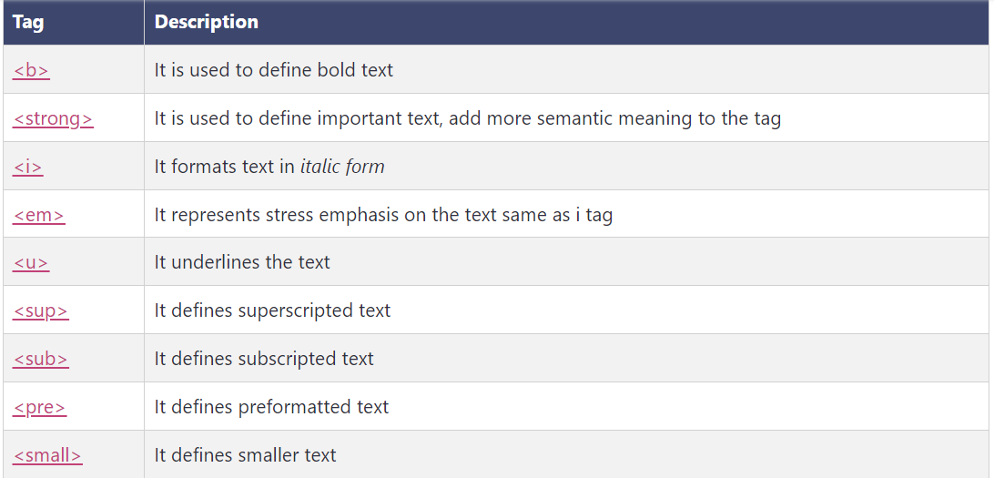
Formatting Tags

Slide 25
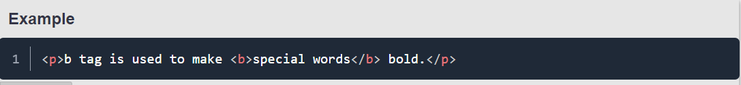
<b> Tag

Slide 26
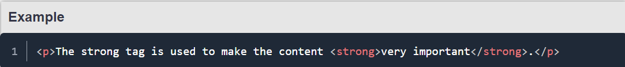
<strong> Tag

Slide 27
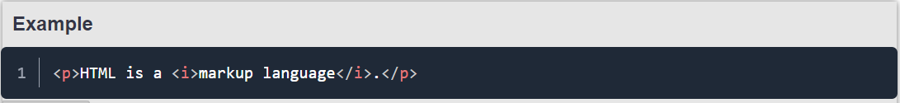
<i> Tag

Slide 28
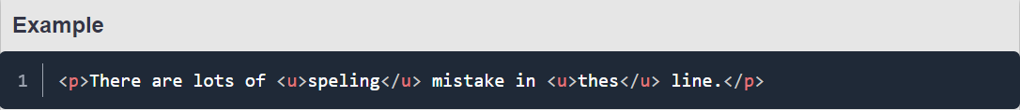
<u> Tag

Slide 29
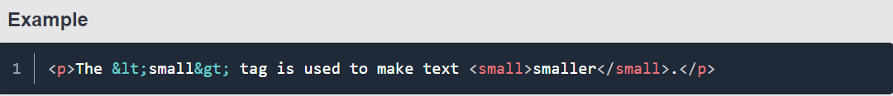
<small> Tag

Slide 30
HTML - Images

Slide 31
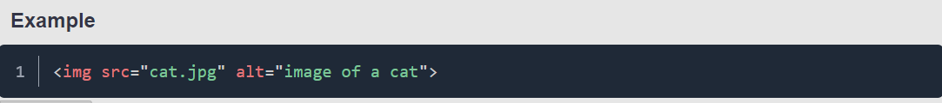
You can insert any image in your web page by using <img> tag.
Insert Image

Slide 32
You can set image width and height based on your requirement using width and height attributes.
Set Image Width & Height
<img src = "bird.png" width=”150” height=”200”/>

Slide 33
By default, image will have a border around it, you can specify border thickness in terms of pixels using border attribute. A thickness of 0 means, no border around the picture.
Set Image Border
<img src = "bird.png" width=”150” height=”200” border=”3” />

Slide 34
HTML - Tables

Slide 35
The HTML tables allow web authors to arrange data like text, images, links, other tables, etc. into rows and columns of cells.
The HTML tables are created using the <table> tag in which the <tr> tag is used to create table rows and <td> tag is used to create data cells.
The elements under <td> are regular and left aligned by default
HTML - Tables

Slide 36
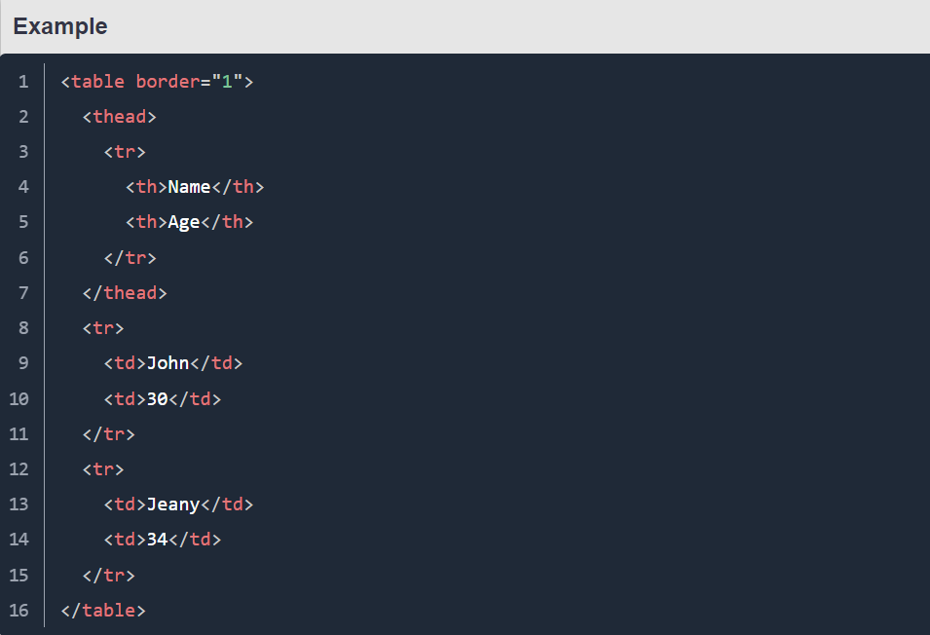
HTML - Tables

Slide 37
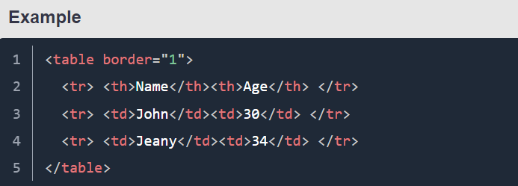
The <tr> tag is used to create a row of cells in a table. For each row create a new <tr> tag. The rows are populated with either <th> tag or <td> tag.
<tr> <th> <td> Tag

Slide 38
HTML - Lists

Slide 39
HTML offers web authors three ways for specifying lists of information.
All lists must contain one or more list elements.
<ul> − An unordered list. This will list items using plain bullets.
<ol> − An ordered list. This will use different schemes of numbers to list your items.
<dl> − A definition list. This arranges your items in the same way as they are arranged in a dictionary.
HTML - Lists

Slide 40
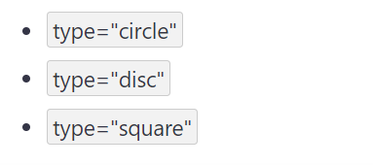
Unordered List
The <ul> tag defines unordered list. It behaves like a container for unordered list items.
The unordered list items are rendered as bullet items however they can be changed using the type attribute.

Slide 41
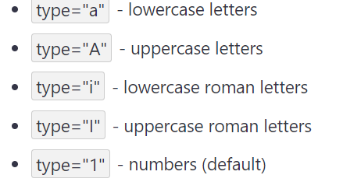
Ordered List
The <ol> tag defines an ordered list of items. It behaves like a container for a list item that is listed in order.
The default order of <ol> tag is 1, 2, 3... and so on. While you can use the type attribute to set different types of numbering.

Slide 42
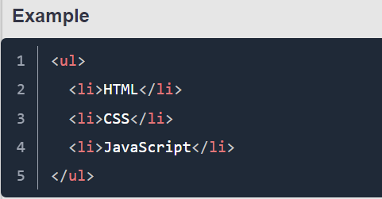
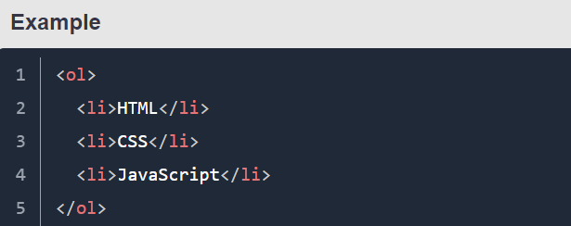
<li> Tag
The <li> tag is used to create list items for all types of lists. It must have a parent like <ol> or <ul>.

Slide 43
Definition List
The <dl> tag defines a definition / description list.
Description list contains a list of groups of the term specified by <dt> and their descriptions specified by <dd>.
The <dt> tag defines a description term in description list. It must lie inside <dl> tag.
The <dd> tag defines description for a term in description list. It is proceeding term of <dd> tag and lies inside <dl> tag.

Slide 44
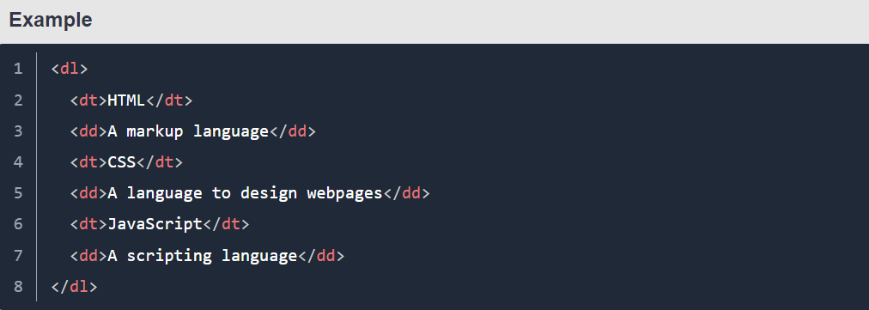
Definition List

Slide 45
HTML - Forms

Slide 46
<form> Tag
The <form> tag is used to define a form in an HTML document for submitting a user's information.
An HTML form includes different types of input for different data submissions.

Slide 47
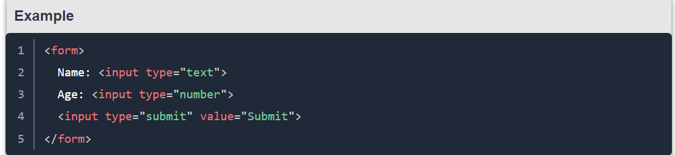
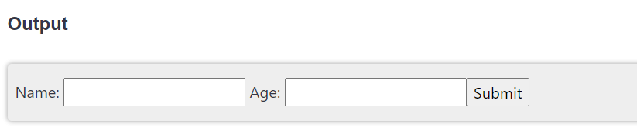
<form> Tag

Slide 48
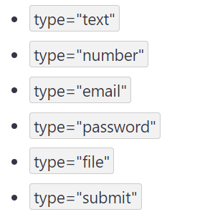
<input> Tag
The <input> tag is used to create an input component in the web pages. It needs a type attribute to tell the browser what type of data this input component will accept.
The default value of type attribute is text. The type attribute can have many different values as shown in the list:

Slide 49
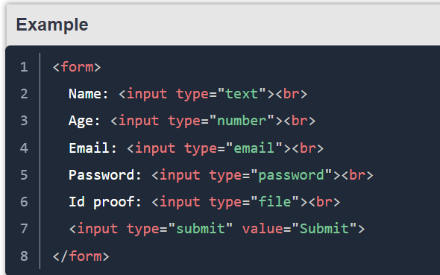
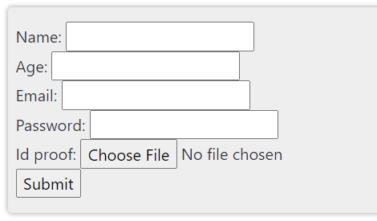
<input> Tag

Slide 50
HTML - Media Tags

Slide 51
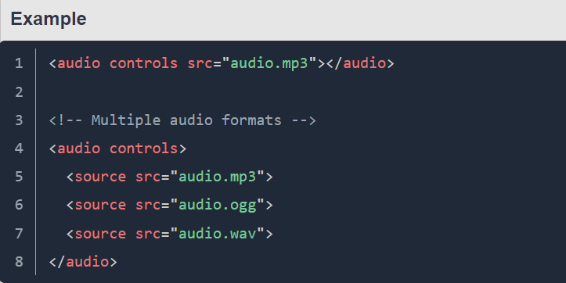
<audio> Tag

Slide 52
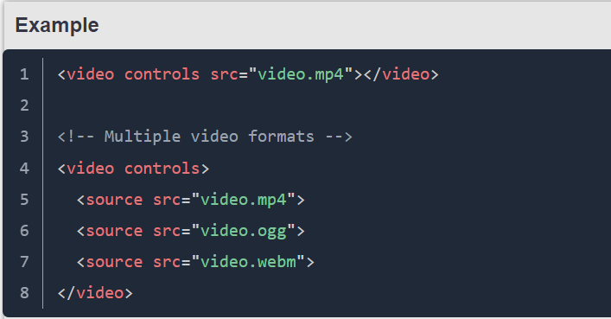
<video> Tag

Slide 53
HTML - General Tags

Slide 54
The <div> tag is used to create a division or a section in an HTML document.
It is used to group HTML elements for styling purposes. Unless it is styled using CSS, it will not be displayed nor will have any effect on the layout of the document.
It can be used to create a header, footer, sidebar, etc.
<div> Tag

Slide 55
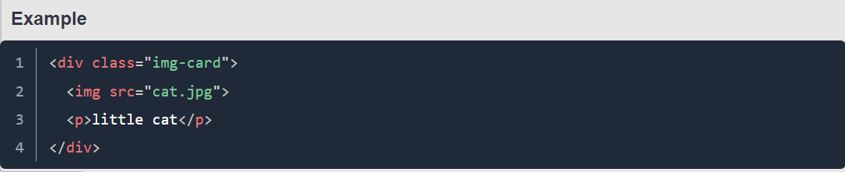
<div> Tag

Slide 56
The <span> tag is an inline container used to mark up a part of a text, or a part of a document.
The <span> tag is easily styled by CSS or manipulated with JavaScript using the class or id attribute.
The <span> tag is much like the <div> element, but <div> is a block-level element and <span> is an inline element.
<span> Tag

Slide 57
HTML - Programming Tags

Slide 58
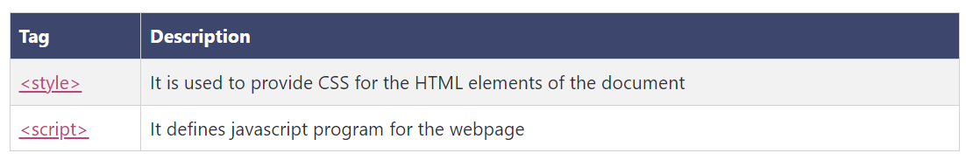
HTML Programming Tags

Slide 59

Check Your Understanding
What is web page?
How to create a web page using HTML?
What are the various tags are available in HTML?

Slide 60

Question & Answer

Slide 61
https://www.w3schools.com/html/
https://www.tutorialspoint.com/html/index.htm
https://www.javatpoint.com/html-tutorial
Reference Materials

Slide 62
Valan Arasu M

