Slide 1
Boosting Algorithms
The main purpose of boosting is to increase predictive accuracy and reduce high bias in machine learning models. Boosting is also one of the ensemble learning techniques, similar to Random Forest, where multiple models are created and combined sequentially to improve overall prediction performance.
Following are the commonly boosting algorithms,
AdaBoost (Adaptive Boosting)
XGBoost (Extreme Gradient Boosting)
LG Boost (Light Gradient Boosting)

Slide 2
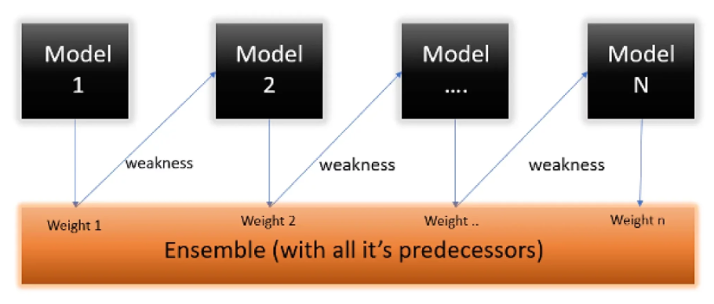
AdaBoost (Adaptive Boosting)
It gives more importance to data points that were predicted poorly in previous rounds.
It is an ensemble method that combines multiple weak models which have low predictive power, to create a strong model with high predictive power.

Slide 3
XGBoost (Extreme Gradient Boosting)
Gradient boosting refers to a class of ensemble machine learning algorithms that can be used for classification or regression predictive modeling problems.
Ensembles are constructed from decision tree models. Trees are added one at a time to the ensemble and fit to correct the prediction errors made by prior models. This is a type of ensemble machine learning model referred to as boosting.
xgboost is not an inbuild library in Python. Using the following pip command to install. pip install xgboost

Slide 4
LG Boost (Light Gradient Boosting)
LightGBM is a type of Gradient Boosting Machine (GBM) that utilizes a structure incorporating tree-based learning algorithms.
lightgbm also not inbuild library, and use following pip command to intall. pip install lightgbm

Slide 5
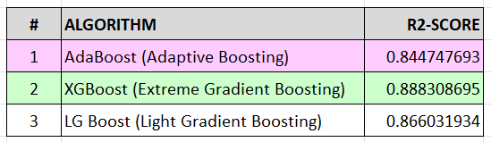
Final touch:
Based on the R2_score, XGBoost preforming better than others and AdaBoost giving poor performance for this dataset.

Slide 6
References:
AdaBoost https://medium.com/@reddyyashu20/adaboostregressor-and-classifier-with-python-and-r-programming-8c4d49f3a50d
XG Boost https://xgboost.readthedocs.io/en/stable/tutorials/model.html
LG Boost (Light Gradient Boosting)
https://www.geeksforgeeks.org/machine-learning/regression-using-lightgbm/

