Slide 1

STOCK PRICE PREDICTION
APPLIED DATA SCIENCE PROJECT
PHASE 2 SUBMISSION
DONE BY:
KANNAPPAN P (2021504011)
KARTHICK K (2021504013)
KARTHIKEYAN B (2021504014)
PATTU HARIHARAAN N (2021504029)
RUBANKUMAR D (2021504034)

Slide 2
OBJECTIVE:
The objective of stock price prediction is to use historical and real-time data, combined with various analytical and computational techniques, to forecast future stock prices accurately.
By employing machine learning algorithms, statistical models, and data analysis, the goal is to help investors, traders, and financial institutions make informed decisions, mitigate risks, and optimize their investment strategies in the volatile and dynamic stock market environment.

Slide 3

WHAT IS STOCK MARKET?
The stock market is a platform where buyers and sellers trade shares of publicly listed companies. It serves as a crucial component of the global financial system, enabling companies to raise capital and investors to buy and sell ownership stakes in businesses.
Major stock market financial centers:
New York
USA
London
UK
Tokyo
Japan
Hong Kong
China
Mumbai
India
Frankfurt
Germany
Paris
France
Toronto
Canada

Slide 4
WORKFLOW:
Start Prediction
Define the problem
Gather data
Data preprocessing
Feature selection
Model selection
Model training
Model evaluation
Hyper parameter Tuning
Deploy model
Monitor & update
Interpret results
End prediction

Slide 5
MODEL SELECTION:
Model selection in stock price prediction entails choosing the most appropriate forecasting algorithm, such as Random Forest, Long Short-Term Memory (LSTM) networks, or regression models.
MODEL SELECTION
RANDOM FOREST
LONG SHORT TERM MEMORY
LINEAR REGRESSION

Slide 6
LINEAR REGRESSION:
Linear regression is a statistical technique employed in stock price prediction by establishing a linear relationship between historical stock prices and selected predictors (features).
The model assumes that stock prices vary linearly with changes in these variables. Such as market indices, trading volumes, or economic indicators.
The linear regression model estimates coefficients to define this relationship and predict future prices. Its interpretability makes it suitable for understanding the influence of individual variables on stock prices, aiding investors in decision-making, especially in less volatile markets

Slide 7
RANDOM FOREST:
Random Forest is a machine learning algorithm that uses decision trees to make stock price predictions.
It has several advantages, including ensemble learning, feature importance, non-linearity handling, robustness, flexibility, reduced risk of overfitting, parameter tuning, and prediction uncertainty estimation.
It combines predictions from multiple decision trees, enhancing accuracy and mitigating overfitting issues.
It ranks features based on their contribution to prediction, providing insights into factors significantly influencing stock prices.
Random Forest is also robust against outliers and noise in data, making it suitable for real-world financial data.
It also offers parameter tuning for optimal performance.

Slide 8
LSTM (LONG SHORT TERM MEMORY):
1.Long Short-Term Memory (LSTM) networks are a type of recurrent neural network (RNN) commonly used in stock price prediction.
2.In stock prediction, LSTMs process historical price and volume data, learning from past trends to make future price forecasts.
3. They can capture both short-term fluctuations and long-term trends, making them suitable for various investment horizons. LSTMs require careful hyper parameter tuning and feature engineering.
STEPS TO APPROACH USING LSTM:
Import the Libraries.
Load the Training Dataset.
Use the Open Stock Price Column to Train Your Model.
Reshape the Data.
Building the Model by Importing the Crucial Libraries and Adding Different Layers to LSTM.

Slide 9
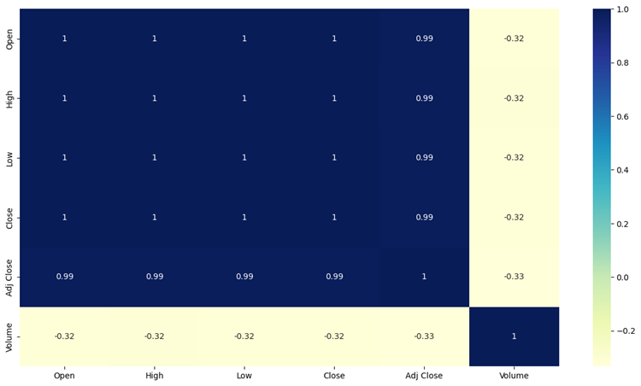
CORRELATION MATRIX

Slide 10
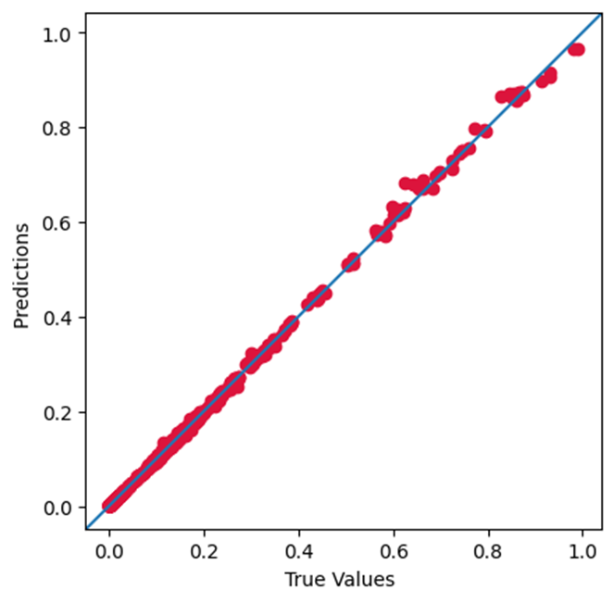
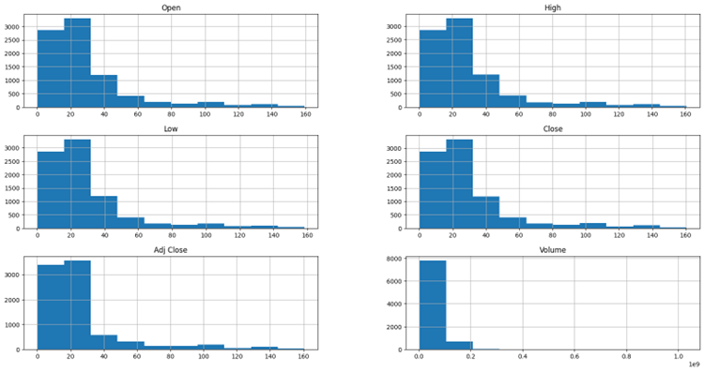
OUTPUT USING LSTM:
ACTUAL VS PREDICTED
HISTOGRAM OF VARIOUS COLUMNS OF DATAFRAME

Slide 11
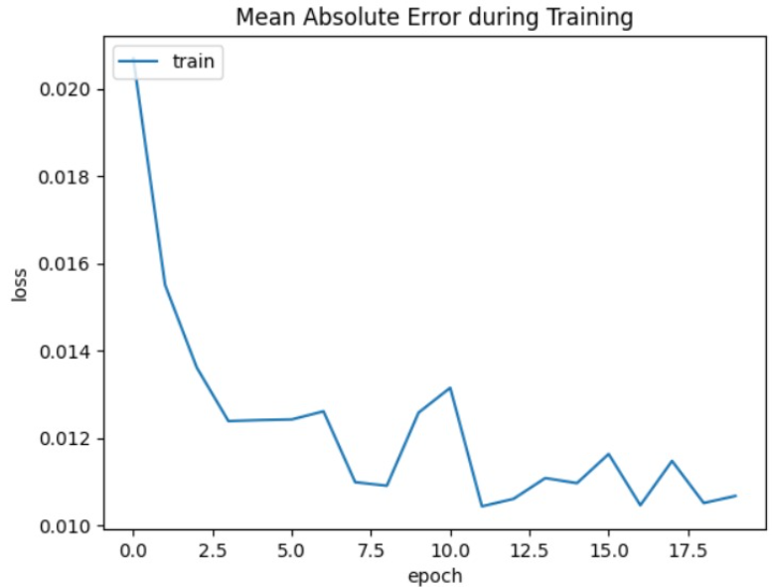
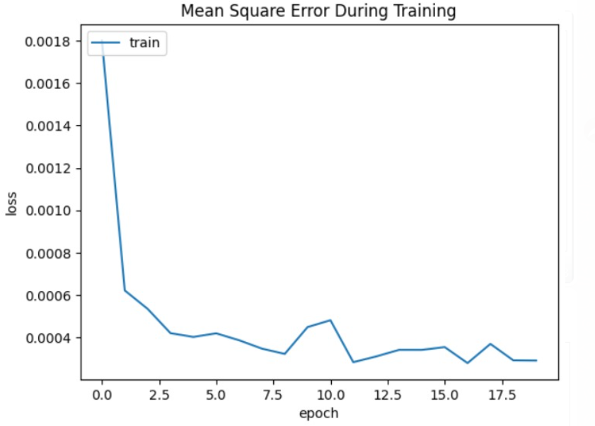
OUTPUT USING LSTM:

Slide 12


