Slide 1

Data System Architecture Final Project
Group - 8
Ramanan Thayalan – 200565744 Niki Patel – 200545936 Anoushka Rastogi – 200593018 Ishan Patel – 200528548 Hellyben Vaghasiya – 200544282 Sahil Kashyap - 200569298

Slide 2

Project Overview
Project Name: Sales Statistics Dashboard
Objective: To analyze historical sales data and provide actionable insights for improving sales performance.
Technologies Used: Python, SQL, Apache Spark, Apache Hadoop, Apache Airflow, PostgreSQL, Apache Kafka, Power BI.
Data Size – 1GB

Slide 3

Business Cases
Purpose: To provide a comprehensive overview of sales performance and facilitate data-driven decision-making.
Deliverables:
Analyze historical data.
Generate sales summaries.
Provide actionable insights.
Future enhancements for real-time data and predictive analytics.

Slide 4

Intended Users/Beneficiaries
Primary Audience: Business stakeholders and shareholders.
Secondary Audience: Data analysts and sales managers.

Slide 5

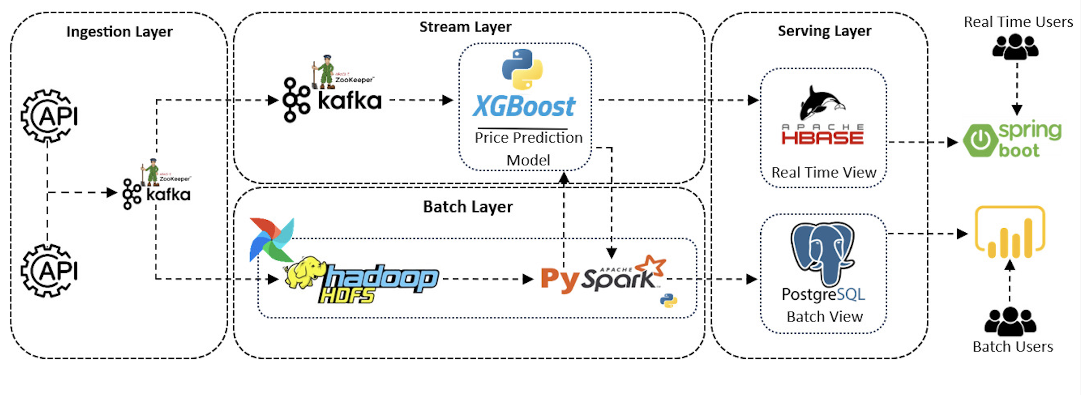
Data flow

Slide 6
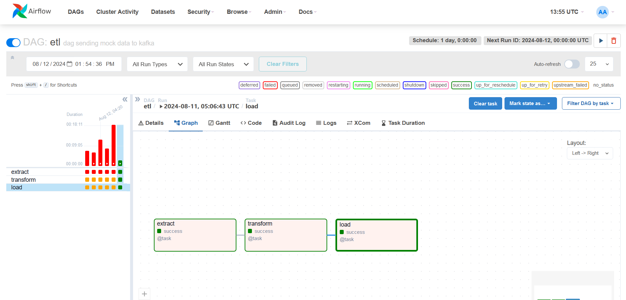
ETL Pipeline

Slide 7

Dashboard

Slide 8
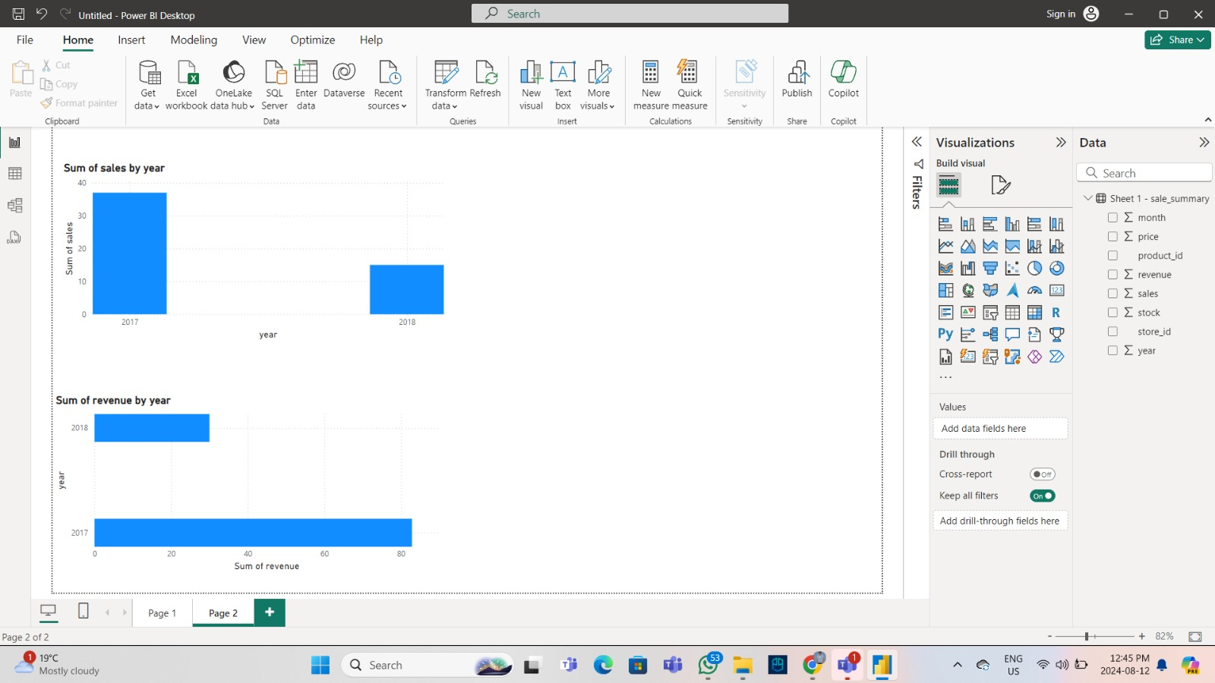

Slide 9
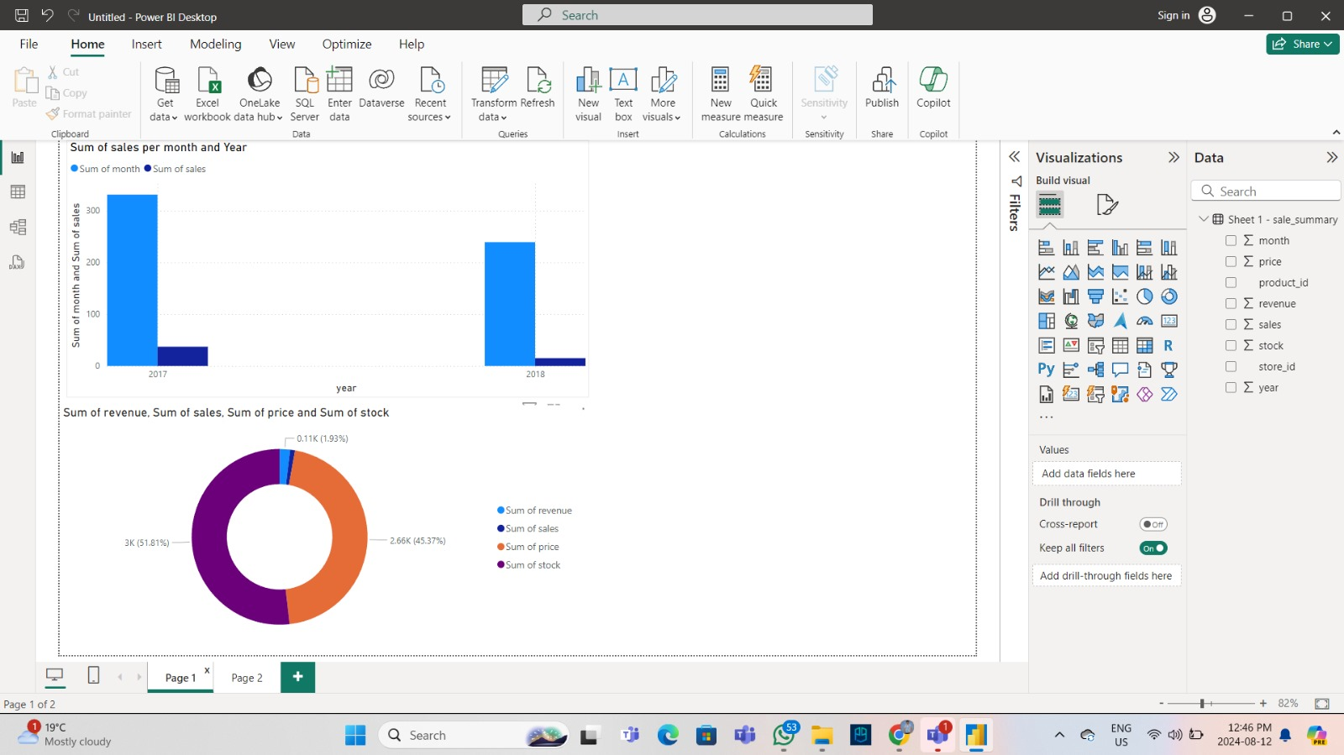
Dashboard

Slide 10

Thank you

