Slide 1

Final Project Data Programming
Team: Ramanan Thayalan: 200565744 Niki patel: 200545936 Anoushka Rastogi: 200593018 Ishan Patel: 200528548 Hellyben Vaghasiya: 200544282 Sodiqu Bello: 200595493

Slide 2

Introduction
Project Name: Stocks Strategic Dashboard
Aim: Develop a strategic dashboard for stock analysis to identify daily patterns and trends, assisting investors and business analysts in making informed decisions.

Slide 3

Technologies
API Source: AlphaVantage API for real-time stock market data.
Data Processing: Apache Airflow for ETL (Extract, Transform, Load) orchestration.
Database: PostgreSQL to store and manage transformed data.
Scripting Language: Python for data extraction, transformation, and interaction with the database and visualization tools.
Containerization: Docker for deploying and managing the application in a consistent environment.
Data Visualization: Power BI for creating interactive dashboards and reports.
Infrastructure: Hosted on an in-house local system using Docker containers for secure and efficient deployment.

Slide 4

Business Cases and Deliverables:
Data-Driven Decision-Making
Market Trend Identification
User Accessibility and Engagement Deliverables – Strategic Dashboard
Data Pipeline
Automated ETL process with Apache Airflow & Python.
Deployment Setup
Dockerized application environment.
Power BI Reports
Predefined reports for stock trends & opportunities.

Slide 5

Intended Users/Beneficiaries
Primary Audience: Investors and Business Analysts
Secondary Audience: Financial Advisors, Traders, and Corporate Stakeholders

Slide 6
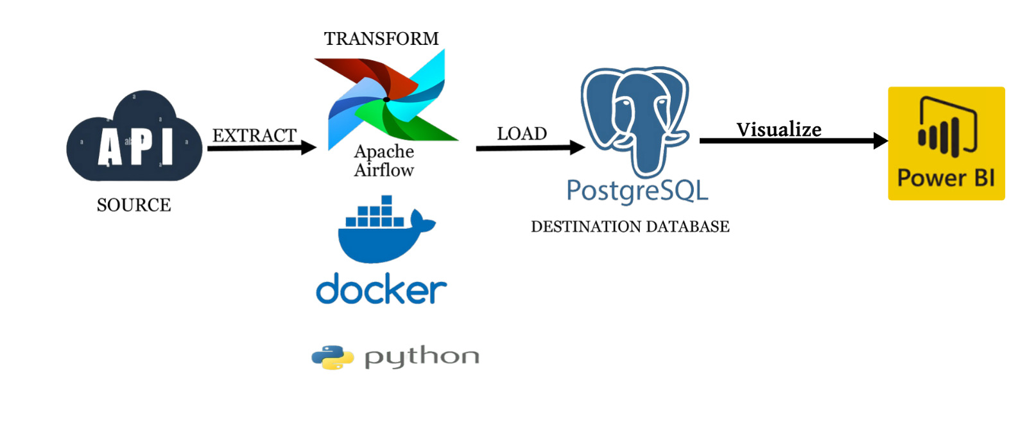
Data Flow

Slide 7
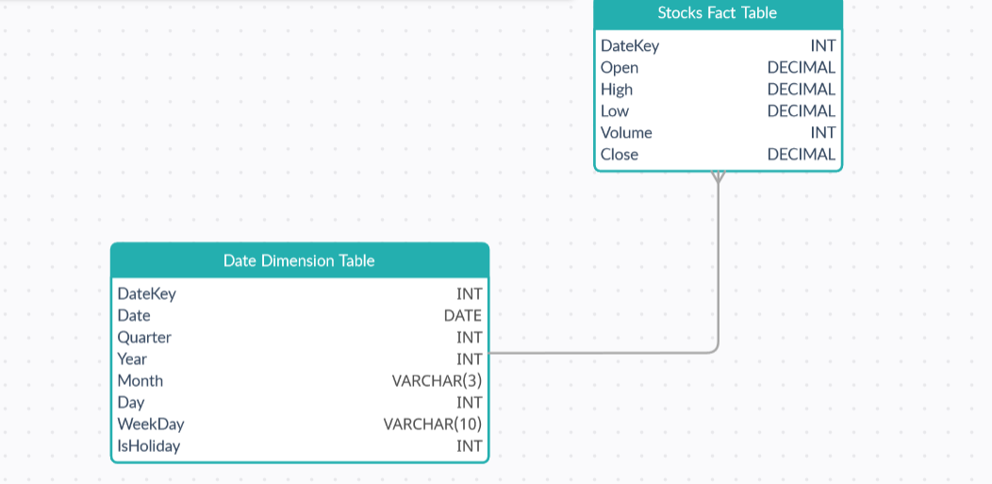
Star Schema

Slide 8
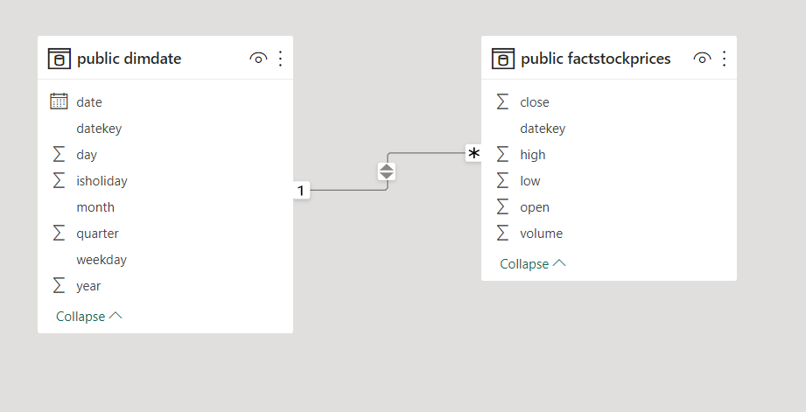

Slide 9
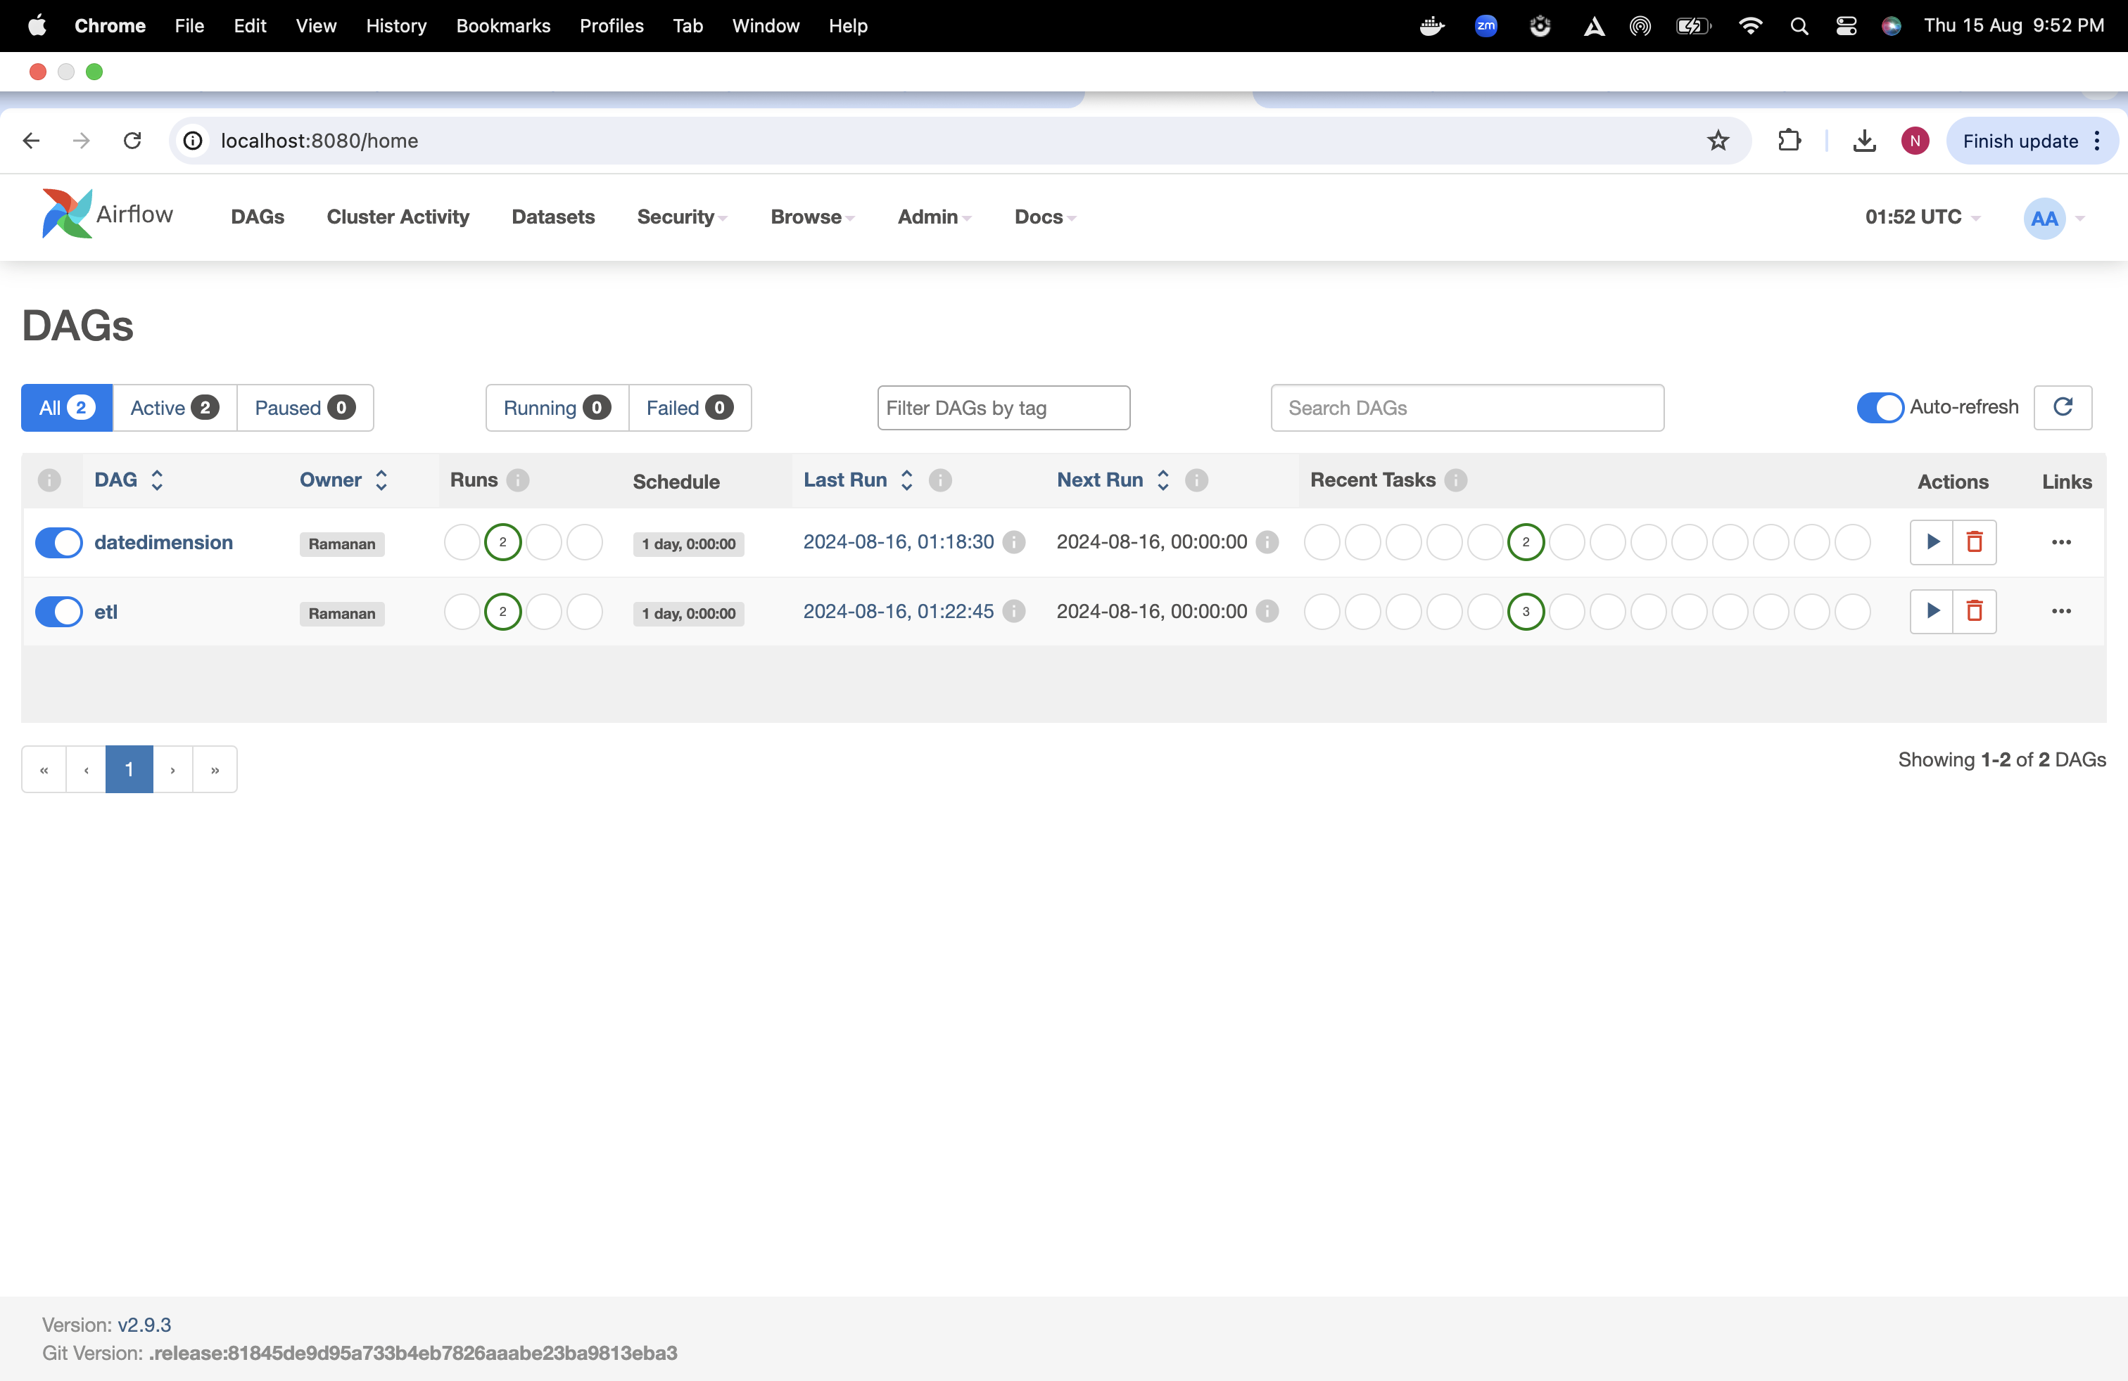
ETL Pipeline

Slide 10
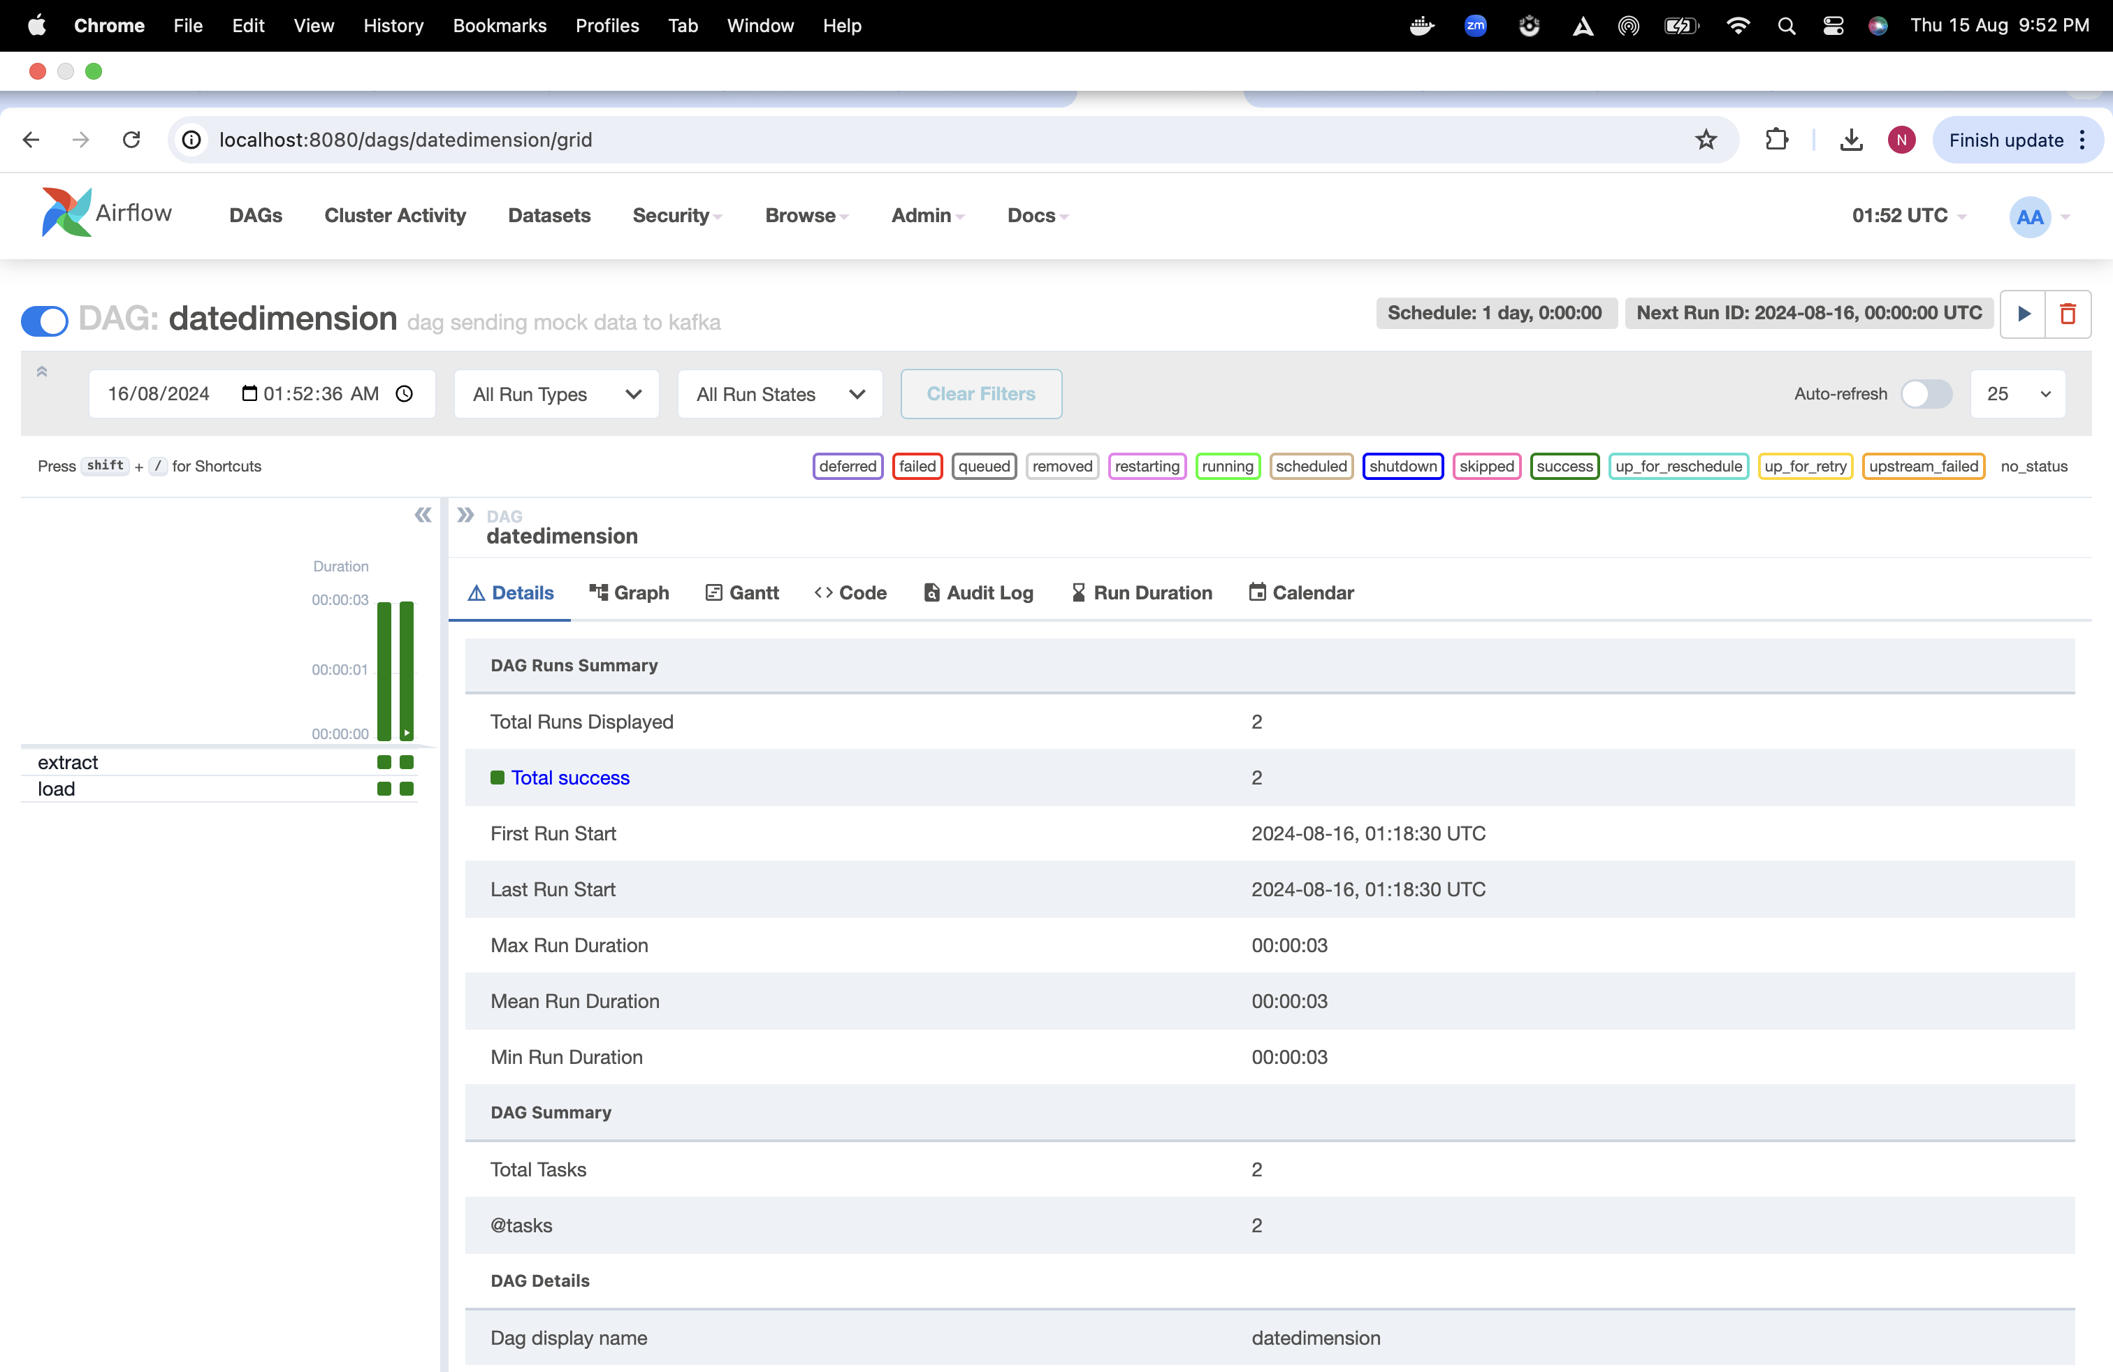

Slide 11
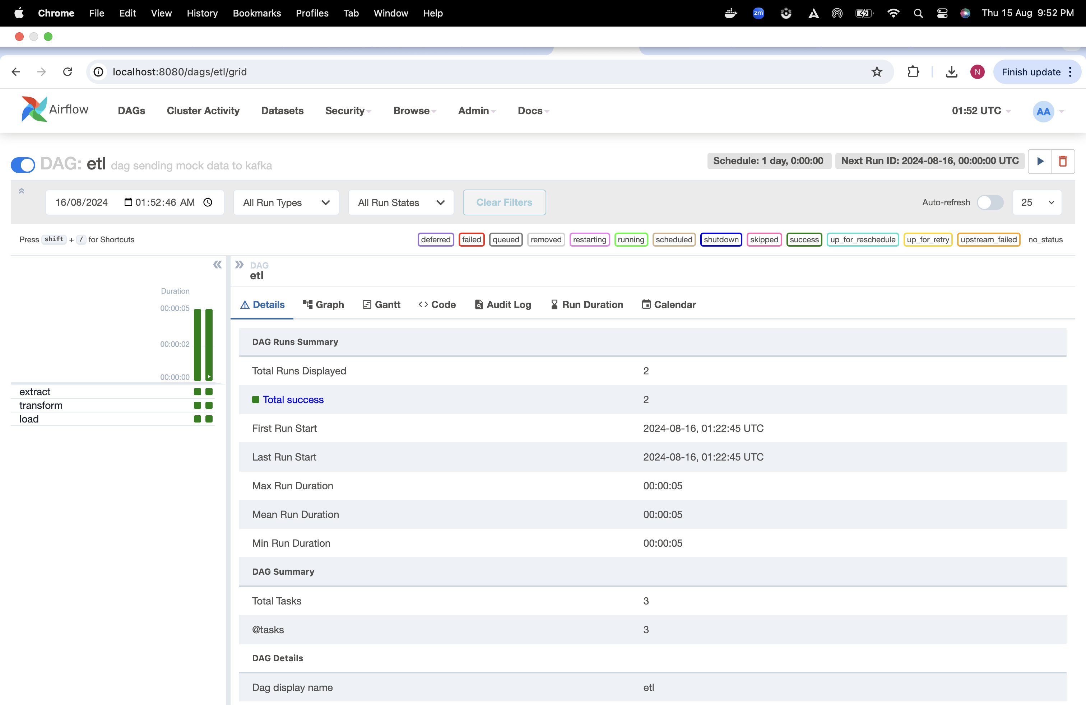

Slide 12

Github
https://github.com/rubaramanan/datamodelling_dp

Slide 13
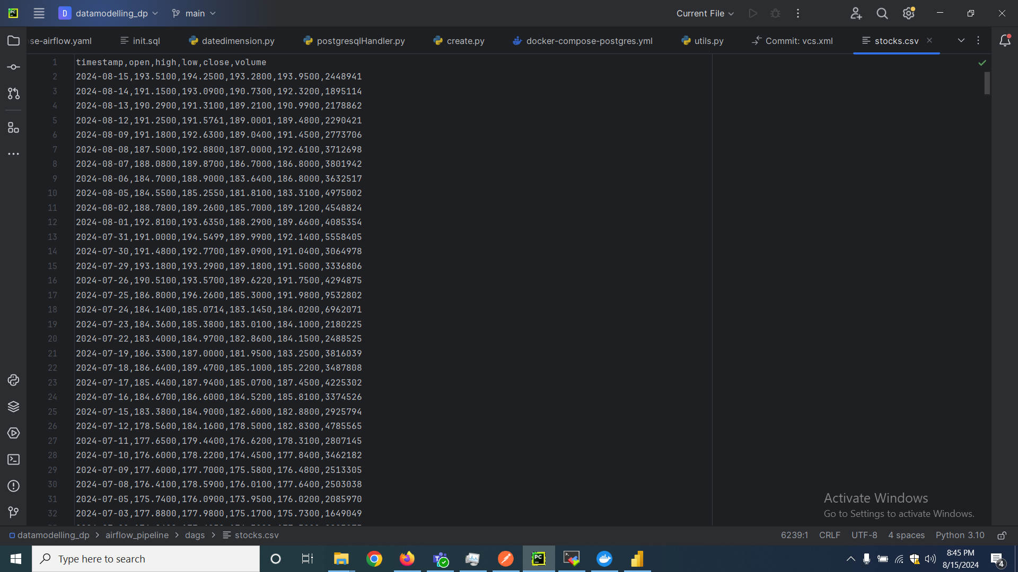
Implementation

Slide 14
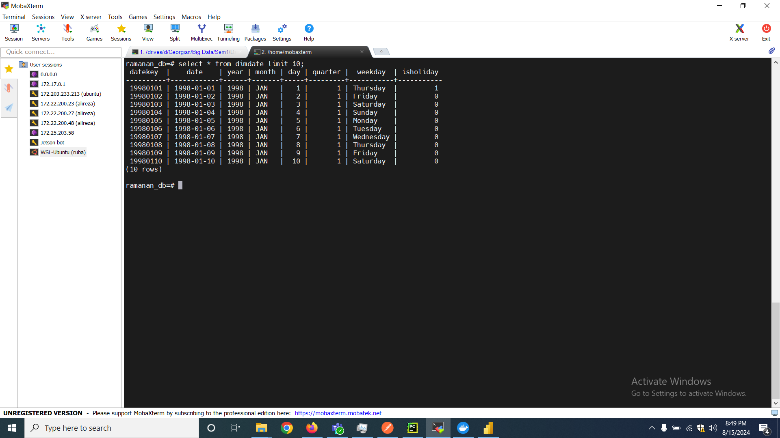

Slide 15
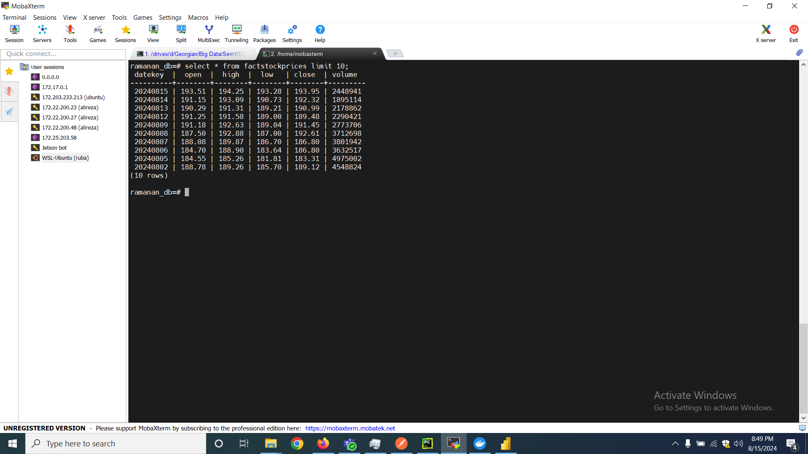

Slide 16
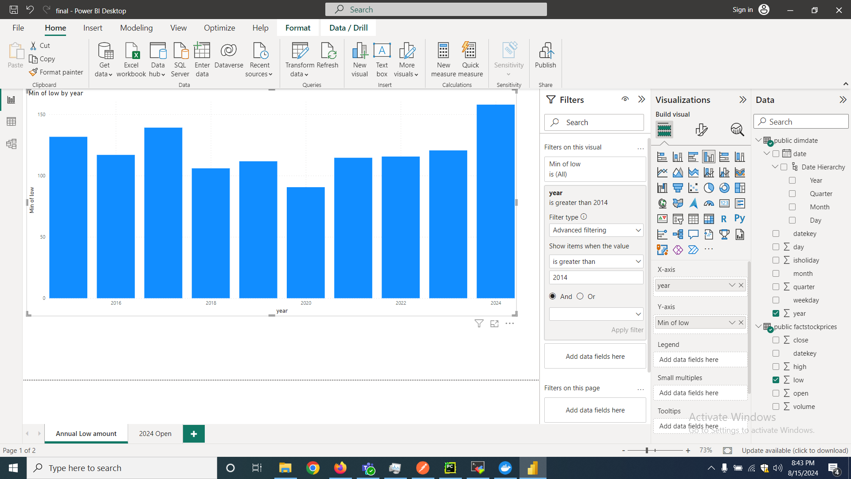

Slide 17
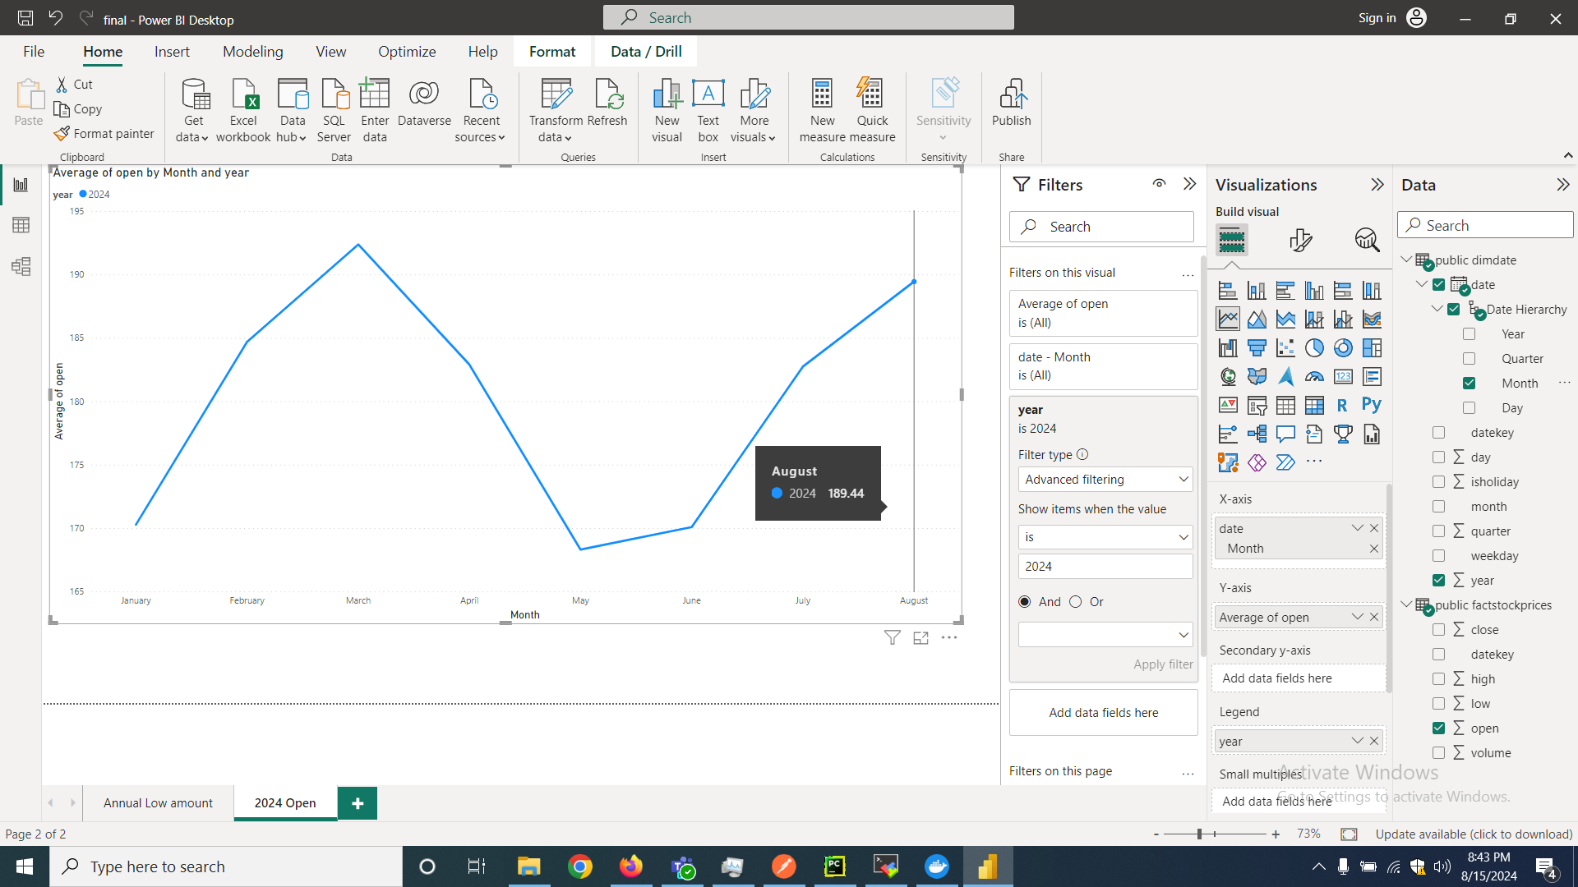

Slide 18
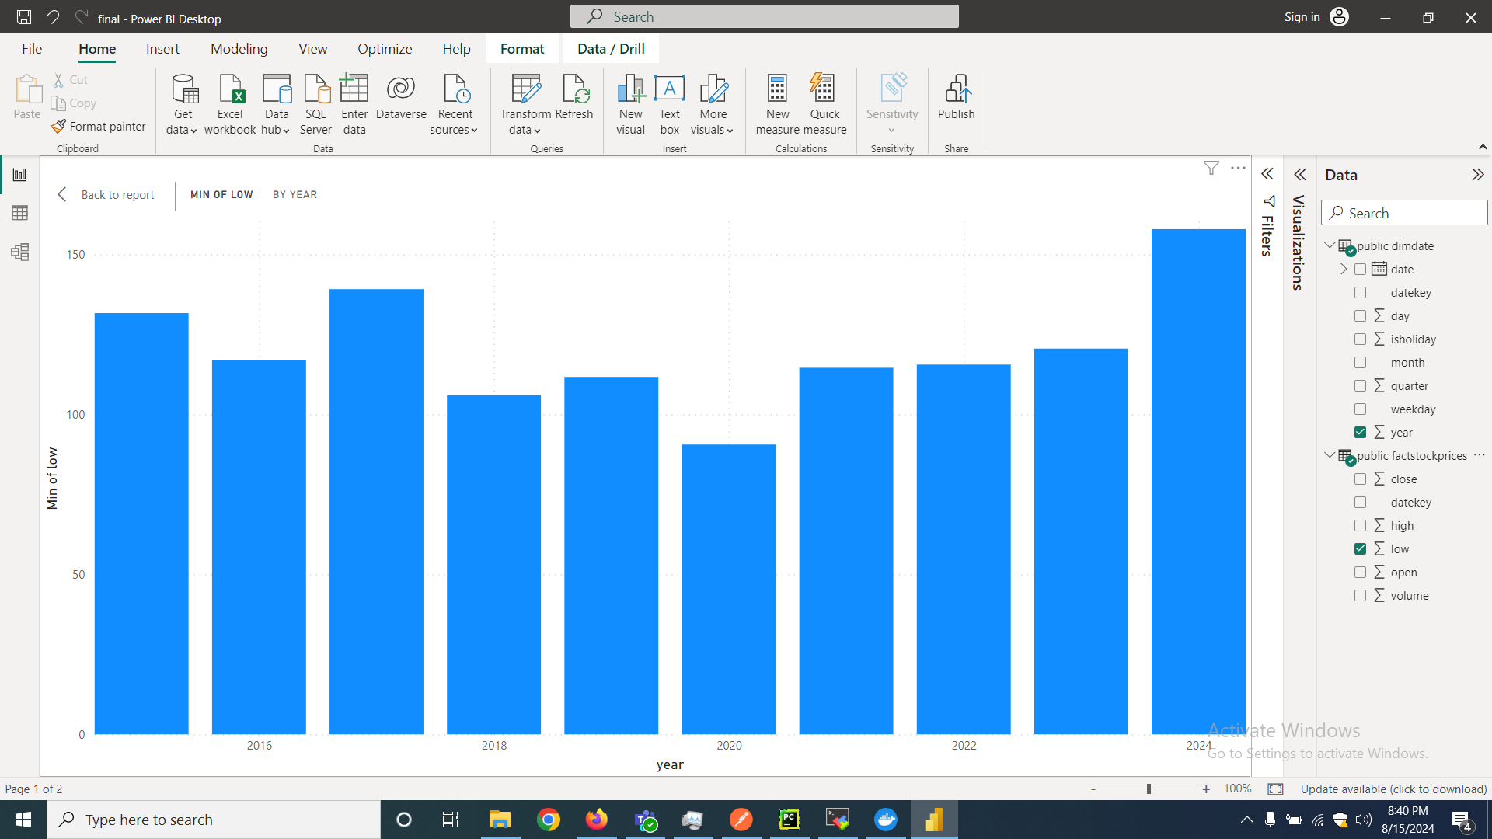

Slide 19

Thank You

