Slide 1

Prediction of Real State Property Prices Using Machine Learning Algorithm
Group no: 07
Presented by:
Md. Rubayatur Bhuyian
Samina Islam Eva
Souradip Dey
Department of Electrical and Computer Engineering

Slide 2
Contents
Introduction
Data Source and Variables
Literature Review
Data Visualization
Feature Engineering
Models
Result
Future Scope
References

Slide 3

Introduction
What should be the perfect price of a house is always the ultimate question both for the customer and seller.
In this project we tried to predict the price of houses having some particular features based on some historical data.

Slide 4
Data Source and Variables
Kaggle Competition.
Dataset: Train & Test dataset provided by Kaggle.
Features: 79 features are present both in the train and test data. The dependent variable “SalePrice” is not present in the test data. It represents the final price at which a house was sold.
We have to predict the “SalePrice” for the test set.
Attributes have both numerical and categorical value.

Slide 5
Literature Review
W. T. Lim, L. Wang, Y. Wang and Q. Chang, "Housing price prediction using neural networks," 2016 12th International Conference on Natural Computation, Fuzzy Systems and Knowledge Discovery (ICNC-FSKD), Changsha, 2016, pp. 518-522.
ANN, ARIMA, MRA
L. Li and K. H. Chu, "Prediction of real estate price variation based on economic parameters," 2017 International Conference on Applied System Innovation (ICASI), Sapporo, 2017, pp. 87-90. doi: 10.1109/ICASI.2017.7988353
Neural Network
Nissan Pow, Emil Janulewicz, and Liu (Dave) Liu, “Prediction of real estate property prices in Montreal”
Linear Regression, k-NN, Random Forest

Slide 6
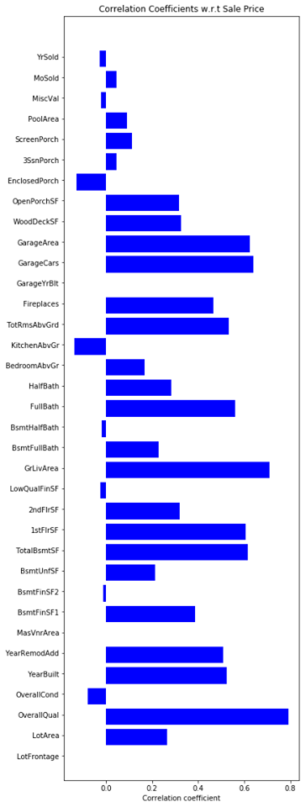
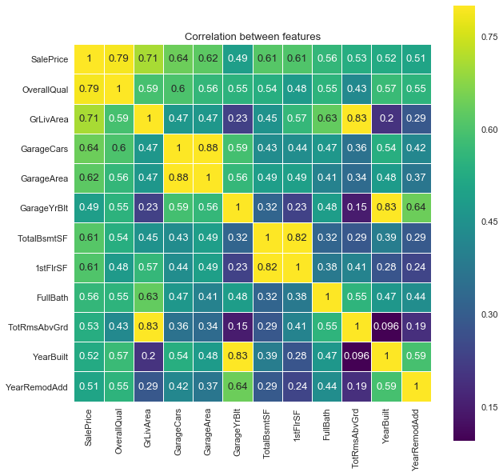
Data Visualization
Correlation
Heatmap

Slide 7
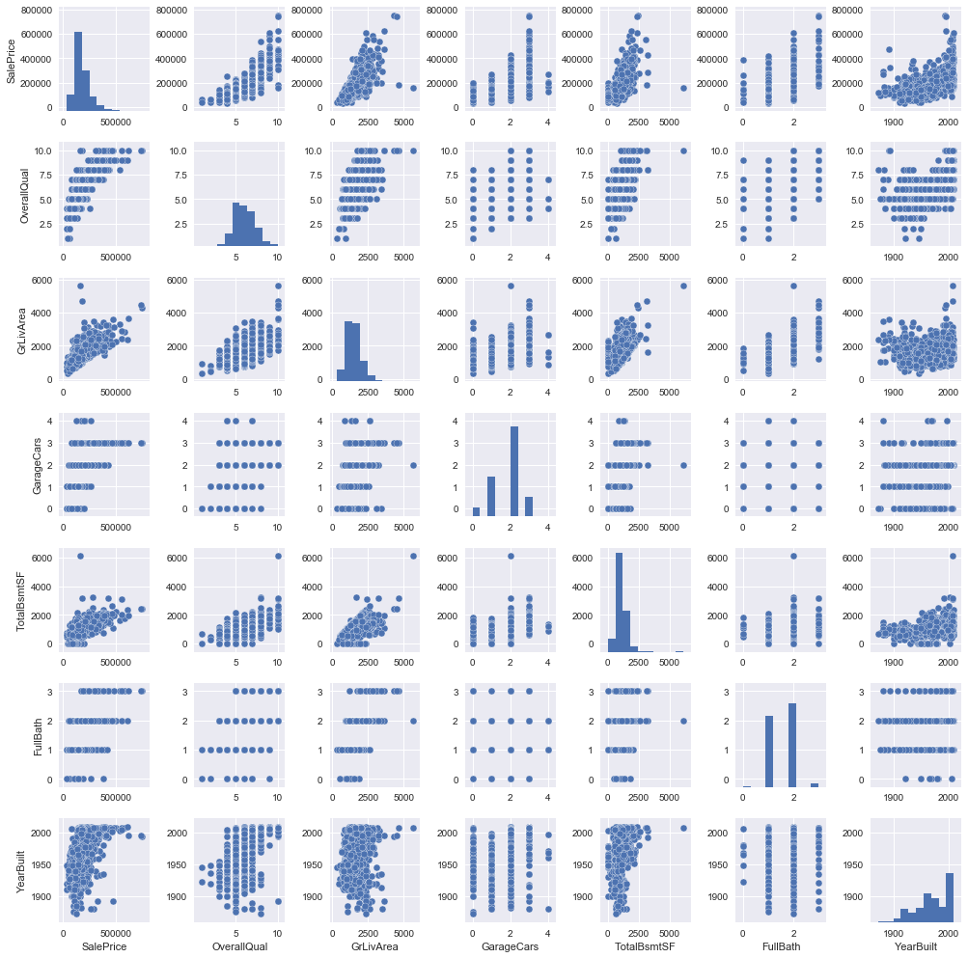
Data Visualization

Slide 8
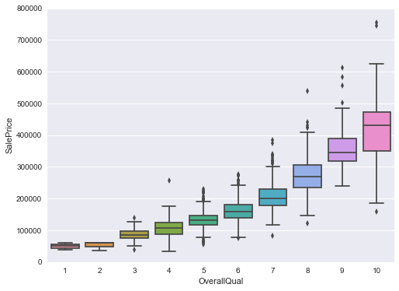
Data Visualization
Figure: Salesprice vs Overall Quality of the house

Slide 9
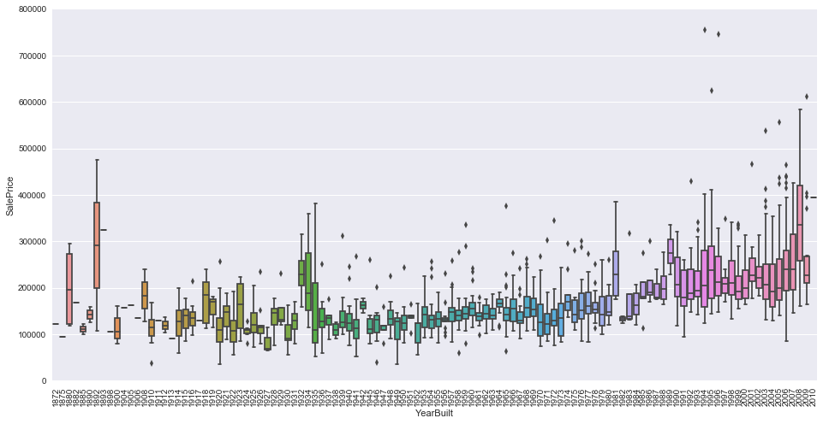
Data Visualization
Figure: Sales price vs Year of building

Slide 10
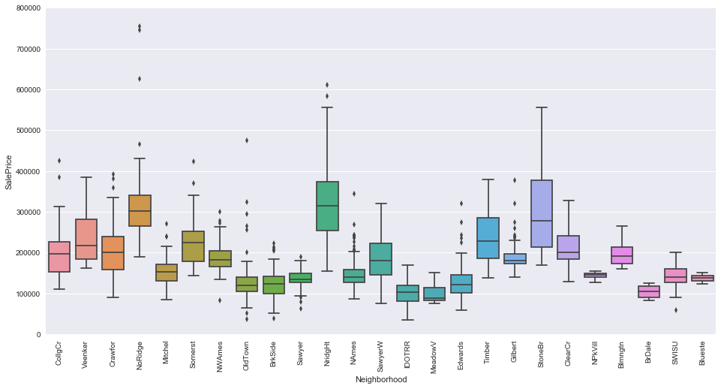
Data Visualization
Figure: Sales price vs Neighborhood

Slide 11
Feature Engineering
Imputing Missing Value
Log transformation
Label encoding
One hot encoding
Normalization

Slide 12
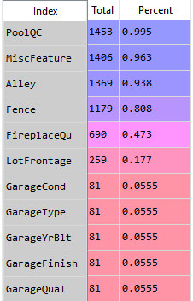
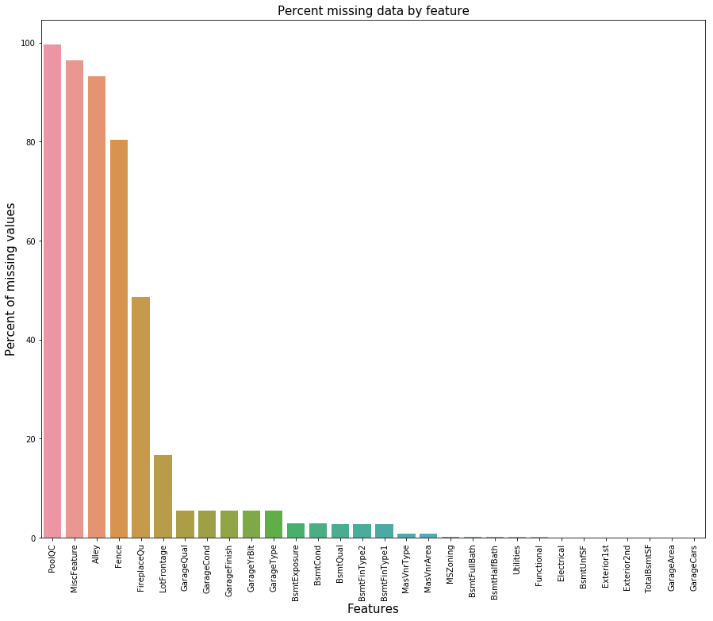
Feature Engineering
Analyzing Missing Value
Percentage of missing value of each attributes.

Slide 13
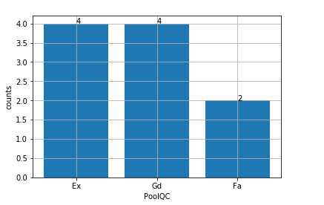



Feature Engineering
Imputing Missing Value (PoolQc)
Comparison with PoolArea

Slide 14
Feature Engineering
Imputing Missing Value (LotFrontage)
Linear feet of street connected to property.
Area of each street connected to the house property is most likely going to have a similar area to other houses in its neighborhood.
Group by each neighborhood and take the mean of each LotFrontage and fill the missing values of each LotFrontage based on what neighborhood the house comes from.

Slide 15
Feature Engineering
Missing Value
MiscFeature, Alley, Fence, FirePlaceQu attributes are handled as per data description.
Functional, NA filled up by “Typ” ase per data description.
Electrical, KitchenQual, Exterior1st and Exterior2nd, SaleType, MSZoning these attributes having missing values have been filled out with their most frequent type.
Dropping feature Utilities.

Slide 16
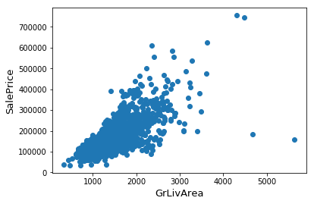
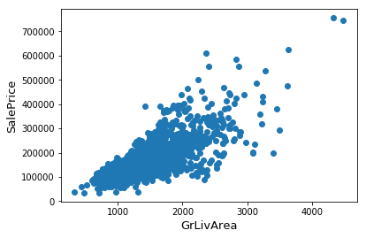
Feature Engineering
Outlier Handing
GrLivArea: Houses having large living area with low sale price is abnormal thus marked two points considered as outlier.

Slide 17
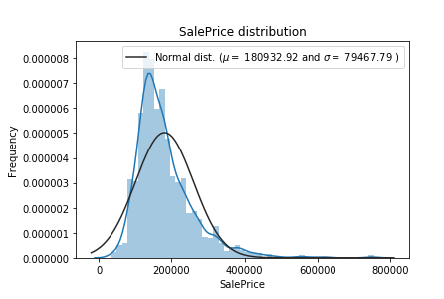
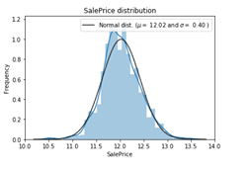
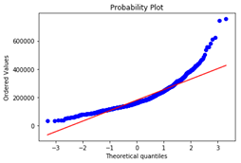
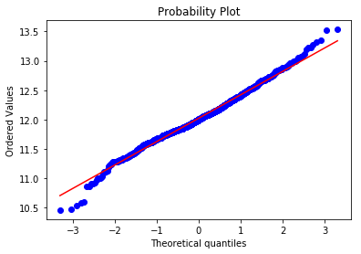
Feature Engineering
Distribution of Target value

Slide 18
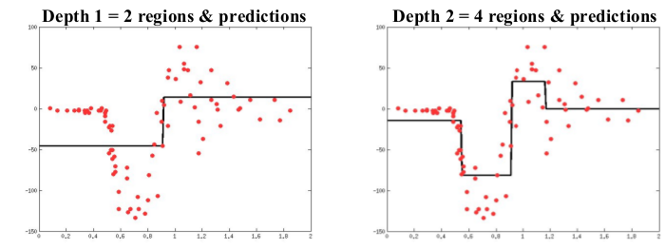
Models
Random Forest Regression
Fitting a regression model to the target variable using each of the independent variables.
For each independent variable, the data is split at several split points.
Calculation of Sum of Squared Error(SSE) at each split point.
Variable resulting in minimum SSE is selected for the node. Then this process is recursively continued till the entire data is covered.
Figure: Leaf node at single scale feature.

Slide 19
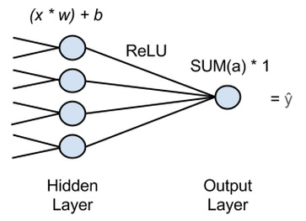
Models
Neural Network
Maps one set of continuous inputs to another set of continuous outputs.
Figure: Linear Regression with Neural Network

Slide 20


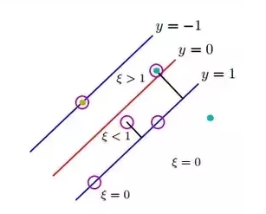
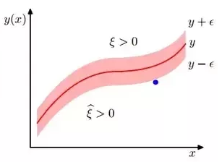
Models
Support Vector Machine
Optimization Function SVM
Figure: SVM
Support Vector Regressor
Optimization function SVR
Figure: SVR

Slide 21
Models
Gradient Boosting Regression
Produces a prediction model in the form of an ensemble of weak prediction models.
It is an ensemble technique where new models are added to correct the errors made by existing models
Prediction is desired such that loss function (MSE) is minimum, gradient descent is used and updating our predictions based on a learning rate, we can find the values where MSE is minimum.

Slide 22
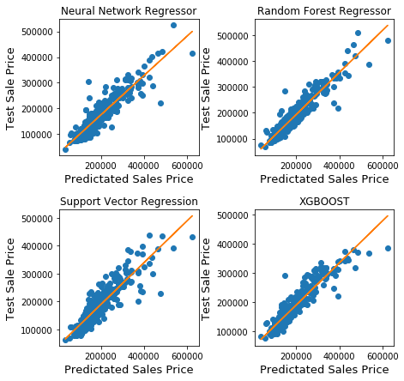
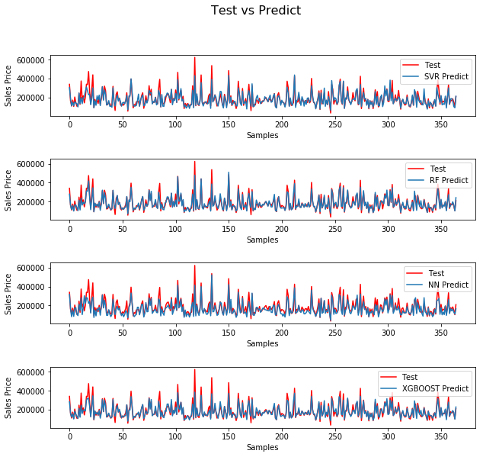
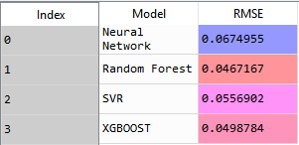
Result Comparison (Before Parameter Tuning)
Prediction of Real State Property Prices Using Machine Learning Algorithm

Slide 23
Parameter Tuning for Random Forest
 |  | Minimum Sample leaf
 |  | 1 | 2 | 3 | 4 | 5
n_estimators | 100 | 0.138287 | 0.13826 | 0.138561 | 0.139595 | 0.140881
 | 150 | 0.137555 | 0.137579 | 0.138277 | 0.1393 | 0.140797
 | 200 | 0.137397 | 0.137501 | 0.138215 | 0.13939 | 0.140878
 | 300 | 0.137384 | 0.137386 | 0.138165 | 0.139421 | 0.140652
 | 400 | 0.137299 | 0.137322 | 0.138044 | 0.139229 | 0.140472
 | 500 | 0.137227 | 0.137243 | 0.137927 | 0.139111 | 0.140383

Slide 24
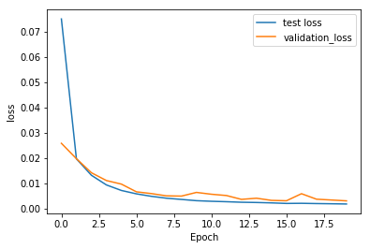
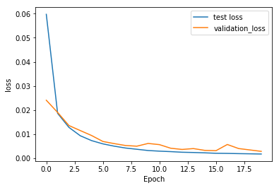
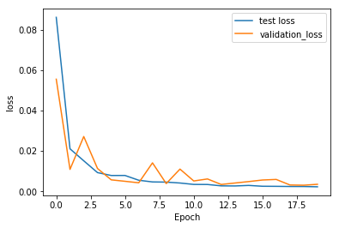
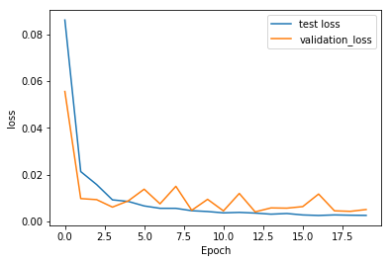
Parameter Tuning for NN
Layer Size=2 activation=“linear”
Layer Size=2 activation=“Relu”
Layer Size=100,100 activation=“linear”
Layer Size=100,100 activation=“linear”

Slide 25
Parameter Tuning for Support Vector Regression (SVR)
kernel="rbf"
 |  | Gamma
 |  | 0.01 | 0.02 | 0.005 | 0.002 | 0.001 | 0.0001 | 0.00002
C | 20 | 0.181731 | 0.223746 | 0.154855 | 0.136421 | 0.126711 | 0.1237 | 0.14395
 | 50 | 0.181731 | 0.223746 | 0.154855 | 0.138249 | 0.131742 | 0.118043 | 0.131321
 | 70 | 0.181731 | 0.223746 | 0.154855 | 0.138285 | 0.132886 | 0.116934 | 0.127435
 | 100 | 0.181731 | 0.223746 | 0.154855 | 0.138285 | 0.133849 | 0.116266 | 0.123461
 | 200 | 0.181731 | 0.223746 | 0.154855 | 0.138285 | 0.136094 | 0.118398 | 0.118868
 | 500 | 0.181731 | 0.223746 | 0.154855 | 0.138285 | 0.136109 | 0.122658 | 0.11678
 | 1000 | 0.181731 | 0.223746 | 0.154855 | 0.138285 | 0.136109 | 0.126933 | 0.117148
kernel="poly"
 |  | Gamma
 |  | 0.01 | 0.02 | 0.005 | 0.002 | 0.001 | 0.0001 | 0.00002
C | 20 | 0.140267 | 0.140267 | 0.140267 | 0.140275 | 0.135125 | 0.161959 | 0.35073
 | 50 | 0.140267 | 0.140267 | 0.140267 | 0.140275 | 0.139719 | 0.146237 | 0.29912
 | 70 | 0.140267 | 0.140267 | 0.140267 | 0.140275 | 0.140275 | 0.141452 | 0.279021
 | 100 | 0.140267 | 0.140267 | 0.140267 | 0.140275 | 0.140275 | 0.137311 | 0.257823
 | 200 | 0.140267 | 0.140267 | 0.140267 | 0.140275 | 0.140275 | 0.128715 | 0.228101
 | 500 | 0.140267 | 0.140267 | 0.140267 | 0.140275 | 0.140275 | 0.120561 | 0.201255
 | 1000 | 0.140267 | 0.140267 | 0.140267 | 0.140275 | 0.140275 | 0.119308 | 0.183091

Slide 26
Parameter Tuning for XGBoost
n_estimator
Max Depth
 |  | n_estimator
 |  | 10000 | 30000
Max Depth | 3 | 0.115374 | 0.115766
 | 4 | 0.115434 | 0.115993
 | 8 | 0.115826 | 0.116173
 | 10 | 0.115968 | 0.116205

Slide 27
Models
Ensemble Averaging
Ensemble averaging is the process of creating multiple models and combining them to produce a desired output, as opposed to creating just one model.
Score: 0.1186 (RF,XGB & SVR)

Slide 28
Error Comparison
Kaggle
Lasso score | Xgboost score | Kernel Ridge Score | Gradient Boosting Score | Ensemble
0.1115 | 0.1161 | 0.1153 | 0.1177 | 0.1091
From Literature
LR | SVR | KNN | Random Forest
0.1725 | 0.1604 | 0.1103 | 0.1135
Our Model
XG Boost | SVR | Neural Network | Random Forest | Enseble
0.1153 | 0.1162 | 0.1305 | 0.13722 | 0.1186

Slide 29
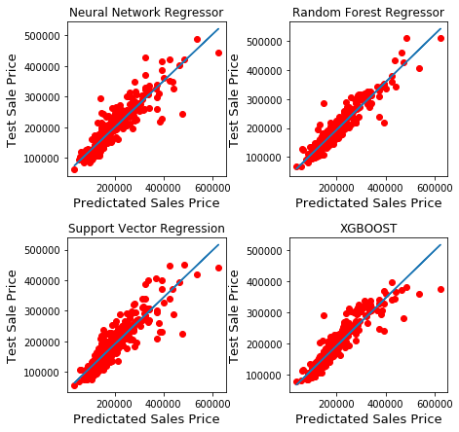
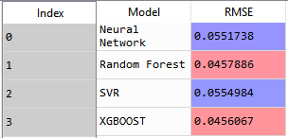
Result Comparison
Initial output
Output after tuning parameter

Slide 30
Future Work Scope
The process we followed can be used to approach any regression problem
Sales prediction.
Future energy consumption.

Slide 31
References
W. T. Lim, L. Wang, Y. Wang and Q. Chang, "Housing price prediction using neural networks," 2016 12th International Conference on Natural Computation, Fuzzy Systems and Knowledge Discovery (ICNC-FSKD), Changsha, 2016, pp. 518-522.
L. Li and K. H. Chu, "Prediction of real estate price variation based on economic parameters," 2017 International Conference on Applied System Innovation (ICASI), Sapporo, 2017, pp. 87-90. doi: 10.1109/ICASI.2017.7988353
Nissan Pow, Emil Janulewicz, and Liu (Dave) Liu, “Prediction of real estate property prices in Montreal”
https://www.kaggle.com/c/house-prices-advanced-regression-techniques
https://www.kaggle.com/
http://scikit-learn.org/

Slide 32
Questions?

