Slide 1
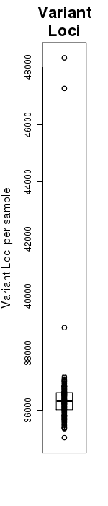
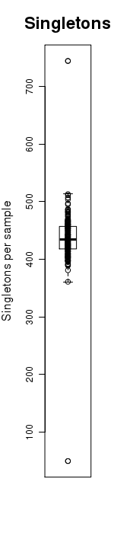
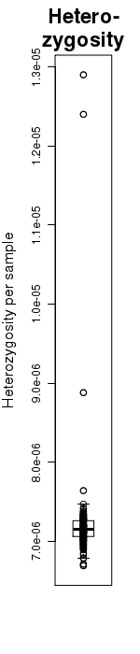
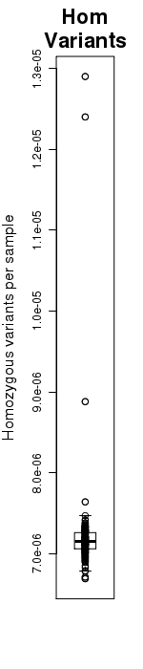
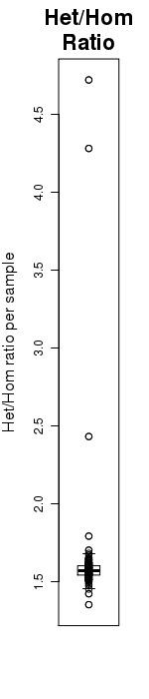
Quality – Current procedure
GATK multi-sample calling
GATK technical quality control -> discarding of outliers
Additional control for false positives. Minimal depth?
Control for population outliers (Principle component analysis)

Slide 2
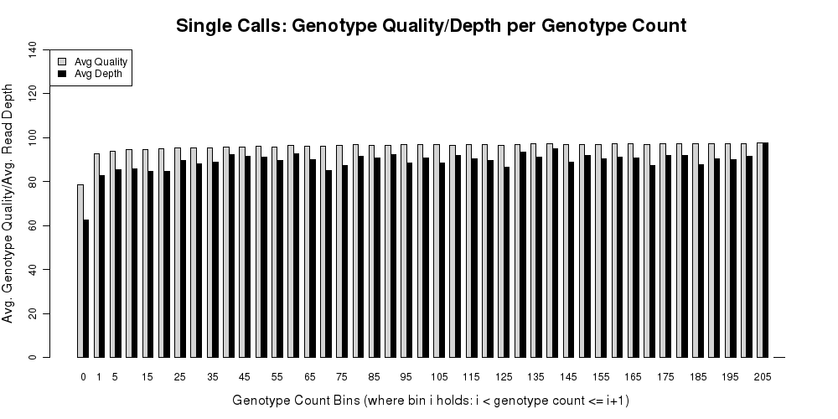
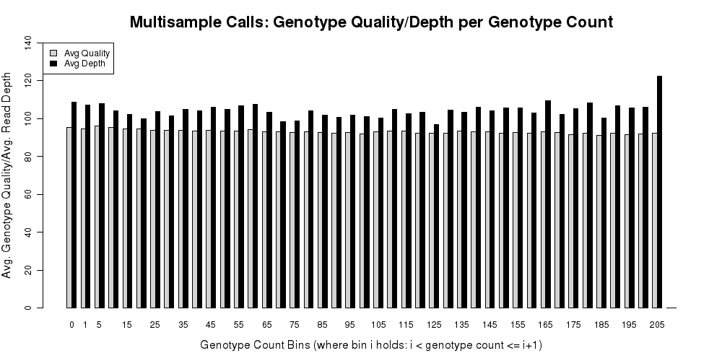
Quality Depth+quality/minor allele calls
Single sample call (SAMtools)
Multi-sample call (GATK)

Slide 3
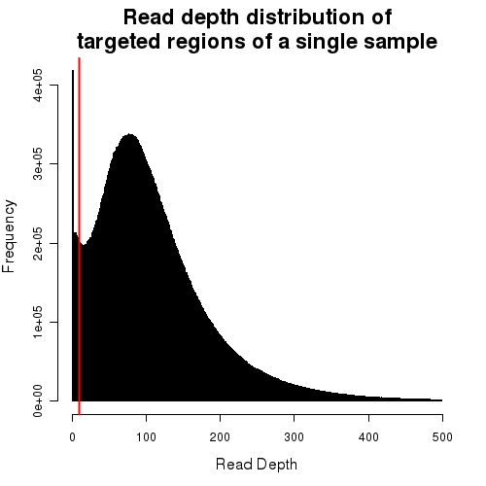
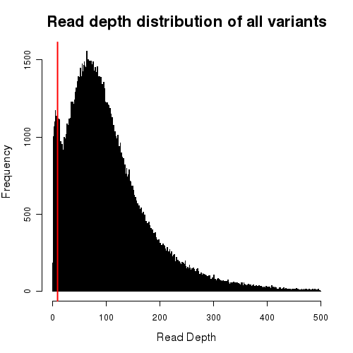
Quality – SNV calls/read depth

Slide 4
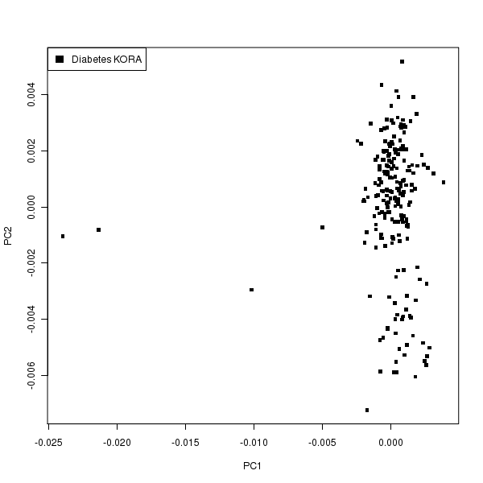
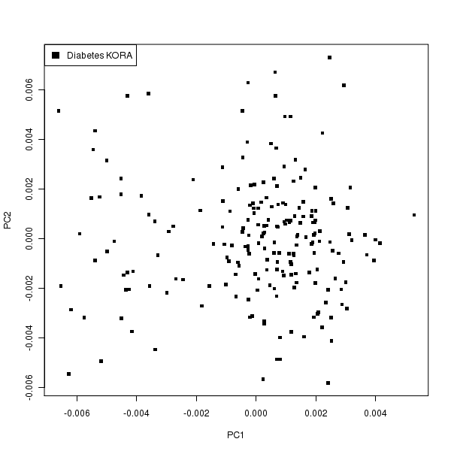
Quality – Principal component analysis
200 KORA samples
Initial multi-sample calling
after removal of 4 outliers

Slide 5
VCF file – Sample and technical header
##SampleSize=200
##Population=German
##Phenotype=Population Cohort, 100 diabetes cases 100 controls
##Sequencer=HiSeq2500
HiSeq2000/GAIIx/Solid??
##Enrichment=SureSelectXT Human All Exon V5
##SeqVersion=TrueSeq PE Cluster Generation Kit v3, SBS Sequencing Kit v3
##Run=100 bp paired-end
##ReferenceSeq=hg19
##Analysis=<Alignment=BWA v0.6,VariantCalling=GATK v1.5,CallingType=multi-sample calling>
##Center=Institute of Human Genetics, Helmholtz Zentrum München
##Contact= Tim M Strom, @TimStrom@helmholtz-muenchen.de
##Files and/or Figures concerning quality measures

Slide 6
VCF file – Genotypes (modified after NHLBI EVS)
##INFO=<ID=GTS,Number=.,Type=String,Description="Observed Genotypes. For INDELs, A1, A2, or An refers to the N-th alternate allele while R refers to the reference allele.">
##INFO=<ID=GTC,Number=.,Type=String,Description="Genotype Counts in the order of listed GTS">
##INFO=<ID=AC,Number=.,Type=String,Description="Allele Count in the order of AltAlleles,RefAllele. For INDELs, A1, A2, or An refers to the
N-th alternate allele while R refers to the reference allele.">
##INFO=<ID=MAF,Number=.,Type=String,Description="Minor Allele Frequency in percent">
##INFO=<ID=DP,Number=1,Type=Integer,Description="Average Sample Read Depth">
##INFO=<ID=SDP,Number=1,Type=Integer,Description="Standard Deviation of Sample Read Depth">
##INFO=<ID=GTDP,Number=.,Type=Integer,Description="Average Sample Read Depth per Genotype in order of listed GTS">
##INFO=<ID=GTSDP,Number=.,Type=Integer,Description="Standard Deviation of Sample Read Depth per Genotype in order of listed GTS">
##INFO=<ID=GQ,Number=1,Type=Integer,Description="Average Sample Genotype Quality">
##INFO=<ID=SGQ,Number=1,Type=Integer,Description="Standard Deviation of Sample Genotype Quality">
##INFO=<ID=GTGQ,Number=.,Type=Integer,Description="Average Sample Genotype Quality per Genotype in order of listed GTS">
##INFO=<ID=GTSGQ,Number=.,Type=Integer,Description="Standard Deviation of Sample Genotype Quality per Genotype in order of listed GTS">

