Slide 1
cBioPortal CombatCancer
Oscar Krijgsman
Jan Hudecek
Jelle ten Hoeve

Slide 2
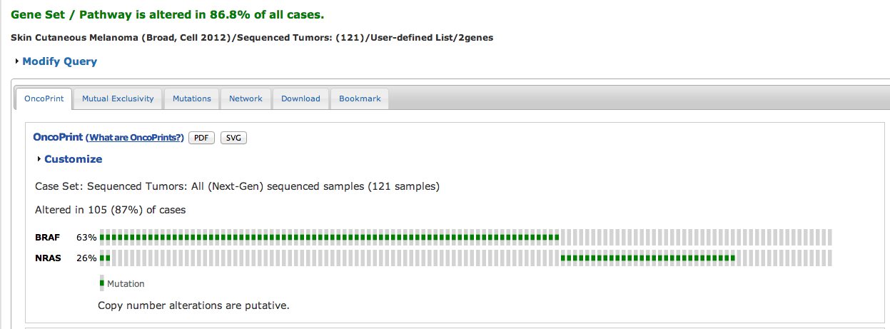
cBioPortal
Developed to visualize TCGA data by MSKCC
All TCGA data available
Expression, Copynumber, Mutations etc..

Slide 3
cBioPortal @NKI
cBioPortal
Initial datasets imported
BRAFi resistant patient M032 (Kristel Kemper)
TCGA breast cancer dataset

Slide 4
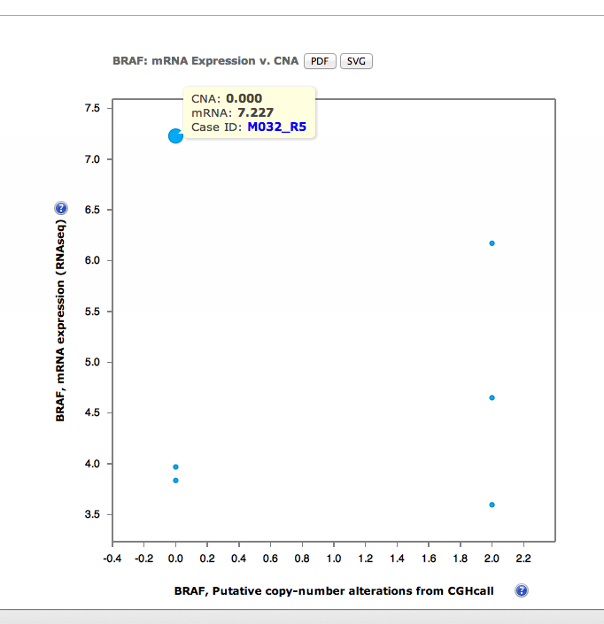
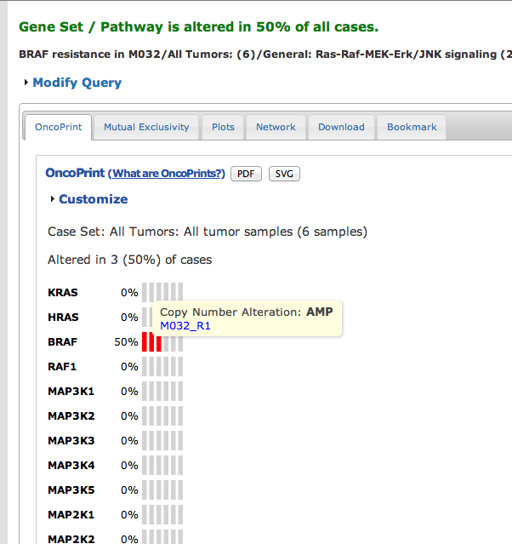

Slide 5
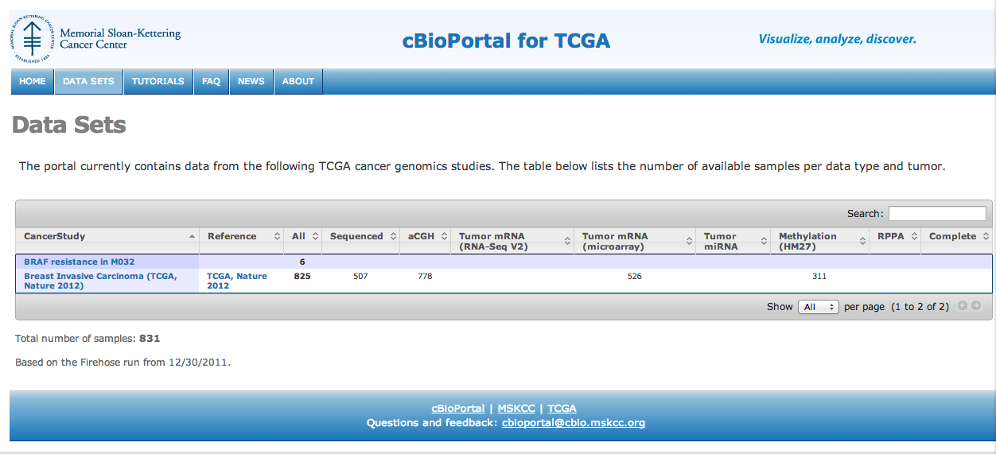
Copynumber
Expression
VCF files
..other..
Parsers
Data files + meta files
cBioPortal

Slide 6
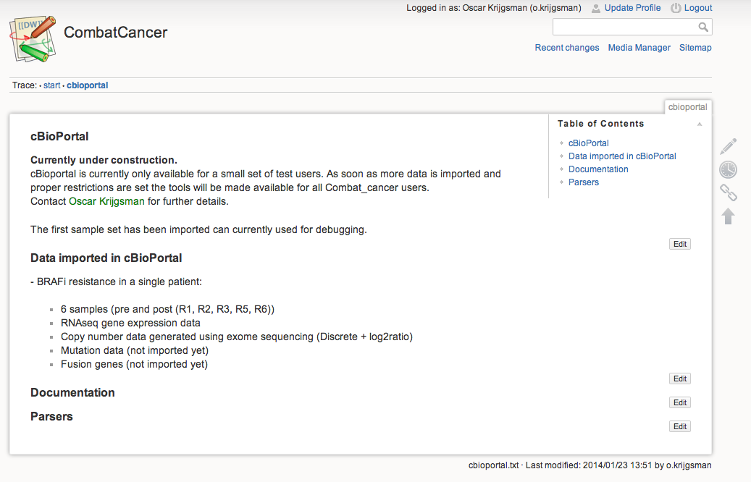
cBioPortal @wiki

Slide 7
In Progress…
Restrictions
Access will be set per dataset
CombatCancer data only accessible to participants (same as for Wiki & Shared folder)
Data import
Sets of parsers for all common datatypes
(VCF, copy number, expression)

