Slide 1
Data Classification by using Artificial Neural Networks
Mohammed Hamdi
CS 6800
Spring 2016, WMU

Slide 2
Outline
What does the Artificial Neural Network do?
The using of ANN.
The learning of ANN.
Data classification.
Hamming Network.
MAXNET Network.
Examples.
References.

Slide 3
What does the Artificial Neural Network do?
The ANN performs many tasks that the computer can not do.
It needs to be learned and it does not need to be reprogrammed.
It always gives required outcomes in all applications.

Slide 4

The using of ANN
Object Recognition.
Speech Recognition.
Data Classification.
Data Mining.
Web Searching.
Image Processing.
Mapping.
Robotics..
Image courtesy of 33rdsquare.com

Slide 5
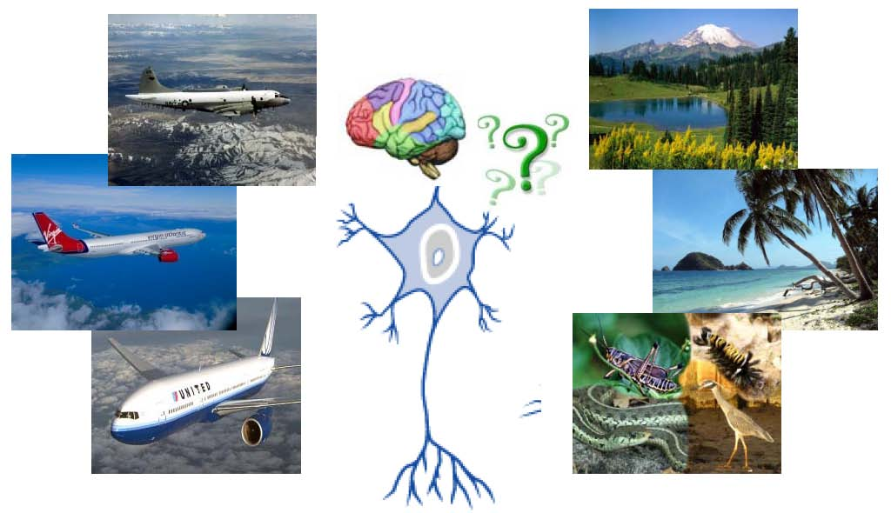
The learning of ANN
It is the basic phase of ANN.
Doing by input and desired output.
Adapt the weights in each presentation.
Image courtesy of svcl.ucsd.edu

Slide 6

Types of learning :
Supervised.
Unsupervised.

Slide 7
Supervised learning :
Under control.
Adapt the weights.
Reduce the error.
What are the features of supervised learning?

Slide 8
Unsupervised learning :
No control.
Learn by itself.
Pick out the structure from the input.
What are the features of unsupervised learning?

Slide 9

After the learning phase, what should the ANN do?
Image courtesy of matricom.net

Slide 10
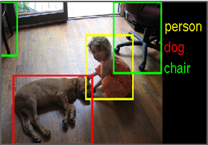
Data Classification :
Recognize the input.
Classify it by its features and give the result.
Image courtesy of devblogs.nvidia.com
How can the ANN classify the object?

Slide 11
Hamming neural network :
Feed forward network.
Single layer network.
A fixed weights network.
Cluster the input.
Input
Output
Hamming Neural Network

Slide 12
MAXNET neural network :
Feed backward network.
Single layer network.
A fixed weights network.
It depends on Winner-Take-All WTA policy (Only one nonzero output).
Input
Output
MAXNET Neural Network
Why is the MAXNET network known as Winner-Take-All WTA?

Slide 13
An example of TB test :
A simple test for Tuberculosis disease.
TB has 11 symptoms, 6 of them come together to the infected people.
Each input (case) of the test is a vector of 11 values.
Two examples in the test, one for infected people and the other one for normal people.
Set a value of (1) for existed symptoms in the input vector, otherwise (-1).
Anybody has six known symptoms or more will be classified as infected people.
Any case with less than six known symptoms will be classified as normal people but he/she may suffer from other disease.

Slide 14
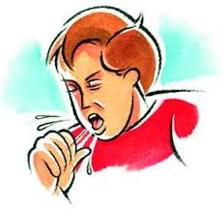

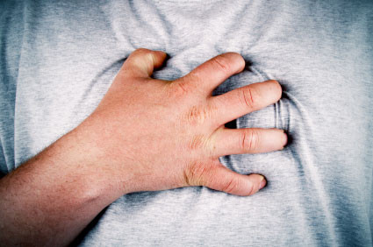



The six known symptoms of TB :
Cough
Fever
Chest pain
Coughing up blood
Fatigue
Night sweating

Slide 15
The TB test :
The case is the input of the first layer which is Hamming network.
The output of Hamming network will be the input of MAXNET network.
Each case is classified to the closest example.
One nonzero output at the end which is the winner.

Slide 16
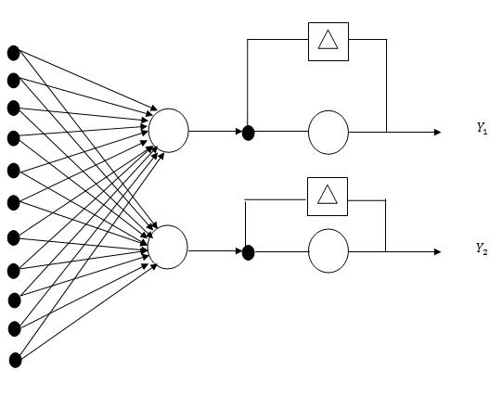
The Hamming & MAXNET network for TB test :

Slide 17

Hamming algorithm :
Step (1) : Specify the examples.
Step (2) : Fix the weights matrix :
Step (3) : Find Ѳ as Ѳ = n / 2.
Step (4) : Specify the input vector :
Step (5) : Find the output as :

Slide 18



MAXNET algorithm :
Step (1) : Fix the weights matrix :
Step (2) : Find :
Step (3) : Repeat step (2) until convergence.

Slide 19

The Hamming - MAXNET for TB test :
The examples are fixed as :
e(1) = [1 1 1 1 -1 -1 -1 -1 -1 -1 -1] for normal people
e(2) = [1 1 1 1 1 1 -1 -1 -1 -1 -1] for infected people
The first six values in e(2) represent the known symptoms of TB.
The weights matrix of Hamming network is :
And Ѳ = 11/2 = 5.5
The weights matrix of MAXNET network is :
We assume ε = 0.4
2*11
2*2

Slide 20
V(1) = [1 1 1 1 1 1 -1 -1 -1 1 -1]
V(2) = [1 1 -1 -1 -1 -1 -1 -1 -1 -1 -1]
For V(1) :
= V(1) * + Ѳ
= [8 10]
= * = [0 4.688] … After 3 iterations
So the person is classified as infected people.
For V(2) :
= V(2)* + Ѳ
= [9 7]
= * = [4.472 0] … After 3 iterations
So the person is classified as normal people.

Slide 21
Hamming-MAXNET Network :
High speed in classification of random inputs.
Only one node which has the short Hamming distance from the example will be the nonzero output at the end (The winner).
Hamming-MAXNET network always give a closed output to the examples.

Slide 22
Why is the MAXNET network used with Hamming network?
To suppress all other nodes which have high Hamming distance from the example.
Why is the MAXNET network used with Hamming network?

Slide 23
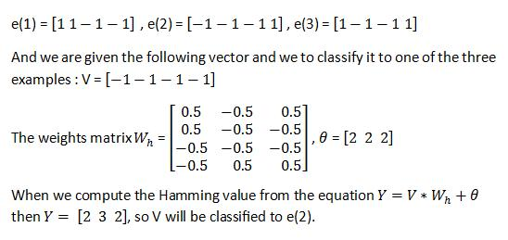
Hamming example :
We consider here the Hamming net has three examples :
e(1) = [1 1 -1 -1], e(2) = [-1 -1 -1 1], e(3) = [1 -1 -1 1]
We are given the following vector and we have to classify it to the closest example :
V = [1 -1 1 1]
The weight matrix = , Ѳ = [2 2 2]
The Hamming value is :
Y = V * + Ѳ
Y = [1 2 3], so V is classified to e(3).

Slide 24
The References :
Ahmed Hashmi, Chemoy Das. (2012). Neural Networks and its Application. www.slideshare.net
Daniel Graupe. (2007). Principles of Artificial Neural Networks. University of Illinois.
K Ming Leung. (2007). Fixed Weight Competitive Nets : Hamming Net. Polytechnic University.
Karam Hatim, Mohammed Hamdi. (2009). Detection of Tuberculosis by using Artificial Neural Networks. University of Mosul
Nilmani Singh. (2010). Neural Network. www.slideshare.net

Slide 25
Thank you

