Slide 1
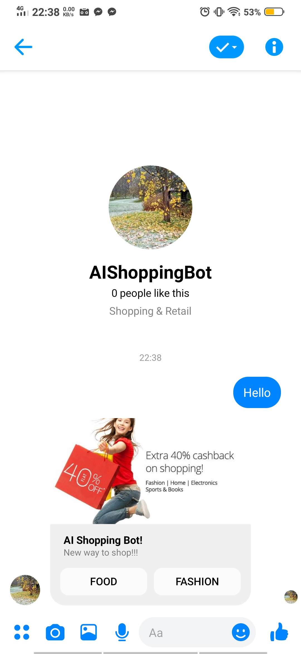
ShoppingBot Serverless FB Chatbot
Farhad Hossain
FB Chatbot, AWS Lambda, AWS API Gateway,
AWS DynamoDB

Slide 2
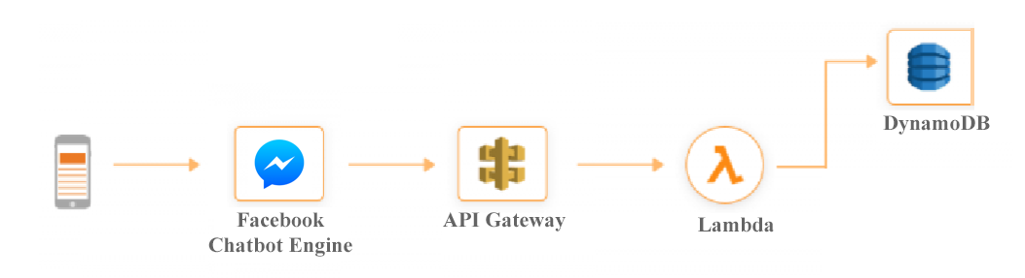
Architecture

Slide 3
Main phases
Facebook
AWS
Lambda
DynamoDB
API Gateway

Slide 4
Facebook
Create FB developer account
Create FB page
Create new App, add FB messenger support and add FB page in the new App
https://developers.facebook.com/docs/messenger-platform/getting-started/quick-start/#starter

Slide 5
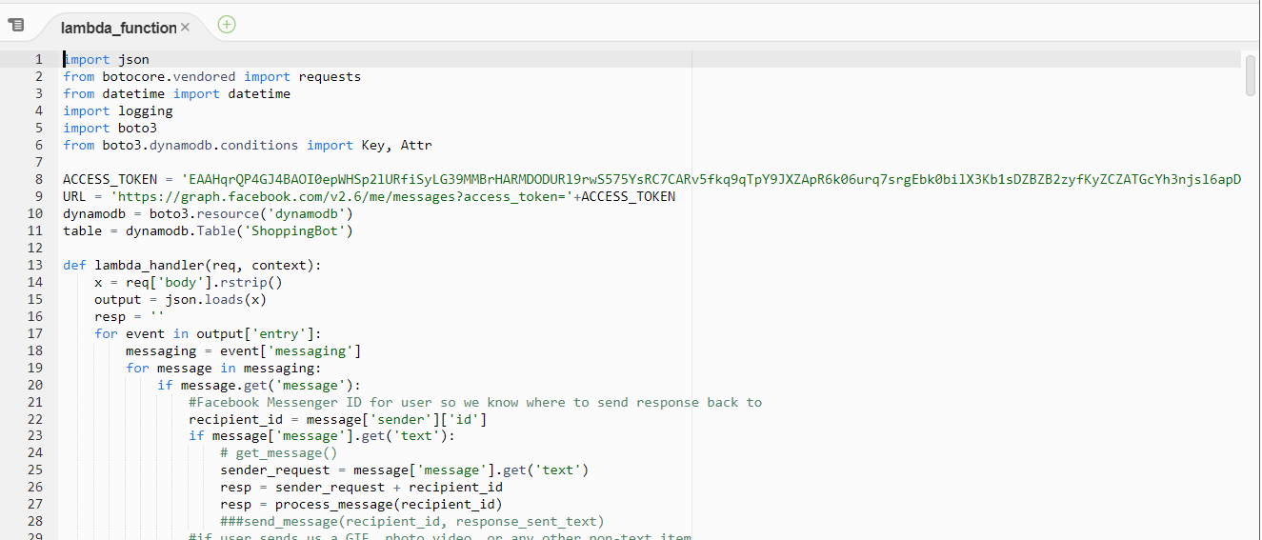
AWS - Lambda
Create 2 new lambda functions with Python 3.7 language support
One for GET
One for POST

Slide 6
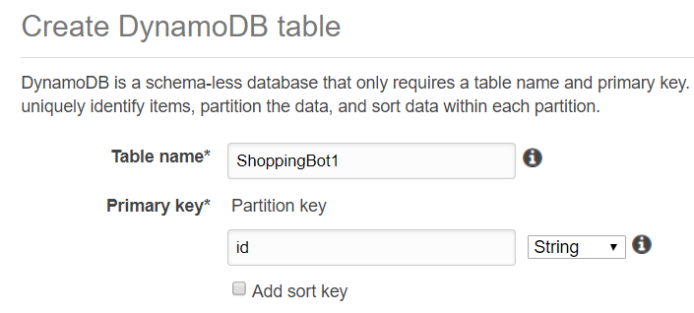
Create DynamoDB Table
Create DynamoDB table (Table name and Primary Key)

Slide 7
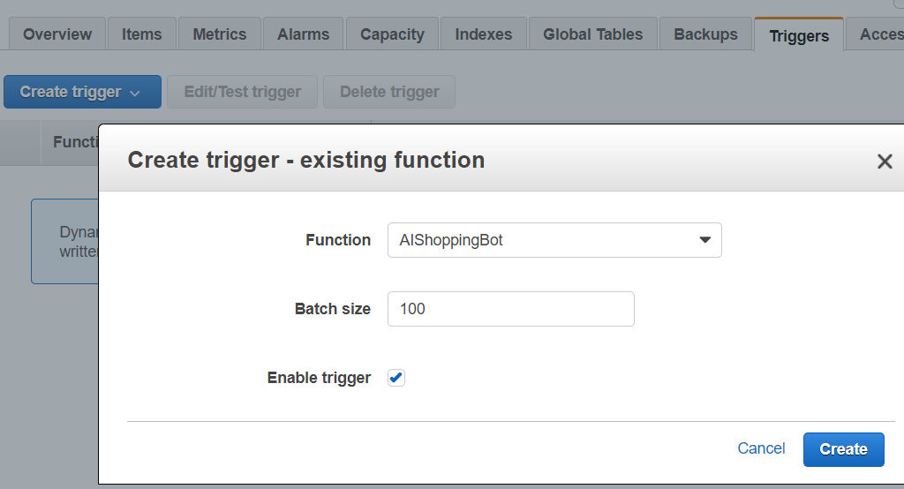
Create DynamoDB Table
Give access to Lambda functions

Slide 8
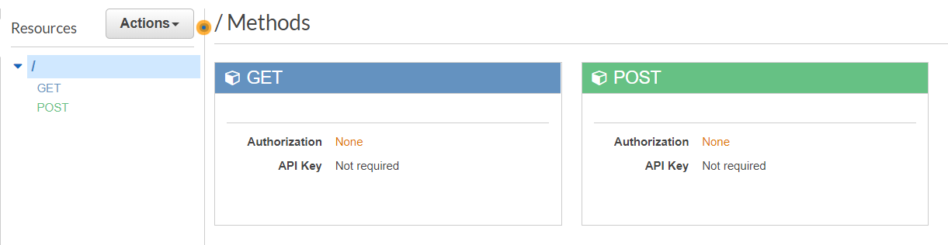
API Gateway
Create one API Gateway with 2 endpoints
GET
POST
Add lambda functions to each endpoint
Stage them

