Slide 1
Quantum Computing
The possible growth of
computing power and the consequences/repercussions that
the same have on the security and privacy of users
Presented by:
Bernardo da Palma Albergaria (no. 41931)
Pedro Miguel Ribeiro (no. 43594)
Rúben André Barreiro (no. 42648)
Tomás António Pessanha (no. 41774)

Slide 2
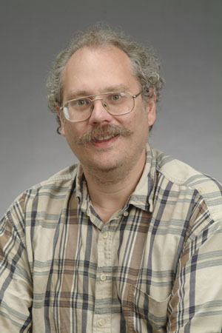
Timeline and History of
Quantum Computing over the Years [1]
The research for the development of the Quantum Computing began as early as the 1950s when was thought in the application of the laws of Physics and Quantum Mechanics to Computers.
In 1981, Richard Feynman presented a proposal for using Quantum Systems in Computers, which would then have a higher processing capacity than ordinary Computers.
As early as 1985, David Deutsch described the first Quantum Computer, a Quantum Turing Machine, it would simulate another Quantum Computer.
In 1994, Peter Shor developed the Shor’s Algorithm, capable of factoring large numbers at a much faster speed than conventional computers.
http://www-math.mit.edu/~shor/pic2.jpg

Slide 3
Timeline and History of
Quantum Computing over the Years [2]
In 1996, Lov Grover, developed Speedup, the first algorithm for Quantum Database Research. In that same year, a model for the correction of the Quantum Error was proposed.
In 1999, the first prototypes of Quantum Computer were built using thermal assembly.
In 2007, was developed by D-Wave Systems, a Quantum 16 qubits processor called Orion that performs practical tasks.
In 2011, D-Wave Systems launched the first Quantum Computer for commercialization, the D-Wave One, which has a 128-qubit processor. But the D-Wave One isn’t yet fully independent, it needs to be used in conjunction with conventional computers.

Slide 4
Timeline and History of
Quantum Computing over the Years [3]
In 2017, D-Wave Systems commercially launched the 2000Q, a Quantum Computer of 2,000 qubits at a meager $ 15 million. The company’s previous Quantum Computer had 1,000 qubits. The D-Wave Systems’ 2000Q is capable to perform 2,2000 operations at the same time.
In this year, Guilherme Tosi, invented a radical new architecture for Quantum Computing, based on ”flip-flop qubits” that can be used in a new type of Quantum Computers thus enabling the manufacture of large-scale Quantum processors can become much cheaper and easier than was thought possible.
Also in 2017, IBM announced a Quantum Computer that handles 50 qubits. The company is also making a 20-qubit system available through its Cloud Computing platform.

Slide 5
Timeline and History of
Quantum Computing over the Years [4]
In 2018, Google announced it has created a 72 qubits chip called Bristlecone which will serve as a basis for its demonstration of Quantum supremacy.
In 2019, IBM unveiled IBM Q System One ™, the world’s first integrated universal approximate Quantum Computer System designed for scientific and commercial use. IBM also announced plans to open its first IBM Q Quantum Computation Center for commercial clients, in New York.
Also in 2019, a team of Physicists from ETH Zurich, “experimentally demonstrate a time reversal” in a single electron, sending a qubit from a more complicated state to a simpler one. The experiment’s results got a success rate of 85% in a Quantum Computer of 2 qubits, occurring more errors and dropping to a success rate to 50%, when introduced a 3rd qubit.

Slide 6
Tractable and Intractable Problems
The Quantum Computing promises to break many paradigms of Classical Computing, in which divide the problems into “tractable problems” that have reasonable, polynomial-time solutions and “intractable problems”, that are problems that don’t have it:
Mathematical Notation | Complexity Time | Tractable/Intractable
O(1) | Constant | Tractable
O(log(n)) | Logarithmic | Tractable
O(n) | Linear | Tractable
O(n x log(n)) | N-Log-N | Tractable
O(n²) | Polynomial (Quadratic) | Tractable
O(n³) | Polynomial (Cubic) | Tractable
O(k^{n}), e.g., O(2^{n}) | Exponential | Intractable
O(n!) | Factorial | Intractable
O(n^{n}) | Super-Exponential | Intractable

Slide 7
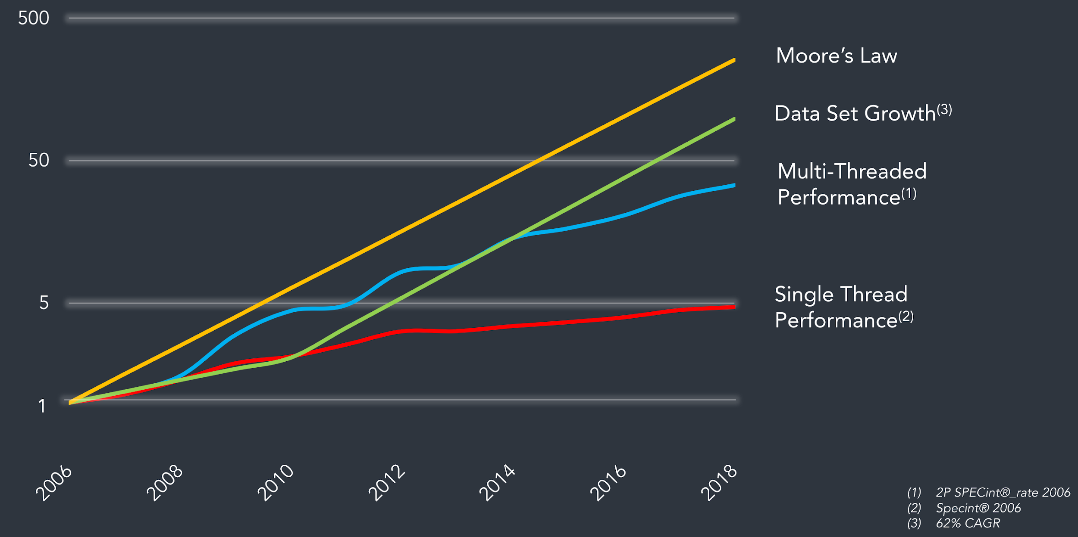
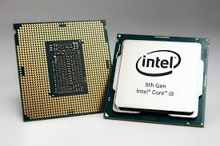
Moore’s Law
The Moore’s Law predicted that computing should reach its limits by 2020s, as it becomes harder to produce processors and chips, in smaller dimensions and geometries:
Rate of CPU Performance Increase is Slowing
https://cdn.wccftech.com/wp-content/uploads/2018/10/Intel-9th-Gen-Core-1-Custom-740x494.jpg
https://blog.tidalscale.com/hubfs/Screen%20Shot%202018-03-06%20at%205.49.02%20PM.png

Slide 8
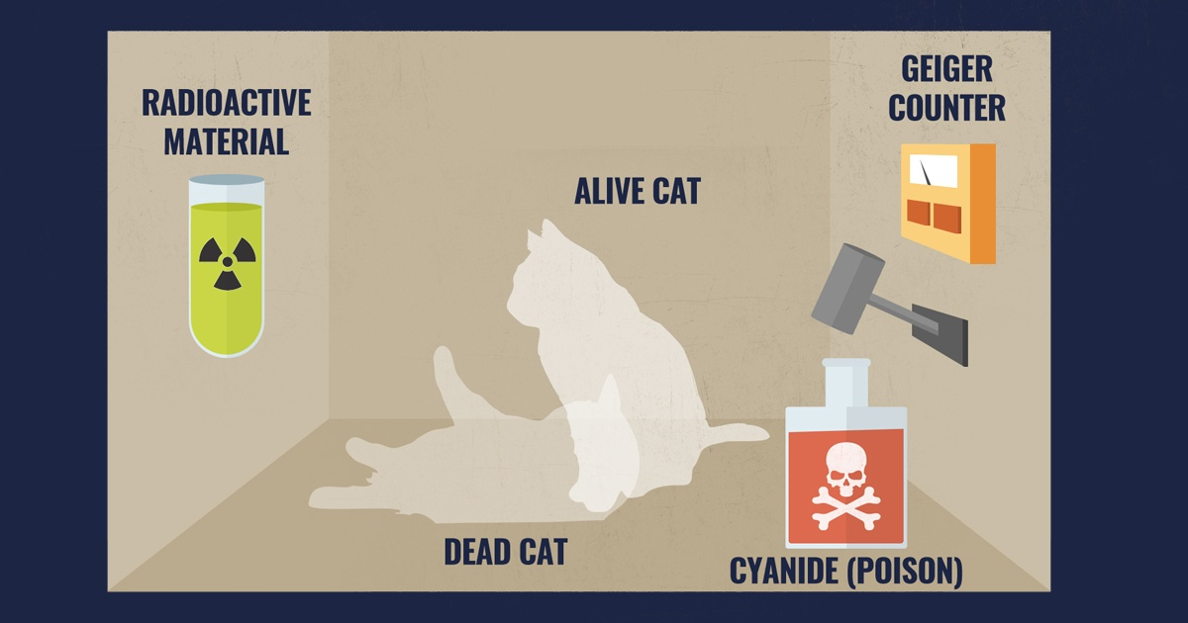
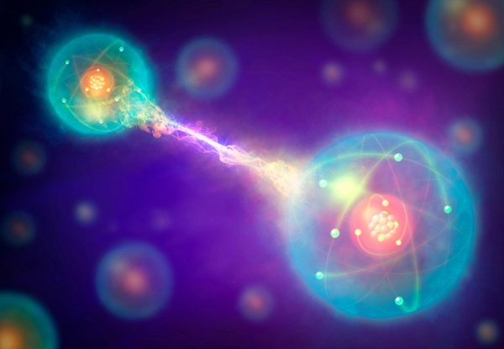
Principles of Quantum Computing [1]
The principles of Quantum Computing, come from some foundations of Classical Physics, where it can be highlighted:
1) Quantum Overlap:
A partially existence of a Physical System in all theoretically possible states simultaneously before being measured. But when measured or observed, the system is shown in a single state;
2) Schrödinger’s Cat Experience:
An experiment seeking to illustrate Copenhagen’s Interpretation of Quantum Mechanics, applied to a cat enclosed in a box, so that it’s not only alive or only dead, but ”undead”;
3) Quantum Entanglement or “Ghostly Action at a Distance”:
Two or more objects to be somehow so connected that an object can’t be correctly described without its counterpart be mentioned (even if may be spatially separated by millions of light years).
http://astronimate.com/wp-content/uploads/2017/03/schrodingers-cat-explained-setup.jpg?x70168
http://www.astronomy.com/-/media/Images/News%20and%20Observing/News/2018/08/quantumentanglement.jpg?mw=600

Slide 9
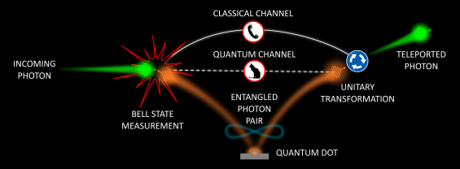
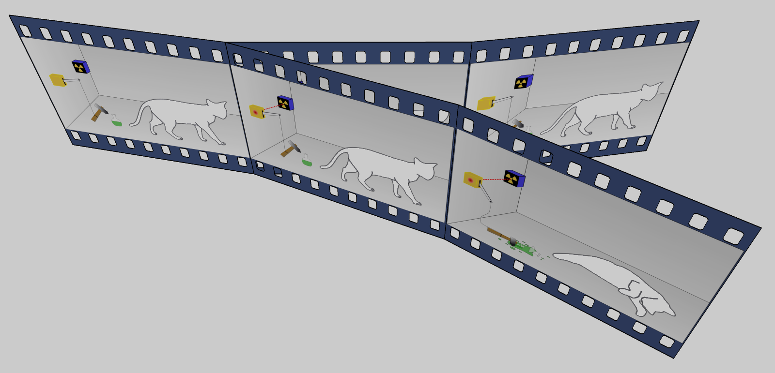
Principles of Quantum Computing [2]
The principles of Quantum Computing, come from some foundations of Classical Physics, where it can be highlighted:
4) Quantum Teleportation:
A technology that allows teleportation of information, such as spinor polarization, (there’s no transport of energy or matter) with the help of classical communication.
5) Rutherford Scattering:
A phenomenon that led to the development of the orbital theory of the atom. It’s now exploited by the Rutherford’s Dispersion Spectrometry Material Analysis technique.
6) Existence of Multiverse:
An interpretation that asserts the objective reality of the universal wave-function and denies the actuality of wave-function collapse. The existence of the other worlds makes it possible to remove randomness and action at a distance from Quantum Theory and thus from all Physics.
The existence of many “worlds”, could explain also the Schrödinger’s Cat Experience:
In this case, in one “world”, the cat would be alive and in the another, the cat would be dead.
https://www.phys.uniroma1.it/fisica/sites/default/files/teleportation%20highlight_3.1%20-%20Rinaldo%20Trotta.png
https://upload.wikimedia.org/wikipedia/commons/b/b7/MWI_Schrodingers_cat.png

Slide 10

The Quantum Bit or Qubit
In Quantum Computing, the basic information unit is the Quantum Bit or qubit.
The reason why Quantum Computing is so powerful lies in its capacity to represent both the zero (’0’) and one (’1’) states at the same time, via Quantum Superposition of those 2 states, instead of a single state, such as in Classic Computing.
A pair of qubits can be in any Quantum Superposition of 4 states, and 3 qubits in any superposition of 8 states. In general, a Quantum Computer with n qubits can be in any superposition of up to 2^{n} different states.
The Schrödinger’s Cat Experience may give some insight into this situation, as the titular cat is in a Quantum Superposition state. In Quantum Computing, the processing is simultaneous, instead of sequential as in Classical Computing.
https://crypviz.io/wp-content/uploads/2017/11/QUBIT.png

Slide 11
The power of Quantum Computing
The following table shows the increase of data that can be processed and represented by qubits, compared to bits:
Qubits (Quantum Bits) vs. Bits
# Qubits | # Bits
1 qubit | 2 bits
2 qubits | 4 bits
3 qubits | 8 bits = 1 byte
4 qubits | 16 bits
5 qubits | 32 bits
6 qubits | 64 bits
7 qubits | 128 bits
8 qubits | 256 bits
9 qubits | 512 bits
10 qubits | 1,024 bits
Qubits (Quantum Bits) vs. Bits
# Qubits | # Bits
13 qubits | 8,192 bits ≈ 1 kilobyte
23 qubits | 8,388,608 bits ≈ 1 megabyte
33 qubits | 8,589,934,592 bits ≈ 1 gigabyte
43 qubits | 8,796,093,022,208 bits ≈ 1 terabyte
44 qubits | 17,592,186,044,416 bits ≈ 2 terabytes
45 qubits | 35,184,372,088,832 bits ≈ 4 terabytes
50 qubits | 1,125,899,906,842,624 bits ≈ 128 terabytes
72 qubits | 4,722,366,482,869,645,213,696 bits ≈ 536,870,912 terabytes ≈ 512 exabytes ≈ 0.5 zettabytes
2,000 qubits | 1.15 × 10602 bits ≈ 1.44 × 10586 terabytes ≈ 1.44 × 10579 exabytes ≈ 1.44 × 10576 zettabytes ≈ 1.44 × 10573 yottabytes ≈ 144,000,000,000 × 10562 yottabytes
n qubits | 2^{n} bits
As a practical example, the volume of information in the entire Internet, in 2016, was estimated at 1.3 zettabytes.
72 qubits (0.5 zettabytes) would represent almost half of this huge amount of data.

Slide 12
How can Quantum Computing impact Internet Security?
With the huge computational power offered by Quantum Computing, some of the currently used Encryption Algorithms, aren’t secure anymore.
Encryption Algorithm | Security against Quantum Computing
Asymmetric (Public and Private) Key Encryption
3DES | Insecure
AES-128 | Insecure
AES-256 | Secure
Symmetric Key Encryption
RSA-1024, RSA-2048, RSA-4096 | Insecure
ECC-256, ECC-512 | Insecure
Diffie-Hellman | Insecure
Elliptical Curve Diffie-Hellman | Insecure
However, Quantum Systems would allow us to build safer Cryptosystems, through Quantum Networks, Quantum Communications, Quantum Cryptography and Quantum Key Distribution, using the added computational power to create longer secret keys and generating them faster, creating more secure communications.
This table demonstrates that the long-term security offered by many cryptosystems is under severe threat.

Slide 13
Some challenges on Communication with Quantum Cryptography and Cybersecurity [1]
Being a recent and expanding area, it has many theoretical and practical challenges that need to be addressed so that Quantum Communication scan grow. Some of the main challenges are:
Development of photon sources of small size and low cost;
Development of Quantum repeaters to increase the reach of a Quantum Network;
Development of new Quantum Cryptography Protocols using Quantum Systems with more than 2 states;
Development and dissemination of new Public Key Distribution, Authentication, and Digital Signature protocols;
Promoting the integration of Quantum Networks with existing infrastructure;
Training specialised Quantum Hackers to test the security of newly developed protocols.

Slide 14
Some challenges on Communication with Quantum Cryptography and Cybersecurity [2]
This also has a direct impact on the buying decisions of Chief Information Security Officers (CISOs) and Chief Technology Officers (CTOs) today, because privacy legislation often requires information like medical records to be kept confidential even after a person dies (e.g., German law stipulates that medical and legal data remain confidential from third parties even after the death of a patient or client).
A buyer/adopter of encryption products will then face two choices:
Purchase a cryptosystem that’s secure in the long-term, but less widely deployed, and with a smaller selection; such cryptosystems may be easily identifiable as quantum resistant or post-quantum cryptography;
Purchase a cryptosystem that’s not secure against quantum-based attacks, and accept that encrypted data will only remain confidential until quantum computers are readily accessible.

Slide 15
Social, Ethic and Moral Analysis of
Quantum Cryptography [1]
Socially, it’s possible to argue that the applications based on Quantum Computing will be good, at general, because they can be a great evolution in Science and Engineering, when applied to some of fields in daily lives of the people.
But, it’s debatable if, per example, to train some Quantum Hackers will be good for the global society:
The act utilitarianism supports the idea of training these Hackers, because it could help the developers to build more secure cryptosystems for the final users and clients, in a long-term.
However, the rule utilitarianism is opposed to it, because a Hacker that uses a Quantum Computer can hack and break some of the current most secure and almost unbreakable cryptosystems, causing harm to some people, in a short-term.
Additionally, hacking it’s a violation of people’s privacy rights, also, illegal and punishable by law.
Also, in the theoretical moral analysis of Kant, it’s reasonable to say that a Hacker that possibly, has bad intentions and wants to cause harm to the people, shouldn’t ever accept to be trained to test these kinds of cryptosystems and possibly, be a Quantum Hacker, in the future.
Notes:
Podemos afirmar que esta tecnologia será um progresso, logo terá um impacto positivo, no geral
Utilitarista -> longo prazo -> desenvolver sistemas mais seguros Curto prazo -> causa prejuizo à sociedade
Analise moral teorica de kant -> se tem más intencoes nao deveria ser aceite para ter contacto com a tecnologia

Slide 16
Social, Ethic and Moral Analysis of
Quantum Cryptography [2]
In analysis of the ethic code, generally used in computing professional area, it’s possible to argue the following:
The society can benefit with these new kinds of cryptosystems because they promise to be much more secure than the current ones. But the global society and some enterprises using the current cryptosystems, aren’t prepared yet, to handle a Security and Cryptography attack made by a powerful Quantum Computer and can be seriously harmed by that;
A Quantum Hacker currently being trained, shouldn’t omit to his supervisor, his possible bad intentions to harm people and violate their privacy rights using Quantum Computer;
The clients that are seeking and demanding these cryptosystems should be always informed about its development, because it addresses the protection of the user’s private data;
Notes:
Segundo o codigo de etica usado na area da computação, surgem os seguintes temas debativeis:
>introduçao da tecnologia tras promessa de melhoria na segurança mas, actualmente a maioria dos sistemas estariam vulneraveis
>alguem com contacto com a tecnologia, caso seja mal intencionado, não deveria omitir estas intençoes ao seu supervisor
>é espectavel que empresas que tenham preocupação com a privacidade dos seus clientes e que estejam interessados nestes sistemas, para tal, deviam ser informados dos desevolvimentos correntes

Slide 17
Social, Ethic and Moral Analysis of
Quantum Cryptography [3]
In analysis of the ethic code, generally used in computing professional area, it’s possible to argue the following:
An enterprise or organization that is trying to implement these kinds of cryptosystems and develop them unsuccessful, causing harm to the society, at general, should be severely punished;
A colleague of a developer of a cryptosystem based on Quantum Computing should be alert to his possible vulnerabilities and risks, warn him and try to show him that aspects;
At the core of computing, at general, shouldn’t be developed software that, possibly, can cause some harm to the global society and try to avoid some aspect that can denigrate the profession itself;
Notes:
> O desenvolvimento sem sucesso destes sistemas pode prejudicar de tal forma a sociedade que deveriam ter consequencias punitivas
> quem desevolve este tipo de sistemas deve ter abertura a feedback de colegas de forma a minimizar risco de erro
> Qualquer software que pode ter impacto negativo na sociedade não deveria ser criado

Slide 18
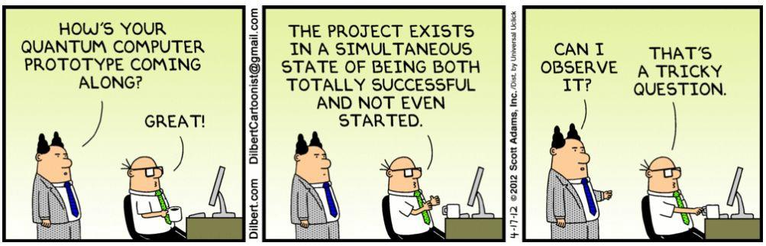
Thank you very much!!!
Any question?!
https://cdn-images-1.medium.com/max/1600/1*tETV7-LwciIZJ2t2fGNo7Q.jpeg

