Slide 1

How a Computer Works
A presentation by Ruben Arakelyan, Simon Harries
and Matt Saunders

Slide 2
Intro to External Hardware
Hardware is basically the computer and all of its associated equipment. It is basically any part of a computer that you can touch, for example the keyboard, mouse, monitor etc. The associated pieces of equipment are called peripherals.
We will start with external hardware, which is any hardware outside of the actual computer base unit.

Slide 3
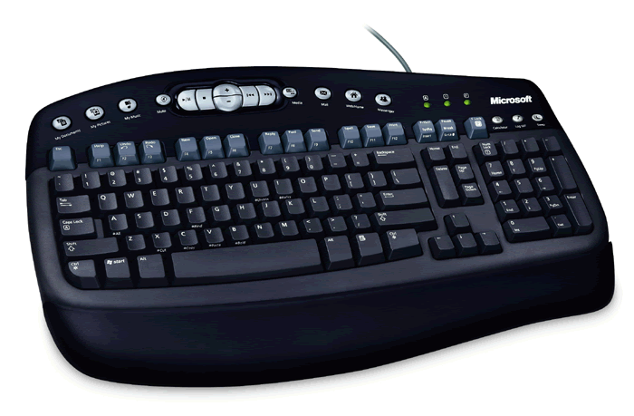
Keyboard
The keyboard is one of the
primary input devices for a
computer – in other words,
it is one of the most used
parts of a PC.
A keyboard is used when you want to enter data into a computer. The “F” keys at the top of the keyboard are called “shortcut keys” – they offer a fast way of carrying out frequent commands. On some keyboards such as the one in the picture, there are also some button at the very top. These are called “hotkeys”, and they work like the “F” keys to carry out frequent commands.
INPUT

Slide 4
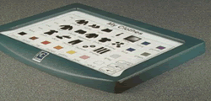
Concept Keyboard
A concept keyboard is a
special type of keyboard that
uses large symbols rather
than keys.
Concept keyboards are used by children and people with special needs or disabilities as the large keys and easily understood symbols make it easier for them to interact with computers.
Concept keyboards are also used by fast food retailers such as McDonald’s and Burger King as they speed up the ordering process.
INPUT

Slide 5
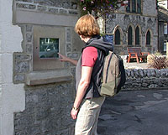
Touch screen
Touch screens are mainly used for
customer-facing kiosks at tourist
attractions, bank cash machines
and other places.
Touch screens work by detecting pressure applied to the screen at certain points. Touch screens display icons which can be touched by the user to select them. The pressure applied by touching an icon is translated into a selection which is then processed by the computer.
INPUT

Slide 6

Mouse
A mouse is a hand-held
button activated input device.
When rolled along a surface, it
moves a pointer around the
screen. A mouse has two buttons,
the left and right buttons. The left mouse button is used for selecting objects on the screen, and the right mouse button is used for other tasks such as activating menus. Some mice such as the one in the picture also have a “rollerball” in the middle of the two buttons. This can either be rolled up and down to scroll a page, or it can be clicked to carry out other actions.
INPUT

Slide 7
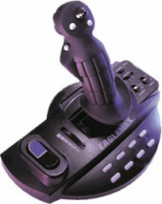
Joystick
Joysticks are often used to play games.
They allow you to move characters
or cars in any direction. Moving the
joystick in a certain direction sends a
signal to the game which then responds
by moving something on screen. Joysticks
are used in gaming as they are more realistic to use than mice. They also have several buttons which do actions such as shoot a laser or score a goal.
INPUT

Slide 8
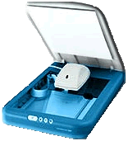
Scanner
A scanner is used to convert
documents into a digital format.
It is like a photocopier for
computers. You can scan
documents into a computer for
archiving, sending, or editing.
A scanner works by reflecting light off the paper you put in it and reading the results to provide an accurate scan in either monochrome or colour.
INPUT

Slide 9
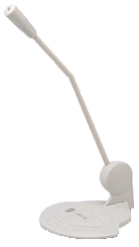
Microphone
A microphone is not as commonly used
as a computer input device as some
of the other devices, but it can be
useful if your computer can accept
voice commands, or if you want to
record sounds onto your computer.
Together with voice recognition software,
you can tell your computer what to do by talking into a microphone.
INPUT

Slide 10
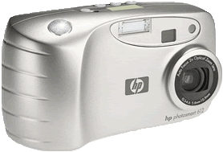
Digital Still Camera
A digital camera is a new piece of
hardware. It is basically a digital
version of the still camera, using
memory cards to store pictures.
It can be connected to a computer
so that you can take the images off
the camera and print them off at home. It also makes it easy to edit photos and to print off as many copies as needed.
INPUT

Slide 11
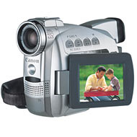
Digital Video Camera
A digital video camera is a new piece
of hardware. It is basically a digital
version of the video camera, using
memory cards, digital tape or even
DVDs to store pictures. It can be
connected to a computer so that
you can take portions of video off
the camera and edit them at home.
INPUT

Slide 12
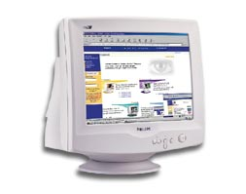
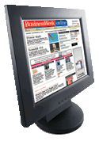
Monitor
The monitor is where the computer
shows you what you are doing.
There are two main types of monitor:
the CRT (cathode ray tube) monitor
which is the most common, and
“flat screen” (TFT) monitors, which are
much thinner and use different technology.
OUTPUT

Slide 13
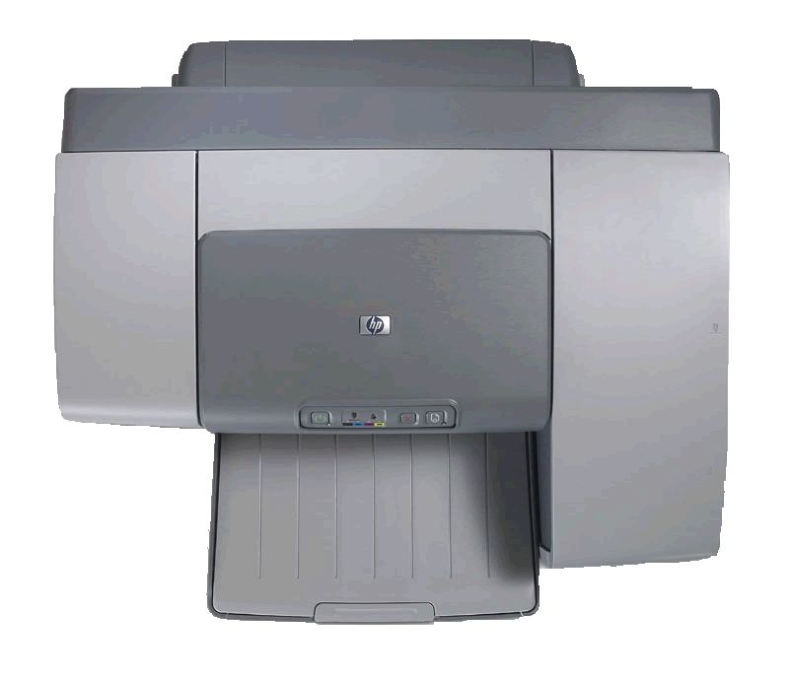
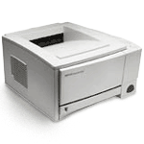
Printer
A printer is a device which makes a
paper copy of a document on the
computer. There are many types of
printer. The most common is inkjet,
and it uses cartridges of ink which it
sprays onto the paper to create the image.
Laser printers use powdered ink
(called toner), also contained in cartridges,
and heat it so that it sticks to the paper.
OUTPUT

Slide 14

Speakers
A pair of speakers is an optional
addition to a computer, but it
adds a lot of opportunities. It
allows you to play audio on your
computer, which useful for those of
you who download songs or like to
listen to CDs.
OUTPUT

Slide 15
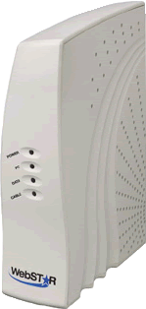
Cable Modem
A cable modem is a device that
connects your computer to the
internet. It can download web pages
and files at high speed, and upload
web pages and files to the internet.
It is used with fast “broadband”
connections.
PROCESSING

Slide 16
Intro to Internal Hardware
You have learnt about external hardware, but what about everything inside your computer?
Anything inside you computer is internal hardware, for example hard drives, CD drives, processor etc.
The main parts of your computer are inside the case, and it pays to know a little about what they are and what they do.

Slide 17
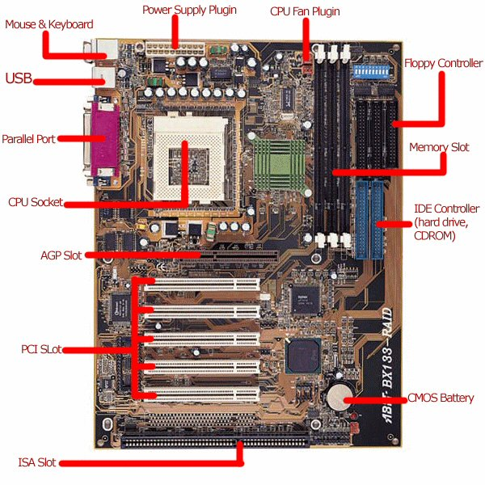
Motherboard
This is the motherboard. Everything inside your computer plugs into the motherboard. It is like the nervous system of your computer. Here, each part has been labelled and each part will be shown in detail.
PROCESSING

Slide 18
ISA Slot
This is an old style “ISA” slot. Old internal hardware cards fit into these types of slots. There are normally one or two of these slots on a motherboard.
PROCESSING

Slide 19
PCI Slot
This is a new style “PCI” slot. New internal hardware cards fit into these types of slots. There are normally three or four of these slots on a motherboard.
PROCESSING

Slide 20
AGP Slot
This is an “AGP” slot. This is where the graphics card slots in. There is only one of this type of slot on a motherboard.
PROCESSING

Slide 21

RAM Slot
These are memory slots, where the computer memory (RAM) sits. Memory is where your PC stores information that it needs frequently, and where all used information passes through. There are three or four slots on a motherboard.
PROCESSING

Slide 22

IDE Controller
These is the “IDE controller”. Hard drives and CD-ROM drives are connected to these controllers with wide cables. There are two of these controllers on a motherboard.
PROCESSING

Slide 23

Floppy Controller
These is the “Floppy controller”. Floppy drives are connected to these controllers with wide cables. There is one controller on a motherboard.
PROCESSING

Slide 24

CPU Fan Plug
These is the CPU fan plug. The fan which cools the CPU and prevents it from overheating connects here to get its power.
PROCESSING

Slide 25

Power Supply Plug
These is the power supply plug. A connector from the power supply connects here and provides power for the motherboard and all connected hardware cards.
PROCESSING

Slide 26
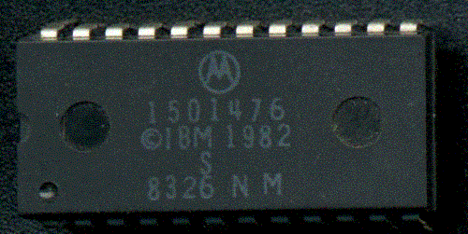
BIOS
This is the BIOS chip. It controls the computer when it is first turned on and carries out checks before handing over to the operating system.
PROCESSING

Slide 27
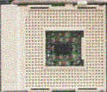
CPU Socket
This is the CPU socket, where the processor sits. Each of the holes house a pin on the processor. Each type of processor has a different number of pins, and so needs a different type of CPU socket.
PROCESSING

Slide 28
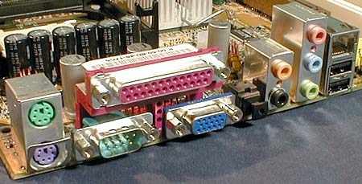
Ports
These are all connectors either on the motherboard or on separate cards. They are called ports and external hardware connect to these ports using cables.
PROCESSING

Slide 29

PS/2 Ports
These are PS/2 ports. Your keyboard and mouse plug into this sort of port.
PROCESSING

Slide 30
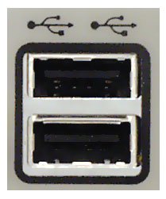
USB Ports
These are USB ports. Many pieces of hardware connect to these ports, like scanners, printers, mice, keyboards, cameras etc.
PROCESSING

Slide 31

Firewire (IEEE 1394) Ports
This is a Firewire port. It is primarily used rather than USB for very fast processing of media from digital video cameras and digital still cameras.
PROCESSING

Slide 32

Parallel (Printer) Port
This is a parallel port. Old printers connect to this type of port. Newer printers tend to use USB.
PROCESSING

Slide 33
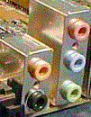
Audio Ports
These are audio connectors. They connect speakers, microphones, and other audio devices to the computer.
PROCESSING

Slide 34

Display Port
This is a display (VGA) connector. It is where the monitor connects to and gets its picture from.
PROCESSING

Slide 35

COM (Serial) Port
This is an old style serial (COM) port. It is used mainly for certain type of mice and external modems. It is not very common anymore.
PROCESSING

Slide 36
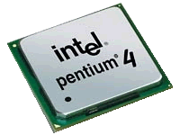
CPU (Processor)
This is a processor. It is the brains of the system, and it controls the computer and tells it what to do. It carries out instructions from the rest of the hardware.
PROCESSING

Slide 37
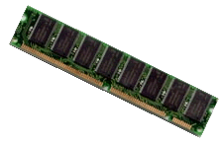
RAM (Memory)
This is computer memory, or “RAM”. This is where frequently used information is stored, and where all information passes through, because it is much faster to take info from this memory than to get it from the hard drive.
PROCESSING

Slide 38
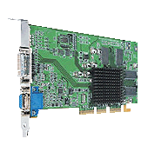
Graphics (Video) Card
This is a graphics card. Your monitor is connected to this and it is where it gets its picture data from.
PROCESSING

Slide 39
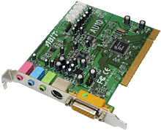
Sound Card
This is a sound card. Your speakers are connected to this and it is where they get the sound data from.
PROCESSING

Slide 40
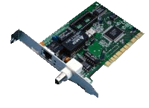
Network Card
This is a network card. Using this and a cable, you can connect computers together to share data and other resources between them.
PROCESSING

Slide 41
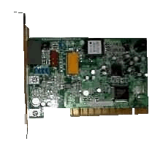
Modem
This is a dialup modem. A dialup modem is used to connect to the Internet through a phone line (dialup). Broadband connections tend to use external modems instead.
PROCESSING

Slide 42
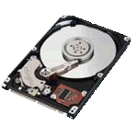
Hard Drive
This is a hard drive. Everything you save on your computer and programs that you install are stored on the hard drive. Data is stored on “platters” (the CD like plates) using magnetic fields.
STORAGE

Slide 43

Floppy Drive
This is a floppy drive. It stores data onto floppy disks which you can take around to transfer data onto other computers.
STORAGE

Slide 44
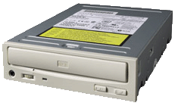
CD/DVD-ROM Drive
This is a CD/DVD-ROM drive. It can read CD-ROMs, which store about 650-700MB of data. It can also read DVD-ROMs, which allows you to watch movies on your computer. Most drives can also read CD-Rs, CD-RWs, DVD-Rs and DVD-RWs, which can all be written to (or “burnt”) so that you can store your own data onto them.
STORAGE

Slide 45
The End
Hopefully, you should have learnt a lot from this presentation, and you will be able to go away and be able to operate a computer while understanding how it actually works and how tasks are carried out.
We hope you enjoyed watching this presentation and that it was helpful to you!

