Slide 1
Ray Tracing and optimization
By Ruben Biesheuvel
And Aloys Erkelens

Slide 2
Ray Tracing: back to high school

Slide 3
Ray Tracing: Can be more difficult

Slide 4
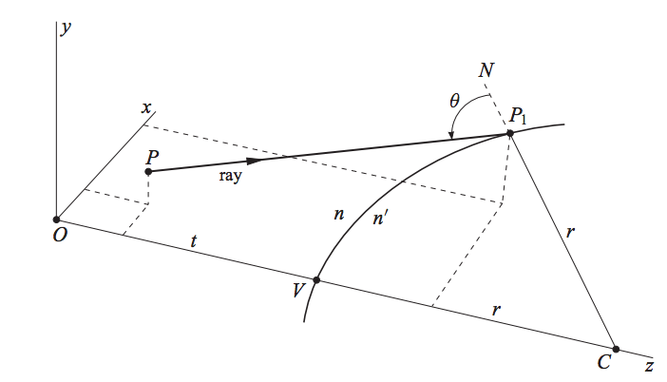
3D ray tracing

Slide 5
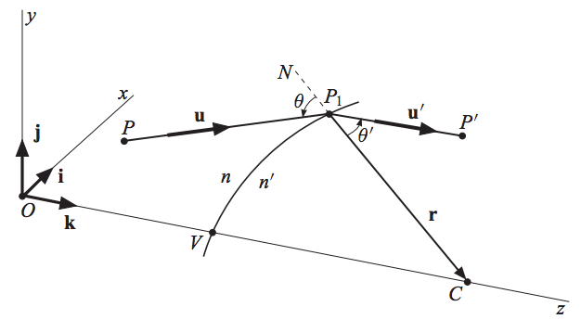
3D ray tracing

Slide 6
Cooke-triplet

Slide 7
Optimization!

Slide 8
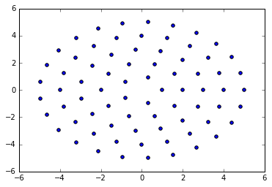
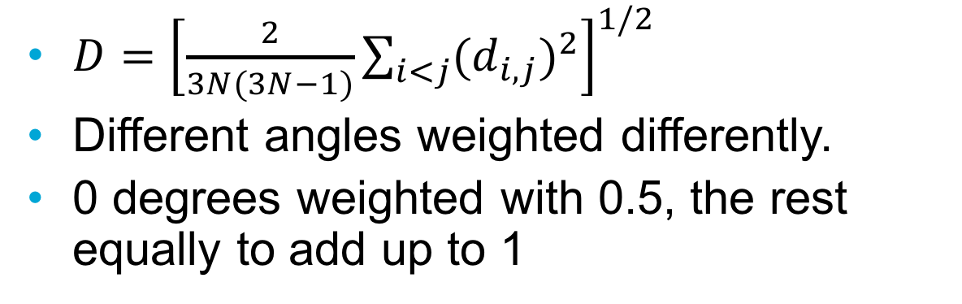
Minimalization
$D={\left[\frac{2}{3N(3N−1)}\sum_{i<j}{{(d_{i,j})}^{2}}\right]}^{1/2}$
Different angles weighted differently.
0 degrees weighted with 0.5, the rest equally to add up to 1

Slide 9
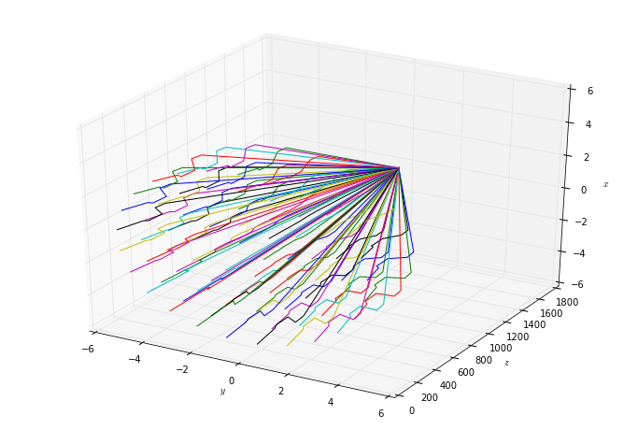
Rays!

Slide 10
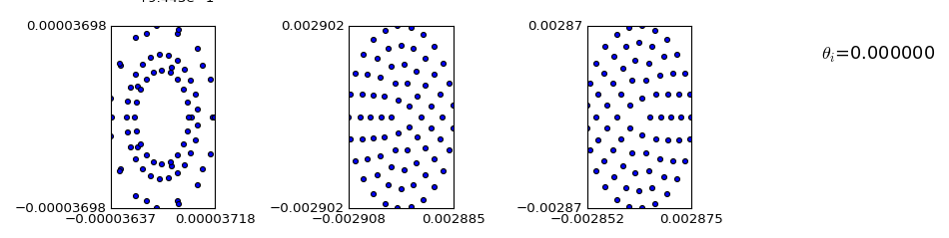
Zero angle result

Slide 11
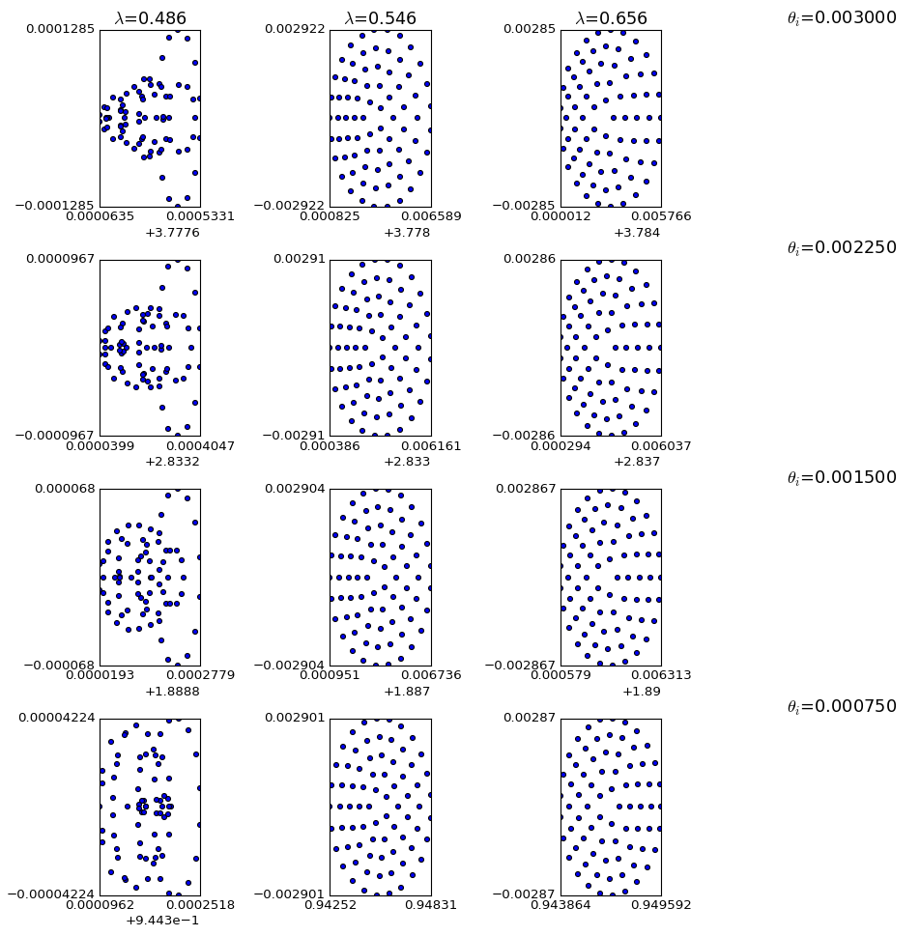
Other angle results

Slide 12
Summary
Cooke-triplet corrects for 2 wavelengths
Optimization does not necessarily converge
Optimization tends towards 1 ray in focus

