Slide 1





LISA – LISA includes Subclassing
Eine objekt-orientierte Programmiersprache mit Subtyping und Subclassing
Ruben Bär
Stefan Heinemann
Betreuer: Prof. Dr. Olivier Biberstein

Slide 2
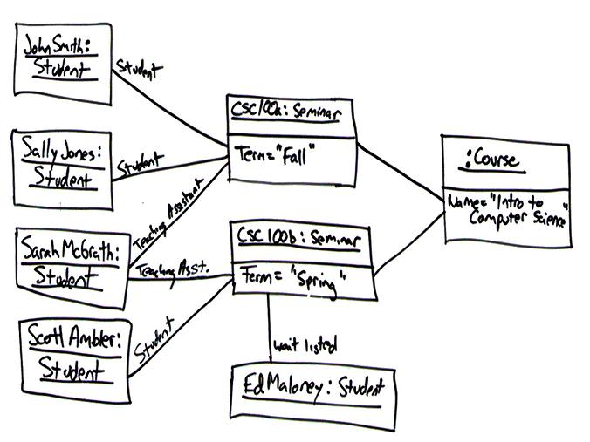
Notes:
Objekt-orientiert

Slide 3

Notes:
Statisch typisiert

Slide 4

Notes:
Nur ein Prototyp!

Slide 5

Notes:
Compiler implementiert

Slide 6
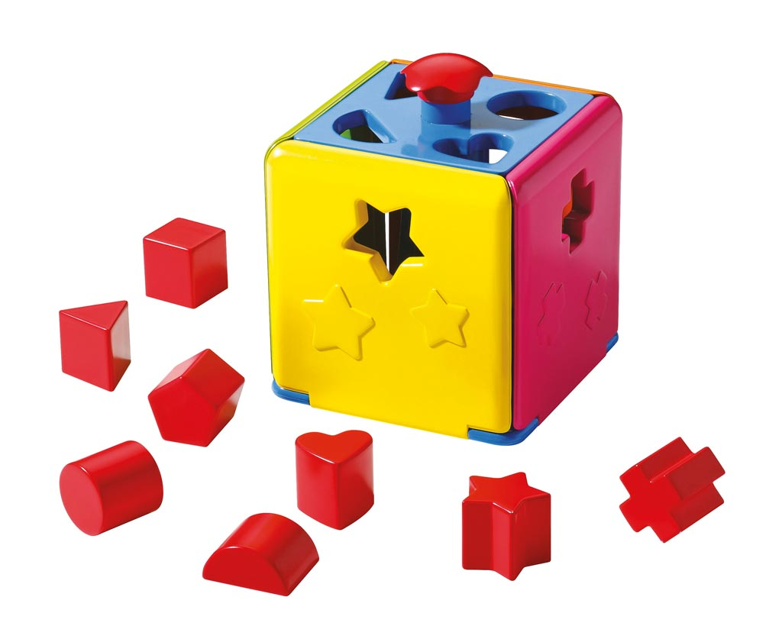
Notes:
Inkl. Type Checker / Type System

Slide 7

Notes:
Geschrieben in Java und Kompiliert auf Java

Slide 8
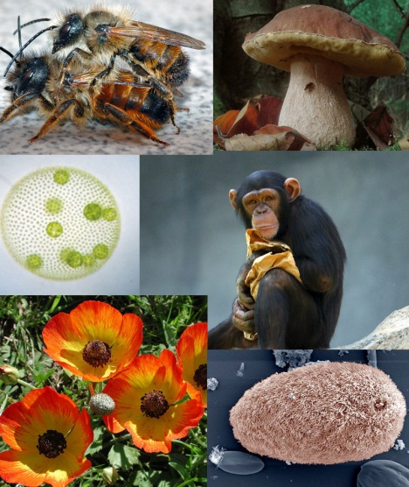
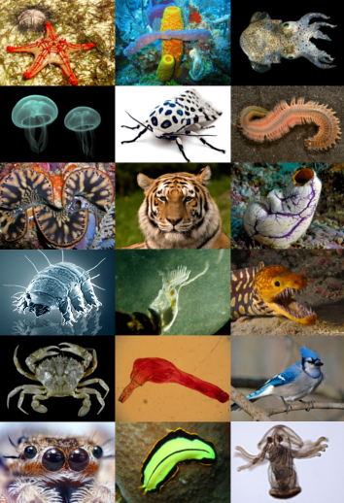









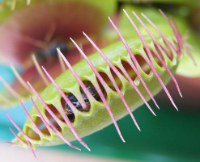

?
Notes:
Java hat explizites subtyping bei hierarchy
Aber ist das auch immer richtig?

Slide 9
public abstract class List {
public void addNext(Node next);
}
public class SinglyLinkedList extends List {
public void addNext(SinglyLinkedNode next) {
// Ooooops. No subtype anymore
// Method overload instead of override
}
}
public class DoublyLinkedList extends List {
public void addNext(DoublyLinkedNode next) {
// Ooooops. No subtype anymore
// Method overload instead of override
}
public void addPrev(DoublyLinkedNode prev) {
// New method definition
}
}

Slide 10
public abstract class List {
public void addNext(Node next);
}
public class SinglyLinkedList extends List {
public void addNext(Node next) {
// Do ugly casts…
// Overloades List.addNext
}
}
public class DoublyLinkedList extends List {
public void addNext(Node next) {
// Do ugly casts…
// Overloades List.addNext
}
public void addPrev (Node prev) {
// New method definition
}
}

Slide 11





Notes:
Generics!!!!!

Slide 12
public abstract class List<T extends Node> {
public void addNext(T next);
}
public class SinglyLinkedList<T extends SinglyLinkedNode> extends List<T> {
public void addNext(T next) {
// Uses bounded type parameter
}
}
public class DoublyLinkedList<T extends DoublyLinkedNode> extends List<T> {
public void addNext(T next) {
// Uses bounded type parameter
}
public void addPrev (T prev) {
// Uses bounded type parameter
}
}

Slide 13
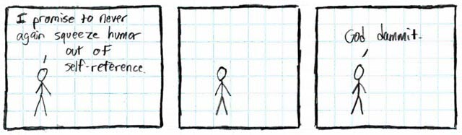
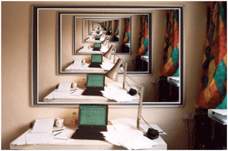

Notes:
Binäre Methoden mit Self-Refences und Rekusion

Slide 14



+mate(Animal): Void
+mate(Animal): Void
+mate(Animal): Void
+needsGrooming: boolean
+mate(Animal): Void

Slide 15
public abstract class Animal {
public Animal mate(Animal other);
}
public class Cat extends Animal {
public Animal mate(Animal other) {
// Perform biological crossovers
}
}
public class Persian extends Cat {
public boolean needsGrooming = false;
public Animal mate(Animal other) {
// Perform biological crossovers
}
}
public class Dog extends Animal {
public Animal mate(Animal other) {
// Perform biological crossovers
}
}

Slide 16
public abstract class Animal<T extends Animal<T>> {
public Animal mate(T other);
}
public class Cat<T extends Cat<T>> extends Animal<T> {
public Animal mate(T other) {
// Perform biological crossovers
}
}
public class Persian<T extends Cat<T>> extends Cat<T> {
public boolean needsGrooming = false;
public Animal mate(T other) {
// Perform biological crossovers
}
}
public class Dog<T extends Dog<T>> extends Animal<T> {
public Animal mate(T other) {
// Perform biological crossovers
}
}

Slide 17
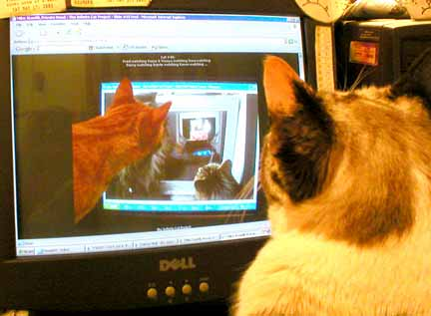
Cat<Cat<Cat<…Cat<Cat<…>>…>>> aCat;
Notes:
Unendlich viele Katzen

Slide 18


Notes:
Eine LÖSUNG - Ausweg

Slide 19
class Animal {
mate(other: MyType): MyType;
}
class Cat subclassOf Animal {
mate(other: MyType): MyType {
// Perform biological crossovers
}
}
class Persian subtypeOf Cat {
mate(other: MyType): MyType {
// Perform biological crossovers
}
}
class Dog subclassOf Animal {
mate(other: MyType): MyType {
// Perform biological crossovers
}
}

Slide 20
class List[T <# Node] {
def addNext(next: T): Void;
}
class SinglyLinkedList[T <# SinglyLinkedNode] subclassOf List[T] {
def addNext(next: T): Void {
// Uses Subclasses of SinglyLinkedNode
}
}
class DoublyLinkedList[T <# DoublyLinkedNode] subclassOf List[T] {
def addNext(next: T): Void {
// Uses Subclasses of DoublyLinkedNode
}
def addPrev (prev: T): Void {
// Uses Subclasses of DoublyLinkedNode
}
}

Slide 21




Slide 22


Slide 23


