Slide 1
Types and Programming Languages
Lecture 15
Simon Gay
Department of Computing Science
University of Glasgow
2006/07

Slide 2
Beyond Let-Polymorphism
With let-polymorphism, only let-bound values can be used
polymorphically. λ-bound values cannot be used polymorphically.
Example:
let f = λg. ...g(1)...g(true)...
in f(λx.x)‏
end
is not typable: when typechecking the definition of f, g has type
X (a fresh type variable) which is then constrained by
X = int→Y and X = bool→Z (Exercise: check this.)‏
Functions cannot take polymorphic functions as parameters.
This is the key limitation of let-polymorphism.
Is there anything better? Yes, of course there is...

Slide 3
Polymorphic Lambda Calculus
We will briefly look at a more powerful polymorphic language,
known variously as System F, polymorphic lambda calculus,
second-order lambda calculus, or λ2.
The idea is to introduce abstraction over types, and an explicit
operation of applying a polymorphic function to a type to create
a specific instance.
The starting point is the simply typed lambda calculus, plus:
Syntax of terms:
λX.t type abstraction (this term is also a value)‏
t [T] type application

Slide 4
Polymorphic Lambda Calculus
Syntax of types:
X type variable
∀X.T universal type
We also have function types, and base types if we want them.
Environments:
Environments contain type variables: e.g. Γ = X, x:X→X
This is to keep track of the scope of type variables.

Slide 5
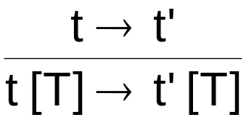
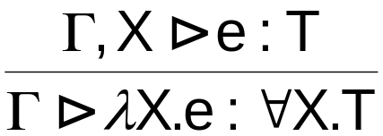
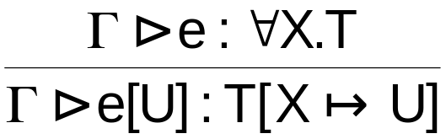
Polymorphic Lambda Calculus
Reduction:
The usual rules, plus
(R-TApp)‏
(λX.t) [ T ] → t [ X  T ]
(R-TAppTAbs)‏
Typing:
The usual rules, plus
(T-TAbs)‏
(T-TApp)‏

Slide 6
Polymorphic Lambda Calculus
Example:
double = λX. λf:X→X. λa:X. f(f(a))‏
has type
∀X. (X→X)→X→X
which can be instantiated as required:
double [int] (λx:int. x+2) 2
double [bool] (λx:bool. x) false
This can also be achieved by let-polymorphism, as we have
seen.
We can go further...

Slide 7
Polymorphic Lambda Calculus
Example:
f = λg:∀X. (X→X)→X→X.
... g [int] (λx:int. x+2) 2 ...
... g [bool] (λx:bool. x) false ...
has type
(∀X. (X→X)→X→X)→...
A polymorphic function can be passed as a parameter; it can be
instantiated as required by the receiving function.
Here we have a type in which ∀ is not at the top level. This is the
crucial difference from let-polymorphism.

Slide 8
Facts about Polymorphic Lambda Calculus
The basic properties of the simply typed lambda calculus are
also true of the polymorphic lambda calculus: type safety and
termination (of course, recursive definitions can be added).
Polymorphic type constructors (e.g. List) can be encoded in the
pure polymorphic lambda calculus.
Type reconstruction for polymorphic lambda calculus is
undecidable (this was an open question since the 1970s,
solved in 1994).

Slide 9
Bounded Polymorphism
Polymorphism and subtyping can be combined. A natural way to
do this is called bounded polymorphism. In polymorphic types,
type variables are associated with bounds, for example
∀X<:T. X→X
is a type in which the type variable X can be instantiated with
any type S which is a subtype of T, and then we have a function
of type S→S .
This is different from the subtype polymorphism in standard OO
languages, where the best we can do is, in effect,
∀X<:T. X→T

Slide 10
Bounded Polymorphism vs Subtype Polymorphism
Standard OO languages provide subtype polymorphism:
we can define (e.g. in Java):
T f(T x) { ... }
and then f can be applied to a value of any subtype of T, say S,
but the result has type T even if f actually returns a value of the
same type as its parameter.
In effect the type of f is ∀X<:T. X→T . If we know that the result
of f has the same type as its parameter, then a cast is required,
with a runtime type check.
A typical example of this problem is when working with generic
data structures.

Slide 11
Hashtable: Subtype Polymorphism
class Hashtable {
...
Object get(Object key) {...}
Object put(Object key, Object value) {...}
...
}
Hashtable h = new Hashtable();
MyClass m = new MyClass();
h.put(“Simon”,m);
MyClass n = (MyClass)h.get(“Simon”);

Slide 12
Hashtable: Bounded Polymorphism
The recently-released version 1.5 of Java adds bounded
polymorphism to the language. It is based on a proposal known
as GJ (Generic Java) (Bracha, Odersky, Stoutamire, Wadler).
C# also supports bounded polymorphism.
class Hashtable<K extends Object,V extends Object> {
...
V get(K key) {...}
V put(K key, V value) {...}
...
}
Hashtable<String,MyClass> h = new Hashtable();
MyClass m = new MyClass();
h.put(“Simon”,m);
MyClass n = h.get(“Simon”);

Slide 13
Reading
Pierce: 23
http://java.sun.com/j2se/1.5/pdf/generics-tutorial.pdf (handout)‏
Exercises
Pierce: 23.4.1, 23.4.2, 23.4.3, 23.4.4
Now that Java has generics, is there any need for the
covariant subtyping rule for arrays?
(if T <: U then T[ ] <: U[ ] )‏

