Slide 1
INTELLIGENT SYSTEMS
Unit 1
Introduction to
Artificial Intelligence
and Intelligent Agents
Computer Science Degree · Escuela Superior de Informática · UCLM
Rubén Juárez Cádiz
Notes:
Abrir la clase con una pregunta: qué hace que un sistema parezca inteligente. Evitar empezar con definiciones largas.

Slide 2
Unit 1
Intelligent Systems · ESI Ciudad Real
Learning outcomes
LO1
Explain the main approaches used to define AI
LO4
Specify a task environment using PEAS
LO2
Define agents, percepts, actions and environments
LO5
Classify environments and agent architectures
LO3
Distinguish rationality from success or omniscience
LO6
Connect agents with state-space search
By the end of this unit, students should be able to reason about an AI system as an agent operating in a task environment.
02
Notes:
Presentar los resultados como criterios de éxito para el tema, no como una lista burocrática.

Slide 3
What is AI?
Intelligent Systems · ESI Ciudad Real
A question before definitions
What makes a system intelligent?
Can it perceive?
Can it reason?
Can it learn?
Can it act?
Artificial Intelligence combines all four dimensions, but different systems emphasize different capabilities.
03
Notes:
Pedir ejemplos a los estudiantes: ChatGPT, un robot, un sistema de recomendación, un coche autónomo.

Slide 4
What is AI?
Intelligent Systems · ESI Ciudad Real
Working definition
Artificial Intelligence is the field concerned with building computational systems capable of perceiving, reasoning, learning and acting to achieve goals.
1
2
3
4
Perception
Reasoning
Learning
Action
04
Notes:
Definición de trabajo, no dogmática. Enfatizar que la asignatura se centra en sistemas que actúan para alcanzar objetivos.

Slide 5
What is AI?
Intelligent Systems · ESI Ciudad Real
Four approaches to AI
Humanly
Rationally
Thinking
humanly
Thinking
rationally
Thinking
Acting
humanly
Acting
rationally
Acting
This course mainly adopts the rational-agent view: design systems that choose effective actions.
05
Notes:
Conectar las cuatro familias de definiciones con el material del libro. Marcar acting rationally como el enfoque del curso.

Slide 6
What is AI?
Intelligent Systems · ESI Ciudad Real
Acting humanly: the Turing Test
Hidden
respondent A
A machine passes if the interrogator cannot reliably distinguish it from a human through conversation.
Human
interrogator
Hidden
respondent B
Useful as an operational test, but not the only way to define intelligence.
06
Notes:
No convertir esta parte en una clase de historia. Usarla para mostrar el enfoque acting humanly y contrastarlo con rational agents.

Slide 7
What is AI?
Intelligent Systems · ESI Ciudad Real
Capabilities behind the Turing Test
Natural Language Processing
Knowledge Representation
Automated Reasoning
Machine Learning
Computer Vision
Robotics
The key idea is not to imitate every human detail, but to understand and engineer useful intelligent behaviour.
07
Notes:
Preguntar: ¿qué capacidades usa hoy ChatGPT? ¿Cuáles no tiene por sí solo si no se conecta a herramientas?

Slide 8
Rational agents
Intelligent Systems · ESI Ciudad Real
Why rational agents?
A rational agent acts so as to achieve the best expected outcome given what it knows.
Knowledge
Goals
Actions
Performance
Rationality gives us an engineering criterion: how should the system choose an action?
08
Notes:
Subrayar que la racionalidad es un criterio de diseño, no un juicio moral ni una garantía de éxito.

Slide 9
Context
Intelligent Systems · ESI Ciudad Real
A very short history of AI
1943
1950
1956
1980s
2012
2022+
2025+
Artificial neuron
Turing
Dartmouth
Expert systems
Deep learning
Generative AI
AI agents
The course starts from classical AI foundations because modern AI agents still need goals, actions, environments and search.
09
Notes:
Historia comprimida. Evitar fechas innecesarias; el objetivo es justificar que los fundamentos siguen siendo actuales.

Slide 10
Context
Intelligent Systems · ESI Ciudad Real
From classical AI to modern AI agents
Classical AI
search · logic · planning
Machine Learning
patterns · prediction
Modern agents
models · tools · feedback
Different technologies, same central question:
What action should the system perform next?
10
Notes:
Esto permite actualizar el tema sin perder el enfoque clásico de la asignatura.

Slide 11
Intelligent agents
Intelligent Systems · ESI Ciudad Real
What is an agent?
An agent is an entity that perceives its environment through sensors and acts upon that environment through actuators.
Agent
Percepts
Actions
Environment
11
Notes:
Repetir la definición varias veces con ejemplos: robot, software bot, tutor inteligente, agente de ciberseguridad.

Slide 12
Intelligent agents
Intelligent Systems · ESI Ciudad Real
The perception–action cycle
Environment
Sensors
Agent program
Actuators
Percepts are inputs. Actions are outputs. The agent program implements the decision process between them.
12
Notes:
Usar la metáfora: sentir → decidir → actuar → observar consecuencias.

Slide 13
Intelligent agents
Intelligent Systems · ESI Ciudad Real
The agent function
f : P* → A
P* = percept histories
A = possible actions
For every possible sequence of percepts, the function specifies what action the agent should take.
13
Notes:
Explicar que es una función ideal/matemática, no necesariamente una tabla implementable.

Slide 14
Intelligent agents
Intelligent Systems · ESI Ciudad Real
Agent function ≠ agent program
Agent function
ideal mathematical mapping
Agent program
concrete implementation
Architecture
hardware / runtime platform
Agent = Architecture + Program
14
Notes:
Puede haber muchas implementaciones para la misma función de agente.

Slide 15
Intelligent agents
Intelligent Systems · ESI Ciudad Real
Example: vacuum-cleaner world
A
Dirty
B
Dirty
IF Dirty → Suck
ELSE IF A → Right
ELSE → Left
This simple example lets us separate percepts, actions, state, rules and performance measures.
15
Notes:
No dedicar demasiado tiempo al mundo aspiradora, pero usarlo como puente para racionalidad y PEAS.

Slide 16
Rational agents
Intelligent Systems · ESI Ciudad Real
Rationality
A rational agent chooses the action expected to maximize its performance measure, given the percept sequence and built-in knowledge.
Performance measure
Prior knowledge
Available actions
Percepts so far
16
Notes:
La racionalidad no se evalúa después de ver si tuvo suerte, sino según la información disponible en el momento.

Slide 17
Rational agents
Intelligent Systems · ESI Ciudad Real
Rationality is not omniscience
Rational
≠
Omniscient
Rational
≠
Clairvoyant
Rational
≠
Always successful
A good decision can still lead to a bad outcome when information is incomplete or the world is uncertain.
17
Notes:
Ejemplo: elegir la ruta más segura no garantiza no encontrar un atasco o accidente.

Slide 18
Rational agents
Intelligent Systems · ESI Ciudad Real
Performance measures
The performance measure defines what counts as success.
Bad measure
“Amount of dirt sucked”
Better measure
“Clean squares over time, minus moves”
A poorly chosen metric can produce undesirable behaviour.
18
Notes:
Conectar con IA responsable: lo que se mide condiciona lo que el agente optimiza.

Slide 19
Task environments
Intelligent Systems · ESI Ciudad Real
PEAS
To design a rational agent, specify the task environment.
P
E
A
S
Performance measure
Environment
Actuators
Sensors
19
Notes:
PEAS será herramienta recurrente para analizar sistemas.

Slide 20
Task environments
Intelligent Systems · ESI Ciudad Real
PEAS example: autonomous taxi
Performance
safety · legality · time · comfort · cost
Environment
roads · traffic · pedestrians · weather
Actuators
steering · accelerator · brakes · indicators
Sensors
cameras · GPS · LiDAR · speed sensors
20
Notes:
Preguntar a los alumnos qué falta o qué cambiarían.

Slide 21
Task environments
Intelligent Systems · ESI Ciudad Real
Class activity: PEAS for an AI tutor
In pairs, design the PEAS description of a conversational AI tutor for this course.
Performance: learning, correctness, safety
Environment: student, course material, conversation
Actuators: text, hints, tool calls
Sensors: prompts, documents, history
Deliverable: one PEAS table and one risk caused by a poor performance measure.
21
Notes:
Actividad breve. Útil para bajar el concepto a IA generativa actual.

Slide 22
Task environments
Intelligent Systems · ESI Ciudad Real
Task environments
The environment type largely determines the agent design.
Observable
Deterministic
Episodic
Static
Discrete
Single-agent
22
Notes:
Explicar que clasificar un entorno no es teoría decorativa: condiciona estructuras de datos y algoritmos.

Slide 23
Task environments
Intelligent Systems · ESI Ciudad Real
Observability and determinism
Fully observable
The agent can access all relevant state information.
Partially observable
The agent must remember or infer hidden information.
Deterministic
Each action has one guaranteed outcome.
Stochastic
Actions may have uncertain outcomes.
23
Notes:
Usar ejemplos: ajedrez vs póker; Loopover vs taxi autónomo.

Slide 24
Task environments
Intelligent Systems · ESI Ciudad Real
Time structure and dynamics
Episodic
Each decision is independent from previous decisions.
Sequential
Current actions affect future decisions.
Static
The environment does not change while the agent deliberates.
Dynamic
The environment can change during deliberation.
24
Notes:
Diferencia clave: búsqueda offline requiere normalmente entornos estáticos o modelables.

Slide 25
Task environments
Intelligent Systems · ESI Ciudad Real
Discrete, continuous, single-agent, multi-agent
Discrete
Finite states, actions or percepts.
Continuous
Variables or actions take real values.
Single-agent
No competing or cooperating agents.
Multi-agent
Other agents affect outcomes.
25
Notes:
Mostrar que juegos competitivos llevan a búsqueda adversarial; de ahí el Tema 5.

Slide 26
Task environments
Intelligent Systems · ESI Ciudad Real
Environment comparison
Env.
Obs.
Det.
Time
Dyn.
Rep.
Agents
Chess
Full
Det.
Seq.
Semi
Disc.
Multi
Taxi
Partial
Stoch.
Seq.
Dyn.
Cont.
Multi
Loopover
Full
Det.
Seq.
Static
Disc.
Single
Loopover is a clean state-space search environment: fully observable, deterministic, sequential, static, discrete and single-agent.
26
Notes:
Esta slide conecta directamente con el laboratorio.

Slide 27
Agent types
Intelligent Systems · ESI Ciudad Real
Agent architectures
Learning agent
Utility-based
Goal-based
Model-based
Simple reflex
Increasing generality and flexibility
27
Notes:
No es una jerarquía estricta de “mejor”; cada arquitectura se adapta a un tipo de problema.

Slide 28
Agent types
Intelligent Systems · ESI Ciudad Real
Simple reflex agents
Condition → Action rules
IF current percept matches condition
THEN execute associated action
Fast and simple, but weak when the current percept is not enough.
28
Notes:
Ejemplo aspiradora. Limitación: no memoria, no objetivos explícitos.

Slide 29
Agent types
Intelligent Systems · ESI Ciudad Real
Model-based agents
Internal state summarizes what the agent cannot currently observe.
Old state
New percept
Updated state
Action
Useful for partial observability: the agent maintains a model of how the world changes.
29
Notes:
Ejemplo: un coche recuerda posiciones de otros vehículos de fotogramas anteriores.

Slide 30
Agent types
Intelligent Systems · ESI Ciudad Real
Goal-based agents
Current state
Planning / Search
Action sequence
Goal
This is the bridge to Unit 2: problem solving and search.
30
Notes:
Aquí empieza a aparecer la búsqueda como mecanismo natural de decisión.

Slide 31
Agent types
Intelligent Systems · ESI Ciudad Real
Utility-based agents
Goals say whether a state is acceptable. Utility says how good it is.
Goal-based
Reach destination
Utility-based
Reach destination safely, quickly and comfortably
Utility functions allow trade-offs between competing preferences.
31
Notes:
No desarrollar teoría matemática profunda; solo introducir la idea.

Slide 32
Agent types
Intelligent Systems · ESI Ciudad Real
Learning agents
Performance element
chooses actions
Critic
evaluates feedback
Learning element
improves behaviour
Problem generator
encourages exploration
Learning agents improve from experience. Unit 6 will study reinforcement learning.
32
Notes:
Conectar con aprendizaje por refuerzo sin anticipar demasiada técnica.

Slide 33
Modern view
Intelligent Systems · ESI Ciudad Real
Modern AI agents and LLMs
Goal
LLM / model
Tools
Environment
A language model is not automatically an agent. It becomes part of an agent when it selects actions, uses tools and observes outcomes.
33
Notes:
Muy actual: separar modelo de agente. Un LLM puede ser motor de razonamiento, no necesariamente agente completo.

Slide 34
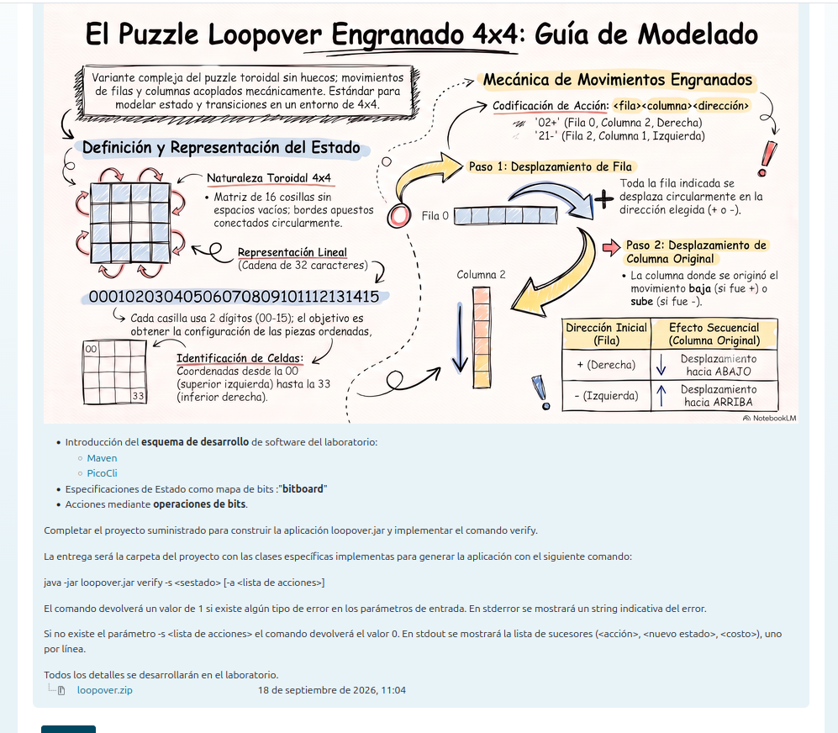
Lab connection
Intelligent Systems · ESI Ciudad Real
Case study: Loopover
Fully observable
Static
Deterministic
Discrete
Sequential
Single-agent
Therefore, Loopover is a natural state-space search problem.
34
Notes:
Conectar teoría y laboratorio. No entrar aún en bitboard salvo como adelanto de representación de estado.

Slide 35
Transition to Unit 2
Intelligent Systems · ESI Ciudad Real
Why search comes next
Initial state
Actions
Successor states
Goal state
Search is simulated exploration of a state space to find an action sequence that reaches a goal.
35
Notes:
Cierre del tema: los agentes basados en objetivos necesitan buscar o planificar.

Slide 36
Practice
Intelligent Systems · ESI Ciudad Real
Class activity
Design an intelligent agent
1. Choose a domain
2. Define PEAS
3. Classify the environment
4. Select an agent architecture
5. Justify what the agent must remember
Suggested domains: autonomous delivery robot · cybersecurity agent · university tutor · healthcare monitoring agent
36
Notes:
Actividad de 20–25 minutos. Recoger 2 o 3 ejemplos en pizarra.

Slide 37
Assessment
Intelligent Systems · ESI Ciudad Real
Mini-check
1. What does f : P* → A represent?
2. Why is rationality not the same as success?
3. What does PEAS stand for?
4. Classify Loopover as a task environment.
5. What is the difference between goal-based and utility-based agents?
37
Notes:
Usar como cierre de clase o como cuestionario rápido en Campus Virtual.

Slide 38
Wrap-up
Intelligent Systems · ESI Ciudad Real
Key takeaways
AI can be studied as the design of rational agents.
Agents perceive, decide and act in task environments.
Rationality depends on performance, knowledge, actions and percepts.
PEAS and environment classification guide agent design.
Goal-based agents naturally lead to state-space search.
Next unit: Problem solving and search
38
Notes:
Cierre: enlazar explícitamente con el Tema 2 y la primera práctica.

