Slide 1
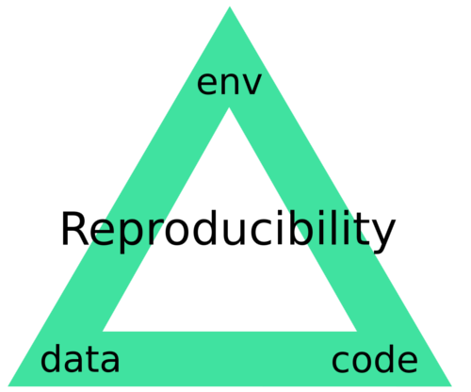
SaRu
Samuel Michel
Ruben De Campos
1

Slide 2
Introduction
Github project :
Small project description and steps to follow
Everything necessary to reproduce the work
Environment
Data
Code
Small code to try to get it to work
Goal : split the project in appropriate files as in the designed workflow
Notes:
2

Slide 3
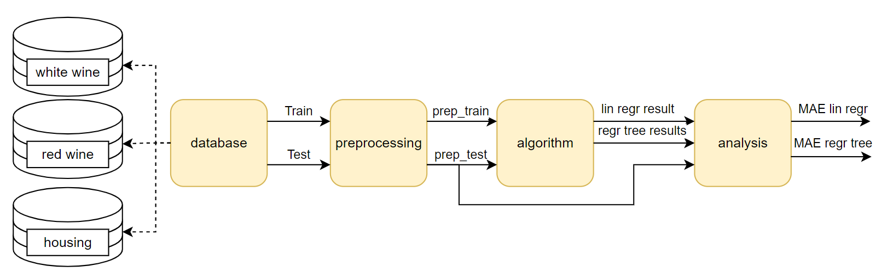
Implementation
Basic workflow
3

Slide 4
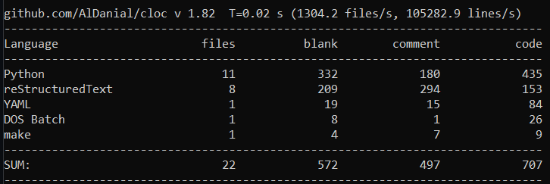

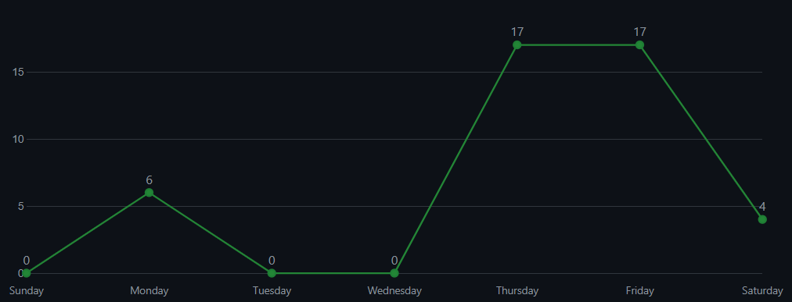
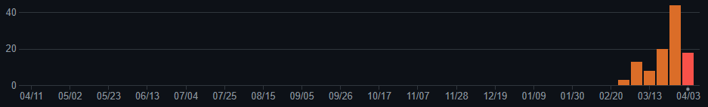

VC Git and Code sharing
Insight :
Github project :
Commit often
Work on different branch
Keep everything tidy
70%
ratio !
Nbr of blank line, comment and code using ‘cloc’
Nbr of commit histogram + graph of our most productive week

Slide 5
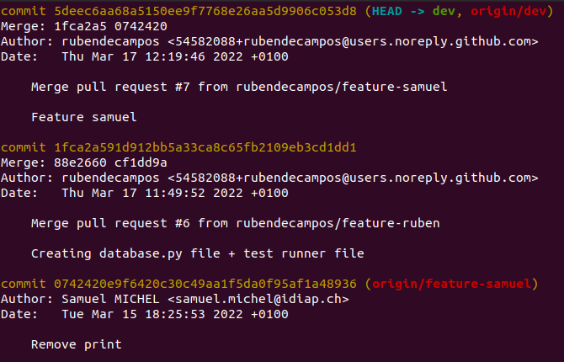
VC Git and Code sharing
Clone of the github repository locally
Collaborative work
Git log of 3 commits

Slide 6
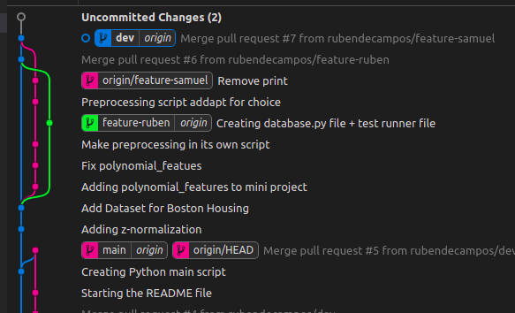
VC Git and Code sharing
Graphical view of our commits
Working on different branches :
Dev
Features
Visual Studio Code’s graphical view of the git branches

Slide 7

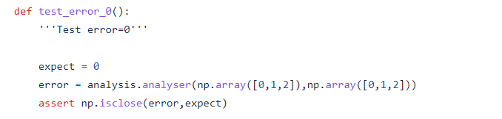
Unit Testing
Code
Test runner
Pytest (with coverage)
function_1()
test_function_1()
Success
function_2()
test_function_2()
Fail
function_3()
test_function_3()
Success
get()
Covered

Slide 8
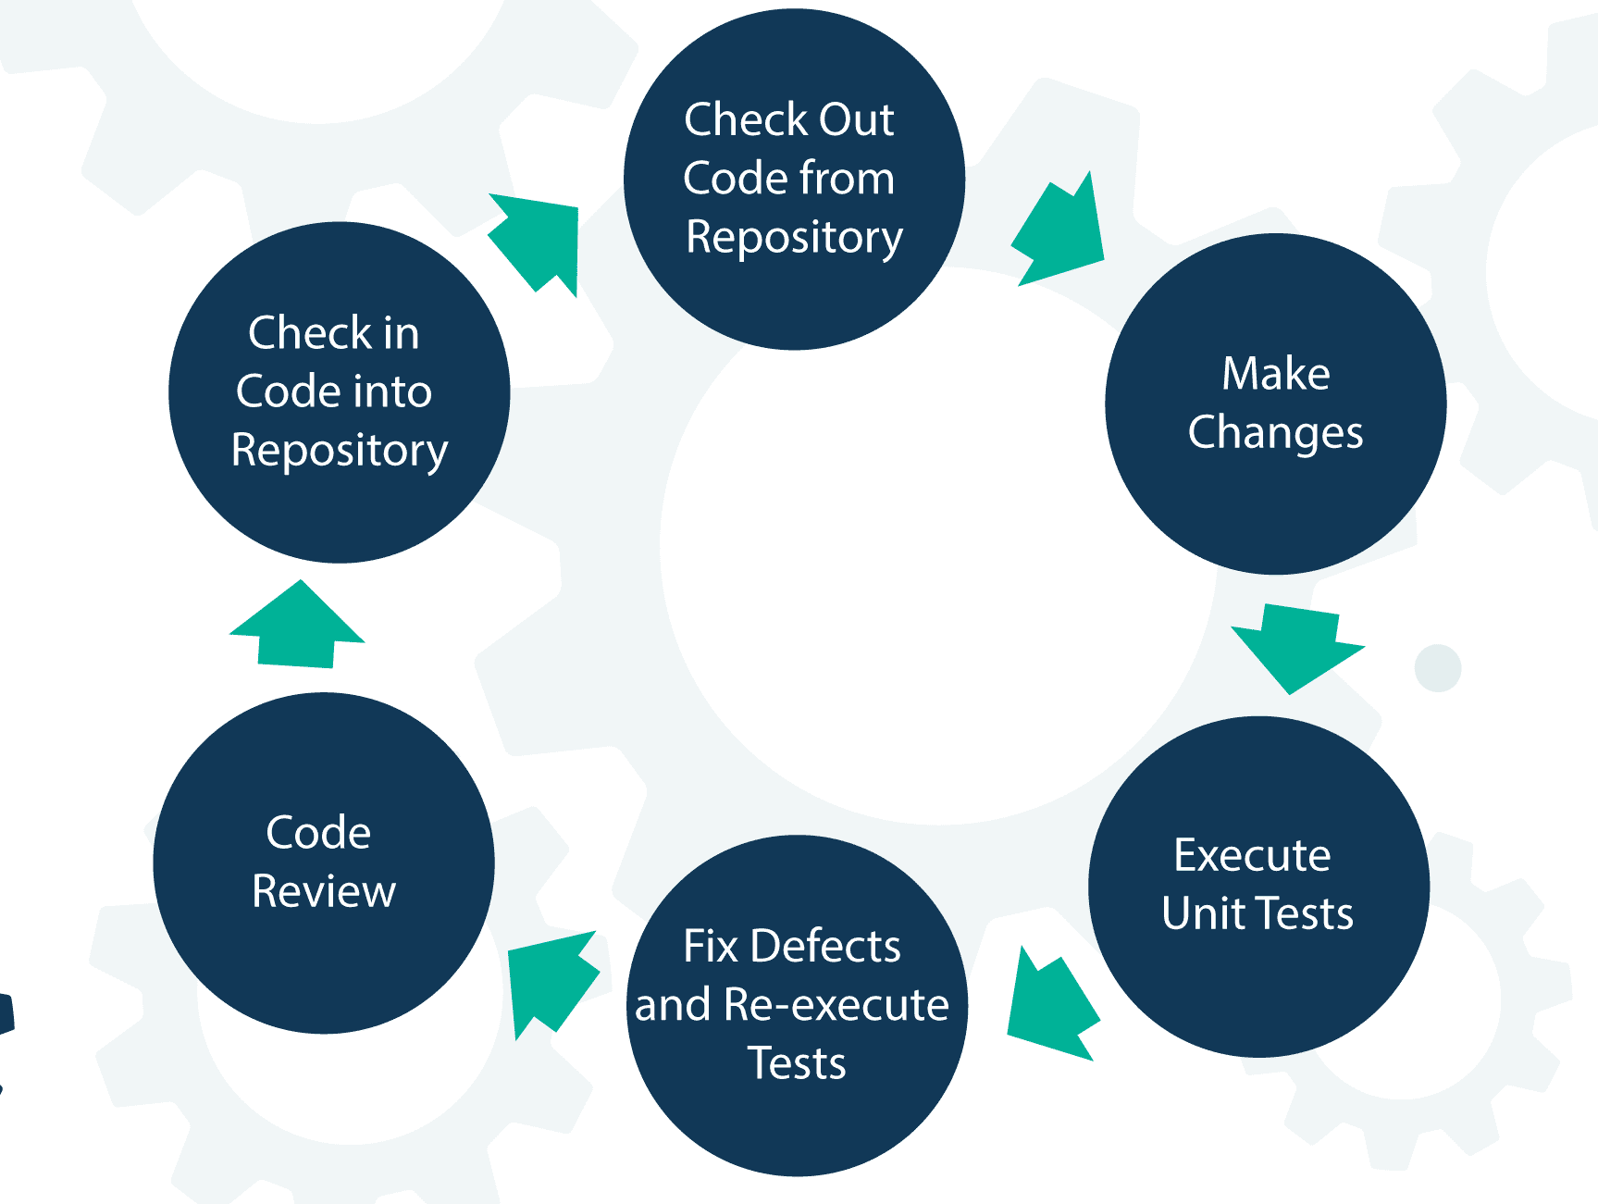
Continuous Integration
Action to verify each modification made to the implementation
Good practice for CI

Slide 9
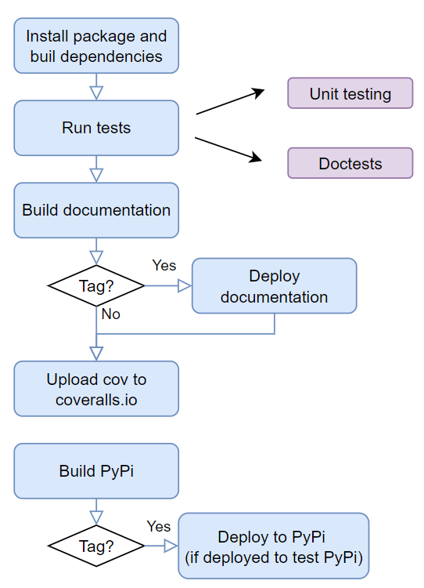
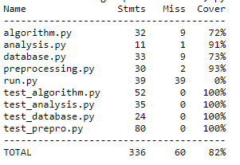
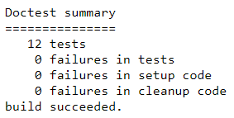
Continuous integration
Test results:
Job workflow:
on push
Unit testing results (w/ coverage)
Doctests results

Slide 10

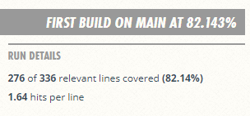
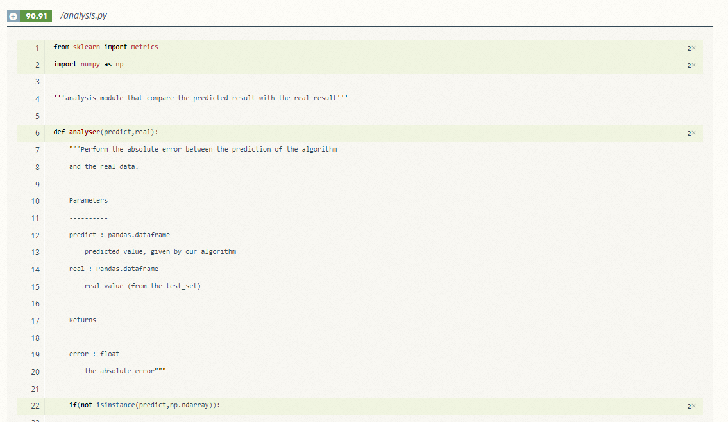
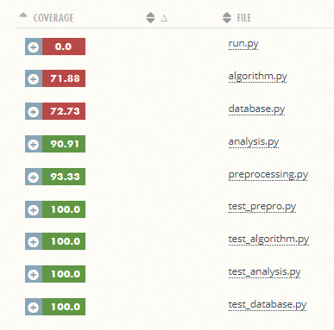
Coveralls.io
Coverage from coveralls.io

Slide 11
Documentation
It explains:
How to install it
How to use it
Every functions and modules
Everything that is important to note
Deployed to Github pages for every push followed by a ‘tag’ (new version)
This is the ‘face’ of our software, that the users will use to understand it.
Notes:
11

Slide 12






Documentation
Generate the documentation with ‘Sphinx’ (doc written in RestructuredText)
Docstrings written in the code generate documentation automatically
Generation of the API
Notes:
12

Slide 13
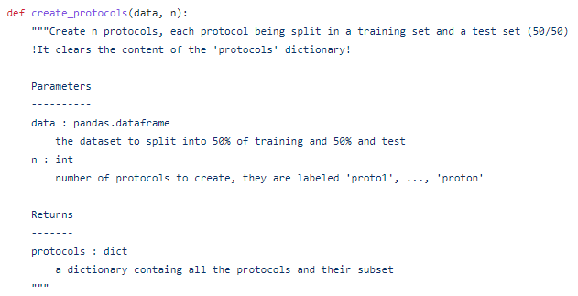
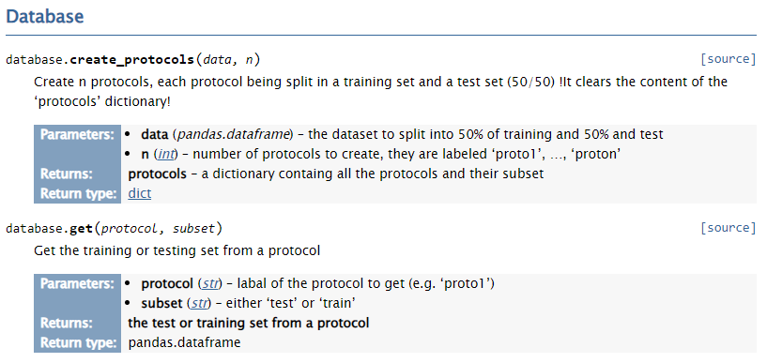
Documentation
A docstring comment:
Its documentation:
Notes:
13

Slide 14
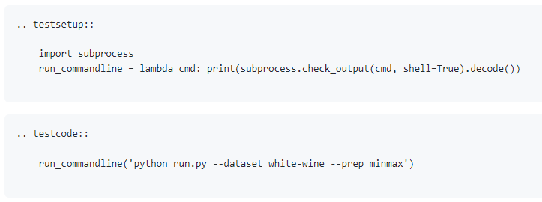
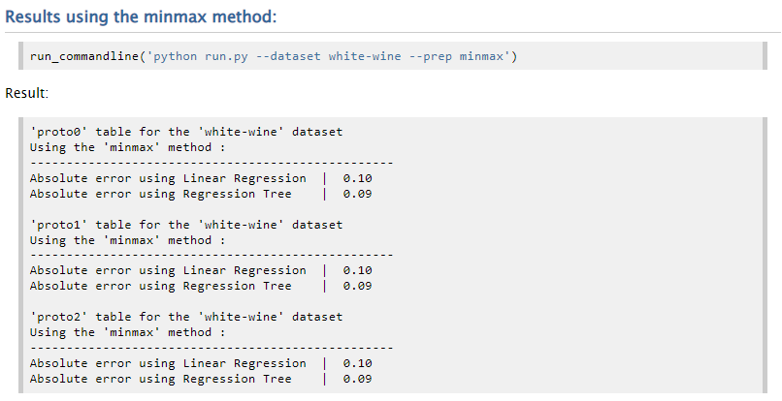
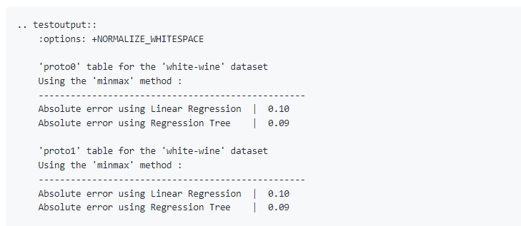
Documentation
Doctests:
Displayed in the documentation:
Notes:
14

Slide 15
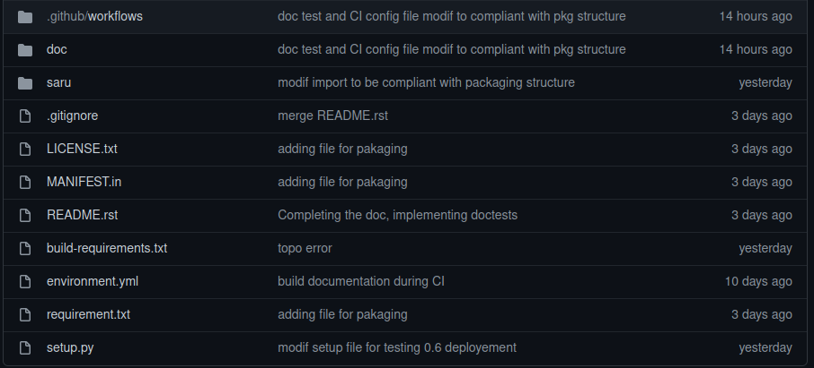
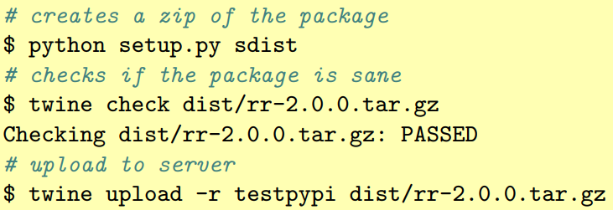
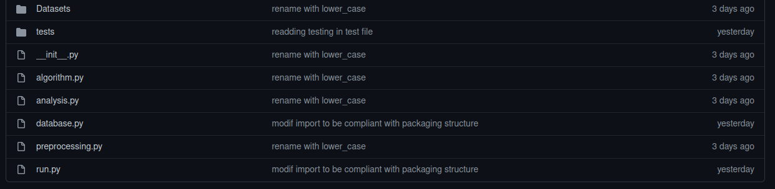
Packaging
New structure:
Manually upload:
Zip the package
Upload to (test)PyPi
Github repository
github action:
pypa/gh-action-pypi-publish@master
SaRu code
Notes:
15

Slide 16
License
Licensed under the 3-clause BSD License
Permissive license
One of the most popular
Few restrictions
3 for 3 clause (remove the acknowledgement)
“this product include software developed by …”
Notes:
16

Slide 17
Useful links
Cloc: https://github.com/AlDanial/cloc
PowerBi: https://app.powerbi.com
SaRu: https://github.com/rubendecampos/mini-project
Coverage: https://coveralls.io/github/rubendecampos/mini-project?branch=main
Notes:
17

