Slide 1

Lumina Bluetooth Lamp
Ruben Engelen

Slide 2
Introduction
Bluetooth
Battery powered
Colourful
Application

Slide 3

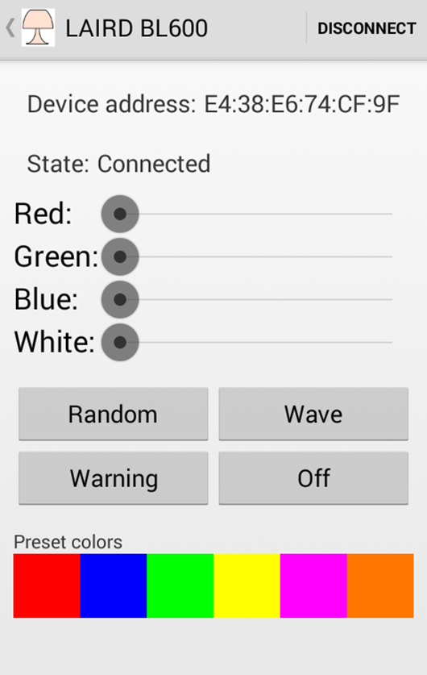
Application
Lumina Control
Elektor
Configurable

Slide 4
Operation
BLE600 Module
Battery powered
Button

Slide 5
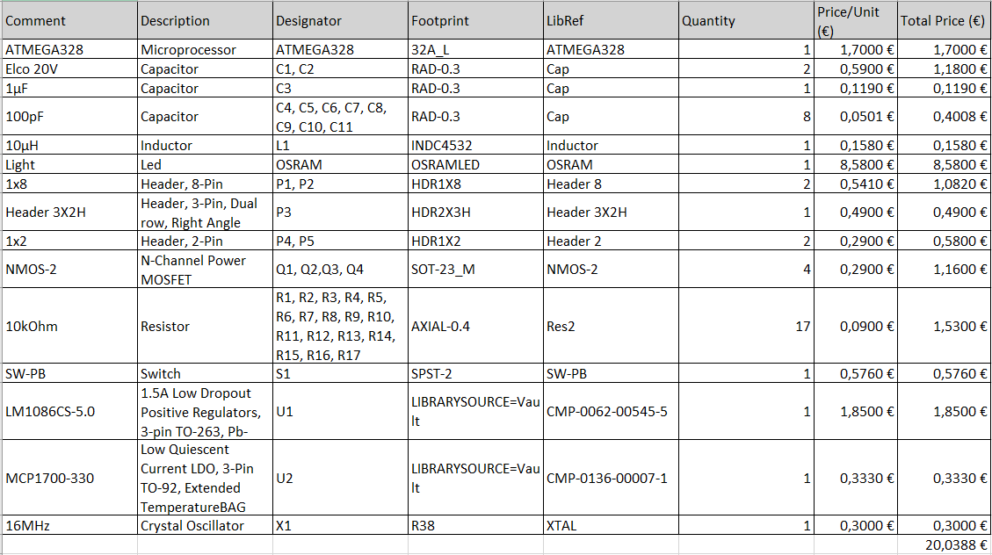
Price

Slide 6
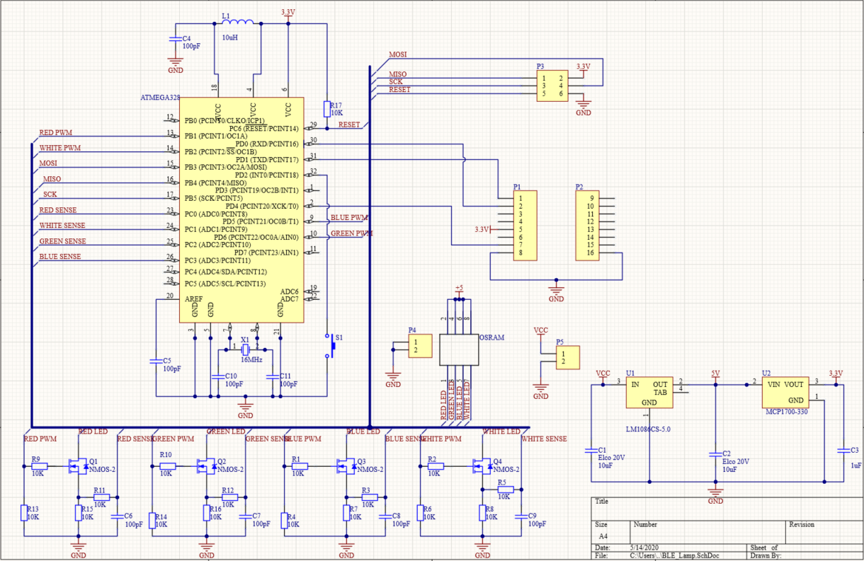
Design: Scheme

Slide 7
Design: components
Trough hole
Personal skill
SMD
Stencil

Slide 8
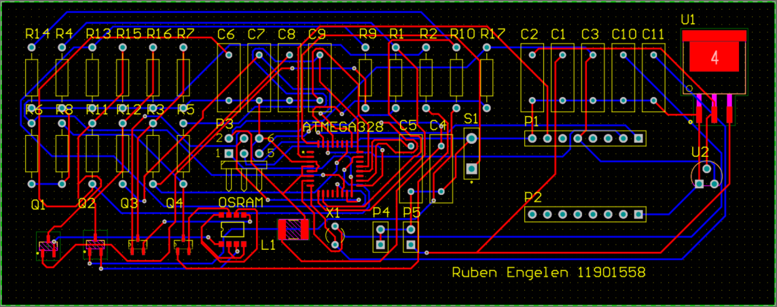
Design: PCB-layout

Slide 9

Design: case
Children
Appealing
Neat
Suited

Slide 10
References
https://www.snapeda.com/
https://www.jlcpcb.com/

