Slide 1
Project of a Mobile Communications’ Base Station in a City near the Spanish Border
16th May 2016
João S. Melo - 73223
Manuel L. Ribeiro - 73773
Miguel P. Rodrigues - 73570
Rúben G. Borralho - 73536
Rúben M. Tadeia - 75268
Notes:
Tirar a numeração de paginas na capa

Slide 2
Outline
Introduction.
Objectives.
Stakeholders.
Scope and Work Breakdown Structure (WBS).
Scheduling.
Resources allocation.
Communication Plan.
Risk Analysis.
Project Closing.
Conclusion.

Slide 3
Introduction
Plan a Base Station Implementation from the Project Manager´s point of view.
Project Management Methodologies.

Slide 4
Objectives (1)
Project Objective – Scope:
The planning, implementation and post
monitoring of the Base Station near the
Spanish border.

Slide 5
Objectives (2)
Project Charter:
Formal document authorizing the project;
Stakeholders necessities and expectations;
Business case: Technological Advance;
Project as a part of the Operator’s Strategical Plan.
3G
4G

Slide 6
Stakeholders (1)
Internal:
Project Leader;
Management Department;
Radio Eng. Department;
Regulation Department;
Law Department;
Marketing Department;
Buying Department.

Slide 7
Stakeholders (2)
External:
Contracted Entities:
Constructor;
Electric Energy Supplier;
Owner;
Negotiator;
Fixed Link Supplier;
Equipment Supplier.
Non-Contracted Entities:
ANACOM;
Municipality;
Spanish Operators.

Slide 8
Scope and WBS (1)
Scope Requirements:
Covered range;
Bandwidth;
Bitrate;
Generation upgrade;
ANACOM and ITU-T norms and recommendations;
Legal requirements;
Keep network unchanged;
Conformance with Spanish operator´s frequencies.

Slide 9
Scope and WBS (2)
Project of a Mobile Communications’ Base Station in a City near the Spanish Border - WBS
Initial Project
Planning
Construction Project
and Legalities
Location Study

Slide 10
Scope and WBS (3)
Telecommunications
Engineering Project
Integration and
Test
Construction
Project Closing

Slide 11
Scheduling (1)
Important Diagrams
Gantt
PERT
List of Task and resources
Important Dates
03/03/2016
14/03/2016
20/04/2016
22/06/2016

Slide 12

Scheduling (2)
Our team
Lead to
Brainstorming
[Fonte: Socialbox, 2015]
Contributed to
Good Communication

Slide 13
Scheduling (3)
What was our focus?
Setting Goals
Site visit
Stakeholders
Negotiations
8 Days
7 Days
Planning
Study

Slide 14
Scheduling (4)
What was our focus?
Building Process
Remote Monitoring
Base Station Construction
Project Closing
23 Days
10 Days
Construction
End

Slide 15

Resources Allocation (1)
Internal Stakeholders
Stakeholder
Workers
Cost
Leader
100€/h
Management D.
75€/h
Radio D.
75€/h
Law D.
75€/h
Regulation D.
50€/h
Buying D.
50€/h
Marketing D.
50€/h
External Stakeholders
Total estimated costs: € 43 388,40

Slide 16
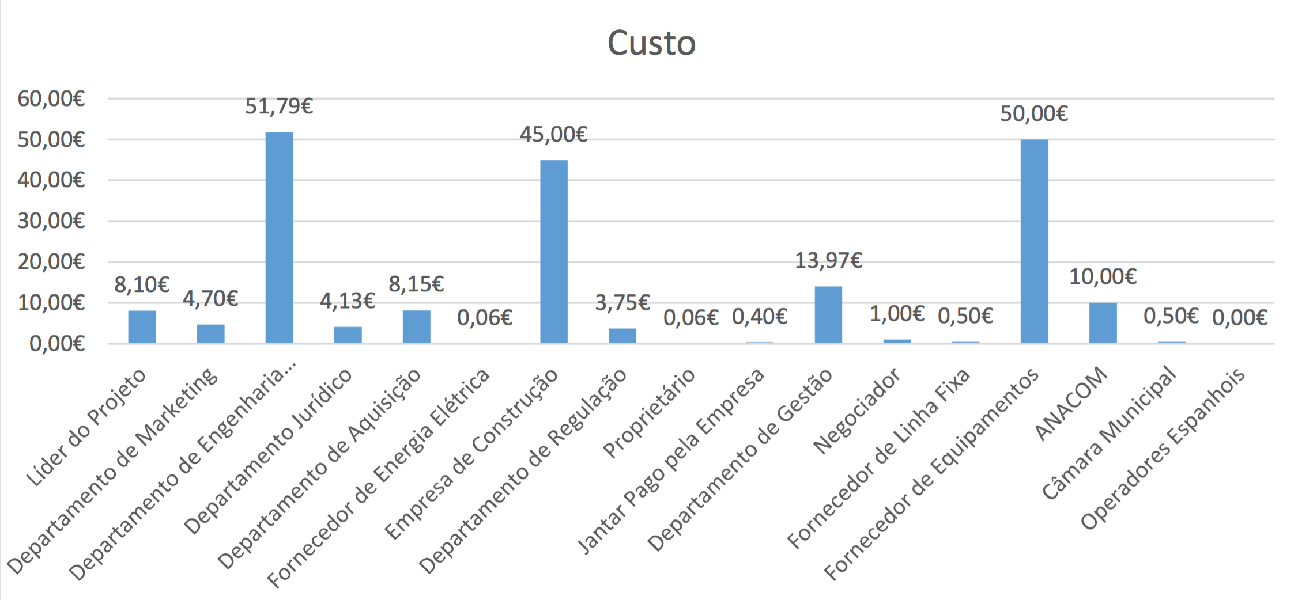
Resources Allocation (2)
Cash Flow Table (in thousands)
Total Cost: € 202 106,92

Slide 17
Communication Plan
Internal Communication Plan
Daily communications:
Personal Calls;
Email.
Crucial communications:
Reports;
Official meetings.
External Communication Plan
Formal communications;
Scheduled when necessary and in agreement with previous WBS definition.

Slide 18
Risk Analysis
Avoid.
Mitigate.
Transfer.
Accept.
Future Uncertainty
Risk examples:
Answer/ Construction/ Licensing Delays;
Price Variations;
Engineering Errors.

Slide 19
Project Closing
Continuous Monitoring.
Periodic Visits.
Contract Closing.
Performance evaluation:
Total Cost: € 202 106,92.
Duration: 80 days.
Knowledge Management.

Slide 20
Conclusion
Project managers inside view.
Project Management (PM) Typical Procedures.
Critical Analysis on the various PM strategies.

