Slide 1
Project of a Mobile Communications’ Base Station in a City near the Spanish Border
16th May 2016
João S. Melo - 73223
Manuel L. Ribeiro - 73773
Miguel P. Rodrigues - 73570
Rúben G. Borralho - 73536
Rúben M. Tadeia - 75268
Notes:
Tirar a numeração de paginas na capa

Slide 2
Scheduling (1)
List of Task and resources
Important Diagrams
Gantt
Pert
Good to communicate with all members
Important Dates
03/03/2016
14/03/2016
20/04/2016
22/06/2016

Slide 3

Scheduling (2)
Our team
Lead to
Brainstorming
[Fonte: Socialbox, 2015]
Contributed to
Good Communication

Slide 4
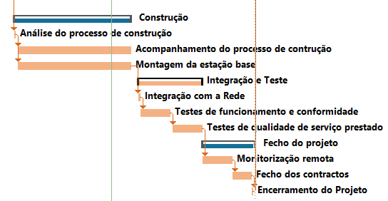
Scheduling (3)
What was our focus?

Slide 5
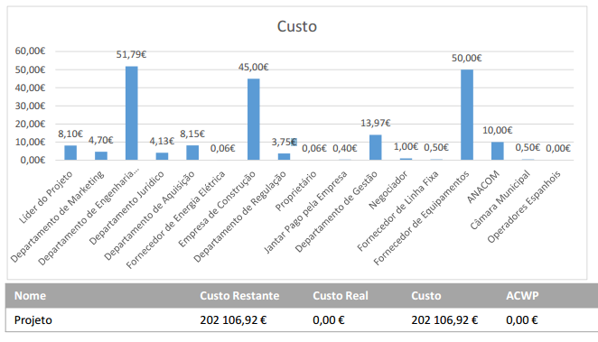
Scheduling (4)
Cash Flow

Slide 6
Conclusion
Project managers inside view.
Project Management (PM) Typical Procedures.
Critical Analysis on the various PM strategies.

