Slide 1
Some feedback

Slide 2
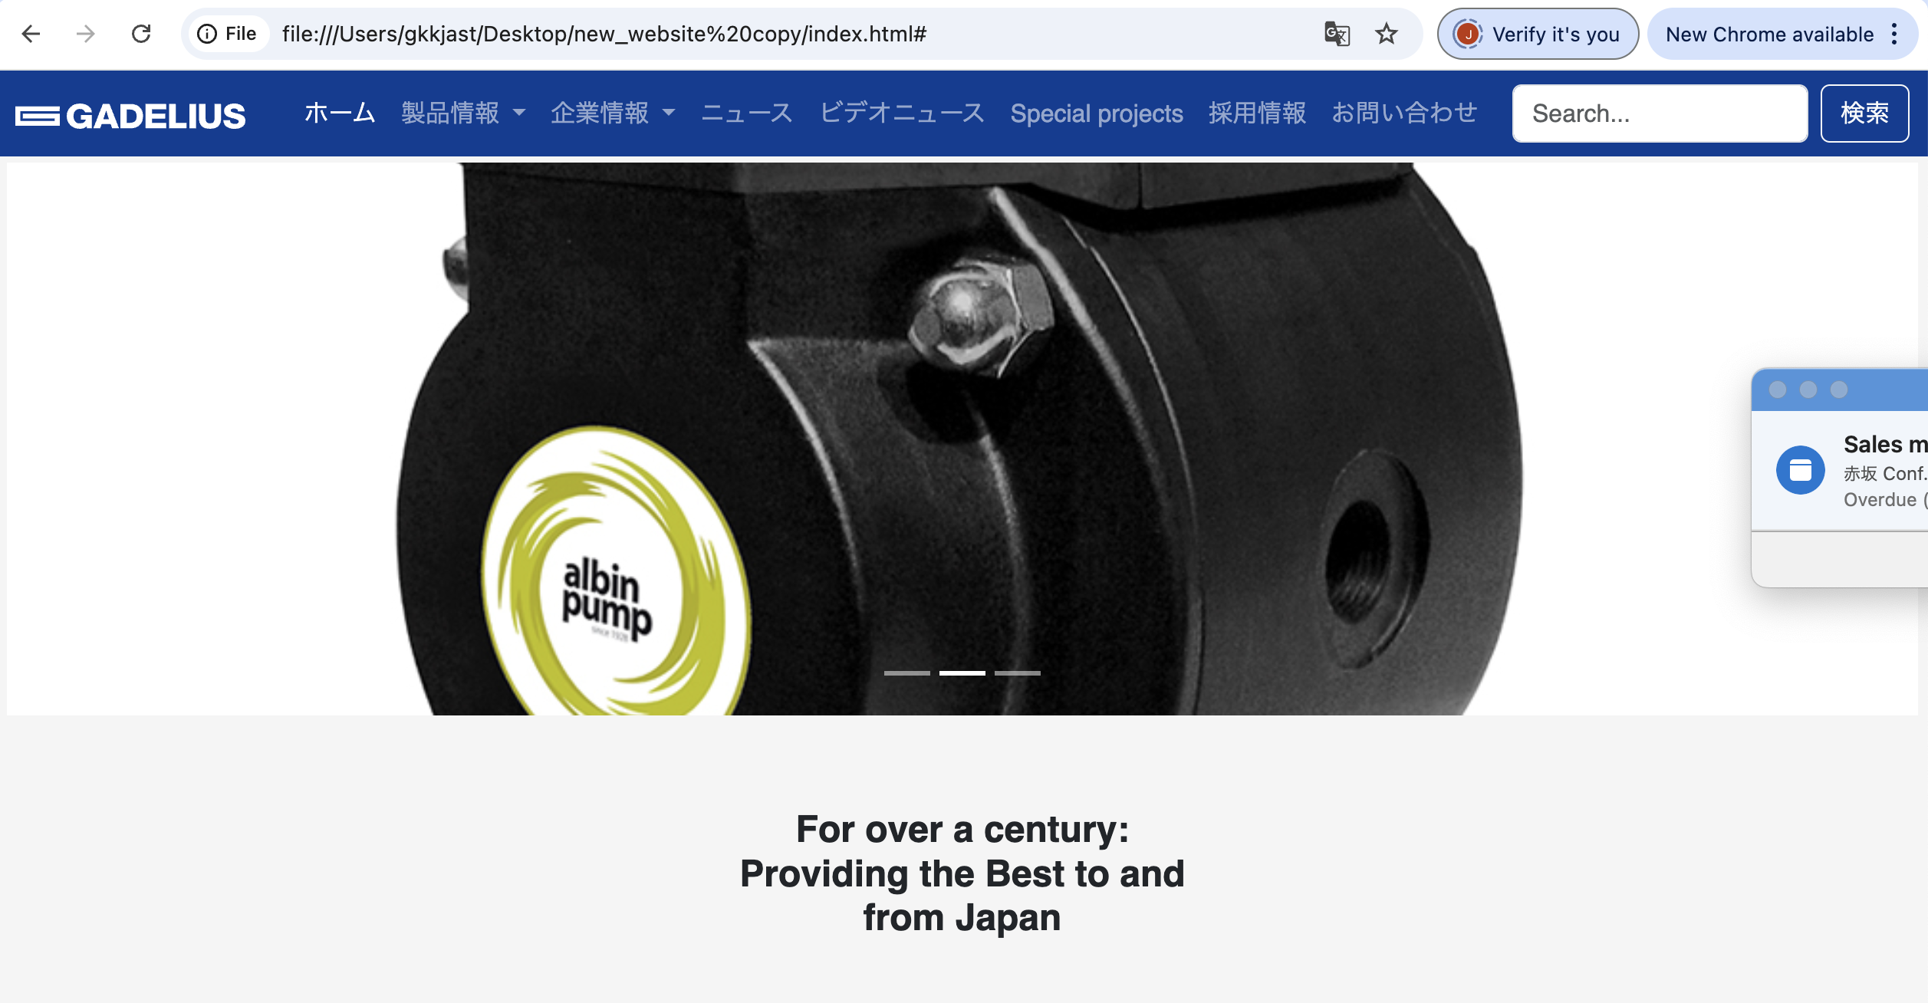
Home Products After Sales Contact About News Careers
OR:
About News Career
Home Products After Sales Contact

Slide 3

4 SQUARES WITH EACH OF CATEGORIES IN PICTURES (WITH TEXT LINE UNDER??) NEWS at bottom?? We do not have so many but Brokk does it well….

