Slide 1
Ontwerp actieve, Chebyshev filter
Ruben Kindt
Notes:
Made by Ruben kindt

Slide 2
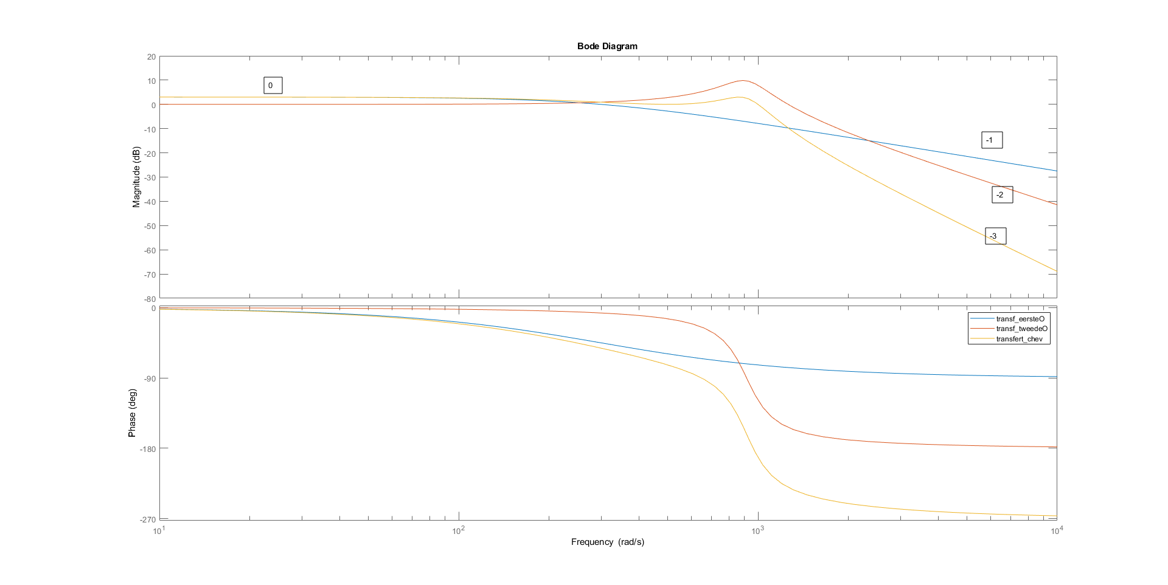
Matlab grafieken
Notes:
Made by Ruben kindt

Slide 3
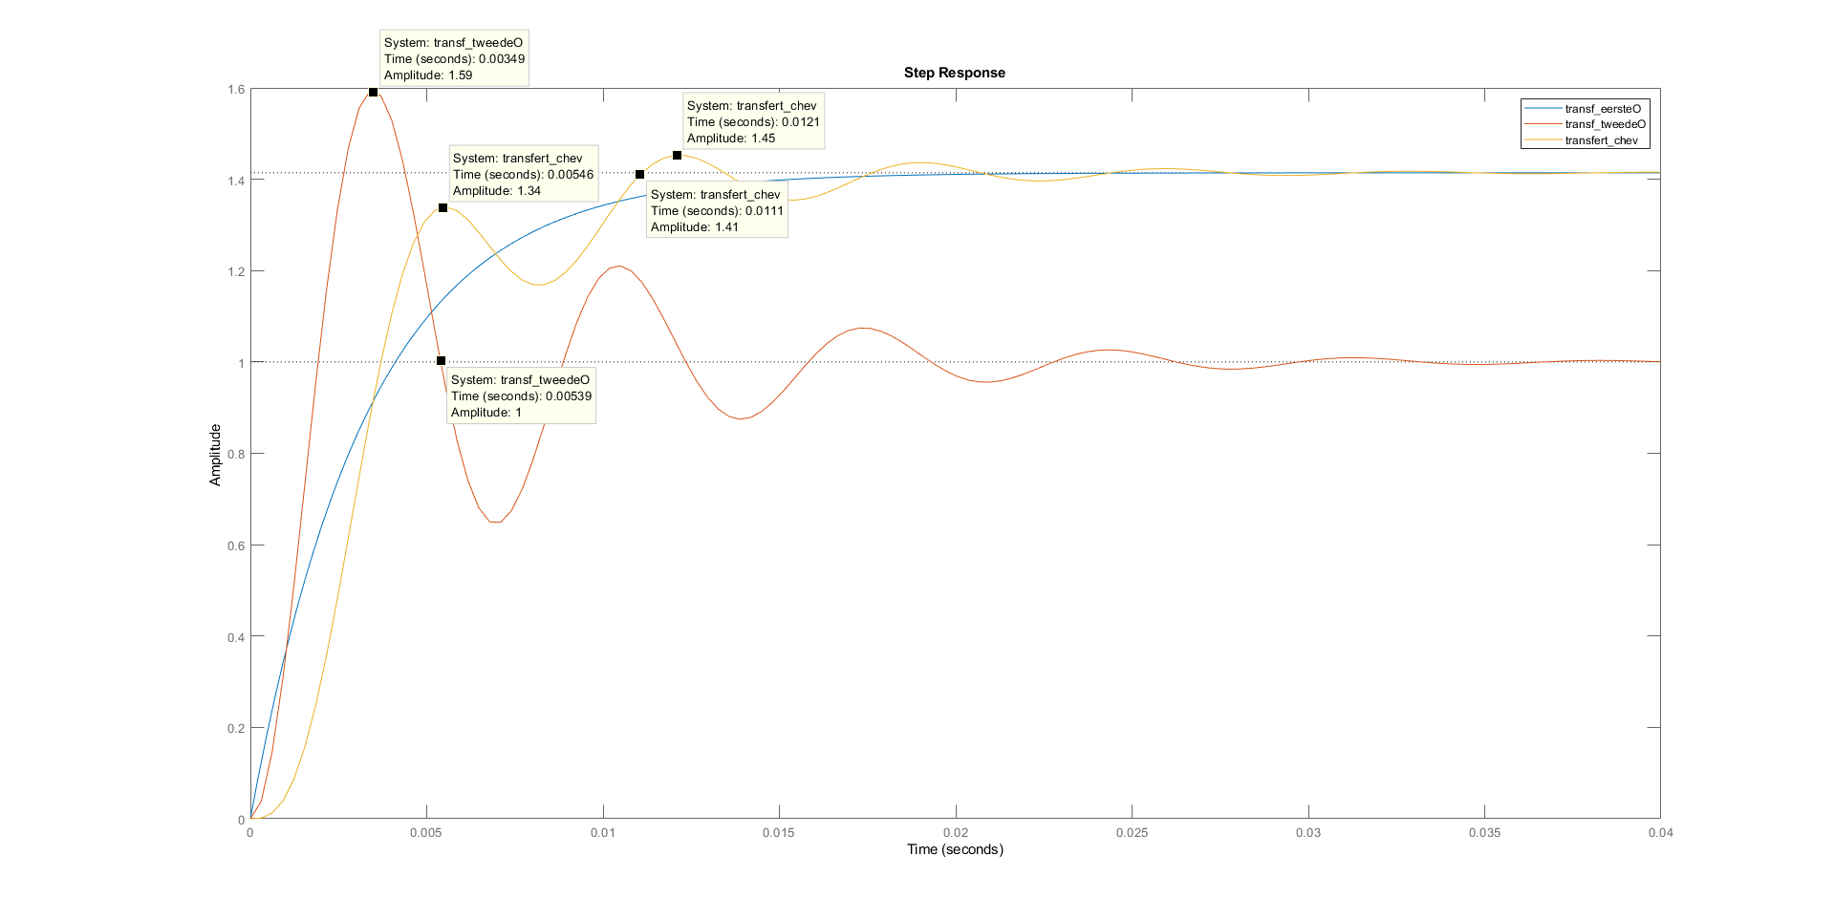
Matlab grafieken
Notes:
Made by Ruben kindt

Slide 4
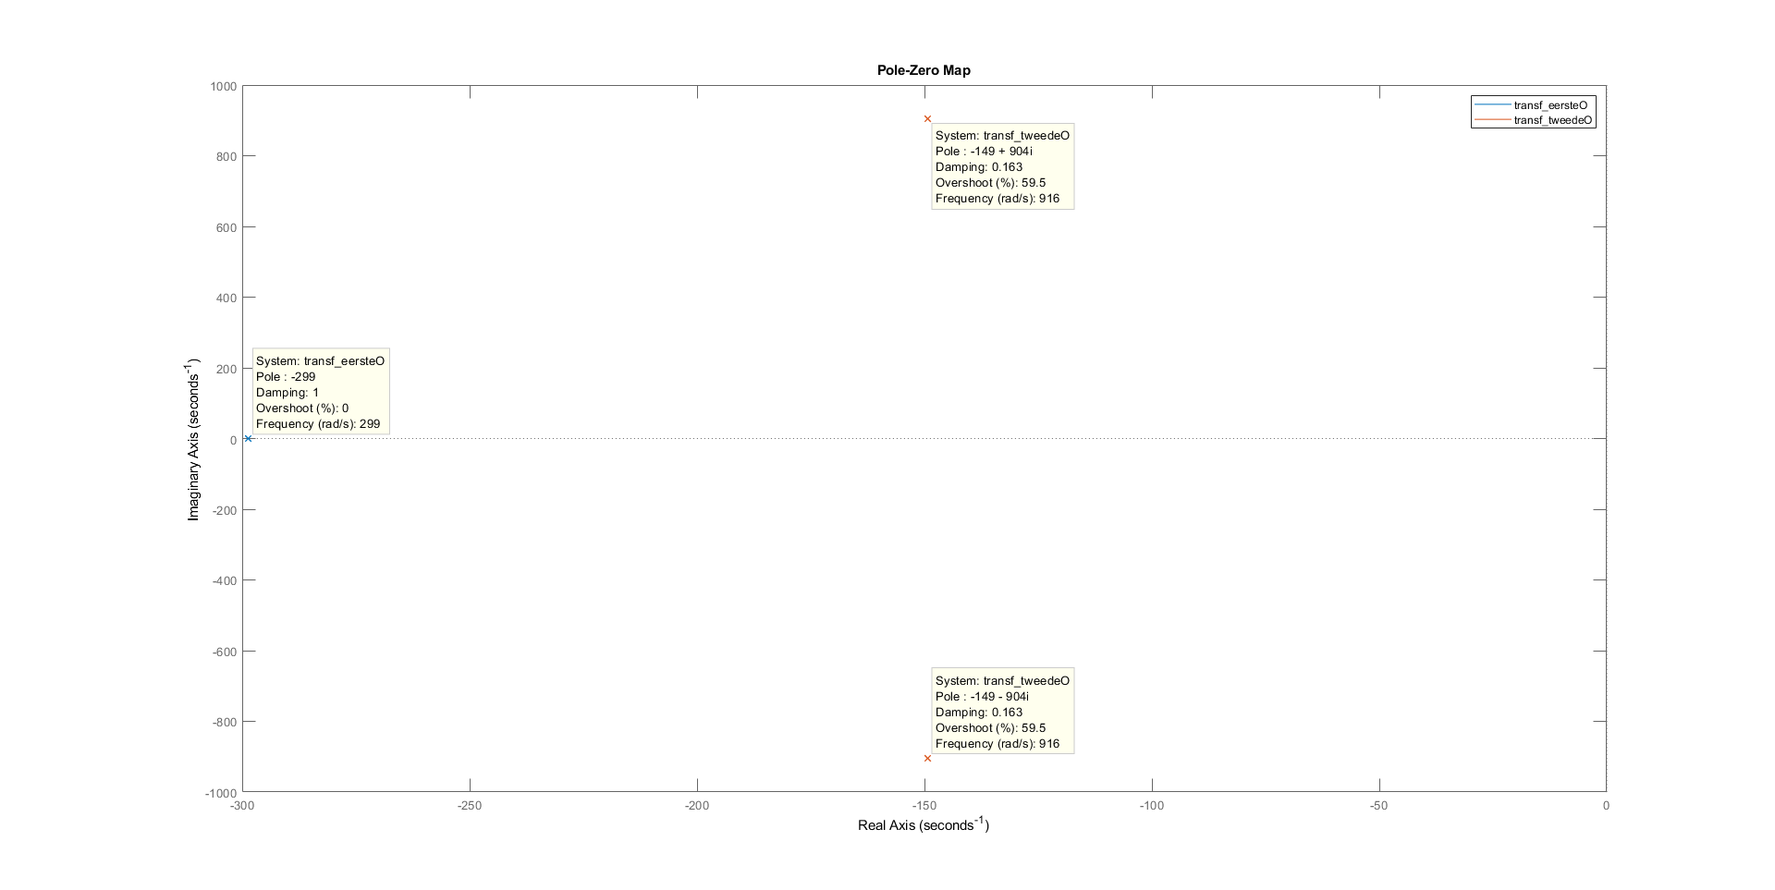
Matlab grafieken
Notes:
Made by Ruben kindt

Slide 5
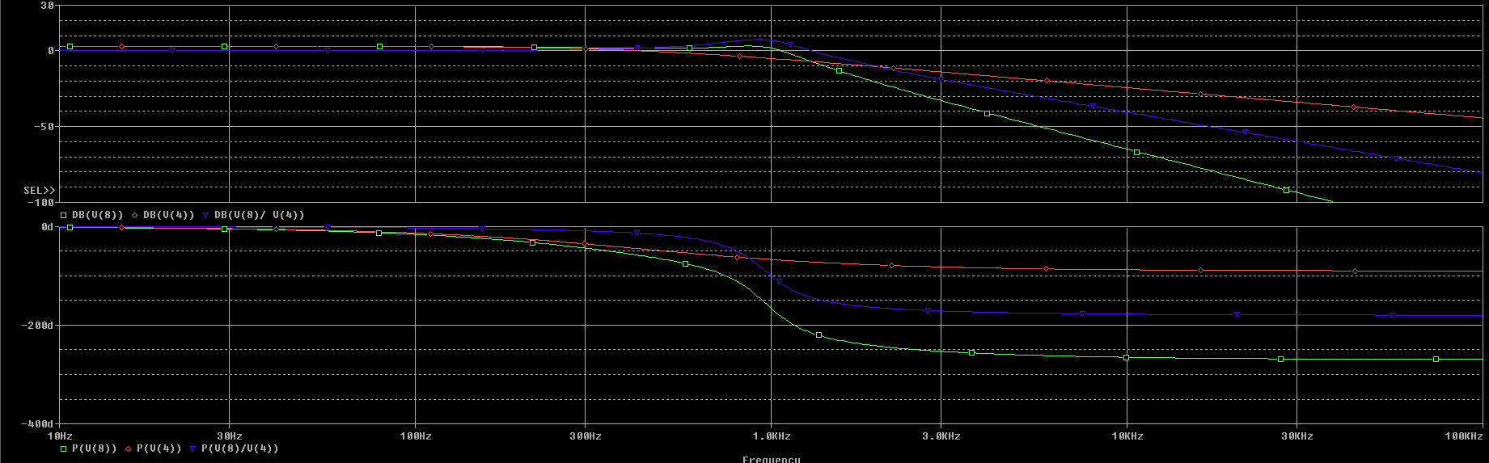
Bode Ideaal
Groen is de totale filter
Blauw is de 2de orde trap
Rood is de eerste orde trap
Notes:
Made by Ruben kindt

Slide 6
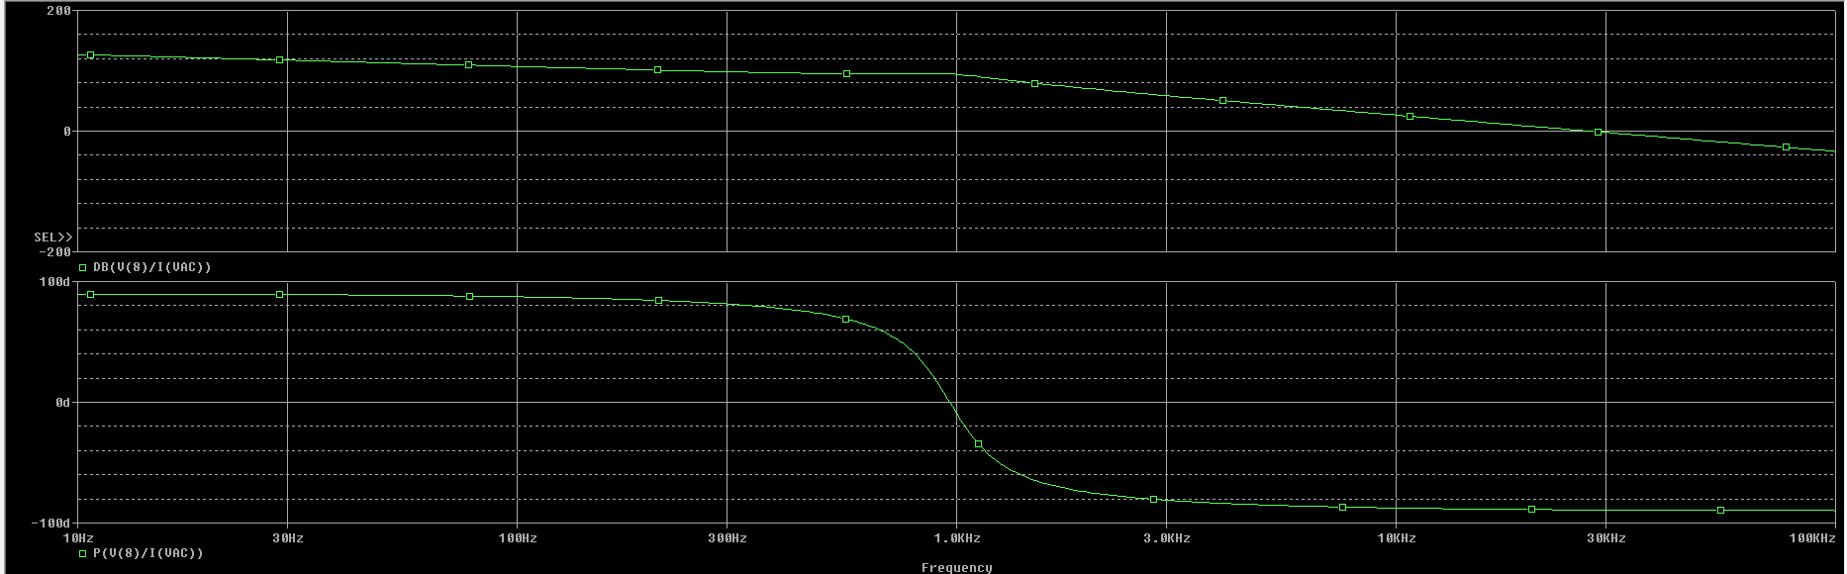
Zin ideaal
Notes:
Made by Ruben kindt

Slide 7
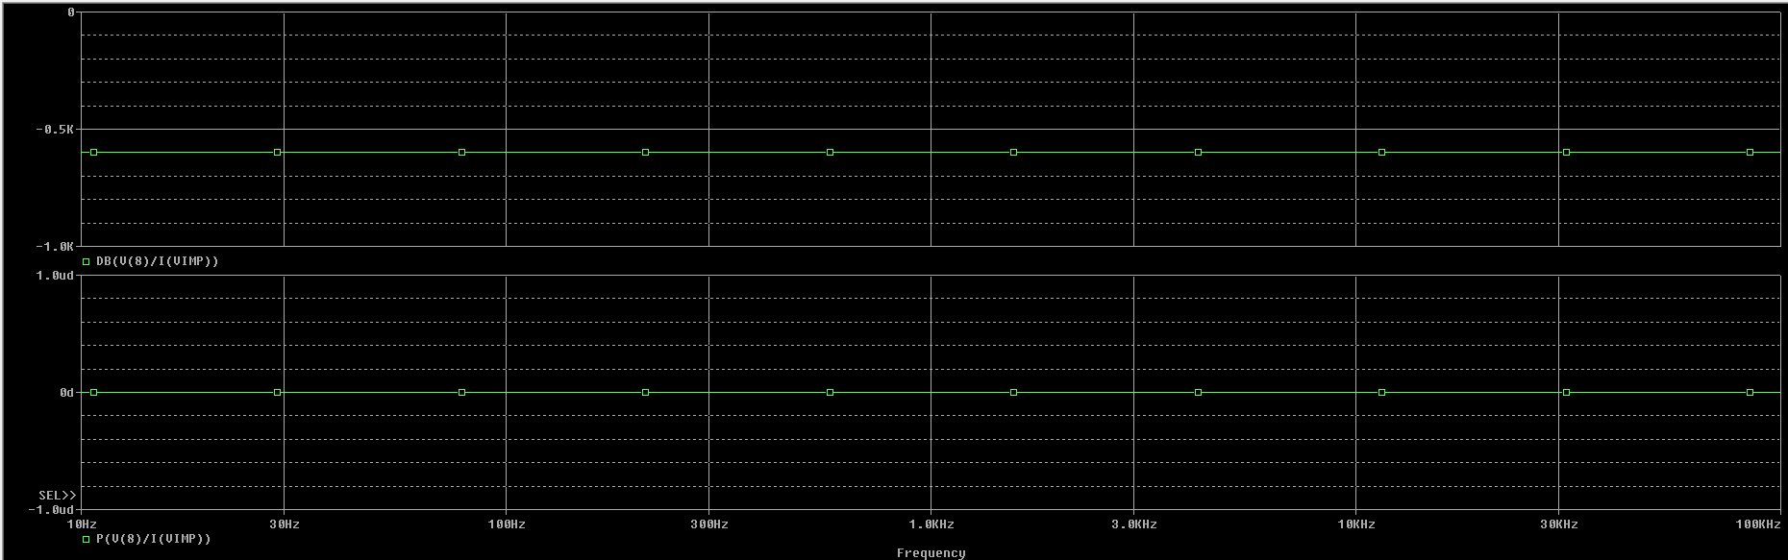
Zout ideaal
Notes:
Made by Ruben kindt

Slide 8
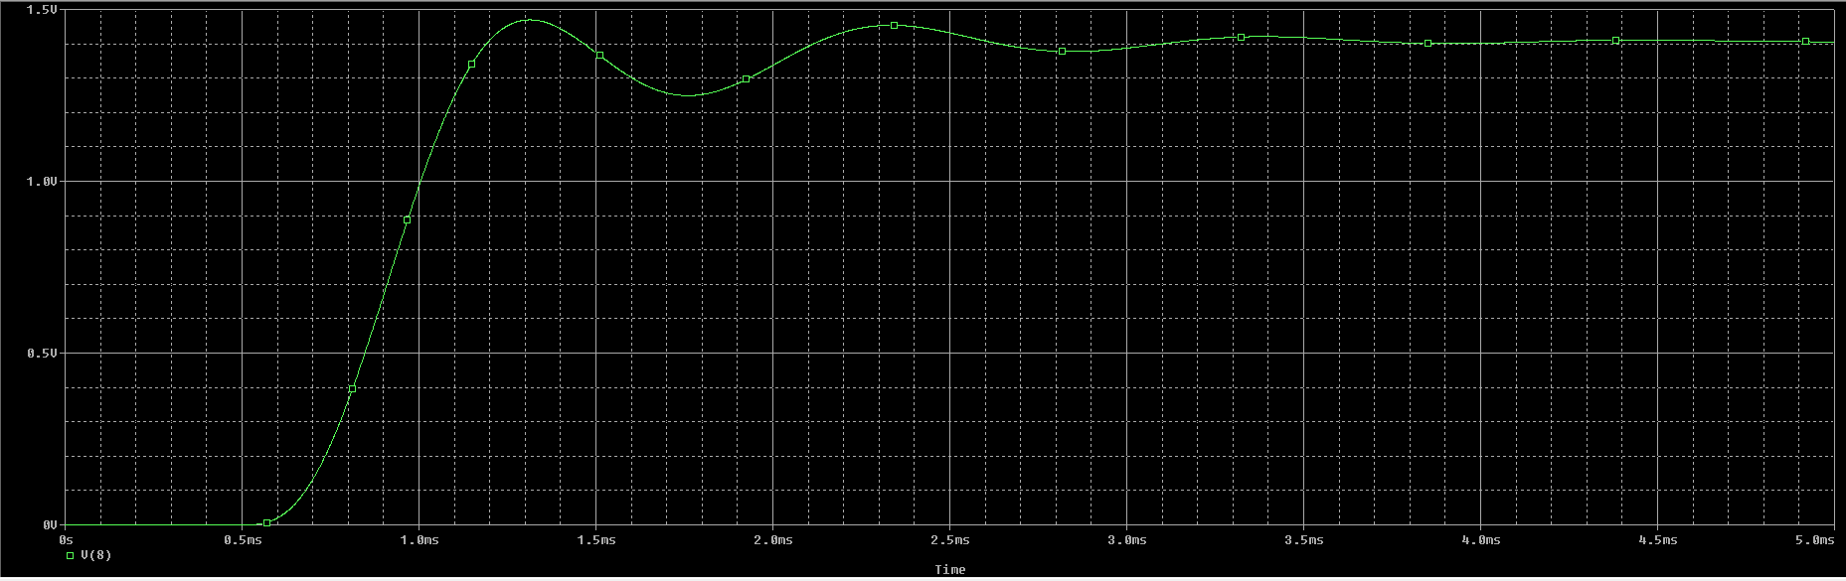
Stapresponsie Ideaal
Notes:
Made by Ruben kindt

