Slide 1
Creating Rich Labels For Binary Functions Using Source Information
Ruben Triwari

Slide 2
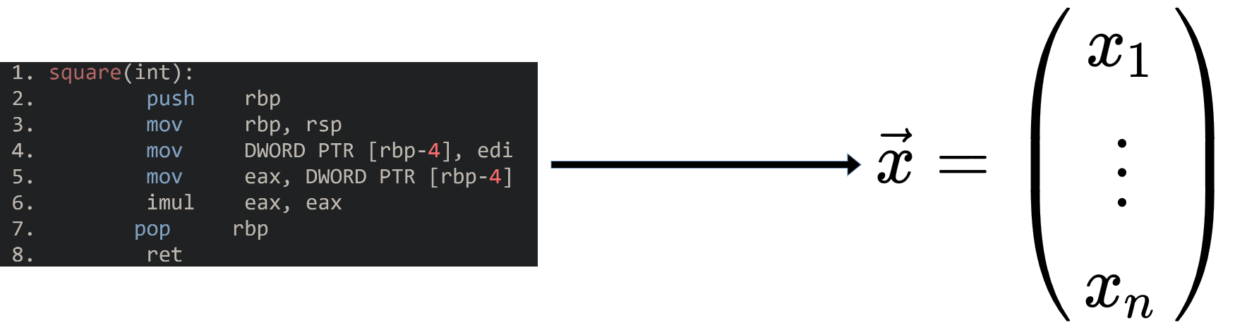

Assembly Code Embedding
Nearest Neighbor Search
Classification with Labels (e.g. Networking, time, …)
XFL: eXtreme Function Labeling
Binary Code Similarity Detection (BCSD)
$⇝$Assist Reverse Engineering

Slide 3
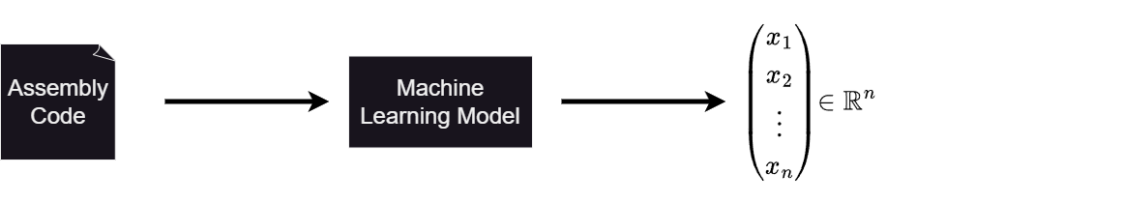
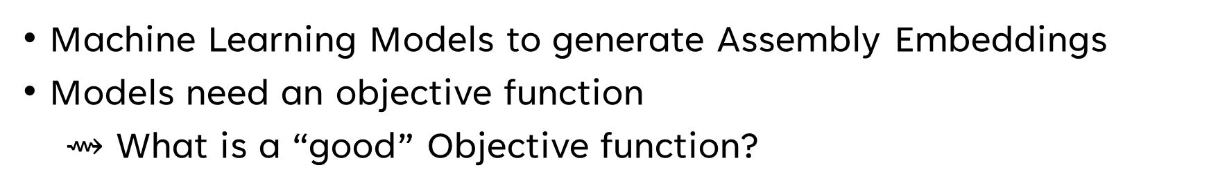
Generating Assembly Embeddings
Machine Learning Models to generate Assembly Embeddings
Models need an objective function
$⇝$ What is a “good” Objective function?

Slide 4
Overview of Different Approaches
PalmTree^{[1]} & JTrans^{[2]}: BERT^{[3]} like model to learn embeddings
SAFE^{[4]}: Supervised Learning with same Source as Label
[1]: Li et al.: PalmTree: Learning an Assembly Language Model for Instruction Embedding, CCS ‘21
[2]: Wang et al.: JTrans: Jump-Aware Transformer for Binary Code Similarity, ISSTA ’22
[3]: Devlin et al.: BERT: Pre-training of Deep Bidirectional Transformers for Language Understanding, NAACL ‘19
[4] Massarelli et al.: SAFE: Self-Attentive Function Embeddings for Binary Similarity, DIMVA ‘19

Slide 5
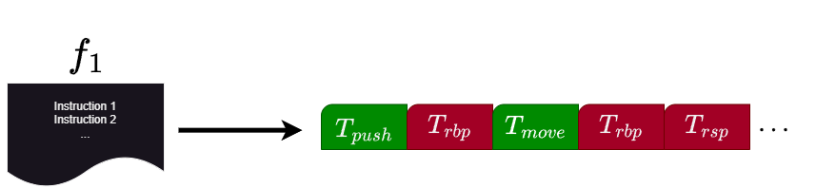
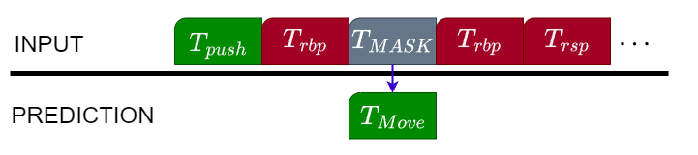
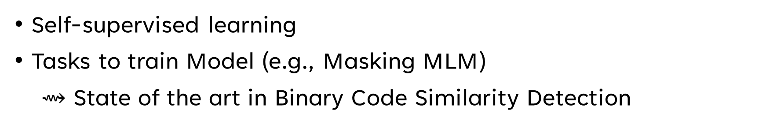
PalmTree & JTrans
Self-supervised learning
Tasks to train Model (e.g., Masking MLM)
$⇝$ State of the art in Binary Code Similarity Detection

Slide 6
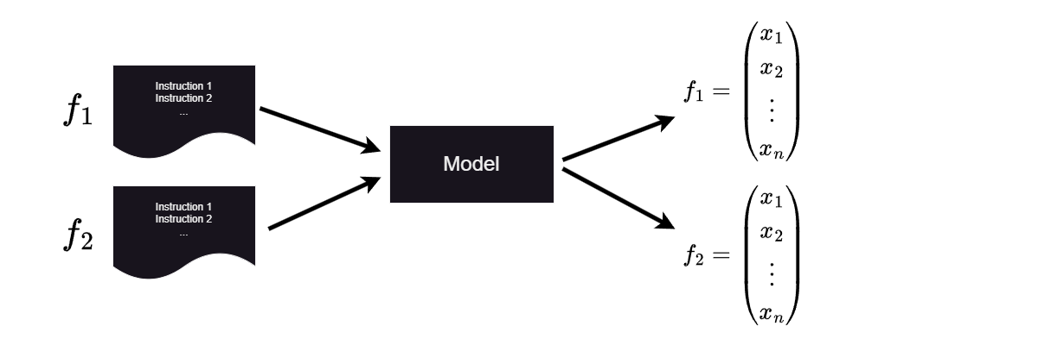
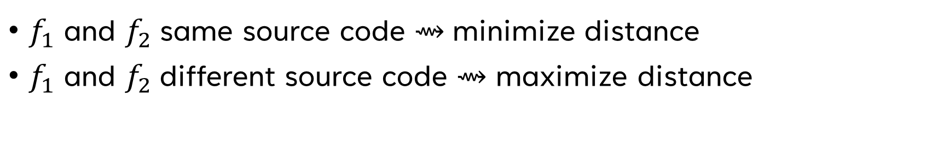
SAFE: Self-Attentive Function Embeddings
$f_{1}$ and $f_{2}$same source code $⇝$minimize distance
$f_{1}$ and $f_{2}$different source code $⇝$ maximize distance
$⇝$ Similar functions are potentially far away from each other

Slide 7
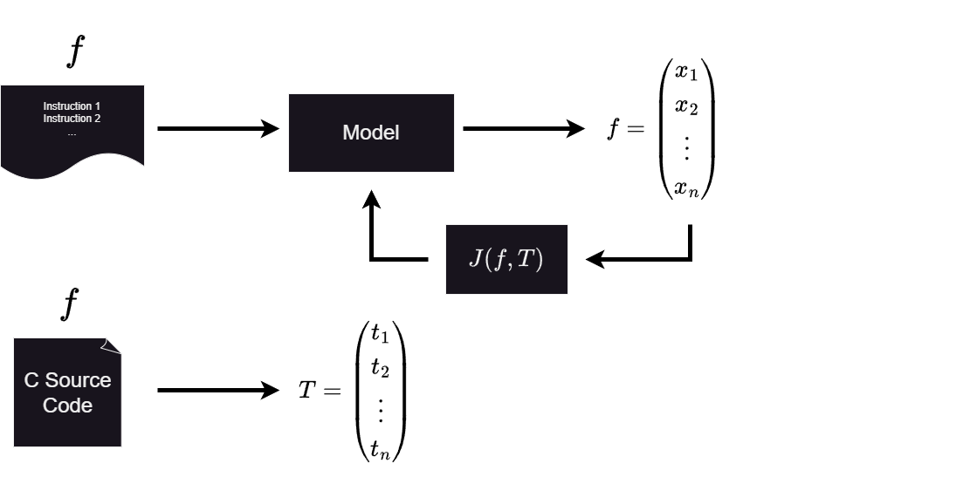
Our Approach
Supervised Learning
Using C Source Code to generate “ground truth”

Slide 8
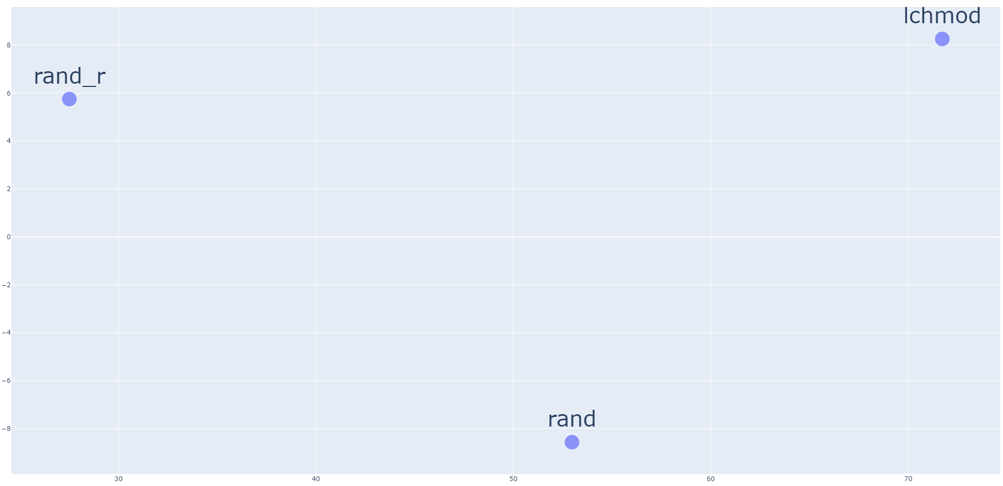
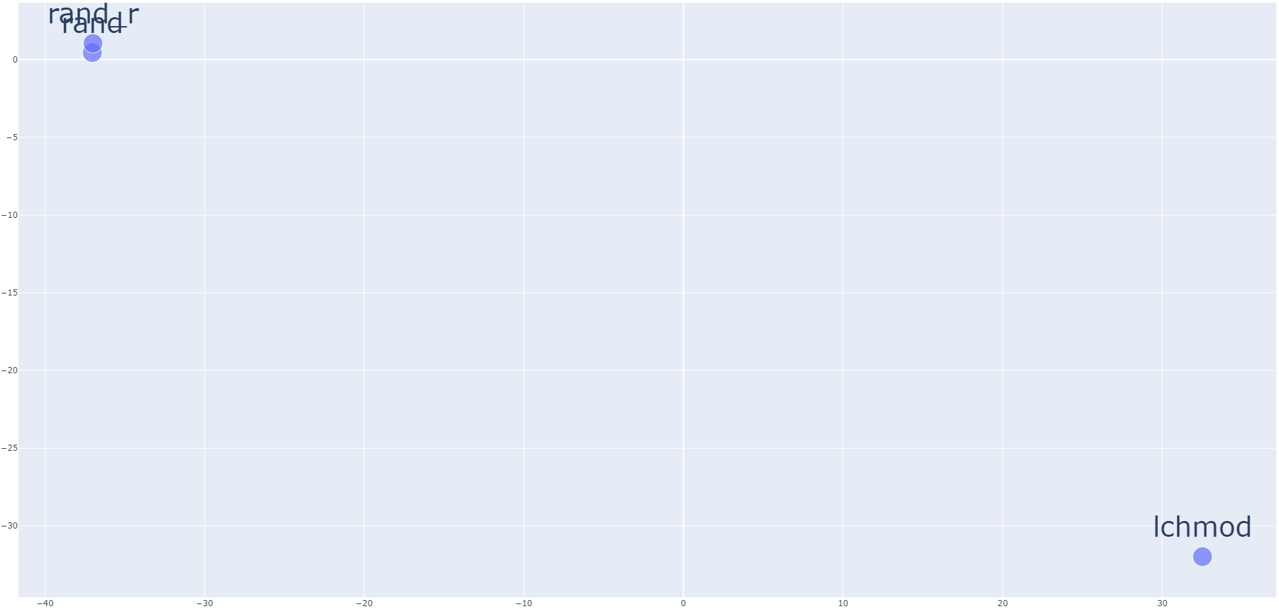
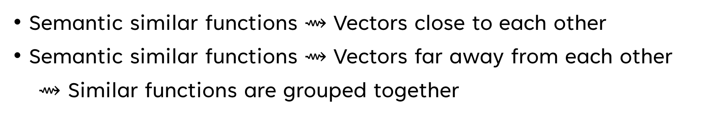
Ground Truth
Semantic similar functions $⇝$ Vectors close to each other
Semantic similar functions $⇝$ Vectors far away from each other
$⇝$ Similar functions are grouped together

Slide 9
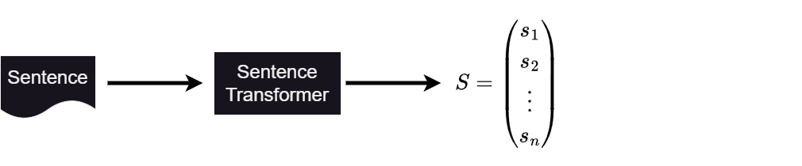
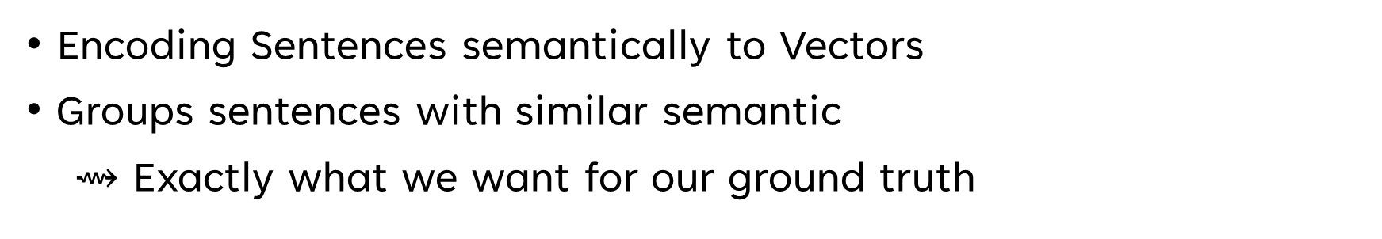
Sentence Transformer^{[1]}
Encoding Sentences semantically to Vectors
Groups sentences with similar semantic
$⇝$ Exactly what we want for our ground truth
[1]: Sentence Transformer: https://www.sbert.net/

Slide 10
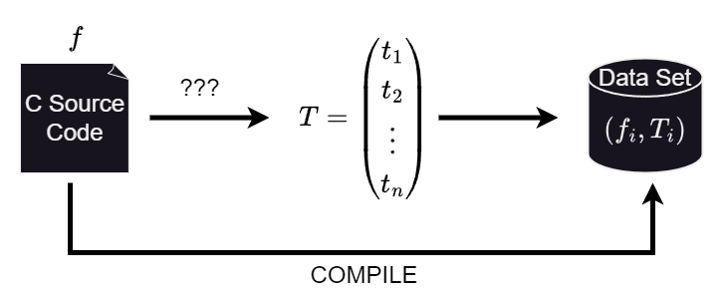
My part
Sentence Transformer on C Source Code Names
Sentence Transformer on C Source Code Comments
Sentence Transformer on LLM Code Summaries generated

Slide 11
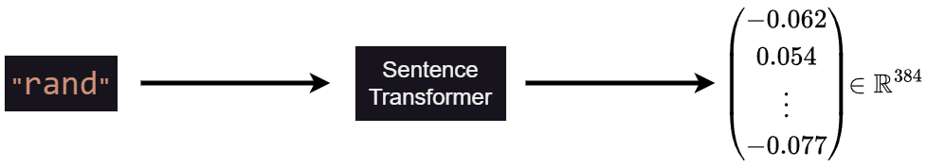
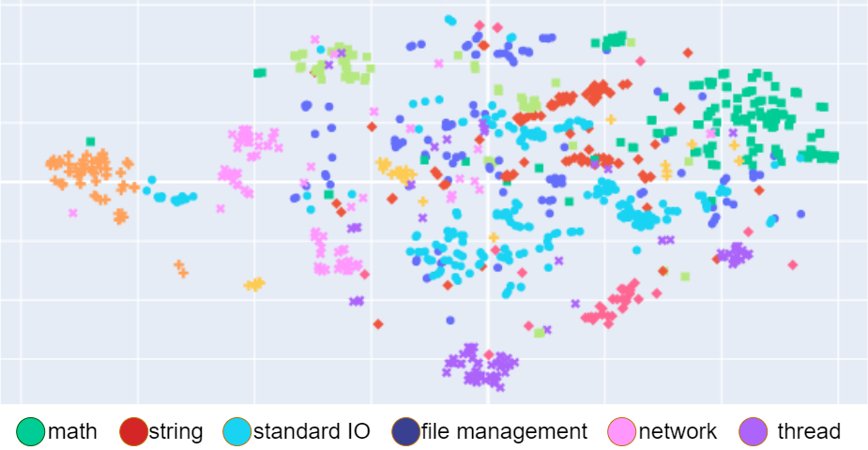
C Source Code Names

Slide 12
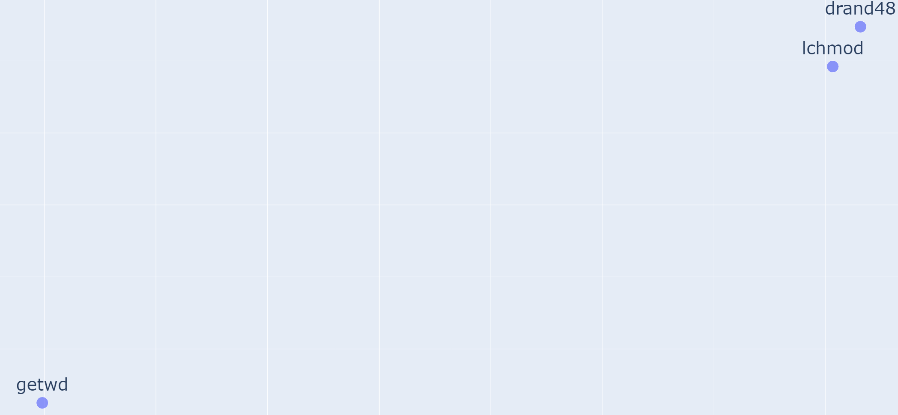
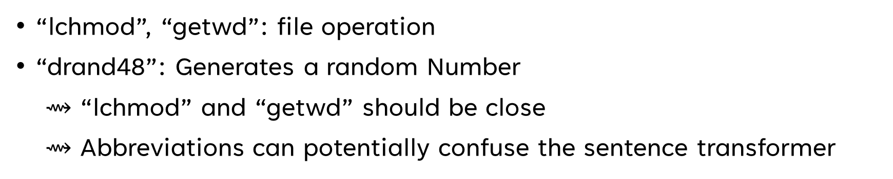
Limitation
“lchmod”, “getwd”: file operation
“drand48”: Generates a random Number
$⇝$ “lchmod” and “getwd” should be close
$⇝$ Abbreviations can potentially confuse the sentence transformer

Slide 13
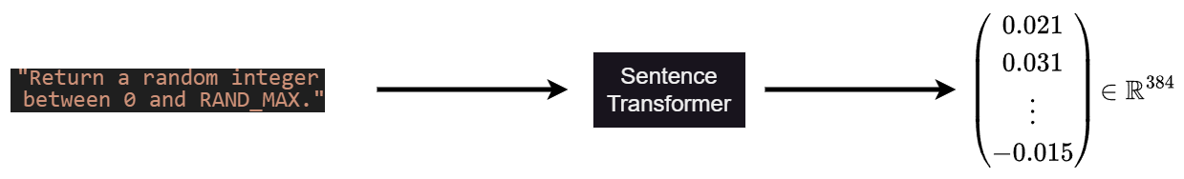
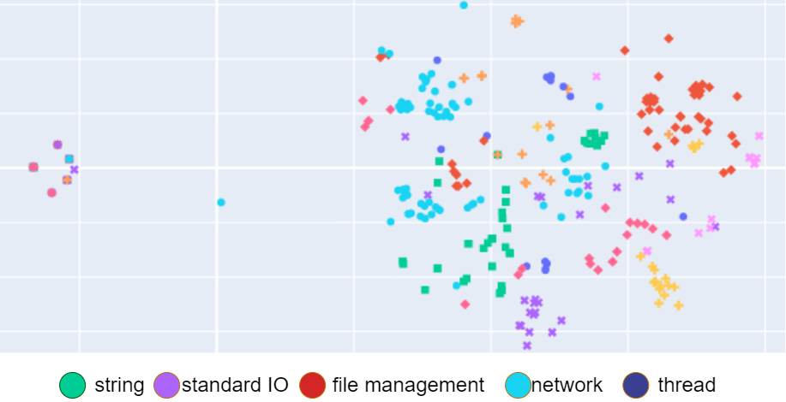
C Source Code Comments

Slide 14
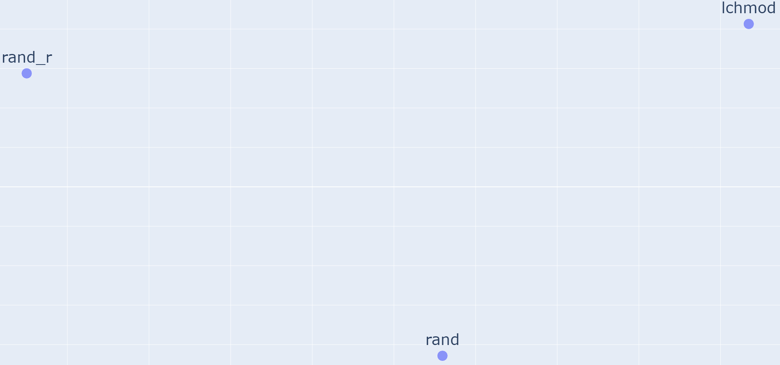
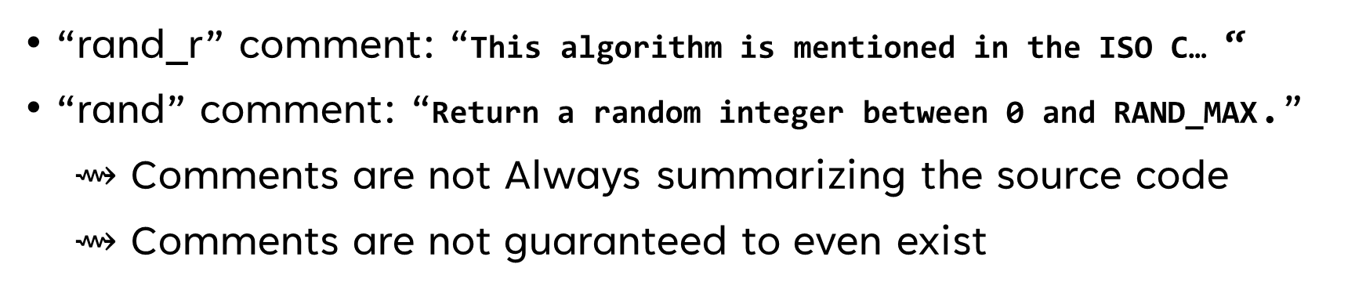
Limitation
“rand_r” comment: “This algorithm is mentioned in the ISO C… “
“rand” comment: “Return a random integer between 0 and RAND_MAX.”
$⇝$ Comments are not Always summarizing the source code
$⇝$ Comments are not guaranteed to even exist

Slide 15
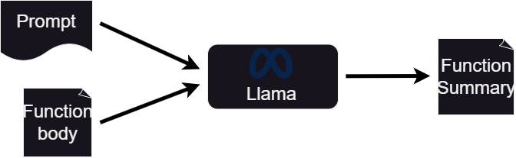
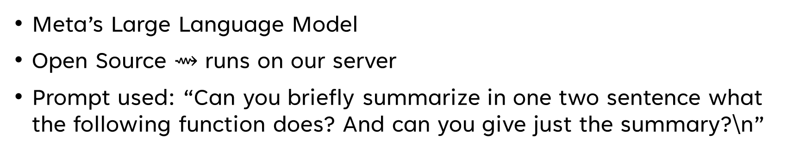
LLAMA
Meta’s Large Language Model
Open Source $⇝$ runs on our server
Prompt used: “Can you briefly summarize in one two sentence what the following function does? And can you give just the summary?\n”

Slide 16
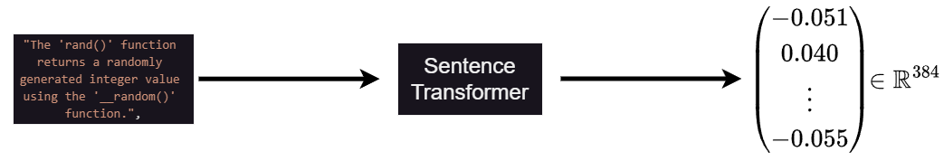
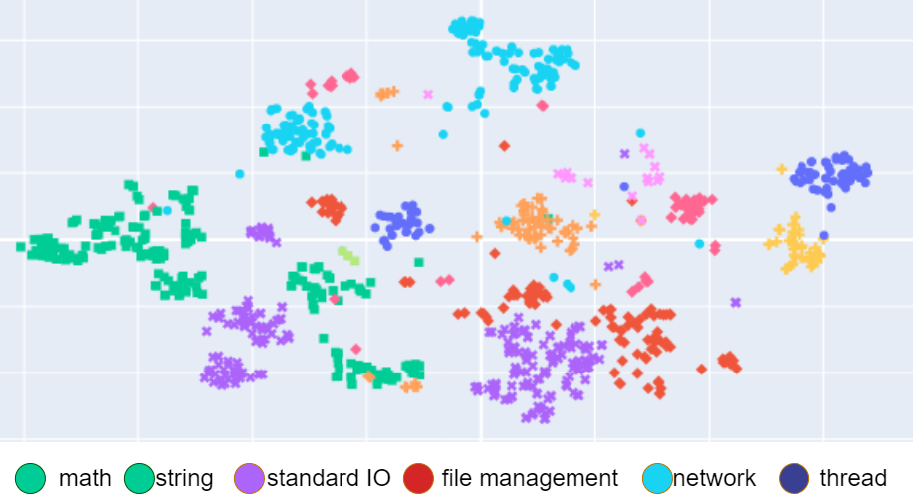
Llama generated Code Summaries

Slide 17
Evaluation
Qualitative evaluation:
Visualize Label Space with different Dimensionality Reduction Techniques
(t-SNE, UMAP, MDS, Kernel-PCA)
Compare Automatic Clustering with DBSCAN/HDBSCAN^{[1]} to manual inspection
Quantitative evaluation:
Train Models with my data set
Performance in downstream task

Slide 18
Discussion
What would be a better Prompt?
C Embeddings with Code2Vec^{[1]}
Use Code Llama instead of standard Llama
Alias problem in “Glibc” data set
Other useful source code information I could extract?
Combining vectors of different source code information?
[1]: Alon et al.: Code2Vec: Learning Distributed Representations of Code, POPL ‘19

