Slide 1
Pitch Vortrag
Ruben Triwari

Slide 2
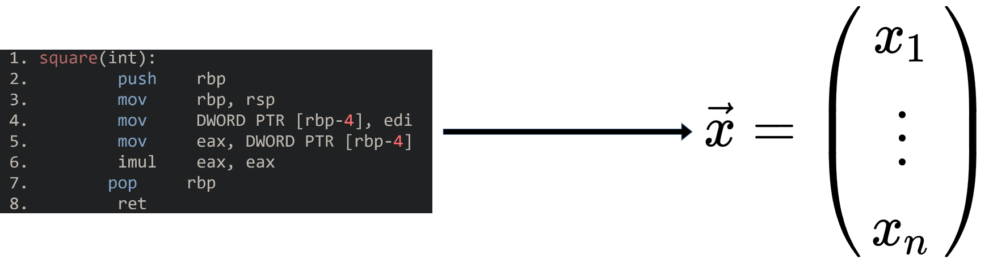
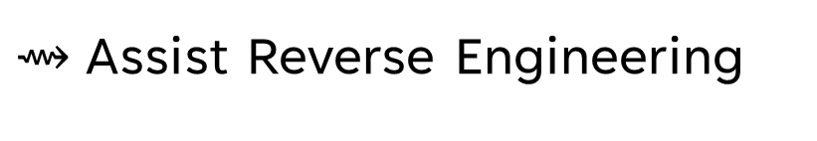
Assembly Code Embedding
Nearest Neighbor Search
Classification with Labels (e.g. Networking, time, …)
XFL: eXtreme Function Labeling
Binary Code Similarity Detection (BCSD)
$⇝$Assist Reverse Engineering

Slide 3
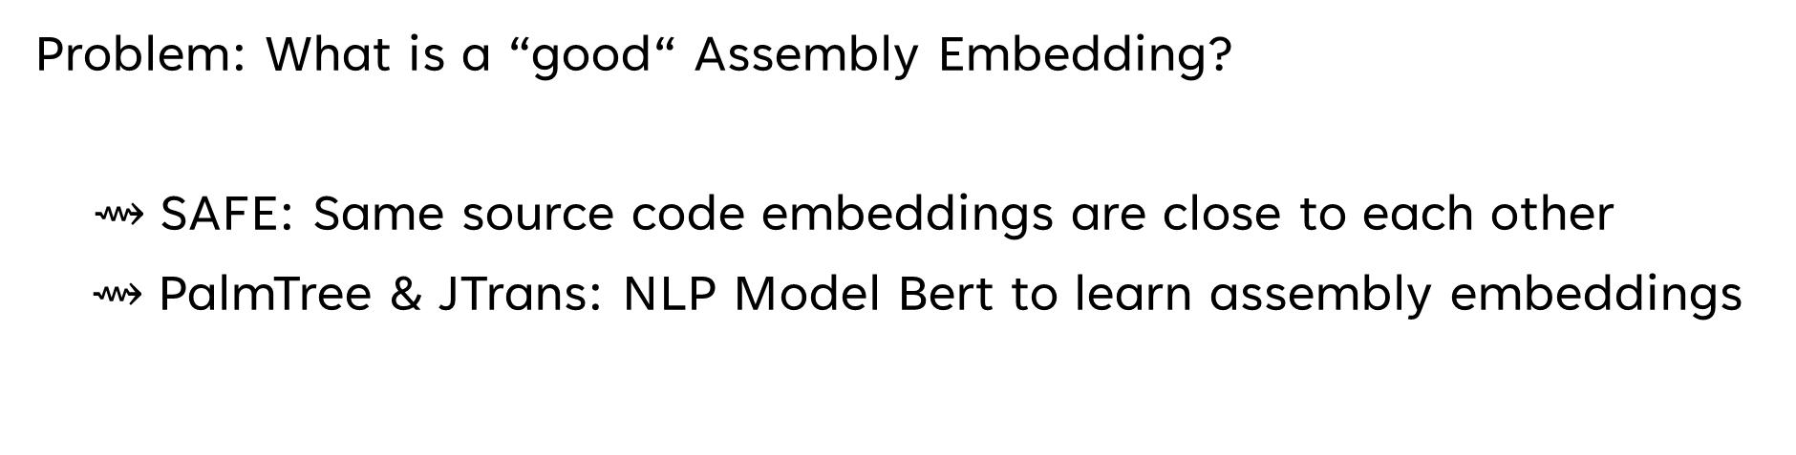
Overview of Diffrent Approaches
Problem: What is a “good“ Assembly Embedding?
$⇝$SAFE: Same source code embeddings are close to each other
$⇝$PalmTree & JTrans: NLP Model Bert to learn assembly embeddings

Slide 4
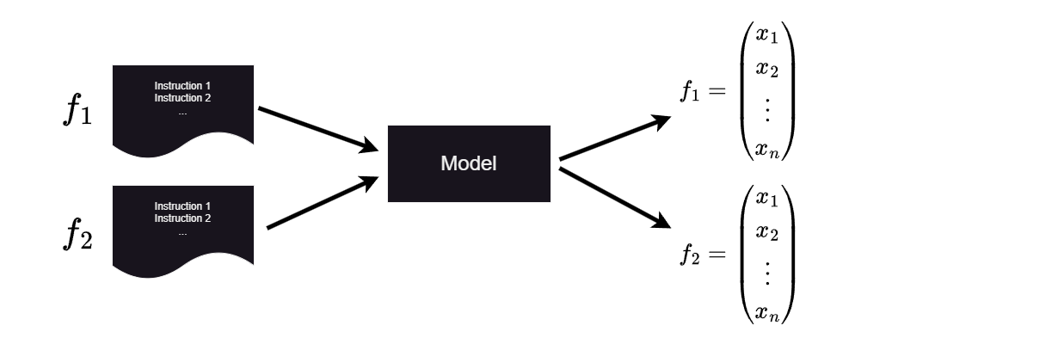
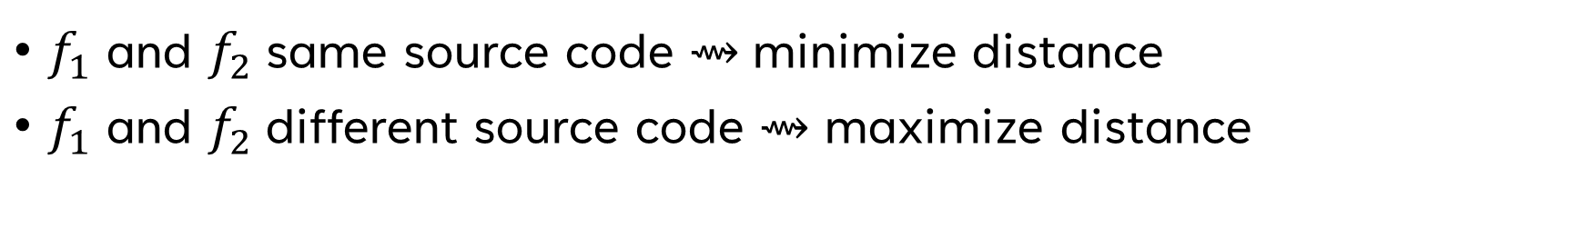
SAFE: Self-Attentive Function Embeddings
$f_{1}$ and $f_{2}$same source code $⇝$minimize distance
$f_{1}$ and $f_{2}$different source code $⇝$ maximize distance
$⇝$ Similar functions are potentially far away from each other

Slide 5
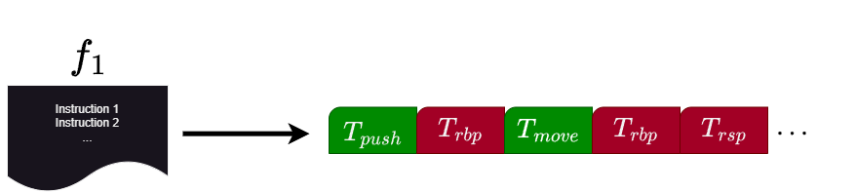
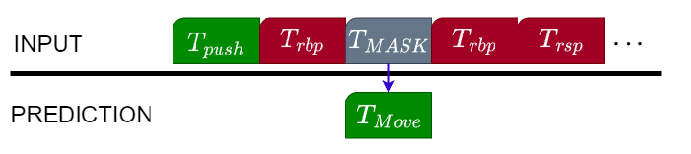
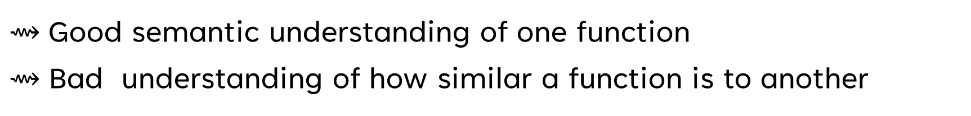
PalmTree & JTrans
$⇝$Good semantic understanding of one function
$⇝$Bad understanding of how similar a function is to another

Slide 6
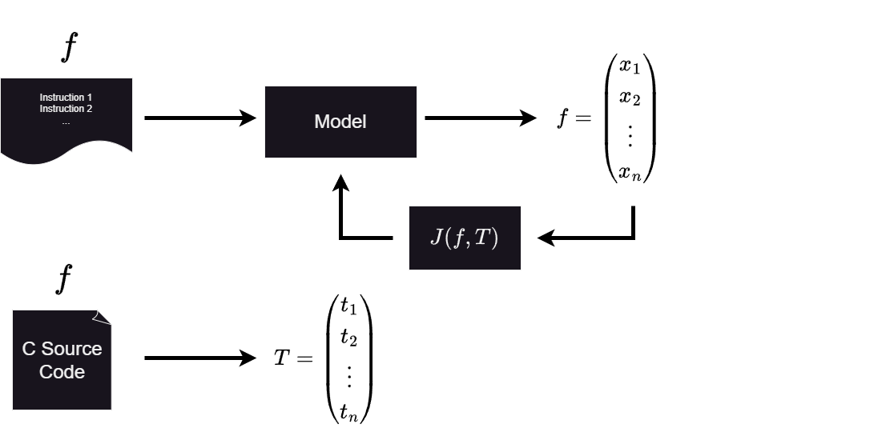
Our Approach
Supervised Learning
Using C Source Code to generate “ground truth”

Slide 7
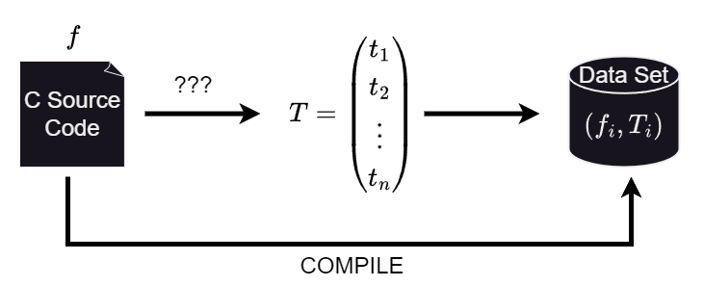
My part
Sentence Transformer on C Source Code Comments
Sentence Transformer on C Source Code Names
Sentence Transformer on Llama generated Code Summaries
Code2Vec

Slide 8
C Source Code Comments

Slide 9
C Source Code Names

Slide 10
Llama generated Code Summaries

Slide 11
Evaluation

Slide 12
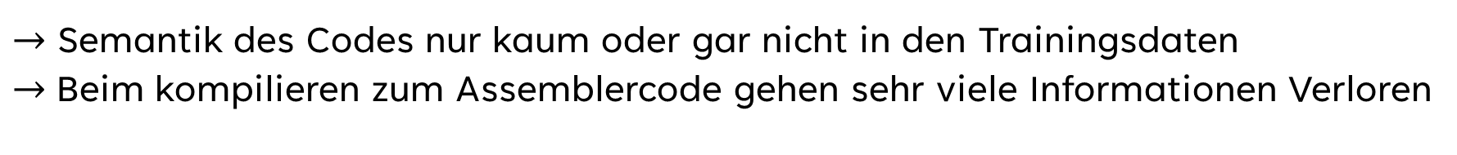
Intuitive Ansätze für Trainings Daten
Byte Darstellung des Assemblercodes
Kontrollflussgraphen des Assemblercodes (Node == Basic Block)
Darstellung als Reihen von Instruktionen des Assemblercodes
$→$ Semantik des Codes nur kaum oder gar nicht in den Trainingsdaten
$→$Beim kompilieren zum Assemblercode gehen sehr viele Informationen Verloren

Slide 13
Trainings Daten mit Source Code Information

