Slide 1
CS5100 Advanced Computer Architecture Trace-Driven Cache Simulation
Prof. Chung-Ta King
Department of Computer Science
National Tsing Hua University, Taiwan
(Materials from http://gem5.org/Documentation, http://learning.gem5.org/book/index.html)

Slide 2
Introduction
Trace-driven simulation is frequently used to evaluate the performance of memory hierarchy
Trace-driven simulation is particularly useful for memory hierarchy because memory hierarchy design is mainly concerned with hits and misses, while timing of events is less of a concern, where trace-driven simulation may fall short of handling timing

Slide 3
Dinero IV- Cache Simulator
Dinero IV is a cache simulator for memory reference traces
Dinero IV is not a timing simulator
No notion of simulated time or cycles, only references
Dinero IV is not a functional simulator
Data and instructions do not move in and out of caches
Primary result of simulation with Dinero IV is hit and miss
Dinero IV is not multi-threaded
If you have a multiprocessor with enough memory, you can run multiple independent simulations concurrently

Slide 4
Installation
Download Dinero from the website: http://pages.cs.wisc.edu/~markhill/DineroIV/
Read “README” for setting and installation
Usage: ./dineroIV valid options < input > output

Slide 5
Valid Options
-lN-Tsize P Size -lN-Tbsize P Block size -lN-Tsbsize P Sub-block size (default same as block size) -lN-Tassoc U Associativity (default 1) -lN-Trepl C Replacement policy (l=LRU, f=FIFO, r=random) (default l) -lN-Tfetch C Fetch policy (d=demand, a=always, m=miss, t=tagged,
l=load forward, s=subblock) (default d) -lN-Tpfdist U Prefetch distance (in sub-blocks) (default 1) -lN-Tpfabort U Prefetch abort percentage (0-100) (default 0) -lN-Twalloc C Write allocate policy (a=always, n=never, f=nofetch) (default a) -lN-Twback C Write back policy (a=always, n=never, f=nofetch) (default a) -lN-Tccc Compulsory/Capacity/Conflict miss statistics -informat C Input trace format (D=extended din, d=traditional din, p=pixie32, P=pixie64, b=binary) (default D)
*Meanings of [U S P C A F N T] are in the next slide.

Slide 6
Notations
U: unsigned decimal integer S: like U but with optional [kKmMgG] scaling suffix P: like S but must be a power of 2 C: single character A: hexadecimal address F: string N: cache level (1 <= N <= 5) T: cache type (u=unified, i=instruction, d=data)

Slide 7
Memory Trace Generation
There are many ways to generating memory trace for Dinero IV to use
From Gem5, we can use its Trace Based Debugging, which ask Gem5 to print out what it is doing
Gem5 contains many DPRINTF statements that print trace messages describing potentially interesting events
Each DPRINTF is associated with a debug flag (e.g., Bus, Cache, Ethernet, Disk, etc.)

Slide 8
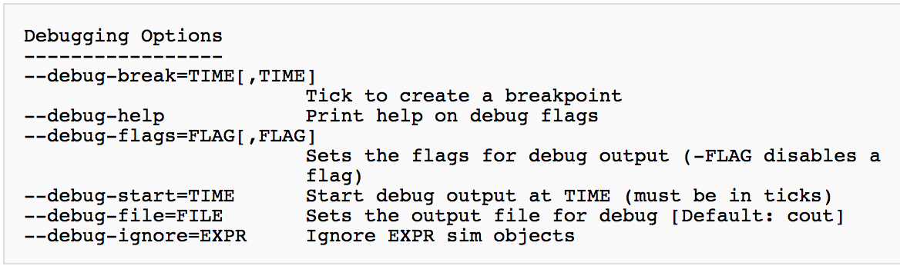
Gem5 Trace Based Debugging
To turn on the trace messages for a particular flag, use the --debug-flags command line argument
E.g. build/X86/gem5.opt --debug-flags=MemoryAccess --debug-file=trace.out configs/example/se.py -c [binary to Execute]

Slide 9
Gem5 Trace Based Debugging
But, Gem5.fast binary does not support tracing
Part of the reason why gem5.fast is faster than gem5.opt is that the DPRINTF code is compiled out
So we cannot use ALPHA/gem5.fast in HW1 to do Trace Based Debugging
For HW2 we need to build a new gem5.opt with X86 ISA
scons build/X86/gem5.opt
Please download binary file Matmul from iLMS, and put it under gem5/

Slide 10
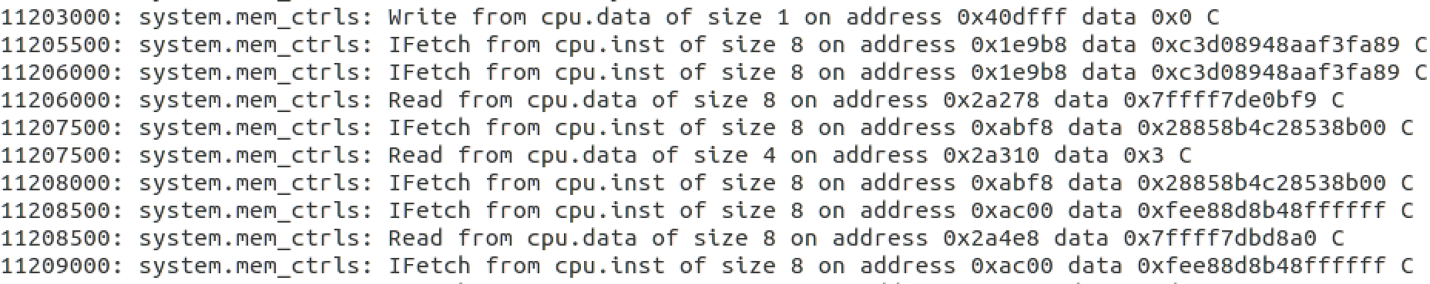
Simulation with Trace Based Debugging
Run gem5 with Trace Based debugging and give the binary file
build/X86/gem5.opt --debug-flags=MemoryAccess --debug-file=trace.out configs/example/se.py -c matmul
Output path of the trace is defaulted under m5out/ directory. The trace file will have the following format:
Tick
Access Type
Address accessed

Slide 11
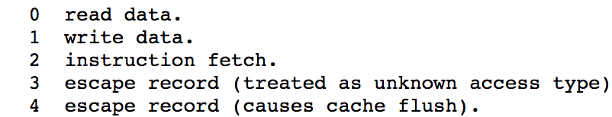
Trace-driven Cache Simulation
To do trace-driven cache simulation using Dinero IV, we need to format trace for Dinero IV to accept
Dinero IV supports multiple input formats. In HW2 we choose the din format
A din record is a two-tuple label address, where a tuple consists of the access type and the address accessed
The address is a hexadecimal byte-address without 0x starting, e.g. 0x40dff7 -> 40dff7
Tag of access type:

Slide 12
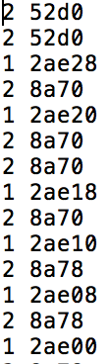
Format Transforming
Please download Format.py from iLMS
Usage: python Format.py [trace file]
The output should be in din format as follows
Then we can use Dinero IV to do the trace-driven cache simulation
Command of the baseline:
./dineroIV -l1-isize 8k -l1-iassoc 2 -l1-ibsize 16 -l1-irepl f -l1-dsize 8k -l1-dassoc 2 -l1-dbsize 16 -l1-drepl f -l1-dwalloc f -l1-dwback a -l1-dccc - informat d < Trace.din > baseline.out

Slide 13
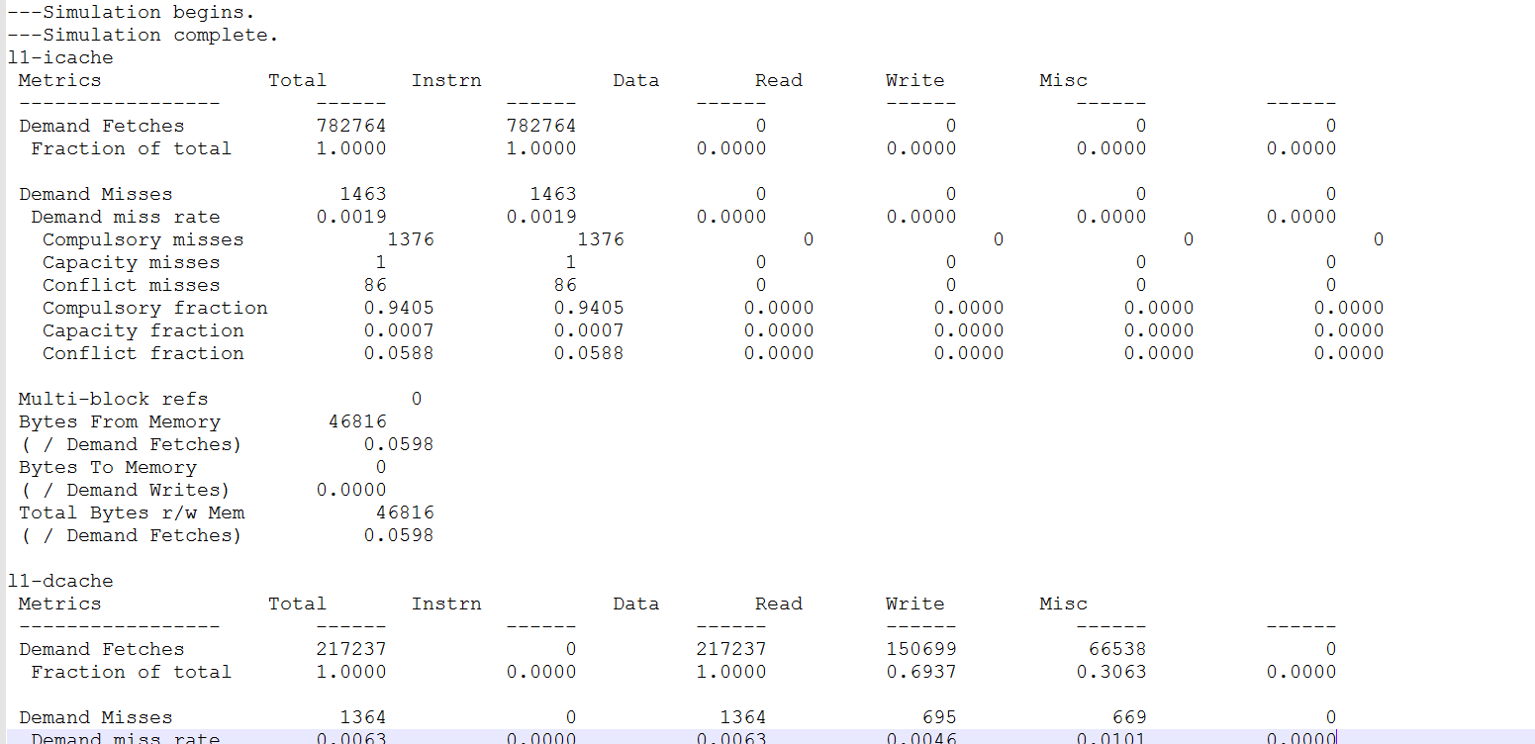
Result

