Slide 1
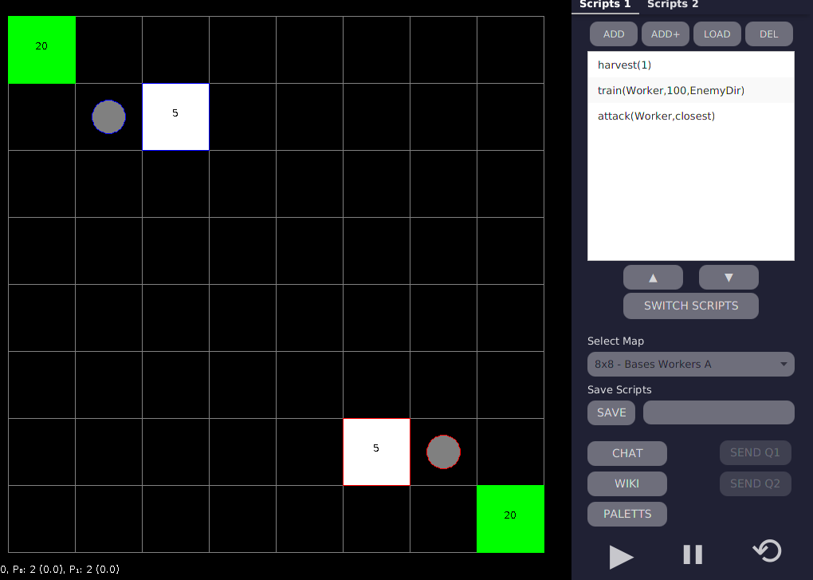
1 - Harvest: There isn’t any resource. The command can’t perform any action.
2 - Train: Considering that the player has resources and a base to train Workers, the command will set this action for the base.
3 - Attack: The worker continues without any command associated. The command attack will send this unit to attack the closes enemy in the courtyard.

