Slide 1
Capstone Project: The Battle of the Neighborhoods
Determining Suitable Neighborhoods For a New Pizza Parlor in New York City.

Slide 2
Business Problem
Pizzerias are all over New York City in high amounts
Stakeholders may encounter a lot of competition when opening a new location
K-Means clustering will help us find a suitable location

Slide 3
Data
Foursquare Places API
New York neighborhoods GeoJSON

Slide 4




Setting Up
Libraries used:

Slide 5
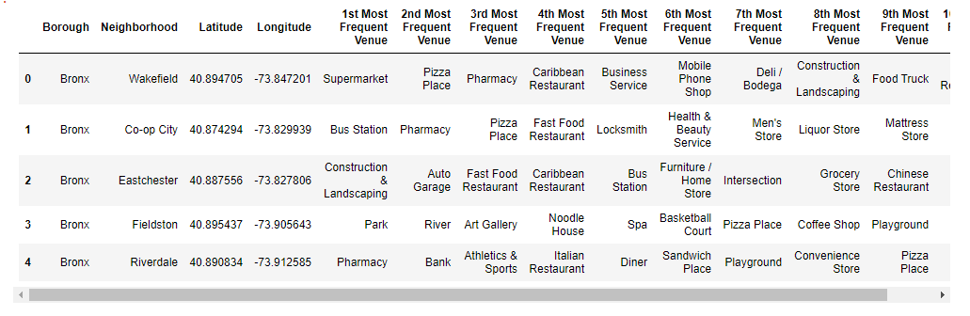
Created Dataframe

Slide 6
Methodology
Run K-Means clustering using our dataframe’s 1st to 10th most frequent venues.
Count the frequency of pizza places appearing as nth most frequent venue on the dataframe grouped by cluster.

Slide 7
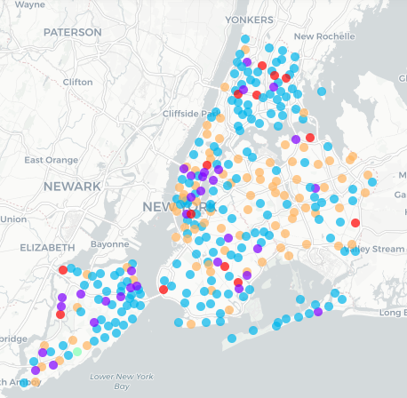
Analysis
Clustered NYC neighborhoods

Slide 8
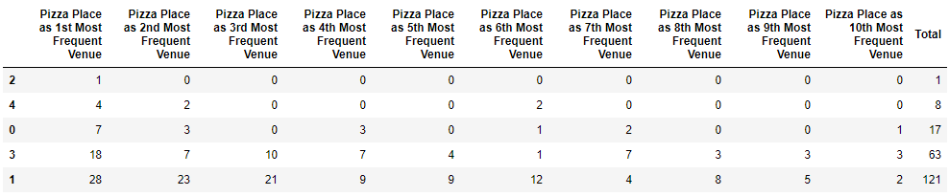
Analysis
Cluster Comparison

Slide 9
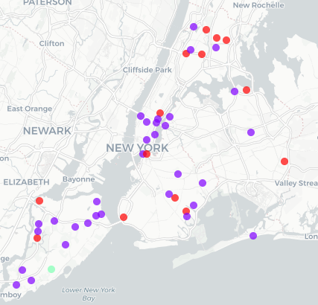
Results
Clusters 2, 4 & 0 have the lowest occurrences of pizza places, becoming the better neighborhoods to open a location.

Slide 10
Conclusion
KMeans clustering is a powerful algorithm that can provide us with good insights of how data is distributed. Of course, there are other factors that can improve our decision making such as demographics and psychographic data.

