Slide 1

SKiIR Explanation Retrieval
Course: Information Retrieval
Lecturer: Alessandro Bozzon
Date: April 7, 2015
Team 7:
Ruben Verboon
Herman Banken
Wiebe van Geest
Kors van Loon
Maarten Steinfort

Slide 2
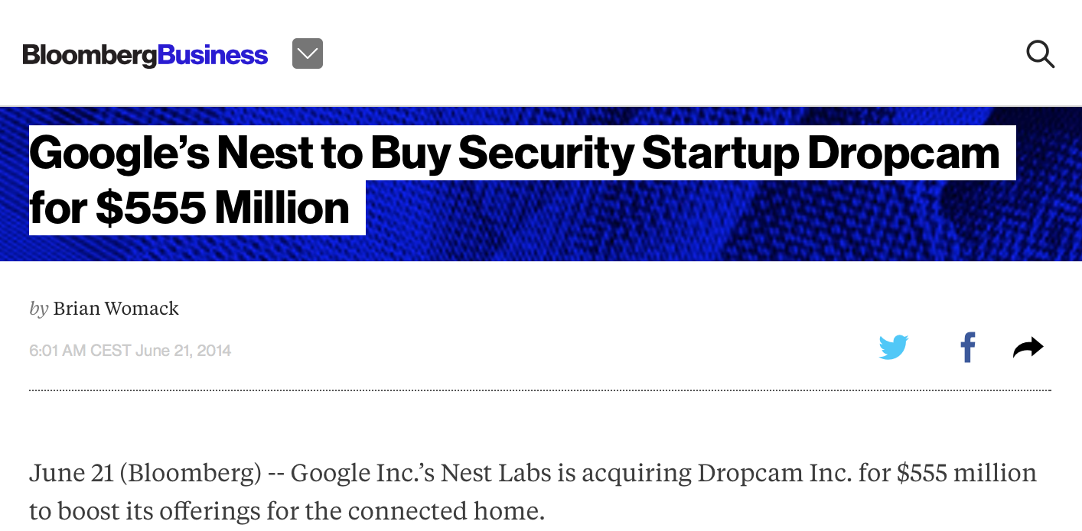
http://www.bloomberg.com/news/articles/2014-06-21/google-s-nest-buying-security-company-dropcam-for-555-million
Imagine
You are reading a newspaper about a new startup
company that has been bought up by Google.

Slide 3
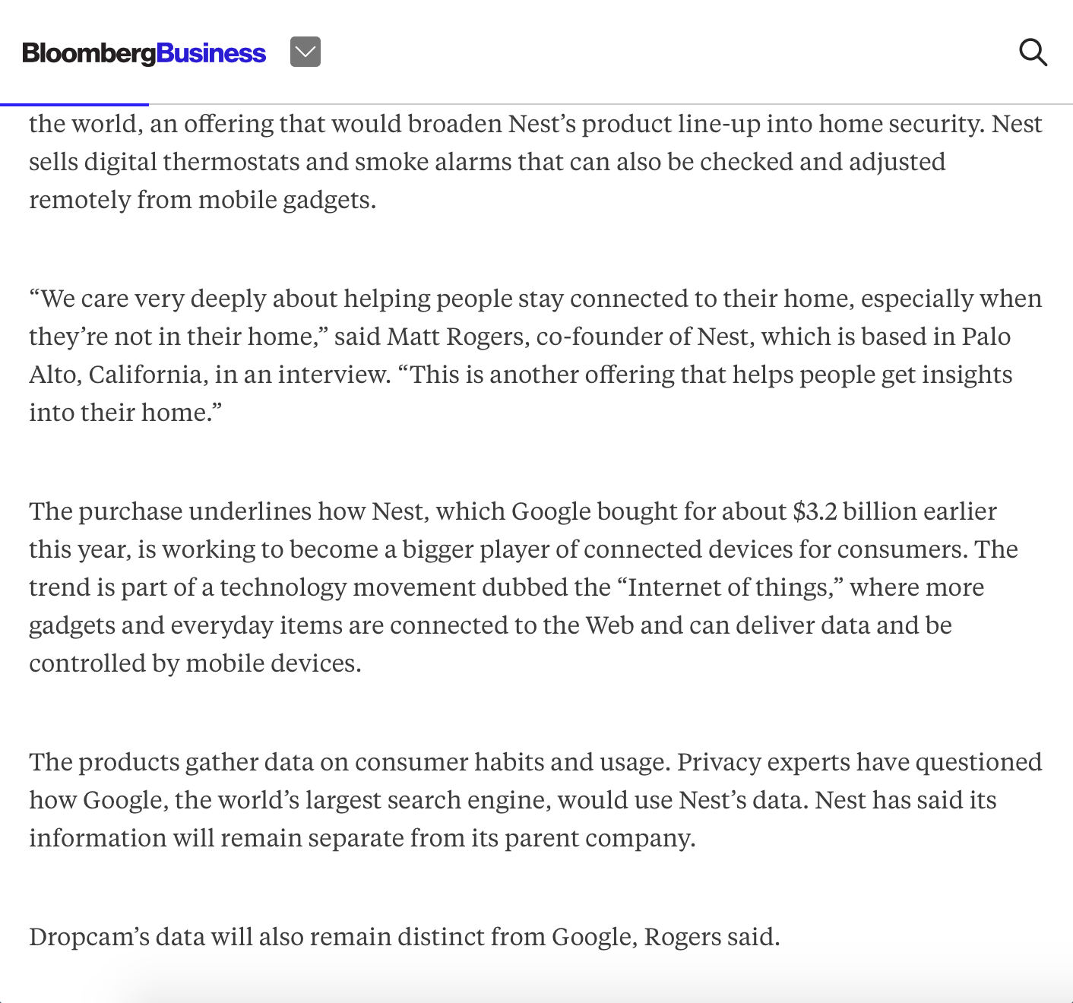

Slide 4
Wow, did I miss something?!
What is Nest?
Why did Google buy it for $3.2 billion dollars?
And now they are buying another company for $555 million dollars?
And.. what is the Internet of Things?
.. where more gadgets and everyday items are connected to the Web and can deliver data and controlled by mobile devices.

Slide 5

What would you do?
What is the Internet of Things?
Quit the article?!

Slide 6
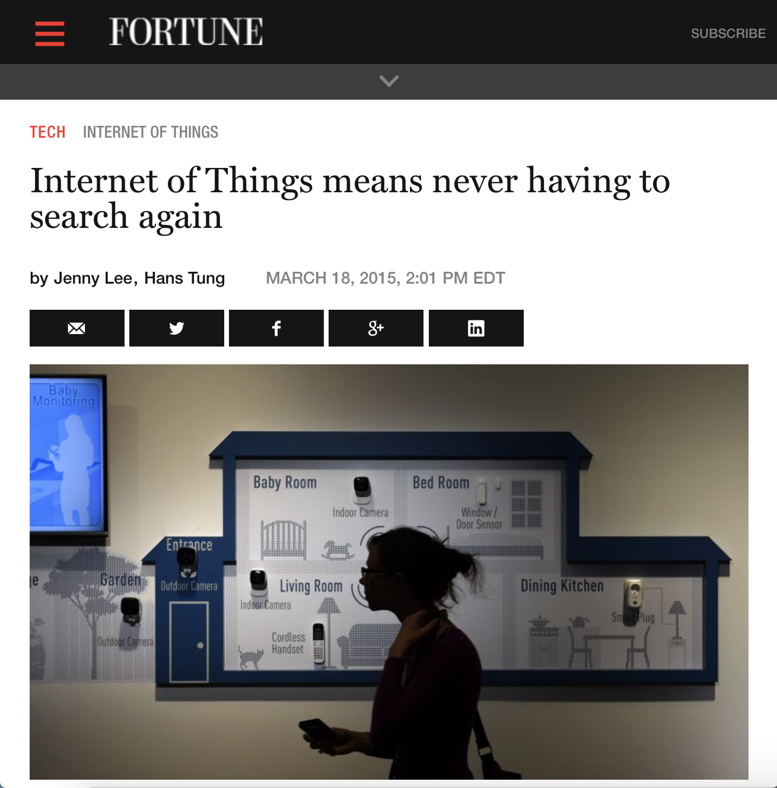
What would you do?
What is the Internet of Things?
Go to a competitor newspaper website?!

Slide 7
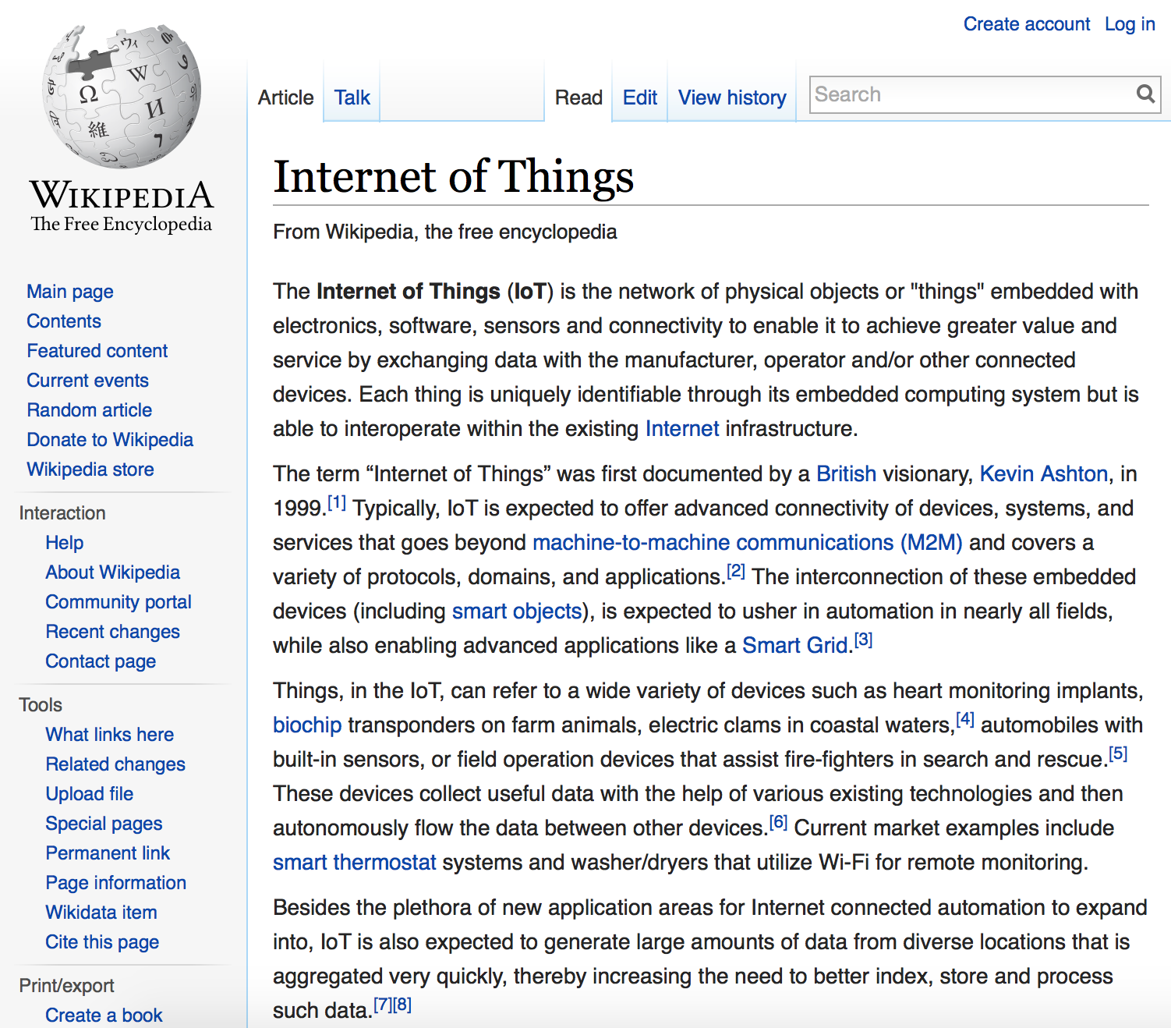


What would you do?
What is the Internet of Things?
Wouldn’t it be nice if someone could explain this to you?
Internet of Things is that all user objects are embedded with software and are connected and interacting with each other.
“It’s like that you can see on you iPhone what is in your fridge while your favorite music is played and lightning the candles automatically.”

Slide 8
So, we have a problem
How can we…
prevent you from visiting other news websites?
let you stay on our news website?
broaden the audience of our articles?

Slide 9
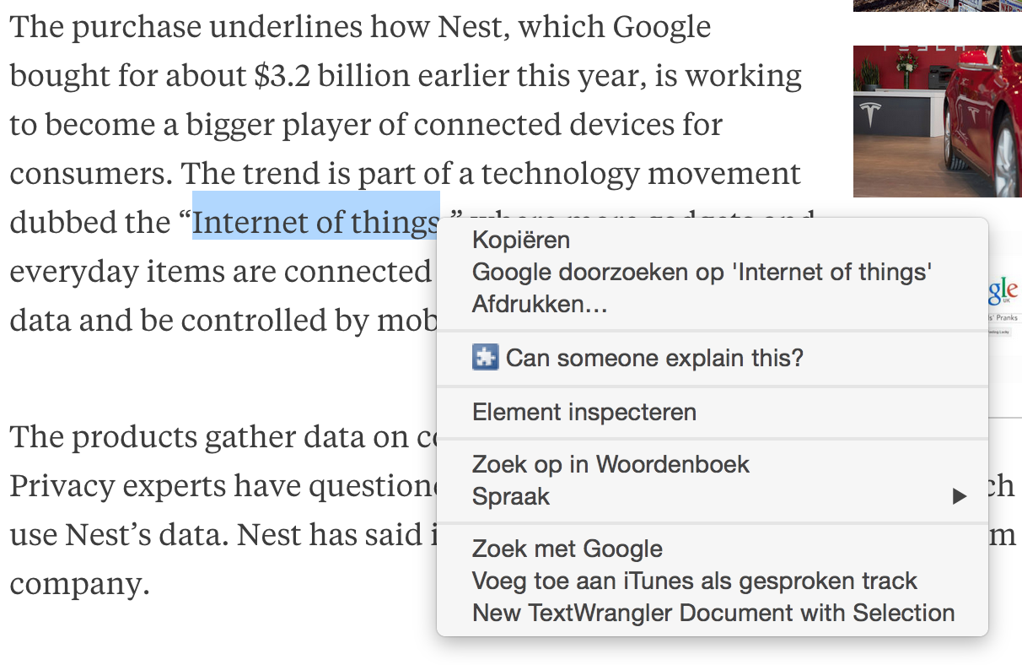
Wow, did I miss something?!
What is the Internet of Things?
Wouldn’t it be nice if someone could explain this to you ONLINE?

Slide 10
Goal
To broaden the audience of our news website by
explaining ‘complex’ terms with online annotations.
Manual explanations Readers explain terms that other readers don’t understand
Automatic explanations Retrieving related articles with semantic searching
But…
Human Computation is scarce!!

Slide 11
Solution
SKiIR
Explanation Retrieval
Powered by

Slide 12





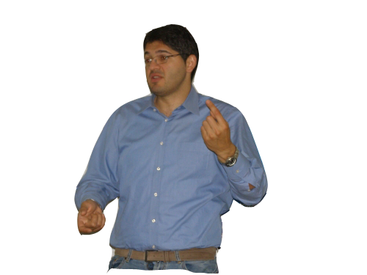


Design choices
SKiIR-app
Scope
Web Application Chrome Extension
News articles Bloomberg
Back-end & Play Framework &
Database PostGreSQL
+
Human Computation Readers
AlchemyAPI &
IR Model DBPedia &
New learnings
+
+

Slide 13
Features - What should it do?
Request explanation
Semantically retrieve explanations
Provide explanation
Review explanation
Scrape news articles

Slide 14
Workflow - How should it work?
Request explanation
Request explanation
Store request

Slide 15
Workflow - How should it work?
2. Scrape news articles
Scrape news article
Store article

Slide 16
Workflow - How should it work?
3. Provide explanation - manually
Provide explanation
Explanation request
Store explanation
Relevant articles

Slide 17
Workflow - How should it work?
4. Semantically retrieve explanation - automatically
Explanation request
Store explanation
Explanation from relevant articles

Slide 18
Workflow - How should it work?
5. Review explanation
Review explanation
Provide explanation
Store review

Slide 19
Workflow - Overview

Slide 20
Explanation Retrieval
Extraction of requisites
Relevance of terms
SCS Connector
Adding diversity
Ranking results

Slide 21
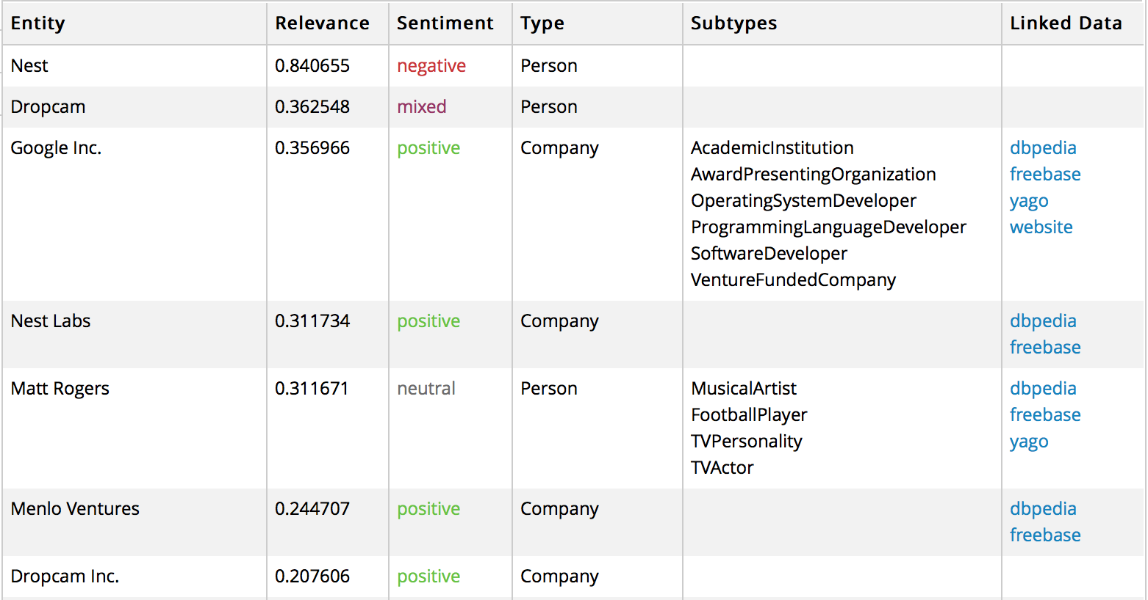
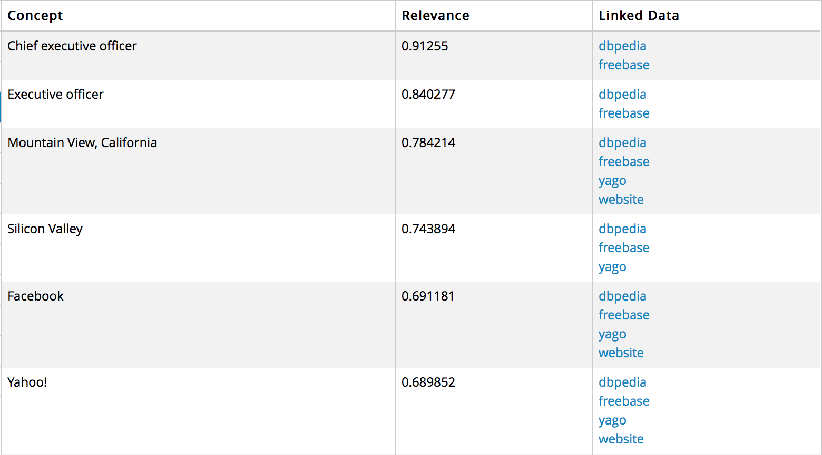
Extraction of Requisites
Entities
Concepts
Type
Linked Data
Relevance - borrowed
Source:

Slide 22
Relevance of terms
Relevance of terms in a specific article
0,35
Petrobras creditors could request an acceleration of payments on some of its debt if the company doesn’t release an audited financial statement by the end of May.
Public prosecutors are investigating 20 companies, including 16 builders, for participating in a alleged cartel to overcharge the oil company. OAS and Galvao Engenharia SA, Brazilian construction companies, filed for bankruptcy after investigations started.
The president said the builders financial difficulties won’t hold up planned tenders to build and operate infrastructure projects. She said she plans tap Chinese investment for a railway linking Brazil’s Atlantic coast with the Pacific Ocean.
The Supreme Court has also authorized investigations of 49 politicians including Senate chief Renan Calheiros and lower house President Eduardo Cunha in relation to the alleged kickbacks at Petrobras. Former officials at the company turned state’s witness said that hundreds of millions of dollars went to political parties, including Rousseff Workers’ Party. The scandal has eroded the support she needs in Congress to approve austerity measures.
0,63
0,11
0,88
0,78
0,63

Slide 23
SCS Connector
Relationship between entities
Petrobras creditors could request an acceleration of payments on some of its debt if the company doesn’t release an audited financial statement by the end of May.
Public prosecutors are investigating 20 companies, including 16 builders, for participating in a alleged cartel to overcharge the oil company. OAS and Galvao Engenharia SA, Brazilian construction companies, filed for bankruptcy after investigations started.
The president said the builders financial difficulties won’t hold up planned tenders to build and operate infrastructure projects. She said she plans tap Chinese investment for a railway linking Brazil’s Atlantic coast with the Pacific Ocean.
The Supreme Court has also authorized investigations of 49 politicians including Senate chief Renan Calheiros and lower house President Eduardo Cunha in relation to the alleged kickbacks at Petrobras. Former officials at the company turned state’s witness said that hundreds of millions of dollars went to political parties, including Rousseff Workers’ Party. The scandal has eroded the support she needs in Congress to approve austerity measures.
0,23
0,56
0,76
0
0,83

Slide 24
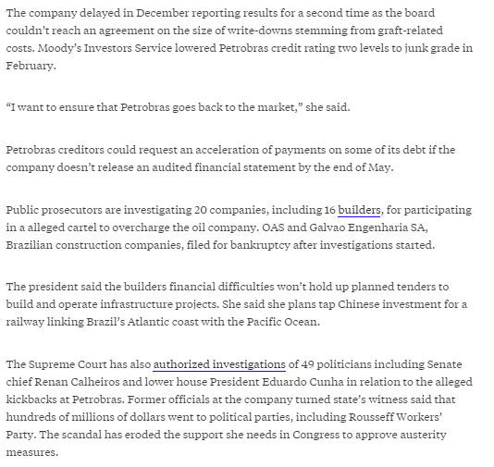
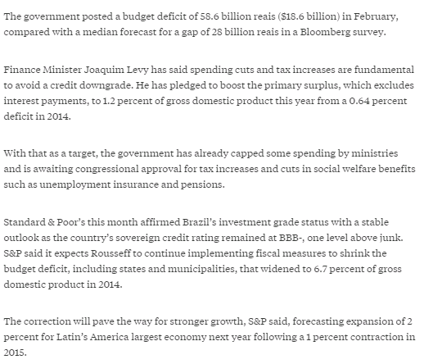
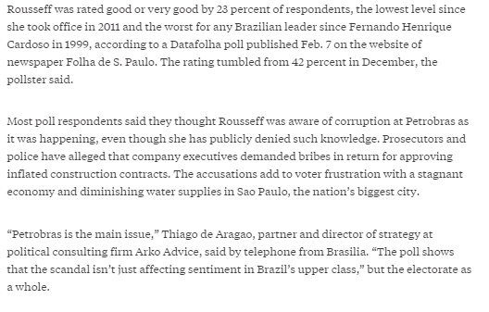
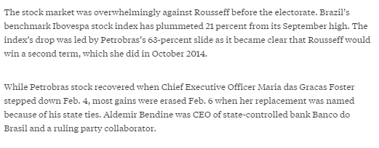
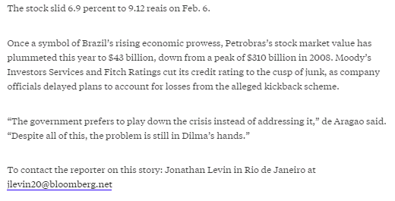
Adding Diversity
Maximal Marginal Relevance (MMR) method
Max Relevance vs Min Relevance
Original document
Other results

Slide 25
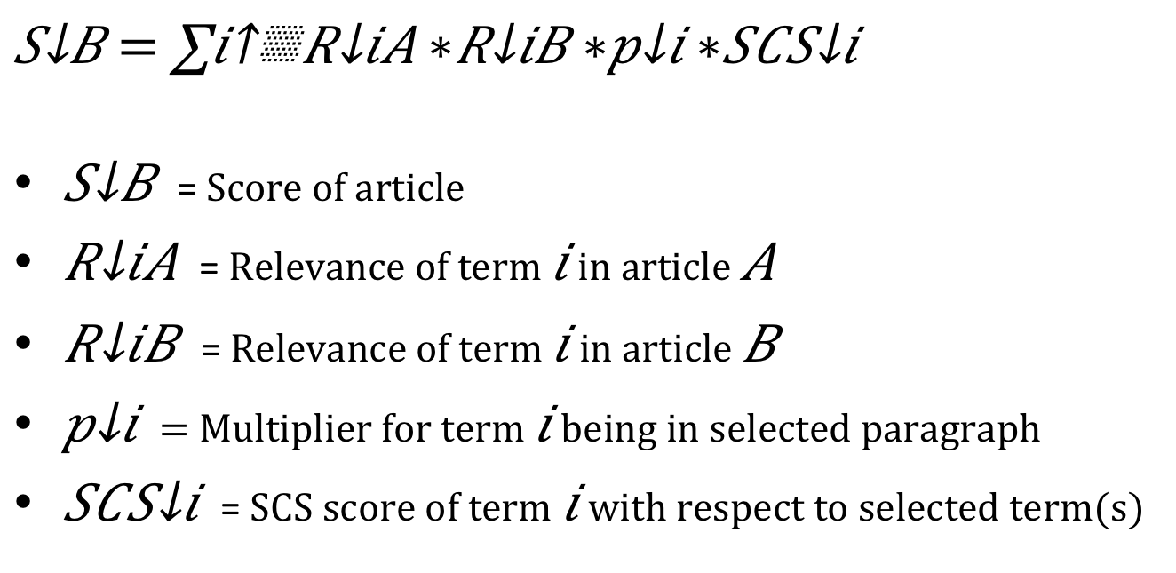
Ranking Results
Combining all to rank the articles on total relevance
= Score of article
= Relevance of term in article
= Relevance of term in article
= Multiplier for term being in selected paragraph
= SCS score of term with respect to selected term(s)

Slide 26
Demonstration
See the application!

Slide 27
Reflection
What have we accomplished?
Recap of the things discussed
WHAT ELSE?

