Slide 1

SKiIR
Course: Information Retrieval
Professor: Alessandro Bozzon
Date: April 7, 2015
Team 7:
Ruben Verboon
Herman Banken
Wiebe van Geest
Kors van Loon
Maarten Steinfort

Slide 2
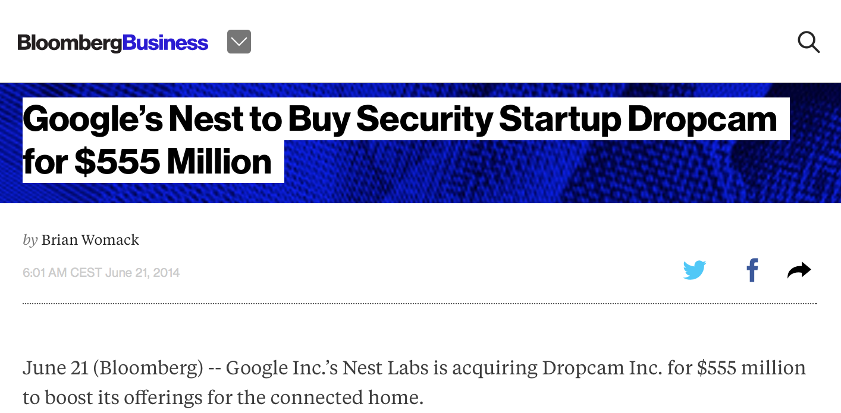
http://www.bloomberg.com/news/articles/2014-06-21/google-s-nest-buying-security-company-dropcam-for-555-million
Imagine
You are reading a newspaper about a new startup
company that has been bought up by Google.

Slide 3
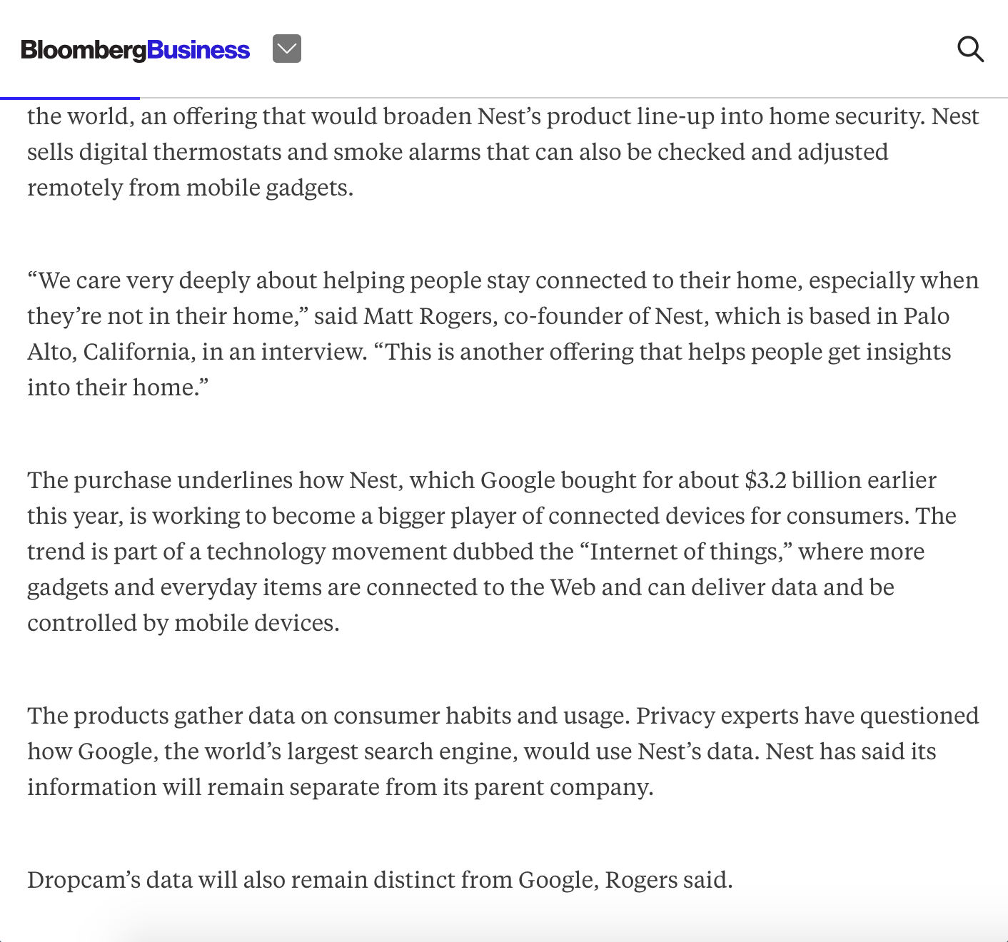

Slide 4
Wow, did I miss something?!
What is Nest?
Why did Google buy it for $3.2 billion dollars?
And.. what is the Internet of Things?
.. where more gadgets and everyday items are connected to the Web and can deliver data and controlled by mobile devices.

Slide 5

What would you do?
What is the Internet of Things?
Quit the article?!

Slide 6
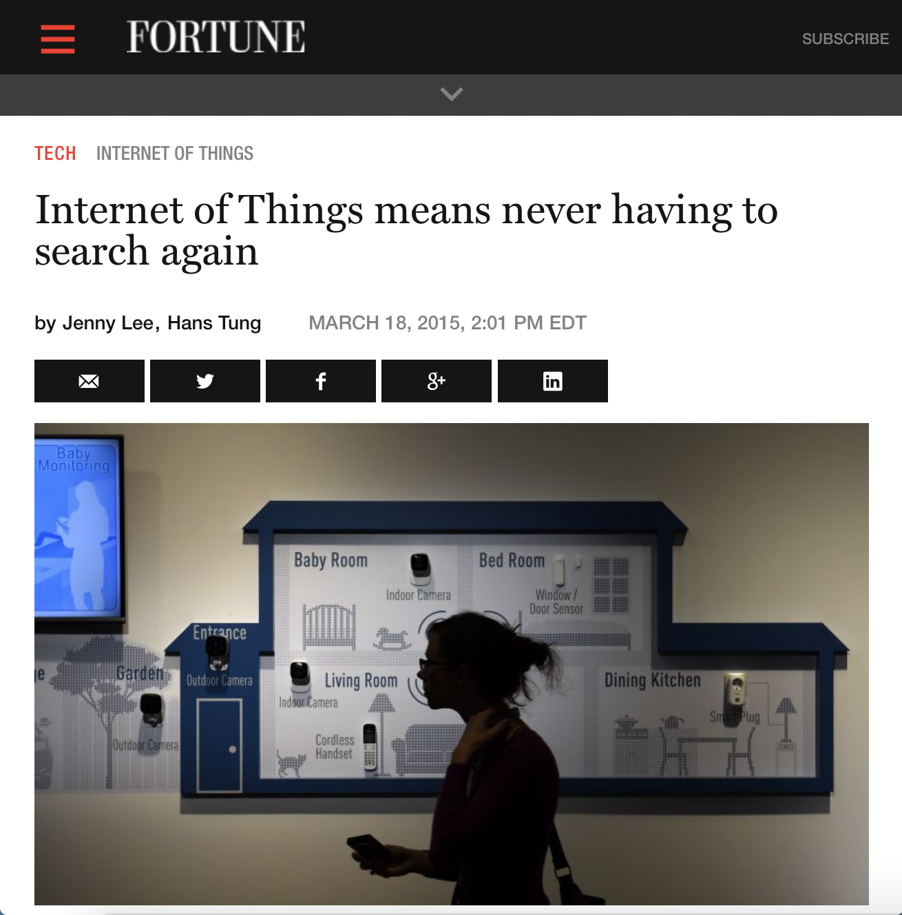
What would you do?
What is the Internet of Things?
Go to a competitor newspaper website?!

Slide 7
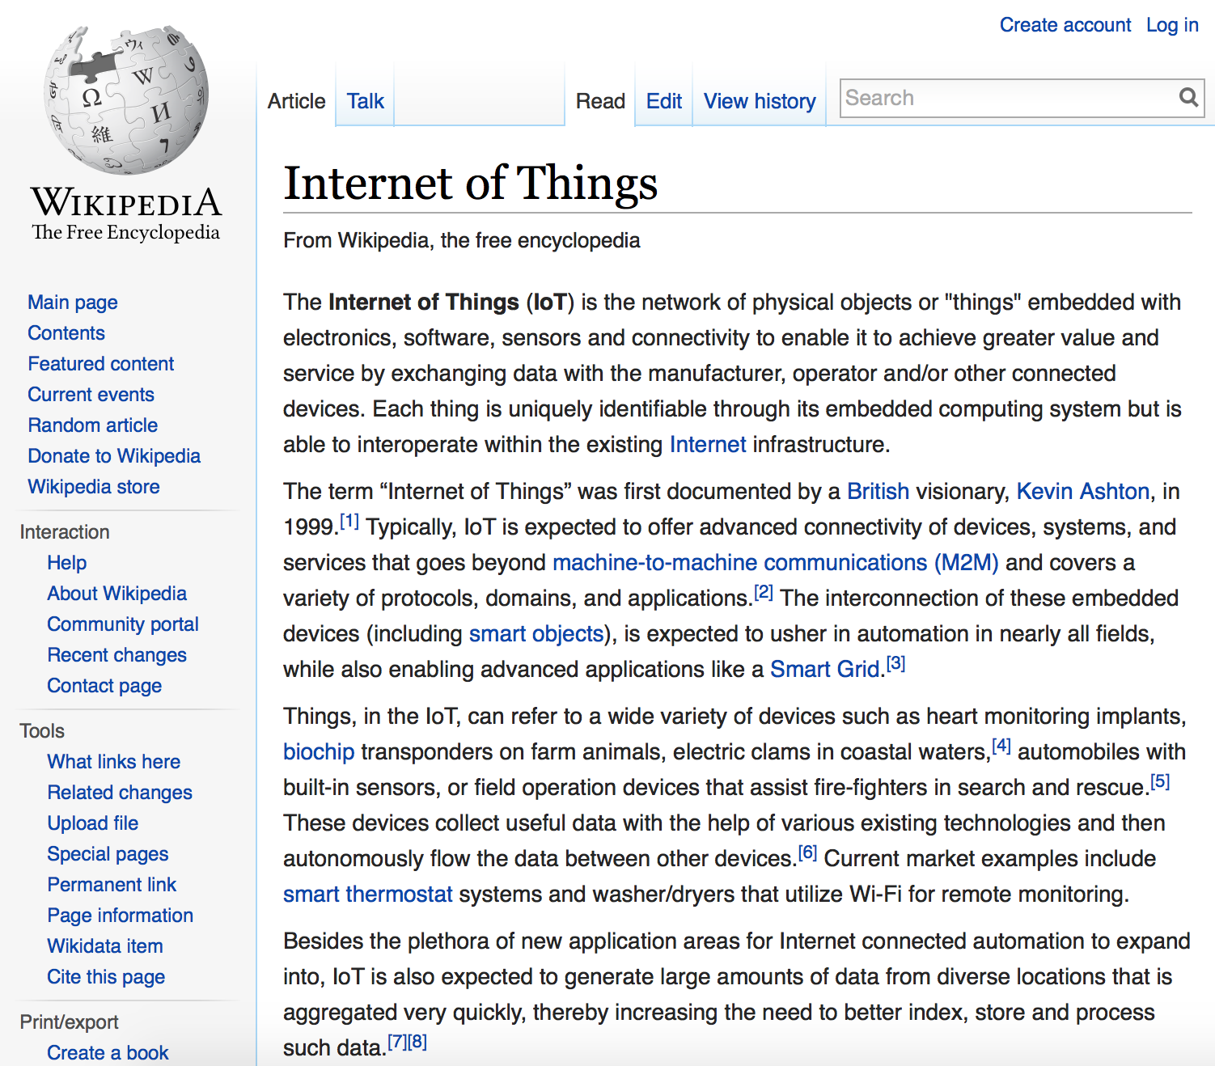
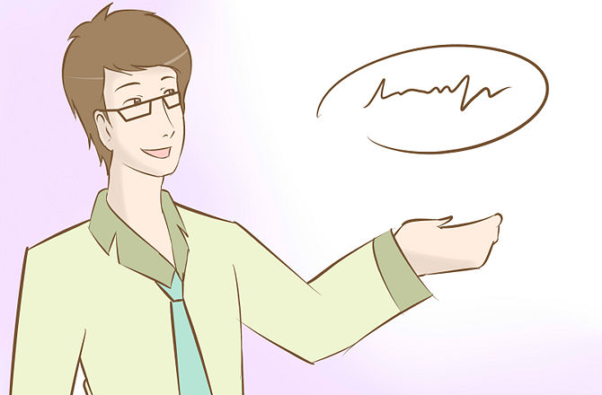
What would you do?
What is the Internet of Things?
Wouldn’t it be nice if someone could explain this to you?

Slide 8
So, we have a problem
How can we
prevent you from visiting other news websites?
let you stay on our news website?
broaden the audience of our articles?

Slide 9
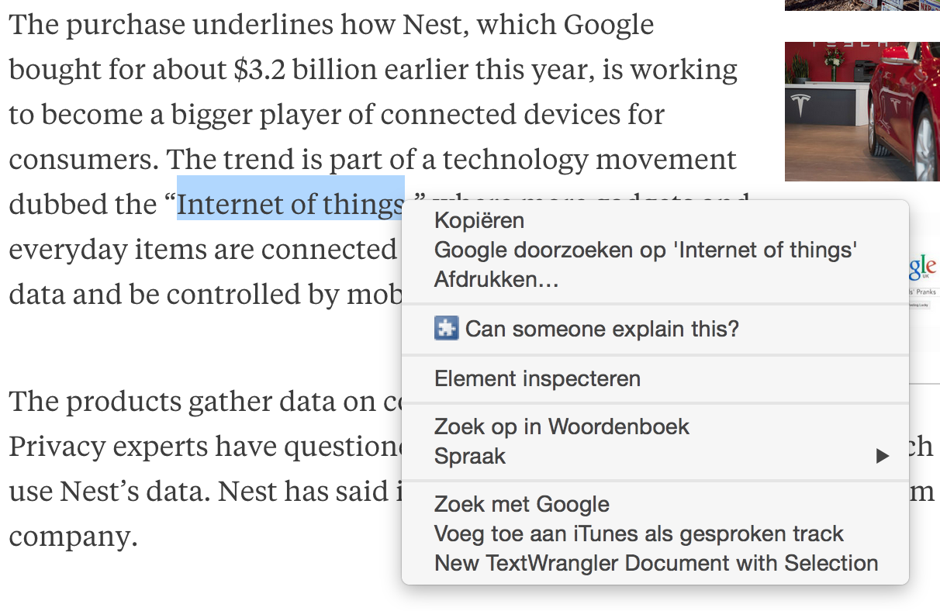
Wow, did I miss something?!
What is the Internet of Things?
Wouldn’t it be nice if someone could explain this to you Online?

Slide 10
Goal
To broaden the audience of our client’s news website by
explaining ‘complex’ terms with online annotations.
Manual explanations Readers explain terms that other readers don’t understand
Automatic explanations Retrieving related articles with semantic searching
But…
Human Computation is scarce!!

Slide 11
Wow, did I miss something?!
What is the Internet of Things?
Internet of Things is that all user objects are embedded with software and are connected and interacting with each other.
“It’s like that you can see on you iPhone what is in your fridge while your favorite music is played and lightning the candles automatically.”
Wouldn’t it be nice if someone could explain this to you Online?

Slide 12





Design choices
SKiIR-app
Scope
Web Application Chrome Extension
News articles Bloomberg
Database PostGreSQL
IR Model AlchemyAPI &
DBPedia
+

Slide 13
How should it work?
}
Request explanation
Provide explanation
Review explanation

