Slide 1

Rubén Alejandro López Reynoso
Data Analyst Jr. Stori Card

Slide 2

Table of contents
Question 1
Question 2
Question 3
Closing Slide

Slide 3

1. Question 1

Slide 4
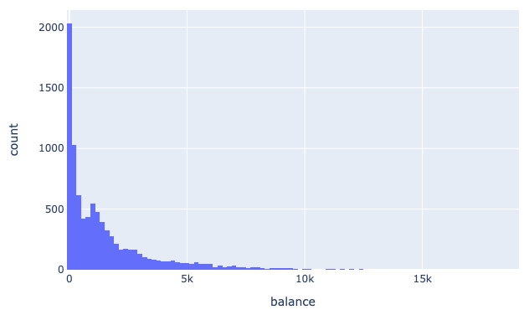
1.1 Balance Histogram
1.2 Insights;
Around 80% of the counts have less of 2K in balance
The population is skewed to the left
Attached you can find the plot in histograma.html

Slide 5
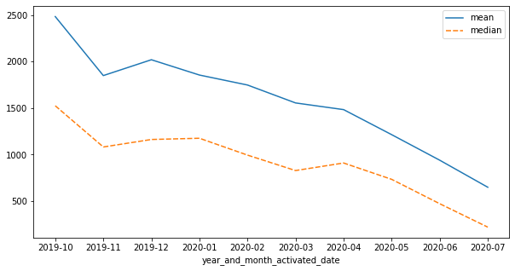
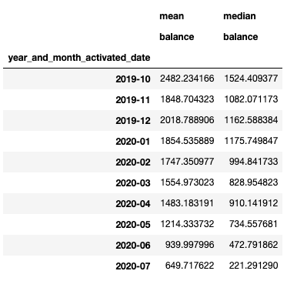
1.3 Mean and Median
Insights;
Average and median balance were falling down every month

Slide 6
2. Question 2

Slide 7
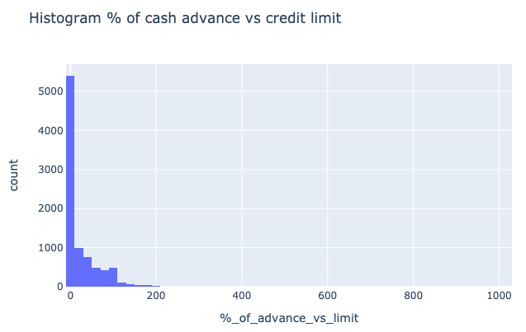
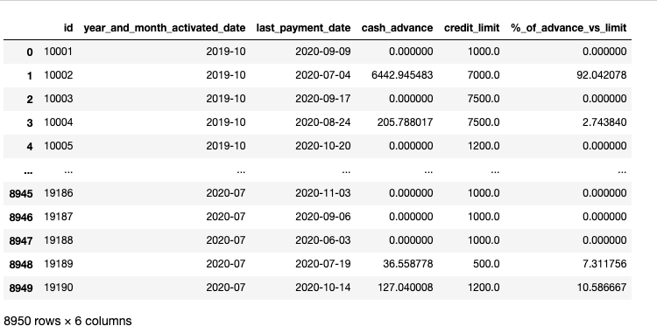
2.1 Reported table
2.1 Insights;
Around 80% of the clients have less of 80% of cash advance vs credit limit
The population is skewed to the left
Attached you can find the plot in histograma_credito.html and the information in pregunta_2.csv)

Slide 8
3. Question 3

Slide 9
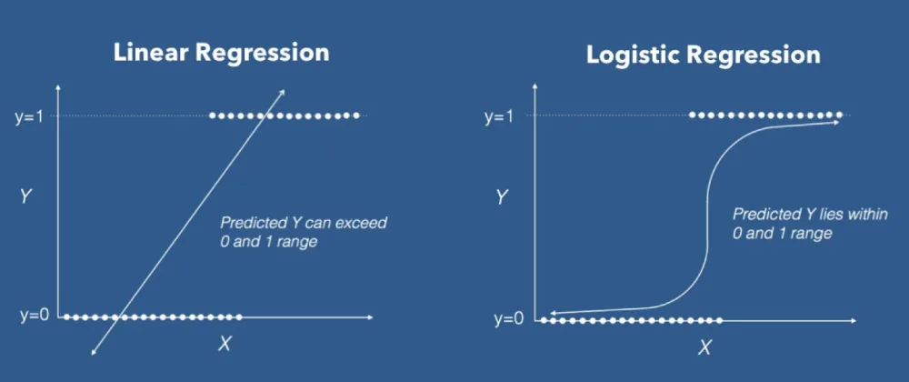
3.1 Predictive Model for fraud
3.1 Insights;
Fraud is a nominal variable, which means it only can take the value of True or false (1 or 0 respectively)
It was apply a machine learning method for prediction called Logistic regression, the details are in the stori_card.ipynb file.
The selected variables were the following: 'balance', 'balance_frequency', 'oneoff_purchases', 'installments_purchases', 'cash_advance', 'purchases_frequency', 'oneoff_purchases_frequency', 'purchases_installments_frequency', 'cash_advance_frequency', 'cash_advance_trx', 'purchases_trx', 'credit_limit', 'payments', 'prc_full_payment'

Slide 10
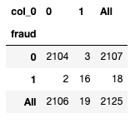
3.1 Predictive Model for fraud
3.1 Evaluation of model
In order to Evaluate the model it was calculate a confusion matrix, in order to obtain the probability of false positives or false negatives:
3.1 Evaluation of the model
The probability of obtaining a false positive is 0.147% (3 / 2, 107 of the predictions)
The probability of obtaining a false negative es 11.11% (2/18 of the predictions)

Slide 11
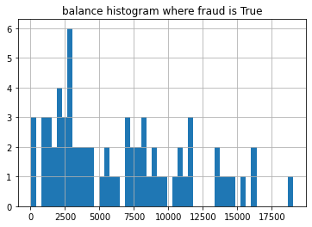
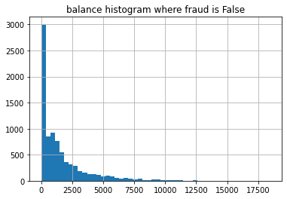
3.2 Most predictive variable for fraud
3.2 Insights;
Where fraud is True most of the cases have a balance above 2500
Where Fraud is False the balance is under 2500

Slide 12
Thank you!

