Slide 1
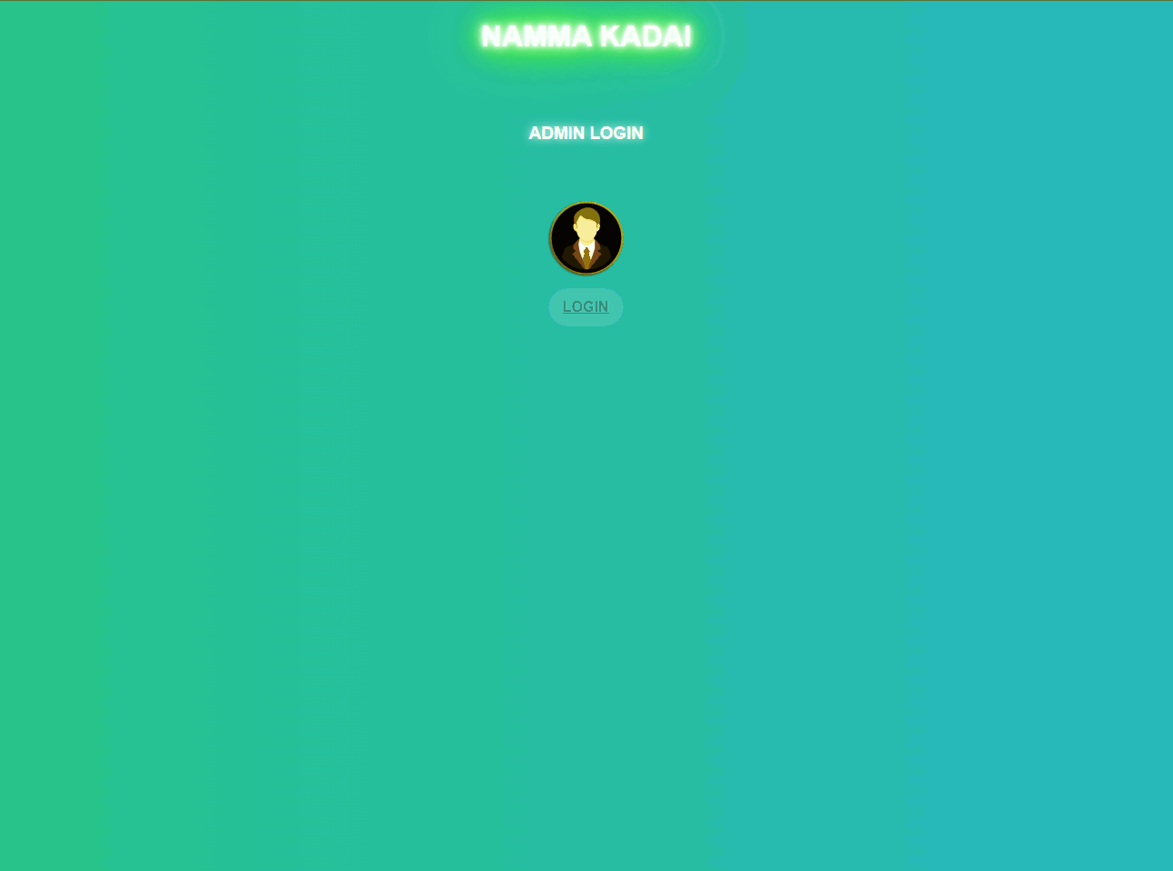
HOME PAGE
ADMIN CAN ONLY ACCESS THE PORTAL

Slide 2
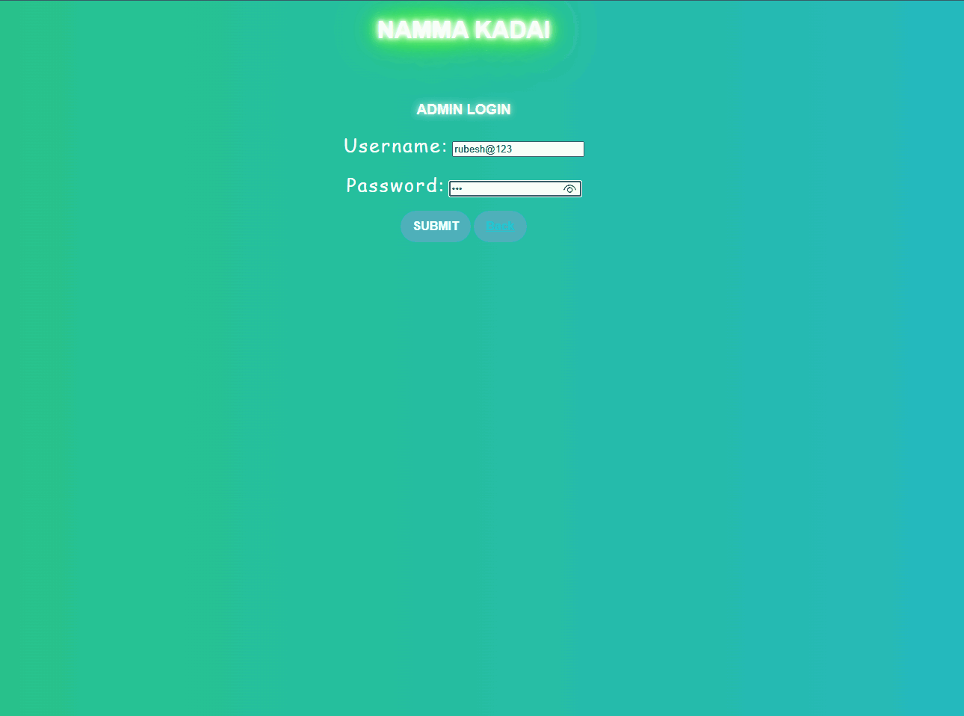
ADMIN LOGIN PAGE
Can access the user only

Slide 3
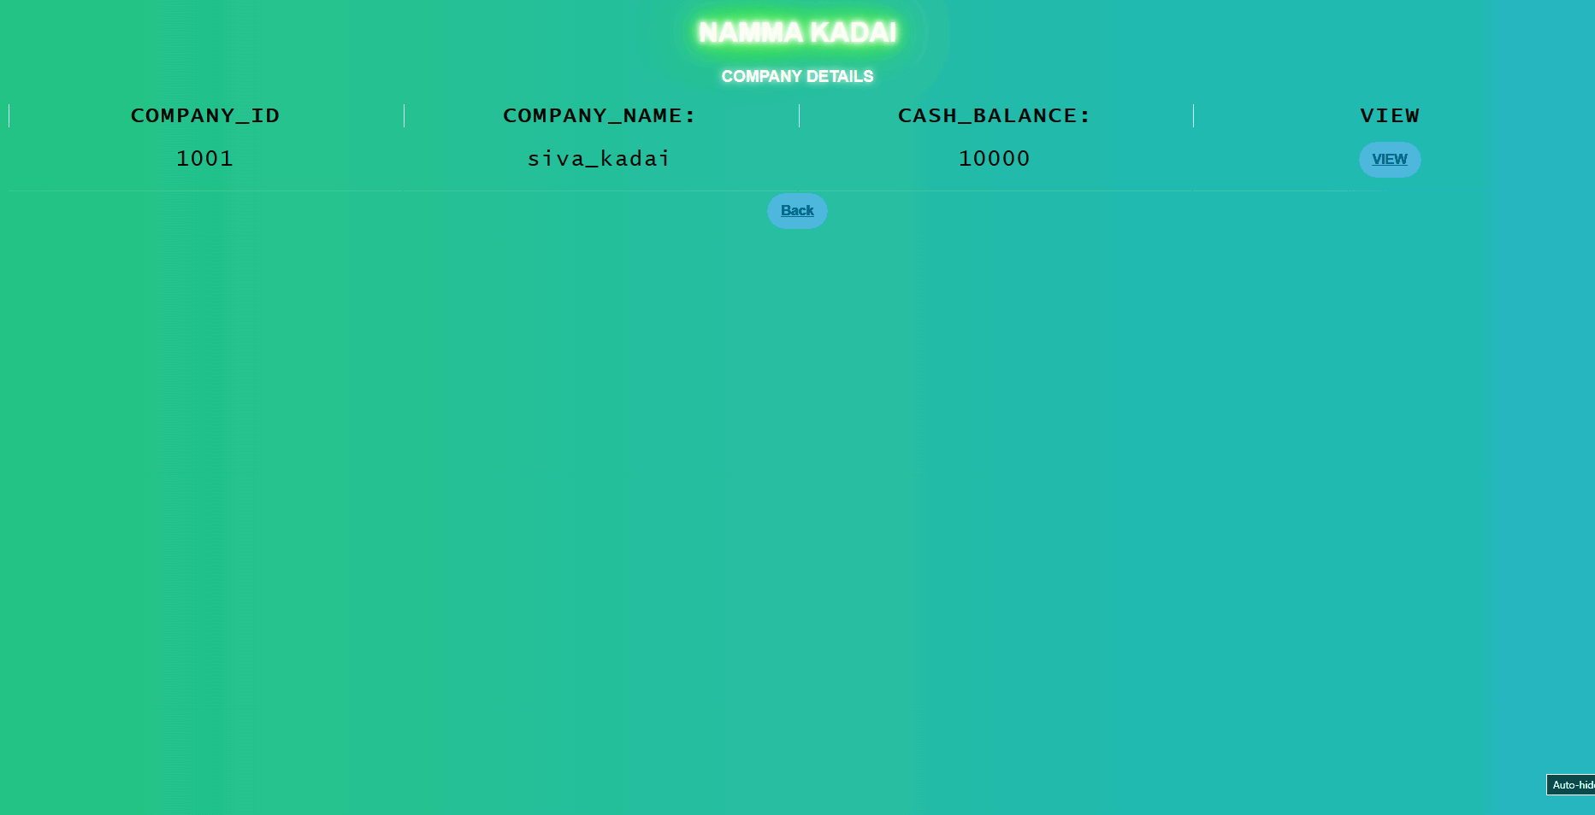
LIST OUT THE COMPANY LIST

Slide 4
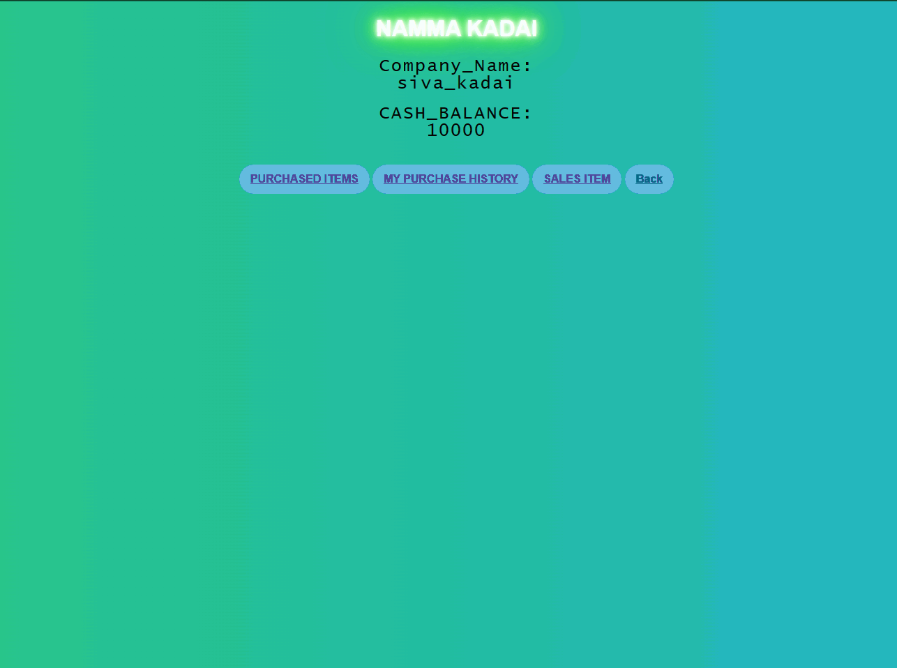
VIEW THE COMPANY DETAILS

Slide 5
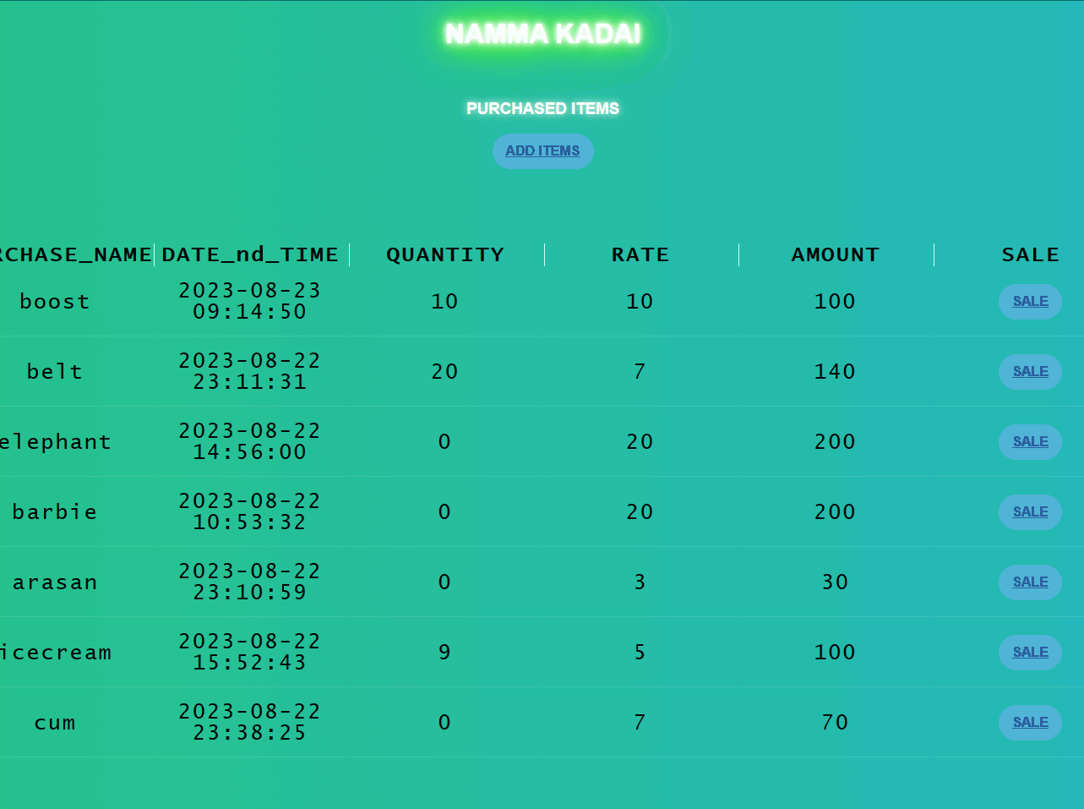
PURCHASE ITEMS SHOWS
LIST OUT OF PURCHASE ITEMS

Slide 6
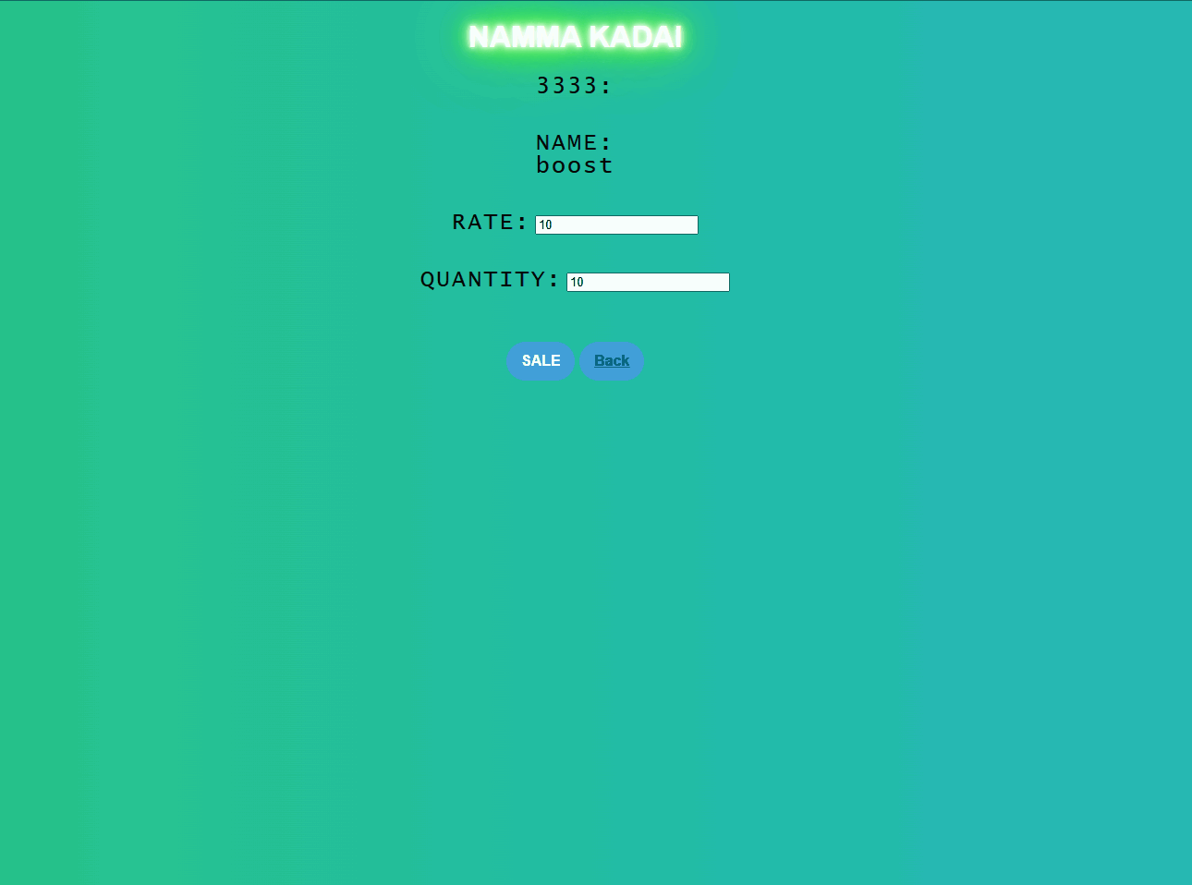
PURCHASED ITEMS TO SALE
WHICH ITEM YOU SELECT TO SALE AND CUSTOMISE THE QUANTITY TO SALE

Slide 7
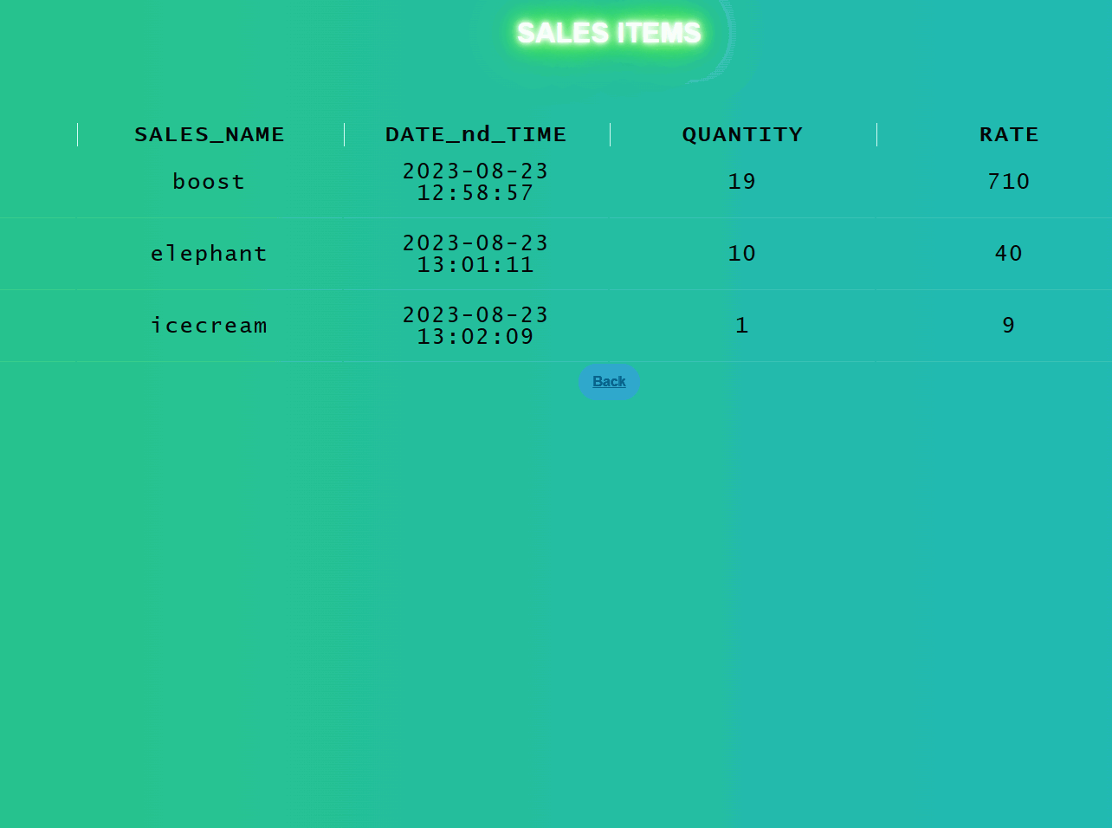
SALES HISTORY
WHICH ITEM YOU SELECT TO SALE CAN STORE THE SALES HISTORY

Slide 8
PURCHASE ITEMS IN ADD ITEMS
'ADD ITEMS' CLICK TO PURCHASE a EXTRA ITEMS

Slide 9
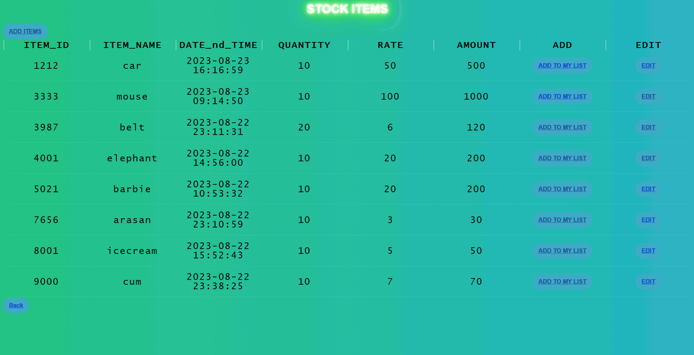
STOCK ITEMS
WHICH ITEM YOU CAN BUY TO CLICK 'ADD TO MY LIST'

Slide 10

UPDATE A PURCHASE ITEMS
BEFORE YOU CAN CLICK THE 'ADD TO MY LIST' TO STORE THE PURCHASE ITEMS

Slide 11
UPDATE SALES HISTORY
WHICH ITEM YOU SELECT TO SALE CAN STORE THE SALES HISTORY

Slide 12
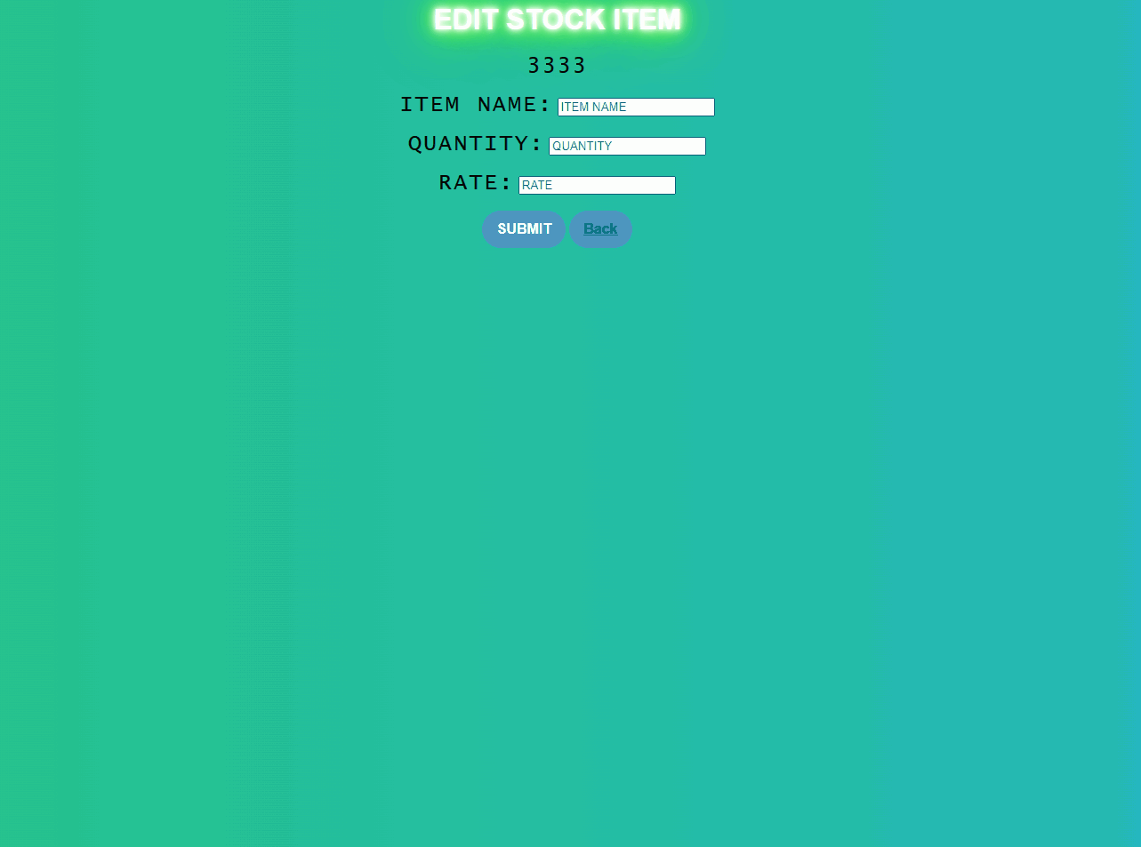
EDIT STOCK ITEMS
For choose an item to store a stock items

Slide 13
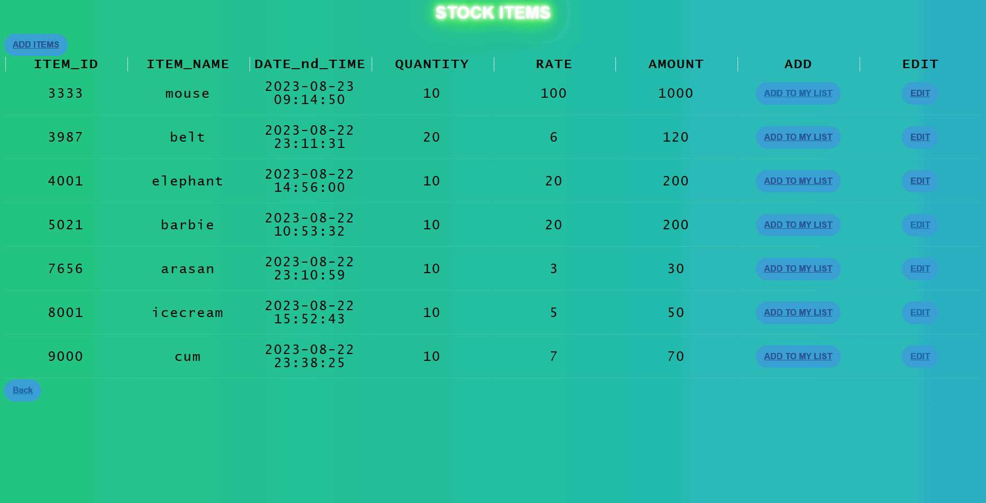
AFTER UPDATE STOCK ITEMS
After edit an item to store a stock items

Slide 14
NEXT PURCHASE HISTORY

Slide 15
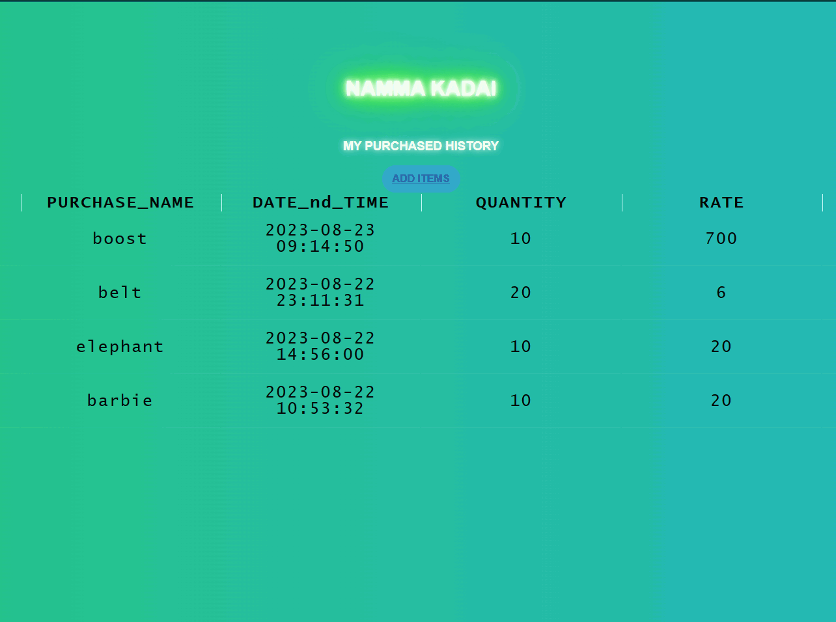
PURCHASE HISTORY
to click add items to purchase from stock items

Slide 16
SALES ITEMS PERFORM TO SHOWS SALES HISTORY
TO CLICK SALES ITEMS TO SHOW A SALES HISTORY

Slide 17
SALES HISTORY
ANY ONE ITEM CAN YOU SALE TO STORE A SALES ITEMS

