Slide 1
Capstone Project
Ajith R
Mobile Price Range Prediction

Slide 2
Data Summary
Dataset | data_mobile_price_range.csv
Data Description | In the competitive mobile phone market companies want to understand sales data of mobile phones and factors which drive the prices.
Problem Description | The objective is to find out some relation between features of a mobile phone(eg:- RAM,Internal Memory, etc) and its selling price. In this problem, we do not have to predict the actual price but a price range indicating how high the price is.
Shape | 2000 rows and 21 columns

Slide 3
Data Fields:
Battery_power - Total energy a battery can store in one time measured in mAh
Blue - Has bluetooth or not
Clock_speed - speed at which microprocessor executes instructions
Dual_sim - Has dual sim support or not
Fc - Front Camera mega pixels
Four_g - Has 4G or not
Int_memory - Internal Memory in Gigabytes
M_dep - Mobile Depth in cm
Mobile_wt - Weight of mobile phone
N_cores - Number of cores of processor
Pc - Primary Camera mega pixels
Px_height - Pixel Resolution Height
Px_width - Pixel Resolution Width
Ram - Random Access Memory in Mega Bytes
Sc_h - Screen Height of mobile in cm
Sc_w - Screen Width of mobile in cm
Talk_time - longest time that a single battery charge will last when you are
Three_g - Has 3G or not
Touch_screen - Has touch screen or not
Wifi - Has wifi or not
Price_range - This is the target variable with value of 0(low cost), 1(medium cost), 2(high cost) and 3(very high cost).

Slide 4

Data Preprocessing
Checking for null values and removing them.
Converting data types.
Removing outliers.
Checking whether column renaming is required.
Creating new columns if required.
Feature Selection
Train-Test Split

Slide 5
Univariate Analysis

Slide 6
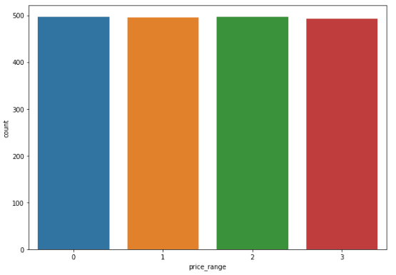
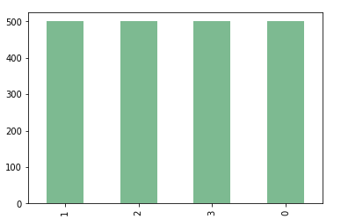
Dependent Variable - price_range

Slide 7
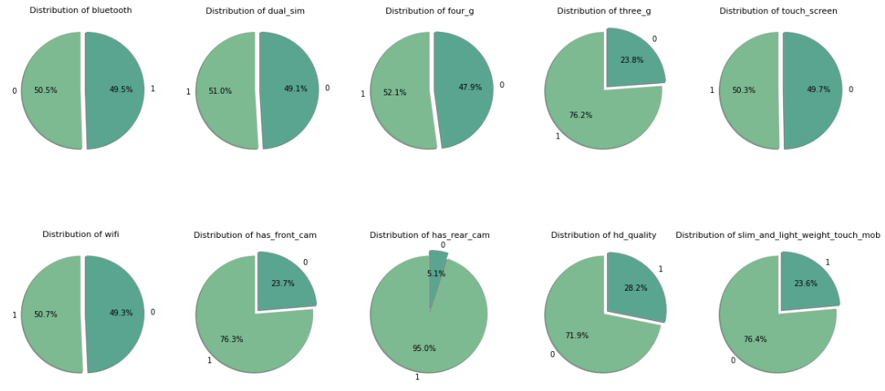
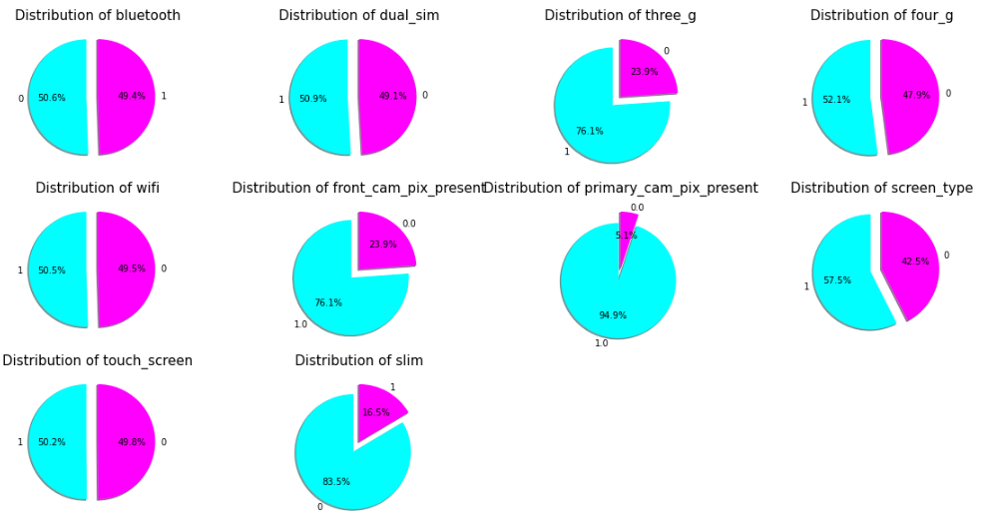
Features with binary values

Slide 8
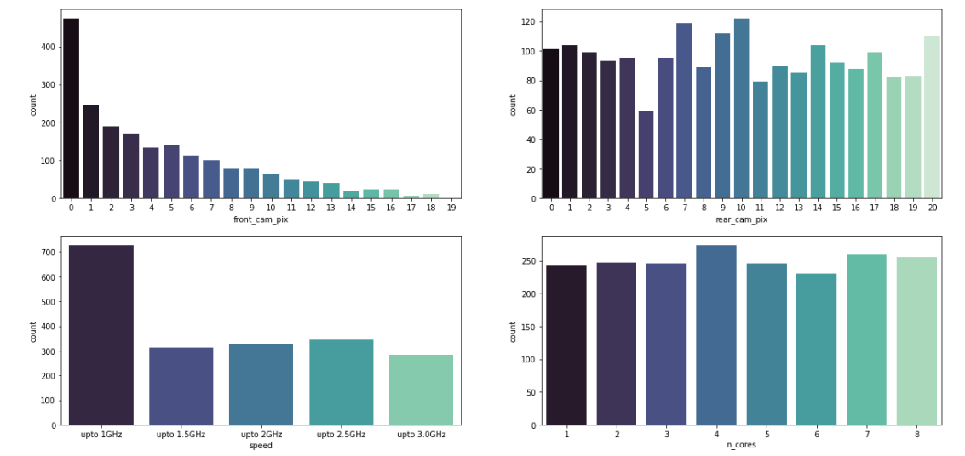
Distinct features analysis

Slide 9
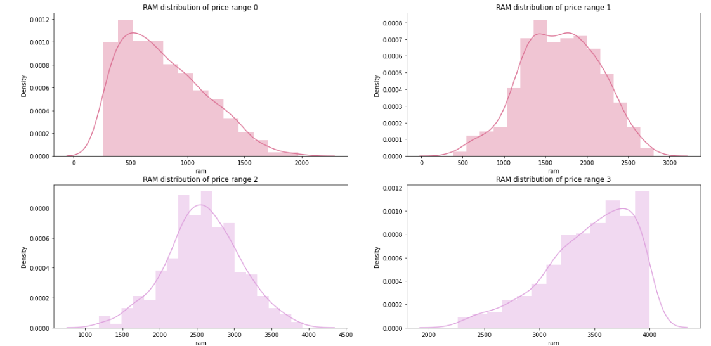
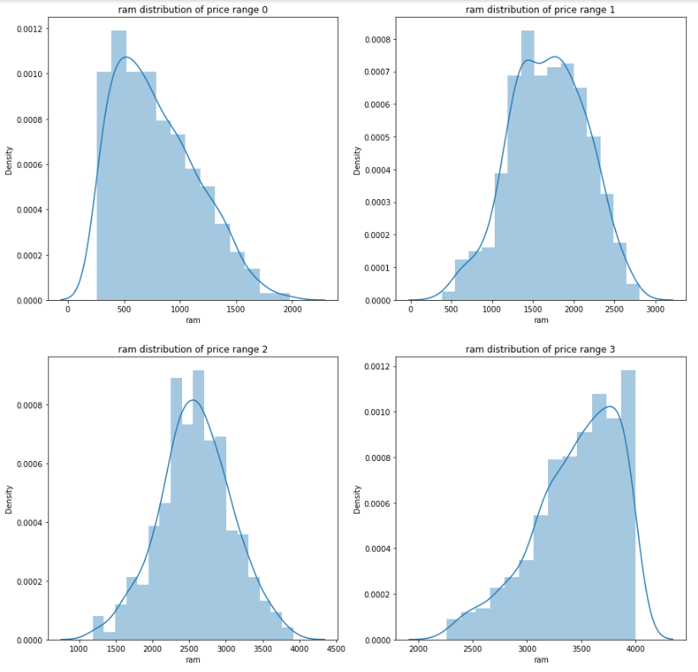
RAM Distribution based on price range

Slide 10
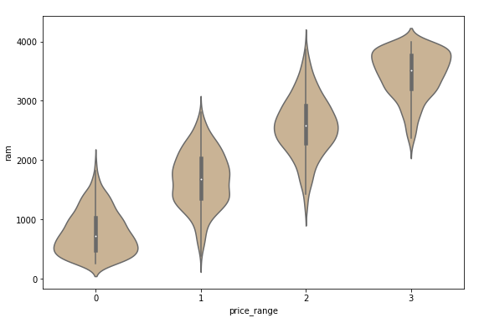
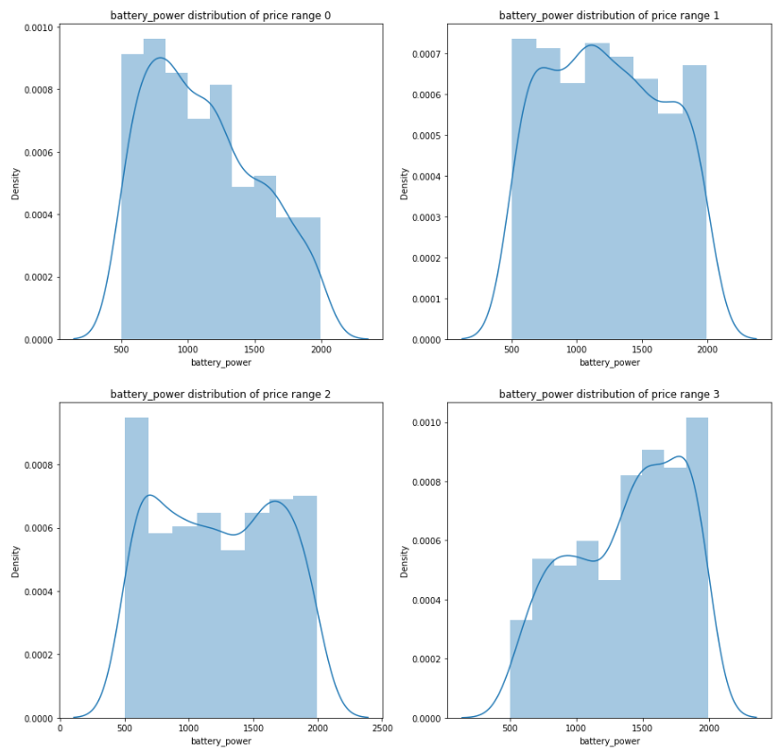
RAM Distribution based on price range

Slide 11
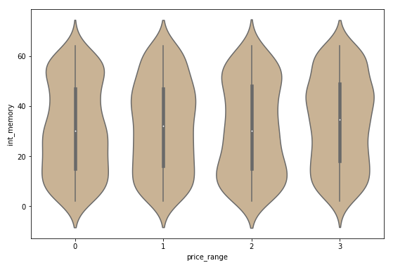
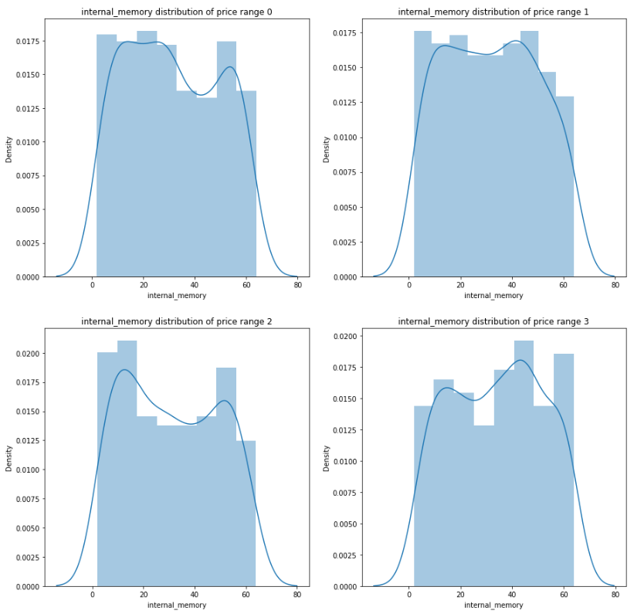
Internal Memory Distribution based on price range

Slide 12
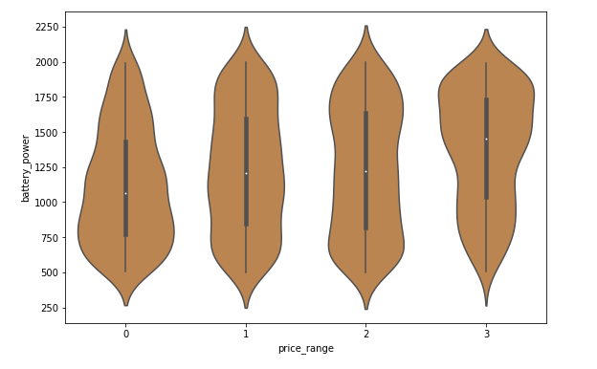
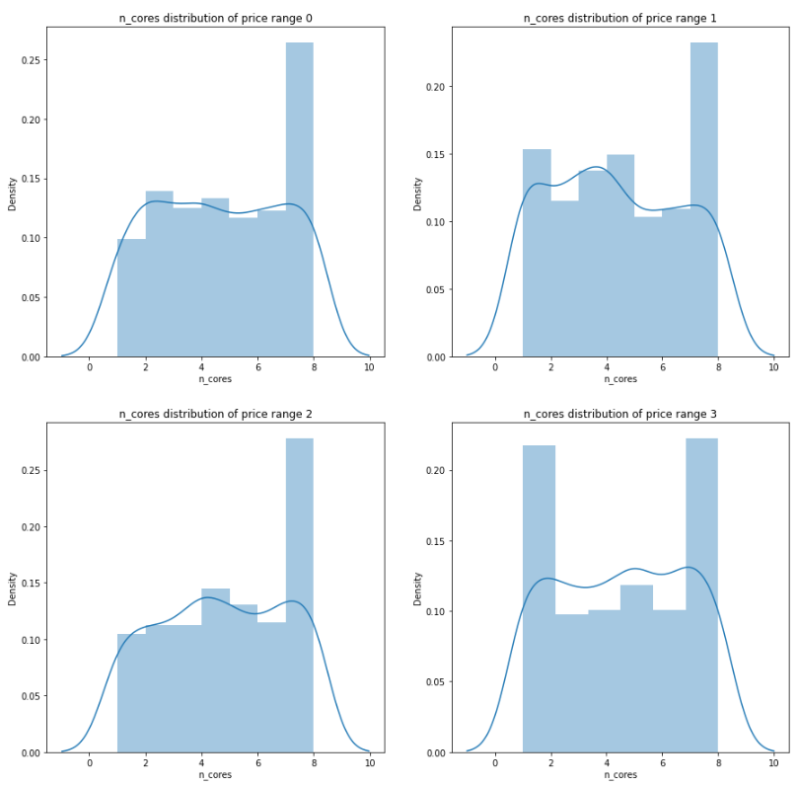
Battery Power Distribution based on price range

Slide 13
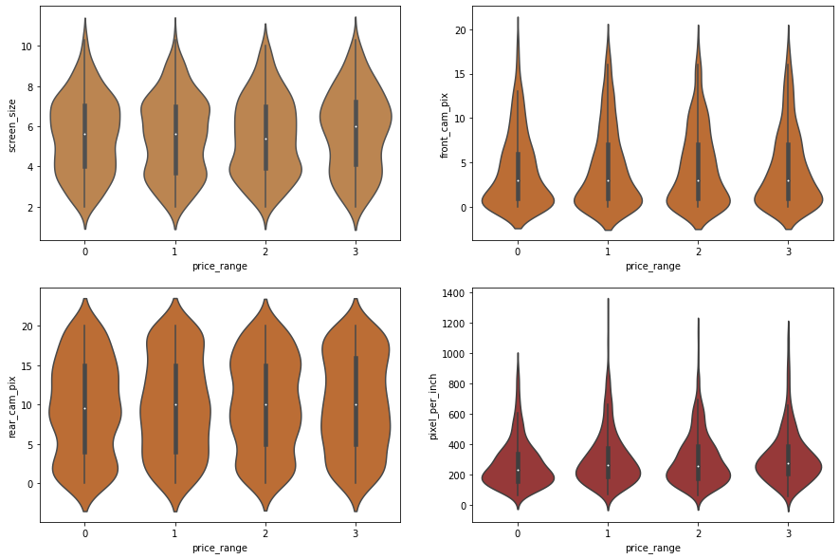

Slide 14
Multivariate Analysis

Slide 15
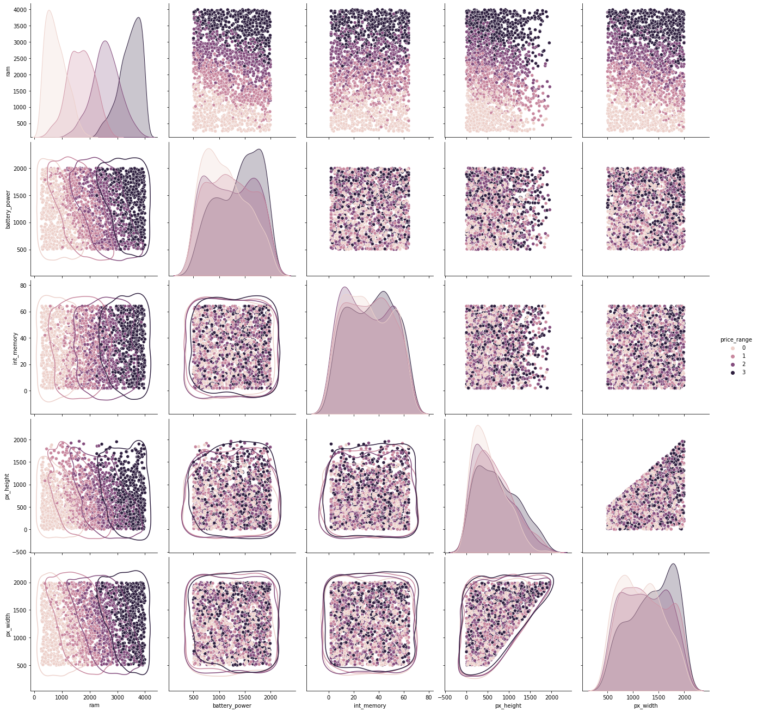

Slide 16
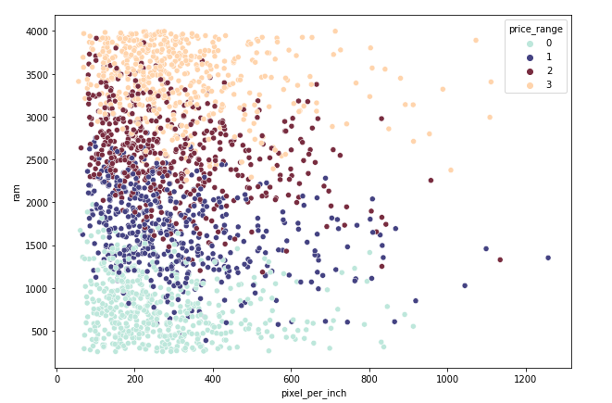
Pixel per Inch vs ram , price_range

Slide 17
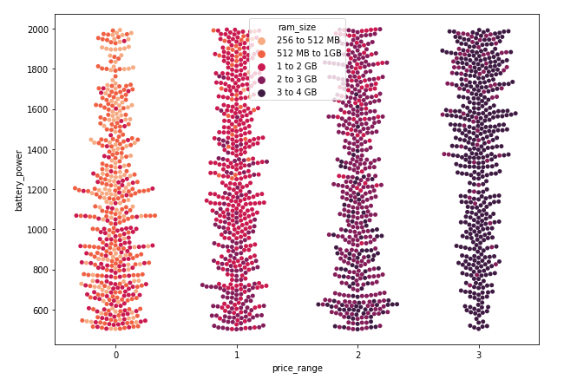
Price Range, Battery Power and RAM size

Slide 18
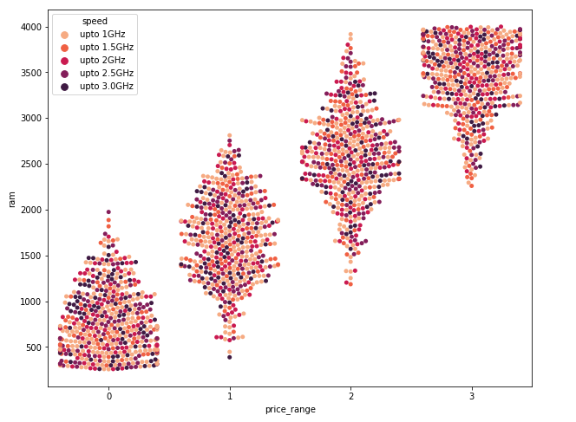
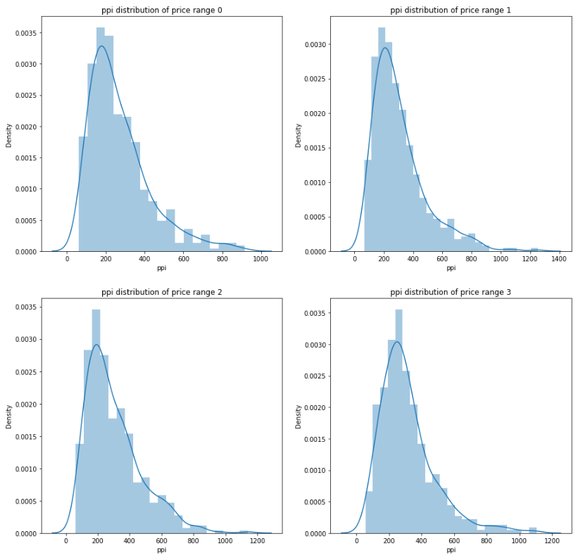
Ram , Clock speed and price range

Slide 19
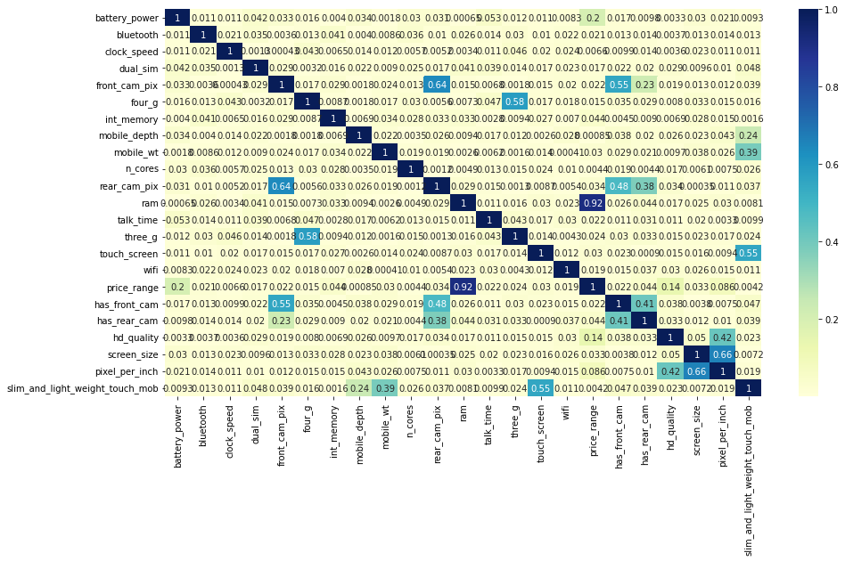
Correlation Analysis

Slide 20
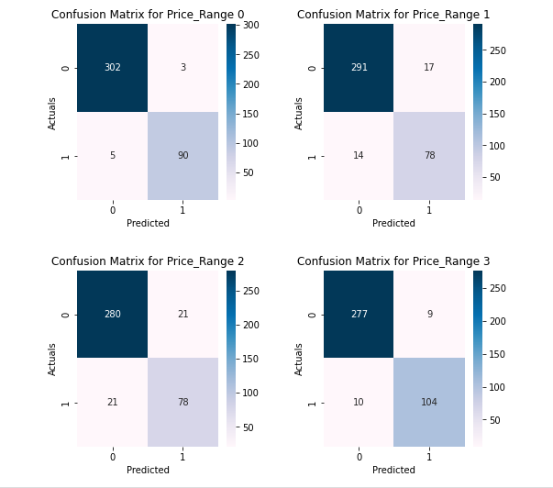
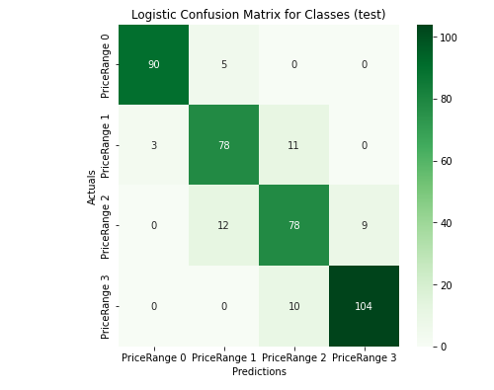
Logistic Regression

Slide 21
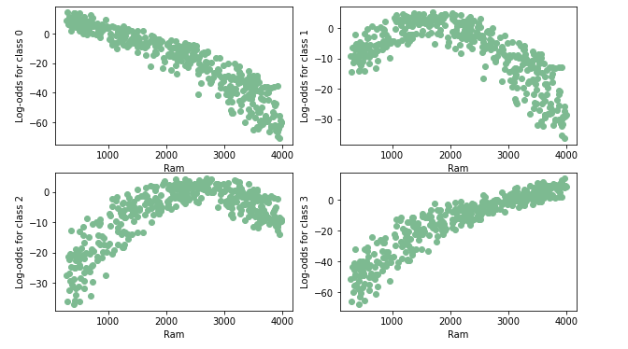
Logistic Regression Linearity assumption

Slide 22
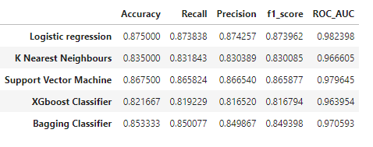
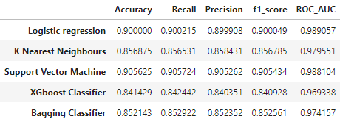

Slide 23
Challenges
Small dataset..
Cross validation computation time.

Slide 24
CONCLUSION
The quality of the phone increases with each price range.
Also many mobiles do not have smartphone features.
This is an old data, where 4G mobiles are in low numbers
Ram variable was 92% correlated with price range, higher the ram size higher the price range were, it was driving the price range
Out of all models Logistic Regression has done better predictions keeping accuracy as our main metric
To be more precise in our prediction we can only take most important columns for price predictions like 6-7 top correlated variables w.r.t Price range for better scores, since most of the features in our data weren't helping price range prediction

