Slide 1
Basic structures
conditionals and loops

Slide 2
If-then-else statement
needed if you want to make a decision
executes a section of code if a condition (test) evaluates to true
else - provides a secondary option of a particular statement execution

Slide 3
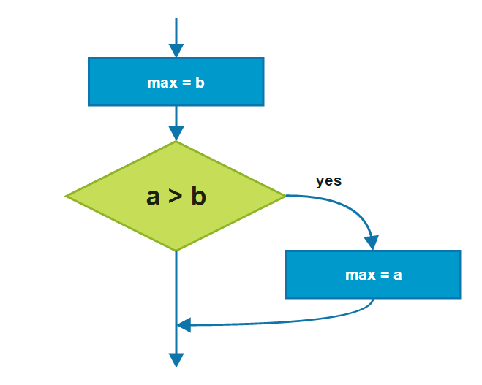
If-then flow chart

Slide 4
Code example
max = b; if (a > b) { max = a; }

Slide 5
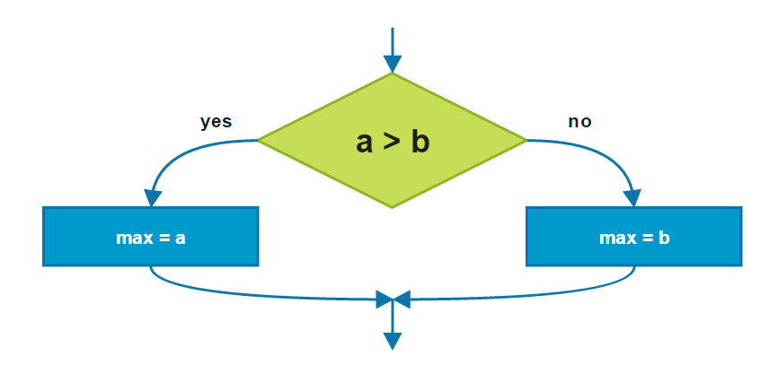
If-then-else flow chart

Slide 6
Code example
if (a > b) { max = a; } else { max = b; }

Slide 7
“? :” operator
max = (a > b) ? a : b;

Slide 8
Relational operators
Relational operator | Meaning
== | equal to
!= | not equal to
> | greater than
>= | greater than or equal to
< | less than
<= | less than or equal to

Slide 9
Conditional and bitwise operators
Operator | Meaning
& | bitwise AND operation
| | bitwise OR operation
>>, <<, >>> | bit shifts
&& | conditional AND
|| | conditional OR

Slide 10
Conditional-AND (&&)
First operand | Second operand | Result (operand1 && operand2)
true | true | true
true | false | false
false | true | false
false | false | false

Slide 11
Conditional-OR (||)
First operand | Second operand | Result (operand1 || operand2)
true | true | true
true | false | true
false | true | true
false | false | false

Slide 12
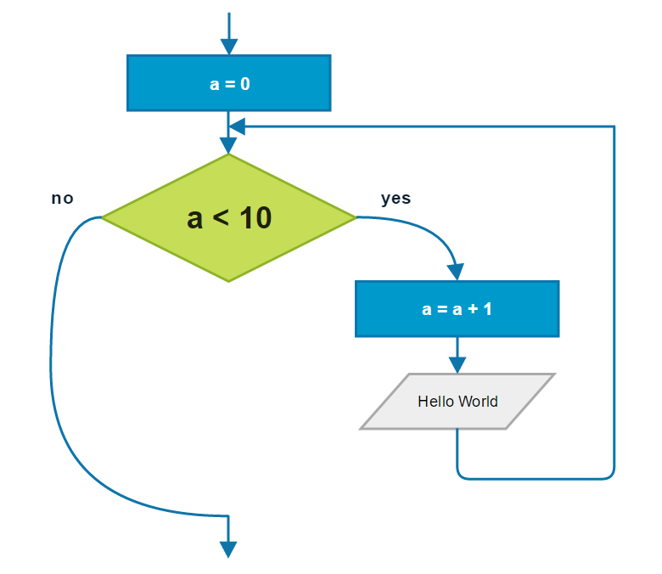
While loop

Slide 13
Code example
a = 0; while (a < 10) { a++; System.out.println("Hello World"); }

Slide 14
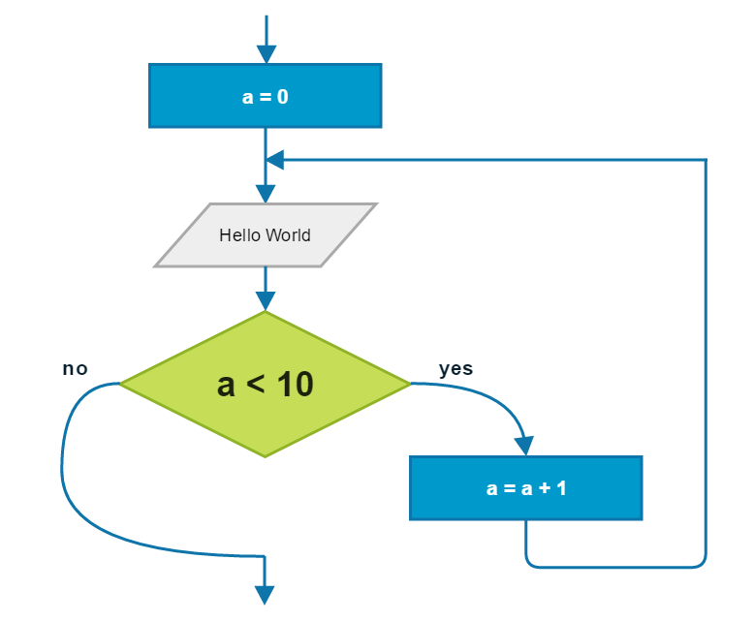
Do-While loop

Slide 15
Code example
a = 0; do { System.out.println("Hello World"); a++; } while (a < 10);

