Slide 1
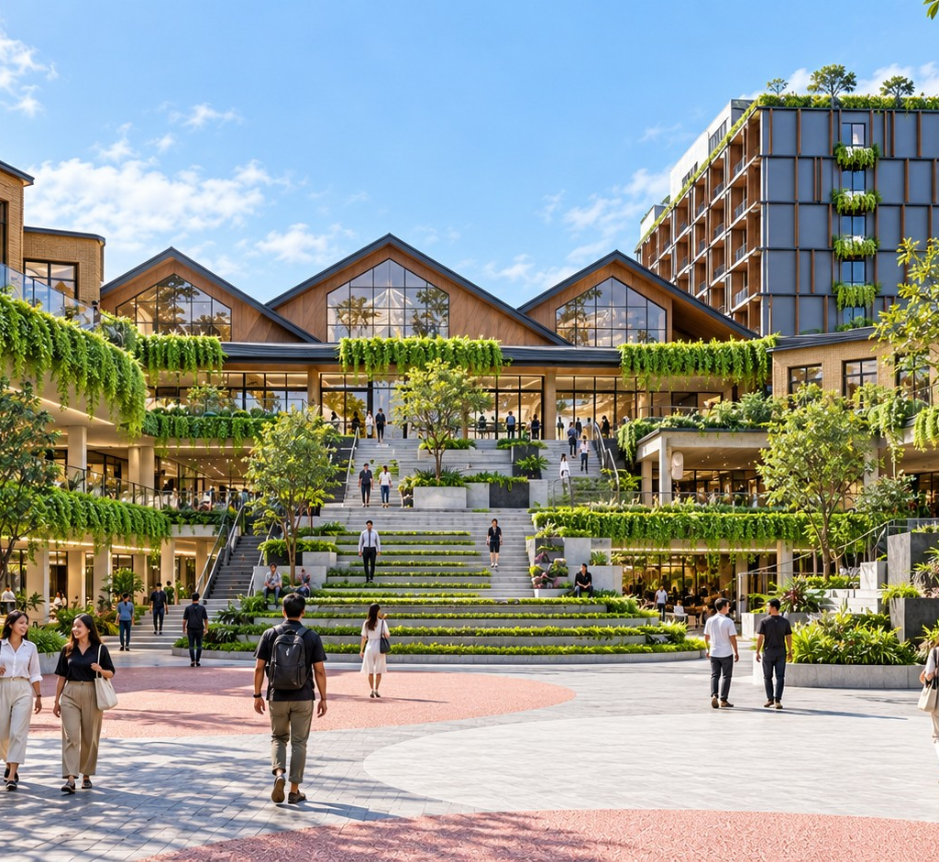
KALINDO / THE COMPLETE BRIEF
DESTINATION & MARKET
KALINDO PROJECT
K
／
A NEW ADDRESS FOR LIFE IN BATAM
DESTINATION & MARKET
SOURCE: KALINDO PROJECT (1).PDF / 01
Notes:
Slide 1: A NEW ADDRESS FOR LIFE IN BATAM
EDITABLE VERSION: all text, photos, tables and backgrounds are native PowerPoint objects. Click to edit, replace or delete them.
KALINDO PROJECT
A NEW ADDRESS FOR LIFE IN BATAM
The source wording is retained. Only PDF line wraps, zero-width characters and bullet styling are normalised. Supplied concept imagery is not verified as built. Market evidence is reproduced from the supplied brief, not independently re-researched.

Slide 2
KALINDO / THE COMPLETE BRIEF
DESTINATION & MARKET
MARKET RESEARCH BASIS
THE MARKET THROUGH SIX DESTINATIONS
The review examines how competing destinations attract visitors, support repeat visits and extend time spent.
Common assessment framework
Evidence labels
Development maturity and positioning.
Verified public information
Traffic generators and access.
Official directories, operator publications and documented activities.
Anchor tenants and category mix.
Strategic interpretation
Our assessment of the commercial mechanism.
Everyday utility and leisure experiences.
Validation required
Programming and community participation.
Actual footfall, occupancy, rent, tenant sales and retention.
Occupancy evidence and operational continuity.
01
02
03
Implications for Kalindo.
Pollux
Nagoya Hill
Grand Batam
04
05
06
Mega Mall
K Square
One Batam
BRIEF NOTES · PRESERVED VERBATIM
Visual: Enam competitor cards. Footer mencantumkan tanggal riset dan sumber.
DESTINATION & MARKET
SOURCE: SUPPLIED BRIEF · RESEARCH DATE NOT SPECIFIED / 02
Notes:
Slide 2: THE MARKET THROUGH SIX DESTINATIONS
EDITABLE VERSION: all text, photos, tables and backgrounds are native PowerPoint objects. Click to edit, replace or delete them.
THE MARKET THROUGH SIX DESTINATIONS
The review examines how competing destinations attract visitors, support repeat visits and
extend time spent.
Common assessment framework
● Development maturity and positioning.
● Traffic generators and access.
● Anchor tenants and category mix.
● Everyday utility and leisure experiences.
● Programming and community participation.
● Occupancy evidence and operational continuity.
● Implications for Kalindo.
Evidence labels
Verified public information
Official directories, operator publications and documented activities.
Strategic interpretation
Our assessment of the commercial mechanism.
Validation required
Actual footfall, occupancy, rent, tenant sales and retention.
Visual: Enam competitor cards. Footer mencantumkan tanggal riset dan sumber.
The source wording is retained. Only PDF line wraps, zero-width characters and bullet styling are normalised. Supplied concept imagery is not verified as built. Market evidence is reproduced from the supplied brief, not independently re-researched.

Slide 3
KALINDO / THE COMPLETE BRIEF
DESTINATION & MARKET
POLLUX MALL BATAM CENTER
FUNCTIONAL VISITS SUPPORT EVERYDAY RELEVANCE
Public evidence
Implication for Kalindo Project
The official store list includes MAKO, J.CO, fashion brands, optical retailers and electronics. Immigration Batam also confirms passport and stay-permit services at the Pollux Immigration Lounge.
Useful services should contribute to the district’s weekday relevance.
Further validation
Source : https://polluxmalls.com/polluxhabibiemall-store-list/?utm_source=
Service-user conversion into tenant spending, weekday footfall and current vacancy.
Commercial interpretation
Services create a specific reason to visit.
POLLUX MALL BATAM CENTER
01
Useful services
Everyday F&B and retail can capture spending around that visit.
The mixed-use setting offers a potential local customer base.
02
Everyday F&B and retail
BRIEF NOTES · PRESERVED VERBATIM
Visual: Diagram sederhana hubungan service visit dengan café/retail. Jangan mengasumsikan captive residents otomatis menjadi pelanggan aktif.
DESTINATION & MARKET
SOURCE: SUPPLIED BRIEF · RESEARCH DATE NOT SPECIFIED / 03
Notes:
Slide 3: FUNCTIONAL VISITS SUPPORT EVERYDAY RELEVANCE
EDITABLE VERSION: all text, photos, tables and backgrounds are native PowerPoint objects. Click to edit, replace or delete them.
FUNCTIONAL VISITS SUPPORT EVERYDAY RELEVANCE
Public evidence
The official store list includes MAKO, J.CO, fashion brands, optical retailers and electronics.
Immigration Batam also confirms passport and stay-permit services at the Pollux
Immigration Lounge.
Source : https://polluxmalls.com/polluxhabibiemall-store-list/?utm_source=
Commercial interpretation
● Services create a specific reason to visit.
● Everyday F&B and retail can capture spending around that visit.
● The mixed-use setting offers a potential local customer base.
Implication for Kalindo Project
Useful services should contribute to the district’s weekday relevance.
Further validation
Service-user conversion into tenant spending, weekday footfall and current vacancy.
Visual: Diagram sederhana hubungan service visit dengan café/retail. Jangan
mengasumsikan captive residents otomatis menjadi pelanggan aktif.
The source wording is retained. Only PDF line wraps, zero-width characters and bullet styling are normalised. Supplied concept imagery is not verified as built. Market evidence is reproduced from the supplied brief, not independently re-researched.

Slide 4
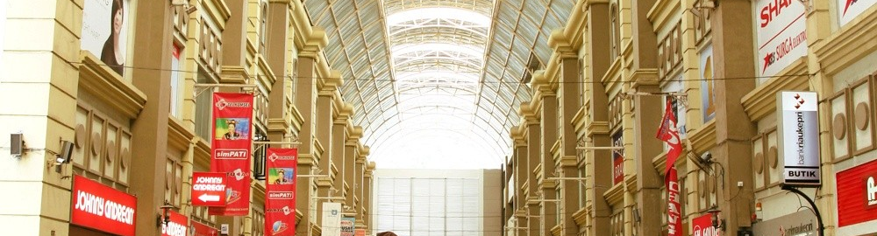
KALINDO / THE COMPLETE BRIEF
DESTINATION & MARKET
NAGOYA HILL
A BROAD MIX SUPPORTS MULTIPLE VISIT MISSIONS
Public evidence
Implication for Kalindo Project
Nagoya Hill’s official website displays Hypermart, Matahari, cinema, F&B, electronics, optical and service brands. Its official description places the superblock within a surrounding concentration of hotels and commercial uses.
Build several dependable reasons to return, supported by distinctive experiences.
Further validation
Comparable occupancy, tenant turnover, visitor origin and daypart performance.
Source : https://nagoyahill.co.id/?utm_source=
Commercial interpretation
Grocery supports routine visits.
Shopping and entertainment create additional occasions.
Dining and services allow several needs within one trip.
Surrounding hospitality broadens the potential catchment.
SUPPLIED CITY REFERENCE · NAGOYA HILL
BRIEF NOTES · PRESERVED VERBATIM
Visual: Visit missions: groceries, dining, services, entertainment.
DESTINATION & MARKET
SOURCE: SUPPLIED BRIEF · RESEARCH DATE NOT SPECIFIED / 04
Notes:
Slide 4: A BROAD MIX SUPPORTS MULTIPLE VISIT MISSIONS
EDITABLE VERSION: all text, photos, tables and backgrounds are native PowerPoint objects. Click to edit, replace or delete them.
A BROAD MIX SUPPORTS MULTIPLE VISIT MISSIONS
Public evidence
Nagoya Hill’s official website displays Hypermart, Matahari, cinema, F&B, electronics, optical
and service brands. Its official description places the superblock within a surrounding
concentration of hotels and commercial uses.
Source : https://nagoyahill.co.id/?utm_source=
Commercial interpretation
● Grocery supports routine visits.
● Shopping and entertainment create additional occasions.
● Dining and services allow several needs within one trip.
● Surrounding hospitality broadens the potential catchment.
Implication for Kalindo Project
Build several dependable reasons to return, supported by distinctive experiences.
Further validation
Comparable occupancy, tenant turnover, visitor origin and daypart performance.
Visual: Visit missions: groceries, dining, services, entertainment.
The source wording is retained. Only PDF line wraps, zero-width characters and bullet styling are normalised. Supplied concept imagery is not verified as built. Market evidence is reproduced from the supplied brief, not independently re-researched.

Slide 5
KALINDO / THE COMPLETE BRIEF
DESTINATION & MARKET
GRAND BATAM
CATEGORY BREADTH AND BRAND DISCOVERY
Public evidence
Implication for Kalindo Project
Grand Batam’s official directory covers anchors, F&B, fashion, beauty, electronics, home living, kids and services. The current directory highlights brands including Sociolla, Huawei, Smiggle, Skechers and Yakiniku Like. Grand Batam Mall
Select anchors that fit the intended customer and support neighbouring experiences.
Further validation
Current anchor roster, category area shares, repeat visits and tenant performance.
Commercial interpretation
Recognisable brands support customer consideration.
Multiple categories enable shopping and leisure within one visit.
GRAND BATAM
Promotions and changing tenant content provide additional discovery.
01
Recognisable brands
02
Multiple categories
03
Promotions
BRIEF NOTES · PRESERVED VERBATIM
Visual: Category ecosystem.
DESTINATION & MARKET
SOURCE: SUPPLIED BRIEF · RESEARCH DATE NOT SPECIFIED / 05
Notes:
Slide 5: CATEGORY BREADTH AND BRAND DISCOVERY
EDITABLE VERSION: all text, photos, tables and backgrounds are native PowerPoint objects. Click to edit, replace or delete them.
CATEGORY BREADTH AND BRAND DISCOVERY
Public evidence
Grand Batam’s official directory covers anchors, F&B, fashion, beauty, electronics, home
living, kids and services. The current directory highlights brands including Sociolla, Huawei,
Smiggle, Skechers and Yakiniku Like. Grand Batam Mall
Commercial interpretation
● Recognisable brands support customer consideration.
● Multiple categories enable shopping and leisure within one visit.
● Promotions and changing tenant content provide additional discovery.
Implication for Kalindo Project
Select anchors that fit the intended customer and support neighbouring experiences.
Further validation
Current anchor roster, category area shares, repeat visits and tenant performance.
Visual: Category ecosystem.
The source wording is retained. Only PDF line wraps, zero-width characters and bullet styling are normalised. Supplied concept imagery is not verified as built. Market evidence is reproduced from the supplied brief, not independently re-researched.

Slide 6
KALINDO / THE COMPLETE BRIEF
DESTINATION & MARKET
MEGA MALL BATAM CENTRE
ACCESS CREATES A COMMERCIAL ADVANTAGE
Public evidence
Implication for Kalindo Project
Mega Mall confirms a bridge connection to Batam Centre International Ferry Terminal. Its website also publishes an October 2026 event calendar and culinary/community programmes.
Regional demand requires a practical route to the destination: transport, booking and partner distribution.
Further validation
Source : https://www.megamallbatam.com/?utm_source=
Ferry-passenger conversion, visitor origin, transfer friction and package demand.
Commercial interpretation
Convenient access can capture visitors already moving through the area.
MEGA MALL BATAM CENTRE
01
Convenient access
Retail and dining provide useful activities around travel.
Programming gives visitors additional reasons to spend time.
02
Retail and dining
03
Programming
BRIEF NOTES · PRESERVED VERBATIM
Visual: Ferry arrival, transfer, destination visit.
DESTINATION & MARKET
SOURCE: SUPPLIED BRIEF · RESEARCH DATE NOT SPECIFIED / 06
Notes:
Slide 6: ACCESS CREATES A COMMERCIAL ADVANTAGE
EDITABLE VERSION: all text, photos, tables and backgrounds are native PowerPoint objects. Click to edit, replace or delete them.
ACCESS CREATES A COMMERCIAL ADVANTAGE
Public evidence
Mega Mall confirms a bridge connection to Batam Centre International Ferry Terminal. Its
website also publishes an October 2026 event calendar and culinary/community
programmes.
Source : https://www.megamallbatam.com/?utm_source=
Commercial interpretation
● Convenient access can capture visitors already moving through the area.
● Retail and dining provide useful activities around travel.
● Programming gives visitors additional reasons to spend time.
Implication for Kalindo Project
Regional demand requires a practical route to the destination: transport, booking and partner
distribution.
Further validation
Ferry-passenger conversion, visitor origin, transfer friction and package demand.
Visual: Ferry arrival, transfer, destination visit.
The source wording is retained. Only PDF line wraps, zero-width characters and bullet styling are normalised. Supplied concept imagery is not verified as built. Market evidence is reproduced from the supplied brief, not independently re-researched.

Slide 7
KALINDO / THE COMPLETE BRIEF
DESTINATION & MARKET
K SQUARE
PROGRAMMING ADDS REASONS TO VISIT
Public evidence
Implication for Kalindo Project
Disbudpar Batam documents the Wonderfood event at K Square on 9–17 April 2026, involving 40 businesses with culinary and entertainment activities. It also records a February 2026 film premiere at Cinépolis K Square.
The Veranda needs a funded programme and operating team from the outset.
Further validation
Event-day uplift, ordinary-day traffic, net event contribution and current permanent tenant mix.
Source : https://disbudpar.batam.go.id/2026/04/28/bazar-kuliner-dan-hiburan-wonderfood-ramaikan-k-square-mall-batam/?utm_source=
Commercial interpretation
K SQUARE
Events introduce changing content.
01
Events
Culinary and entertainment can attract different audiences.
Culinary and entertainment
Successful activation needs conversion into surrounding tenant activity.
02
03
Surrounding tenant activity
BRIEF NOTES · PRESERVED VERBATIM
Visual: Permanent tenant activity dibandingkan dengan event-day activation.
Catatan: Kehadiran event membuktikan kegiatan berlangsung; belum membuktikan uplift atau profitabilitas.
DESTINATION & MARKET
SOURCE: SUPPLIED BRIEF · RESEARCH DATE NOT SPECIFIED / 07
Notes:
Slide 7: PROGRAMMING ADDS REASONS TO VISIT
EDITABLE VERSION: all text, photos, tables and backgrounds are native PowerPoint objects. Click to edit, replace or delete them.
PROGRAMMING ADDS REASONS TO VISIT
Public evidence
Disbudpar Batam documents the Wonderfood event at K Square on 9–17 April 2026,
involving 40 businesses with culinary and entertainment activities. It also records a February
2026 film premiere at Cinépolis K Square.
Source :
https://disbudpar.batam.go.id/2026/04/28/bazar-kuliner-dan-hiburan-wonderfood-ram
aikan-k-square-mall-batam/?utm_source=
Commercial interpretation
● Events introduce changing content.
● Culinary and entertainment can attract different audiences.
● Successful activation needs conversion into surrounding tenant activity.
Implication for Kalindo Project
The Veranda needs a funded programme and operating team from the outset.
Further validation
Event-day uplift, ordinary-day traffic, net event contribution and current permanent tenant
mix.
Visual: Permanent tenant activity dibandingkan dengan event-day activation.
Catatan: Kehadiran event membuktikan kegiatan berlangsung; belum membuktikan uplift
atau profitabilitas.
The source wording is retained. Only PDF line wraps, zero-width characters and bullet styling are normalised. Supplied concept imagery is not verified as built. Market evidence is reproduced from the supplied brief, not independently re-researched.

Slide 8
KALINDO / THE COMPLETE BRIEF
DESTINATION & MARKET
ONE BATAM MALL
COMMUNITIES CREATE RECURRING OCCASIONS
Public evidence
Implication for Kalindo Project
Gattchaa’s own channels identify its One Batam Mall location. Official Pokémon event listings also document activities at that venue.
Seek tenants that bring customers and a repeatable activity calendar.
Source : https://linktr.ee/gattchaa?utm_source=
Further validation
Participation frequency, spending conversion, current mall mix and occupancy.
Commercial interpretation
Specialist tenants can host recurring participation.
A customer may return because an activity or community meets there.
ONE BATAM MALL
Community activity can support visits beyond product purchases.
01
Specialist tenants
02
Activity or community
03
Return occasion
BRIEF NOTES · PRESERVED VERBATIM
Visual: Community participation, café visit, return occasion.
Catatan: Konsep awal alfresco/marketplace merupakan historical positioning. Jangan menganggap semua ambisi awal sudah berjalan penuh.
DESTINATION & MARKET
SOURCE: SUPPLIED BRIEF · RESEARCH DATE NOT SPECIFIED / 08
Notes:
Slide 8: COMMUNITIES CREATE RECURRING OCCASIONS
EDITABLE VERSION: all text, photos, tables and backgrounds are native PowerPoint objects. Click to edit, replace or delete them.
COMMUNITIES CREATE RECURRING OCCASIONS
Public evidence
Gattchaa’s own channels identify its One Batam Mall location. Official Pokémon event
listings also document activities at that venue.
Source : https://linktr.ee/gattchaa?utm_source=
Commercial interpretation
● Specialist tenants can host recurring participation.
● A customer may return because an activity or community meets there.
● Community activity can support visits beyond product purchases.
Implication for Kalindo Project
Seek tenants that bring customers and a repeatable activity calendar.
Further validation
Participation frequency, spending conversion, current mall mix and occupancy.
Visual: Community participation, café visit, return occasion.
Catatan: Konsep awal alfresco/marketplace merupakan historical positioning. Jangan
menganggap semua ambisi awal sudah berjalan penuh.
The source wording is retained. Only PDF line wraps, zero-width characters and bullet styling are normalised. Supplied concept imagery is not verified as built. Market evidence is reproduced from the supplied brief, not independently re-researched.

Slide 9
KALINDO / THE COMPLETE BRIEF
DESTINATION & MARKET
COMPETITIVE LESSONS
SIX COMMERCIAL MECHANISMS TO LEARN FROM
Strategic interpretation
based on the preceding evidence.
Competitor
Mechanism to study
Application for Kalindo
Pollux
Useful services and everyday visits
Functional tenants that support local routines
Nagoya Hill
Several visit missions
A balanced mix of necessity and leisure
Grand Batam
Brand discovery and category breadth
Selective anchors with customer relevance
Mega Mall
Convenient tourism access
Transport and distribution partnerships
K Square
Changing event content
A managed calendar for The Veranda
One Batam
Specialist community participation
Tenants with recurring activities
DESTINATION & MARKET
SOURCE: KALINDO PROJECT (1).PDF / 09
Notes:
Slide 9: SIX COMMERCIAL MECHANISMS TO LEARN FROM
EDITABLE VERSION: all text, photos, tables and backgrounds are native PowerPoint objects. Click to edit, replace or delete them.
SIX COMMERCIAL MECHANISMS TO LEARN FROM
Strategic interpretation based on the preceding evidence.
Competitor Mechanism to study Application for Kalindo
Pollux Useful services and everyday Functional tenants that support local
visits routines
Nagoya Hill Several visit missions A balanced mix of necessity and leisure
Grand Brand discovery and category Selective anchors with customer
Batam breadth relevance
Mega Mall Convenient tourism access Transport and distribution partnerships
K Square Changing event content A managed calendar for The Veranda
One Batam Specialist community Tenants with recurring activities
participation
The source wording is retained. Only PDF line wraps, zero-width characters and bullet styling are normalised. Supplied concept imagery is not verified as built. Market evidence is reproduced from the supplied brief, not independently re-researched.

Slide 10
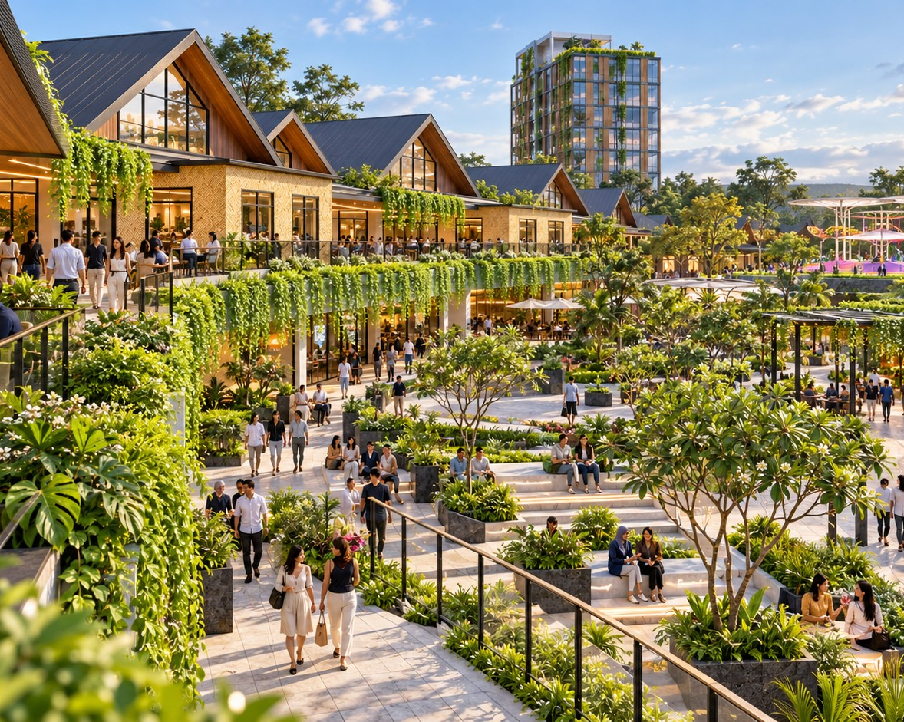
KALINDO / THE COMPLETE BRIEF
DESTINATION & MARKET
KALINDO’S COMPETITIVE OPPORTUNITY
A CONNECTED DAY IN BATAM
Kalindo can bring everyday utility, culinary discovery, family participation and hospitality together around a recognisable public heart.
The opportunity lies in making movement between these activities comfortable and worthwhile.
The proposed advantage
Useful enough for regular local visits.
Distinctive enough for culinary and leisure discovery.
Comfortable enough to extend time spent.
Organised enough to support events and regional packages.
SUPPLIED CONCEPT VISUAL · APPROVAL STATUS UNVERIFIED
BRIEF NOTES · PRESERVED VERBATIM
Visual: Visitor journeys yang bertemu di The Veranda.
DESTINATION & MARKET
SOURCE: KALINDO PROJECT (1).PDF / 10
Notes:
Slide 10: A CONNECTED DAY IN BATAM
EDITABLE VERSION: all text, photos, tables and backgrounds are native PowerPoint objects. Click to edit, replace or delete them.
A CONNECTED DAY IN BATAM
Kalindo can bring everyday utility, culinary discovery, family participation and hospitality
together around a recognisable public heart.
The opportunity lies in making movement between these activities comfortable and
worthwhile.
The proposed advantage
● Useful enough for regular local visits.
● Distinctive enough for culinary and leisure discovery.
● Comfortable enough to extend time spent.
● Organised enough to support events and regional packages.
Visual: Visitor journeys yang bertemu di The Veranda.
The source wording is retained. Only PDF line wraps, zero-width characters and bullet styling are normalised. Supplied concept imagery is not verified as built. Market evidence is reproduced from the supplied brief, not independently re-researched.

Slide 11
KALINDO / THE COMPLETE BRIEF
DESTINATION & MARKET
REMAINING MARKET VALIDATION
PUBLIC RESEARCH ESTABLISHES THE DIRECTION. FIELDWORK TESTS THE ECONOMICS.
Question
Required evidence
Which periods need stronger demand?
Comparable weekday/weekend observations
Which categories remain underserved?
Customer interviews and operator feedback
Which tenants can perform here?
Catchment assessment and sounding
What rents are achievable?
Comparable terms and operator responses
Which regional offers are bookable?
Travel/hotel partner discussions
What sustains occupancy?
Vacancy, turnover and lease-renewal evidence
DESTINATION & MARKET
SOURCE: KALINDO PROJECT (1).PDF / 11
Notes:
Slide 11: PUBLIC RESEARCH ESTABLISHES THE DIRECTION. FIELDWORK TESTS THE ECONOMICS.
EDITABLE VERSION: all text, photos, tables and backgrounds are native PowerPoint objects. Click to edit, replace or delete them.
PUBLIC RESEARCH ESTABLISHES THE DIRECTION.
FIELDWORK TESTS THE ECONOMICS.
Question Required evidence
Which periods need stronger Comparable weekday/weekend observations
demand?
Which categories remain Customer interviews and operator feedback
underserved?
Which tenants can perform here? Catchment assessment and sounding
What rents are achievable? Comparable terms and operator responses
Which regional offers are bookable? Travel/hotel partner discussions
What sustains occupancy? Vacancy, turnover and lease-renewal
evidence
The source wording is retained. Only PDF line wraps, zero-width characters and bullet styling are normalised. Supplied concept imagery is not verified as built. Market evidence is reproduced from the supplied brief, not independently re-researched.

Slide 12
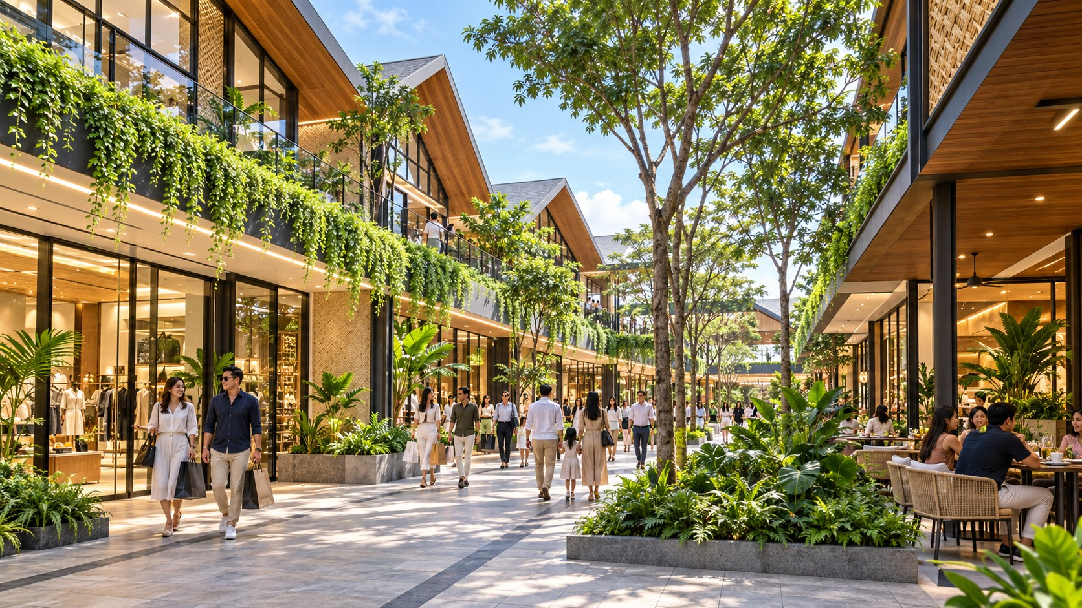
KALINDO / THE COMPLETE BRIEF
POSITIONING & TENANT STRATEGY
BRAND POSITIONING
BATAM’S TROPICAL LIFESTYLE DISTRICT
For Batam residents and regional leisure visitors, this place brings everyday essentials, culinary discovery, family experiences and hospitality into a comfortable, walkable setting centred on The Veranda.
Working market position
Middle-to-upper lifestyle with welcoming service and a considered range of prices.
Brand promise
More to discover. More reasons to stay.
BRIEF NOTES · PRESERVED VERBATIM
SUPPLIED CONCEPT VISUAL · APPROVAL STATUS UNVERIFIED
Catatan: Bobot sport, wellness, grocery dan entertainment tetap mengikuti hasil sounding.
POSITIONING & TENANT STRATEGY
SOURCE: KALINDO PROJECT (1).PDF / 12
Notes:
Slide 12: BATAM’S TROPICAL LIFESTYLE DISTRICT
EDITABLE VERSION: all text, photos, tables and backgrounds are native PowerPoint objects. Click to edit, replace or delete them.
BATAM’S TROPICAL LIFESTYLE DISTRICT
For Batam residents and regional leisure visitors, this place brings everyday essentials,
culinary discovery, family experiences and hospitality into a comfortable, walkable setting
centred on The Veranda.
Working market position
Middle-to-upper lifestyle with welcoming service and a considered range of prices.
Brand promise
More to discover. More reasons to stay.
Catatan: Bobot sport, wellness, grocery dan entertainment tetap mengikuti hasil sounding.
The source wording is retained. Only PDF line wraps, zero-width characters and bullet styling are normalised. Supplied concept imagery is not verified as built. Market evidence is reproduced from the supplied brief, not independently re-researched.

Slide 13
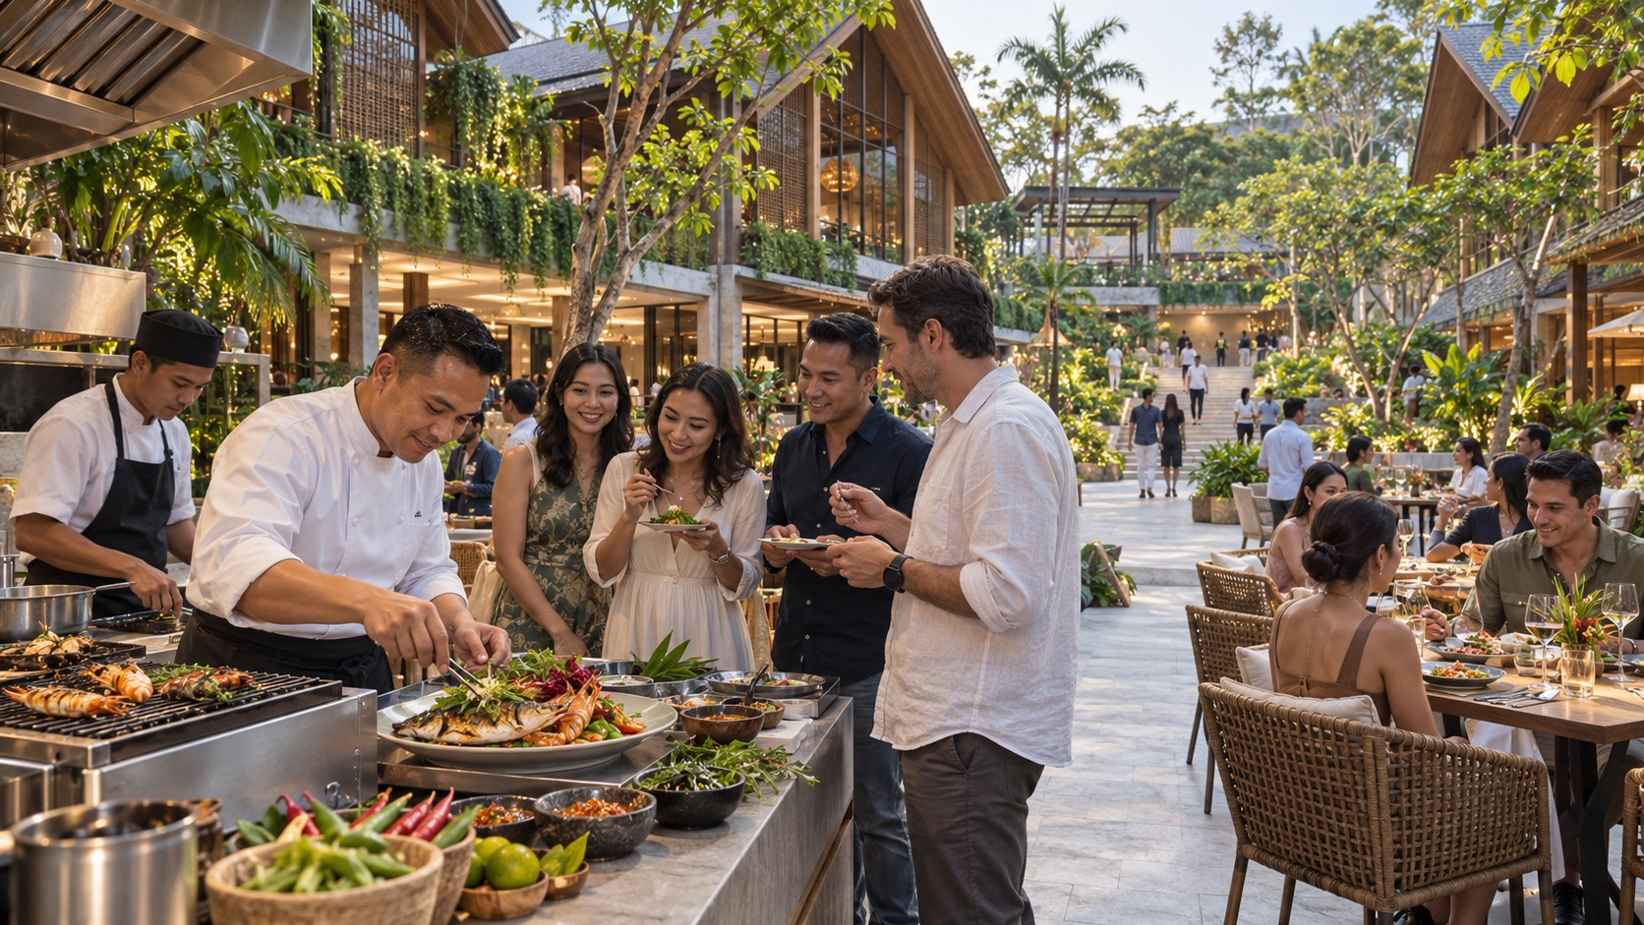
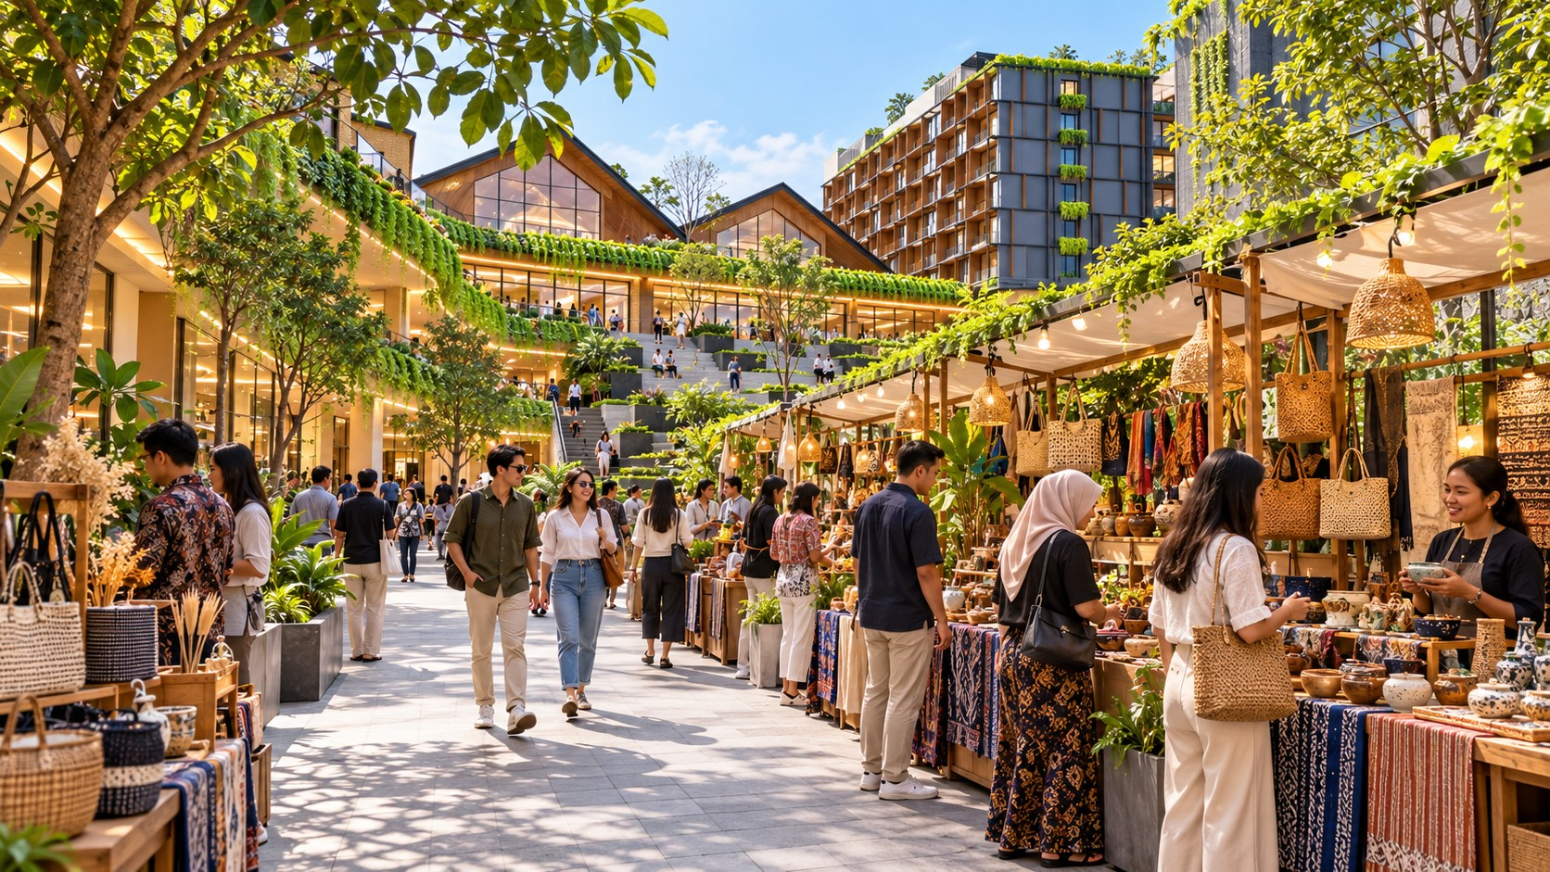
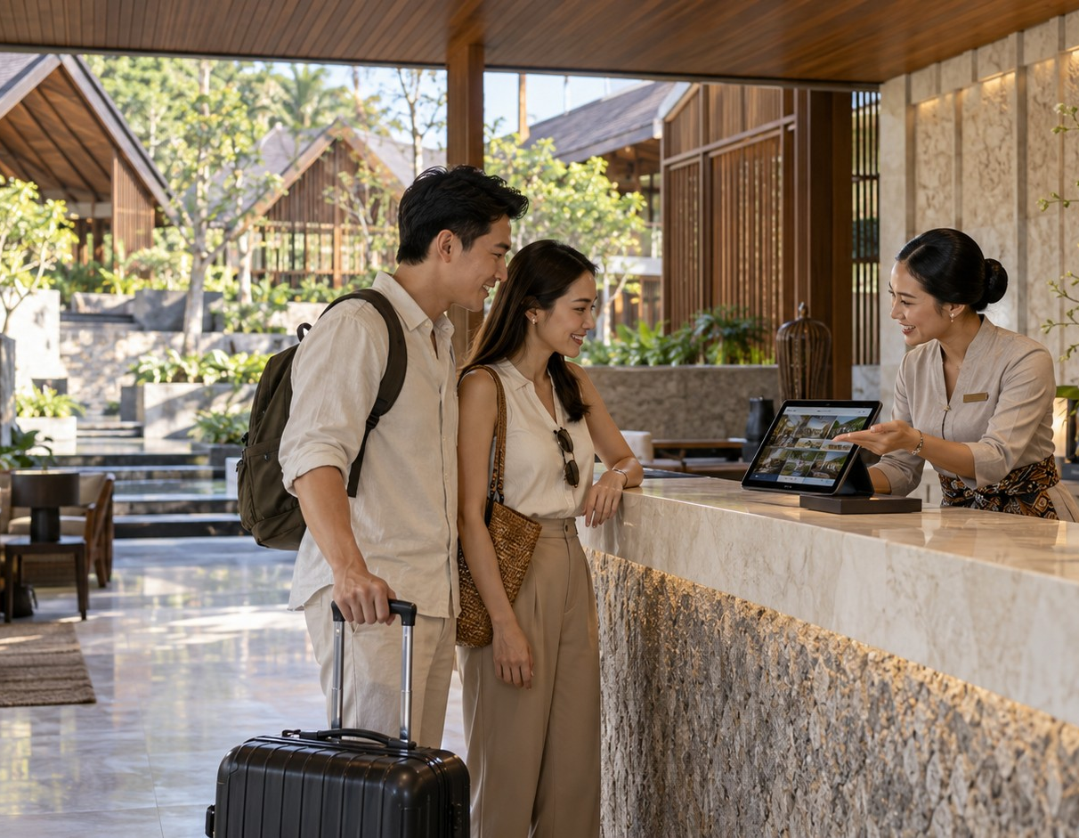
KALINDO / THE COMPLETE BRIEF
POSITIONING & TENANT STRATEGY
COMPETITIVE PROPOSITION
EVERYDAY RELEVANCE. SHARED EXPERIENCES.
SUPPLIED CONCEPT VISUAL · APPROVAL STATUS UNVERIFIED
SUPPLIED CONCEPT VISUAL · APPROVAL STATUS UNVERIFIED
SUPPLIED CONCEPT VISUAL · APPROVAL STATUS UNVERIFIED
SUPPLIED CONCEPT VISUAL · APPROVAL STATUS UNVERIFIED
01
02
03
04
Everyday tenants create dependable reasons to visit.
Culinary and leisure experiences encourage discovery.
The Veranda brings people together through a changing calendar.
Hospitality allows the experience to extend into a stay.
BRIEF NOTES · PRESERVED VERBATIM
Visual: Empat commercial roles dengan bukti ruang dan layanan.
POSITIONING & TENANT STRATEGY
SOURCE: KALINDO PROJECT (1).PDF / 13
Notes:
Slide 13: EVERYDAY RELEVANCE. SHARED EXPERIENCES.
EDITABLE VERSION: all text, photos, tables and backgrounds are native PowerPoint objects. Click to edit, replace or delete them.
EVERYDAY RELEVANCE. SHARED EXPERIENCES.
Everyday tenants create dependable reasons to visit.
Culinary and leisure experiences encourage discovery.
The Veranda brings people together through a changing calendar.
Hospitality allows the experience to extend into a stay.
Visual: Empat commercial roles dengan bukti ruang dan layanan.
The source wording is retained. Only PDF line wraps, zero-width characters and bullet styling are normalised. Supplied concept imagery is not verified as built. Market evidence is reproduced from the supplied brief, not independently re-researched.

Slide 14
KALINDO / THE COMPLETE BRIEF
POSITIONING & TENANT STRATEGY
TENANT MIX PRINCIPLE
EVERY TENANT HAS A ROLE IN THE VISIT
Role
Commercial contribution
Destination anchor
Gives people a specific reason to choose Kalindo
Frequency anchor
Supports recurring visits
Dwell anchor
Extends time spent
Spend extender
Encourages an additional purchase
Community tenant
Hosts repeat participation
Supporting tenant
Serves needs around the main activities
A tenant may serve several roles.
POSITIONING & TENANT STRATEGY
SOURCE: KALINDO PROJECT (1).PDF / 14
Notes:
Slide 14: EVERY TENANT HAS A ROLE IN THE VISIT
EDITABLE VERSION: all text, photos, tables and backgrounds are native PowerPoint objects. Click to edit, replace or delete them.
EVERY TENANT HAS A ROLE IN THE VISIT
Role Commercial contribution
Destination Gives people a specific reason to choose
anchor Kalindo
Frequency anchor Supports recurring visits
Dwell anchor Extends time spent
Spend extender Encourages an additional purchase
Community tenant Hosts repeat participation
Supporting tenant Serves needs around the main activities
A tenant may serve several roles.
The source wording is retained. Only PDF line wraps, zero-width characters and bullet styling are normalised. Supplied concept imagery is not verified as built. Market evidence is reproduced from the supplied brief, not independently re-researched.

Slide 15
KALINDO / THE COMPLETE BRIEF
POSITIONING & TENANT STRATEGY
PROPOSED CATEGORY FRAMEWORK
A BALANCED MIX FOR LIFE THROUGHOUT THE DAY
Category
Primary role
Planning priority
Destination dining and everyday F&B
Attraction, dwell and spending
Very high
Family activities and learning
Frequency and shared visits
Very high
Grocery and everyday services
Routine local visits
High
Sport and active lifestyle
Membership and scheduled participation
High, subject to operator fit
Social entertainment
Evening and group visits
High
Wellness and recovery
Service visits and complementary spending
Test demand and space needs
Curated lifestyle retail
Discovery and supporting purchases
Selective
BRIEF NOTES · PRESERVED VERBATIM
Visual: Category cards.
POSITIONING & TENANT STRATEGY
SOURCE: KALINDO PROJECT (1).PDF / 15
Notes:
Slide 15: A BALANCED MIX FOR LIFE THROUGHOUT THE DAY
EDITABLE VERSION: all text, photos, tables and backgrounds are native PowerPoint objects. Click to edit, replace or delete them.
A BALANCED MIX FOR LIFE THROUGHOUT THE DAY
Category Primary role Planning priority
Destination dining and Attraction, dwell and spending Very high
everyday F&B
Family activities and learning Frequency and shared visits Very high
Grocery and everyday Routine local visits High
services
Sport and active lifestyle Membership and scheduled High, subject to
participation operator fit
Social entertainment Evening and group visits High
Wellness and recovery Service visits and complementary Test demand and
spending space needs
Curated lifestyle retail Discovery and supporting Selective
purchases
Visual: Category cards.
The source wording is retained. Only PDF line wraps, zero-width characters and bullet styling are normalised. Supplied concept imagery is not verified as built. Market evidence is reproduced from the supplied brief, not independently re-researched.

Slide 16
KALINDO / THE COMPLETE BRIEF
POSITIONING & TENANT STRATEGY
CULINARY ANCHORS
A FEW STRONG REASONS TO COME FOR FOOD
Initial sounding should test a small group of complementary concepts:
Indonesian destination restaurant.
Seafood dining experience.
All-day social dining.
Café and bakery.
A rotating chef or culinary collaboration format.
Space considerations
Garden frontage, kitchen and exhaust, loading, waste handling, acoustic impact and practical terrace operation.
Commercial test
Can the concept attract its own customers and support neighbouring activity?
SUPPLIED CONCEPT VISUAL · APPROVAL STATUS UNVERIFIED
BRIEF NOTES · PRESERVED VERBATIM
Visual: Culinary frontage di sekitar The Veranda.
POSITIONING & TENANT STRATEGY
SOURCE: KALINDO PROJECT (1).PDF / 16
Notes:
Slide 16: A FEW STRONG REASONS TO COME FOR FOOD
EDITABLE VERSION: all text, photos, tables and backgrounds are native PowerPoint objects. Click to edit, replace or delete them.
A FEW STRONG REASONS TO COME FOR FOOD
Initial sounding should test a small group of complementary concepts:
● Indonesian destination restaurant.
● Seafood dining experience.
● All-day social dining.
● Café and bakery.
● A rotating chef or culinary collaboration format.
Space considerations
Garden frontage, kitchen and exhaust, loading, waste handling, acoustic impact and
practical terrace operation.
Commercial test
Can the concept attract its own customers and support neighbouring activity?
Visual: Culinary frontage di sekitar The Veranda.
The source wording is retained. Only PDF line wraps, zero-width characters and bullet styling are normalised. Supplied concept imagery is not verified as built. Market evidence is reproduced from the supplied brief, not independently re-researched.

Slide 17
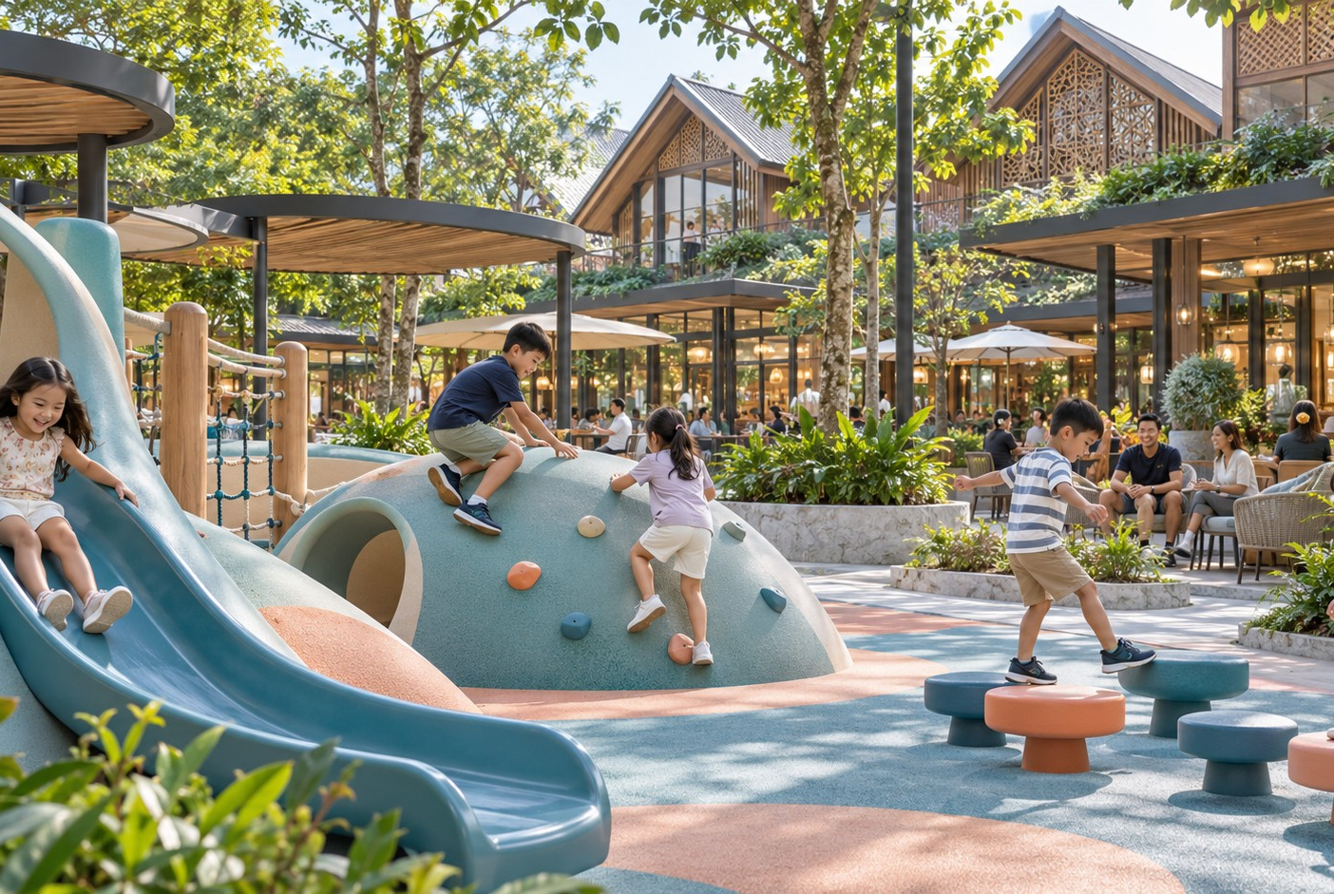
KALINDO / THE COMPLETE BRIEF
POSITIONING & TENANT STRATEGY
FAMILY ANCHORS
ACTIVITIES THAT FAMILIES CAN BUILD INTO THEIR ROUTINE
Potential operator profiles:
Indoor discovery/play.
Creative learning studio.
Scheduled academy or classes.
Family activity operator.
Experience relationship
Child activity connects with nearby cafés, retail and family dining.
Operating requirements
Supervision, age groups, drop-off rules, toilets, stroller access and safe circulation.
SUPPLIED CONCEPT VISUAL · APPROVAL STATUS UNVERIFIED
BRIEF NOTES · PRESERVED VERBATIM
Visual: Family cluster adjacency. Frekuensi kunjungan berasal dari jadwal operator, bukan angka asumsi umum.
POSITIONING & TENANT STRATEGY
SOURCE: KALINDO PROJECT (1).PDF / 17
Notes:
Slide 17: ACTIVITIES THAT FAMILIES CAN BUILD INTO THEIR ROUTINE
EDITABLE VERSION: all text, photos, tables and backgrounds are native PowerPoint objects. Click to edit, replace or delete them.
ACTIVITIES THAT FAMILIES CAN BUILD INTO THEIR ROUTINE
Potential operator profiles:
● Indoor discovery/play.
● Creative learning studio.
● Scheduled academy or classes.
● Family activity operator.
Experience relationship
Child activity connects with nearby cafés, retail and family dining.
Operating requirements
Supervision, age groups, drop-off rules, toilets, stroller access and safe circulation.
Visual: Family cluster adjacency. Frekuensi kunjungan berasal dari jadwal operator, bukan
angka asumsi umum.
The source wording is retained. Only PDF line wraps, zero-width characters and bullet styling are normalised. Supplied concept imagery is not verified as built. Market evidence is reproduced from the supplied brief, not independently re-researched.

Slide 18
KALINDO / THE COMPLETE BRIEF
POSITIONING & TENANT STRATEGY
SPORT, WELLNESS & RECOVERY
RECURRING PARTICIPATION WITH COMPLEMENTARY SERVICES
Category
Role to test
Key requirement
Fitness club
Membership frequency
Catchment, equipment and operating hours
Boutique studio
Scheduled classes
Appropriate room sizes and customer pricing
Racket/activity operator
Group participation
Clear height, structure, noise and access
Recovery/physiotherapy
Repeat service visits
Operator capability and customer demand
Spa/wellness
Local and hotel spending
Privacy, acoustics and service economics
BRIEF NOTES · PRESERVED VERBATIM
Visual: Activity-to-café relationship, dengan quiet buffer menuju hotel/wellness.
POSITIONING & TENANT STRATEGY
SOURCE: KALINDO PROJECT (1).PDF / 18
Notes:
Slide 18: RECURRING PARTICIPATION WITH COMPLEMENTARY SERVICES
EDITABLE VERSION: all text, photos, tables and backgrounds are native PowerPoint objects. Click to edit, replace or delete them.
RECURRING PARTICIPATION WITH COMPLEMENTARY SERVICES
Category Role to test Key requirement
Fitness club Membership Catchment, equipment and operating
frequency hours
Boutique studio Scheduled classes Appropriate room sizes and customer
pricing
Racket/activity Group participation Clear height, structure, noise and
operator access
Recovery/physiothera Repeat service visits Operator capability and customer
py demand
Spa/wellness Local and hotel Privacy, acoustics and service
spending economics
Visual: Activity-to-café relationship, dengan quiet buffer menuju hotel/wellness.
The source wording is retained. Only PDF line wraps, zero-width characters and bullet styling are normalised. Supplied concept imagery is not verified as built. Market evidence is reproduced from the supplied brief, not independently re-researched.

Slide 19
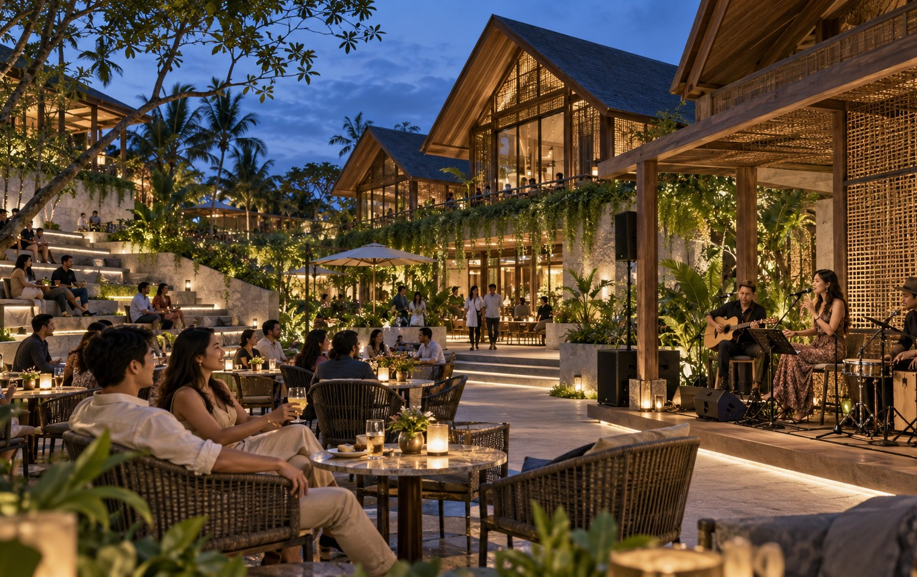
KALINDO / THE COMPLETE BRIEF
POSITIONING & TENANT STRATEGY
EVERYDAY & SOCIAL ANCHORS
REASONS TO RETURN, AND REASONS TO CONTINUE THE EVENING
Everyday candidates
Specialty grocery, personal services and selected useful retail.
Social candidates
Participatory games, hobby concepts, social dining and managed performance formats.
Selection principle
Each concept must fit the customer, available space and surrounding uses.
SUPPLIED CONCEPT VISUAL · APPROVAL STATUS UNVERIFIED
BRIEF NOTES · PRESERVED VERBATIM
Visual: Grocery morning dan social evening.
Catatan: Cinema tetap dapat diuji bila ada operator demand. Keberadaan cinema di kompetitor tidak otomatis membuatnya tidak layak.
POSITIONING & TENANT STRATEGY
SOURCE: KALINDO PROJECT (1).PDF / 19
Notes:
Slide 19: REASONS TO RETURN, AND REASONS TO CONTINUE THE EVENING
EDITABLE VERSION: all text, photos, tables and backgrounds are native PowerPoint objects. Click to edit, replace or delete them.
REASONS TO RETURN, AND REASONS TO CONTINUE THE EVENING
Everyday candidates
Specialty grocery, personal services and selected useful retail.
Social candidates
Participatory games, hobby concepts, social dining and managed performance formats.
Selection principle
Each concept must fit the customer, available space and surrounding uses.
Visual: Grocery morning dan social evening.
Catatan: Cinema tetap dapat diuji bila ada operator demand. Keberadaan cinema di
kompetitor tidak otomatis membuatnya tidak layak.
The source wording is retained. Only PDF line wraps, zero-width characters and bullet styling are normalised. Supplied concept imagery is not verified as built. Market evidence is reproduced from the supplied brief, not independently re-researched.

Slide 20
KALINDO / THE COMPLETE BRIEF
POSITIONING & TENANT STRATEGY
TENANT ADJACENCY
THE MIX WORKS THROUGH ITS CONNECTIONS
Relationship
Intended outcome
Design implication
Family activity + café/dining
Parents spend time nearby
Safe, convenient access
Sport + café/recovery
Additional visits after activity
Compatible hours and frontage
Grocery + useful services
Several needs within one trip
Easy access and visible connections
Hotel + culinary
Guest spending across the district
Clear public/private transition
The Veranda + dining
Event activity supports tenants
Frontage, seating and access
Wellness + hotel
Convenient quieter experiences
Acoustic and privacy buffers
BRIEF NOTES · PRESERVED VERBATIM
Visual: Annotated zoning map.
POSITIONING & TENANT STRATEGY
SOURCE: KALINDO PROJECT (1).PDF / 20
Notes:
Slide 20: THE MIX WORKS THROUGH ITS CONNECTIONS
EDITABLE VERSION: all text, photos, tables and backgrounds are native PowerPoint objects. Click to edit, replace or delete them.
THE MIX WORKS THROUGH ITS CONNECTIONS
Relationship Intended outcome Design implication
Family activity + Parents spend time nearby Safe, convenient access
café/dining
Sport + café/recovery Additional visits after activity Compatible hours and frontage
Grocery + useful services Several needs within one trip Easy access and visible
connections
Hotel + culinary Guest spending across the Clear public/private transition
district
The Veranda + dining Event activity supports Frontage, seating and access
tenants
Wellness + hotel Convenient quieter Acoustic and privacy buffers
experiences
Visual: Annotated zoning map.
The source wording is retained. Only PDF line wraps, zero-width characters and bullet styling are normalised. Supplied concept imagery is not verified as built. Market evidence is reproduced from the supplied brief, not independently re-researched.

Slide 21
KALINDO / THE COMPLETE BRIEF
COMMERCIAL VALIDATION
ANCHOR AREA CHECK
SPACE ALLOCATION FOLLOWS OPERATOR REQUIREMENTS
Current working figures from the feedback document.
Item
Alternative 1
Alternative 2
Anchor area at ground level
1,880 m²
2,185 m²
Anchor area at P1
1,880 m²
2,185 m²
Combined anchor allocation
3,760 m²
4,370 m²
The commercial team must test whether operators require one large unit, several subdivisions or a connected multi-level format.
Validation points
Independent access, loading, visibility, vertical connection and technical fit.
BRIEF NOTES · PRESERVED VERBATIM
Visual: Kedua opsi dengan anchor allocation ditandai. Jangan menganggap dua lantai otomatis cocok untuk satu operator.
COMMERCIAL VALIDATION
SOURCE: KALINDO PROJECT (1).PDF / 21
Notes:
Slide 21: SPACE ALLOCATION FOLLOWS OPERATOR REQUIREMENTS
EDITABLE VERSION: all text, photos, tables and backgrounds are native PowerPoint objects. Click to edit, replace or delete them.
SPACE ALLOCATION FOLLOWS OPERATOR REQUIREMENTS
Current working figures from the feedback document.
Item Alternative 1 Alternative 2
Anchor area at ground level 1,880 m² 2,185 m²
Anchor area at P1 1,880 m² 2,185 m²
Combined anchor allocation 3,760 m² 4,370 m²
The commercial team must test whether operators require one large unit, several
subdivisions or a connected multi-level format.
Validation points
Independent access, loading, visibility, vertical connection and technical fit.
Visual: Kedua opsi dengan anchor allocation ditandai. Jangan menganggap dua lantai
otomatis cocok untuk satu operator.
The source wording is retained. Only PDF line wraps, zero-width characters and bullet styling are normalised. Supplied concept imagery is not verified as built. Market evidence is reproduced from the supplied brief, not independently re-researched.

Slide 22
KALINDO / THE COMPLETE BRIEF
COMMERCIAL VALIDATION
INITIAL SOUNDING PLAN
TWENTY FOCUSED OPERATOR CONVERSATIONS
Proposed outreach allocation.
20
Category
Conversations
Culinary
5
Family and learning
3
Sport and fitness
4
Wellness and recovery
3
Grocery
2
The first round tests interest and requirements before formal leasing proposals.
Social entertainment
3
Total
20
BRIEF NOTES · PRESERVED VERBATIM
Visual: Priority pipeline.
Catatan: Ini target conversations, bukan jumlah tenant final atau bukti minat.
COMMERCIAL VALIDATION
SOURCE: KALINDO PROJECT (1).PDF / 22
Notes:
Slide 22: TWENTY FOCUSED OPERATOR CONVERSATIONS
EDITABLE VERSION: all text, photos, tables and backgrounds are native PowerPoint objects. Click to edit, replace or delete them.
TWENTY FOCUSED OPERATOR CONVERSATIONS
Proposed outreach allocation.
Category Conversation
s
Culinary 5
Family and learning 3
Sport and fitness 4
Wellness and 3
recovery
Grocery 2
Social entertainment 3
Total 20
The first round tests interest and requirements before formal leasing proposals.
Visual: Priority pipeline.
Catatan: Ini target conversations, bukan jumlah tenant final atau bukti minat.
The source wording is retained. Only PDF line wraps, zero-width characters and bullet styling are normalised. Supplied concept imagery is not verified as built. Market evidence is reproduced from the supplied brief, not independently re-researched.

Slide 23
KALINDO / THE COMPLETE BRIEF
COMMERCIAL VALIDATION
SOUNDING MATRIX
INTEREST BECOMES A COMMERCIAL REQUIREMENT
Capture for each operator:
Required output
A traceable operator matrix with dates, contact details and supporting records.
Interest level and target customer.
Preferred area and location.
Indicative rent and total occupancy cost.
Interest level and target customer.
Preferred area and location.
Lease structure and duration.
Technical and opening requirements.
Indicative rent and total occupancy cost.
Main concerns and decision timeline.
Fit-out responsibilities.
Main concerns and decision timeline.
BRIEF NOTES · PRESERVED VERBATIM
Visual: Contoh satu baris matrix. Hindari label “Done” tanpa hasil yang dapat ditinjau.
COMMERCIAL VALIDATION
SOURCE: KALINDO PROJECT (1).PDF / 23
Notes:
Slide 23: INTEREST BECOMES A COMMERCIAL REQUIREMENT
EDITABLE VERSION: all text, photos, tables and backgrounds are native PowerPoint objects. Click to edit, replace or delete them.
INTEREST BECOMES A COMMERCIAL REQUIREMENT
Capture for each operator:
● Interest level and target customer.
● Preferred area and location.
● Indicative rent and total occupancy cost.
● Lease structure and duration.
● Technical and opening requirements.
● Fit-out responsibilities.
● Main concerns and decision timeline.
Required output
A traceable operator matrix with dates, contact details and supporting records.
Visual: Contoh satu baris matrix. Hindari label “Done” tanpa hasil yang dapat ditinjau.
The source wording is retained. Only PDF line wraps, zero-width characters and bullet styling are normalised. Supplied concept imagery is not verified as built. Market evidence is reproduced from the supplied brief, not independently re-researched.

Slide 24
KALINDO / THE COMPLETE BRIEF
COMMERCIAL VALIDATION
LEASE STRUCTURE
COMMERCIAL TERMS REFLECT THE OPERATOR MODEL
Model
Potential application
Validation
Fixed rent
Established retail and service operators
Affordability and comparable terms
Minimum guarantee + turnover rent
Selected F&B and experience concepts
Sales reporting and agreed calculation
Revenue share
Selected operating partnerships
Risk allocation, costs and audit rights
Short-term licence
Pop-ups and activation
Inventory, booked days and operating rules
Strategic partnership
Tourism and distribution
Acquisition cost and contribution
BRIEF NOTES · PRESERVED VERBATIM
Visual: Commercial model table.
Catatan: Anchor lease duration harus dibahas bersama investasi fit-out, break clauses, opening obligations dan operator capability.
COMMERCIAL VALIDATION
SOURCE: KALINDO PROJECT (1).PDF / 24
Notes:
Slide 24: COMMERCIAL TERMS REFLECT THE OPERATOR MODEL
EDITABLE VERSION: all text, photos, tables and backgrounds are native PowerPoint objects. Click to edit, replace or delete them.
COMMERCIAL TERMS REFLECT THE OPERATOR MODEL
Model Potential application Validation
Fixed rent Established retail and Affordability and comparable
service operators terms
Minimum guarantee + Selected F&B and Sales reporting and agreed
turnover rent experience concepts calculation
Revenue share Selected operating Risk allocation, costs and audit
partnerships rights
Short-term licence Pop-ups and activation Inventory, booked days and
operating rules
Strategic partnership Tourism and distribution Acquisition cost and
contribution
Visual: Commercial model table.
Catatan: Anchor lease duration harus dibahas bersama investasi fit-out, break clauses,
opening obligations dan operator capability.
The source wording is retained. Only PDF line wraps, zero-width characters and bullet styling are normalised. Supplied concept imagery is not verified as built. Market evidence is reproduced from the supplied brief, not independently re-researched.

Slide 25
KALINDO / THE COMPLETE BRIEF
COMMERCIAL VALIDATION
TENANT SELECTION & PHASING
AN OPENING MIX THAT CAN OPERATE AS A DESTINATION
Selection criteria
Customer relevance, operator capability, commercial contribution, technical fit and willingness to participate.
Phase-one priorities
A complete everyday visit, a credible culinary offer, family activity and a functioning The Veranda.
Later additions
Categories that need stronger demand evidence or specialist infrastructure.
SUPPLIED CONCEPT VISUAL · APPROVAL STATUS UNVERIFIED
BRIEF NOTES · PRESERVED VERBATIM
Visual: Phase-one experience map.
Catatan: Jadwal final mengikuti controlled masterplan, QS dan tenant readiness.
COMMERCIAL VALIDATION
SOURCE: KALINDO PROJECT (1).PDF / 25
Notes:
Slide 25: AN OPENING MIX THAT CAN OPERATE AS A DESTINATION
EDITABLE VERSION: all text, photos, tables and backgrounds are native PowerPoint objects. Click to edit, replace or delete them.
AN OPENING MIX THAT CAN OPERATE AS A DESTINATION
Selection criteria
Customer relevance, operator capability, commercial contribution, technical fit and
willingness to participate.
Phase-one priorities
A complete everyday visit, a credible culinary offer, family activity and a functioning The
Veranda.
Later additions
Categories that need stronger demand evidence or specialist infrastructure.
Visual: Phase-one experience map.
Catatan: Jadwal final mengikuti controlled masterplan, QS dan tenant readiness.
The source wording is retained. Only PDF line wraps, zero-width characters and bullet styling are normalised. Supplied concept imagery is not verified as built. Market evidence is reproduced from the supplied brief, not independently re-researched.

Slide 26
KALINDO / THE COMPLETE BRIEF
COMMERCIAL VALIDATION
REVENUE SCENARIOS
THREE SCENARIOS, BUILT FROM THE SAME INVENTORY
Scenario
Working basis
Bottom-up additional revenue
Events: available booking slots × booked share × fee.
Conservative
Slower occupancy, lower achieved rents and lower activation utilisation
Media: assets × rate × sell-through.
Activations: locations × booked days × rate.
Base
Current assumptions, adjusted as evidence becomes available
Sponsorship: contracted packages and recognised period.
Tourism: fulfilled bookings × net fee or commission.
Upside
Supported improvements in occupancy, rent and commercial utilisation
BRIEF NOTES · PRESERVED VERBATIM
Catatan: Pendapatan event, sponsorship dan activation harus dicek agar tidak menghitung paket yang sama dua kali. Inventory amphitheatre pada feedback perlu diselaraskan dengan The Veranda dan layout terbaru.
COMMERCIAL VALIDATION
SOURCE: KALINDO PROJECT (1).PDF / 26
Notes:
Slide 26: THREE SCENARIOS, BUILT FROM THE SAME INVENTORY
EDITABLE VERSION: all text, photos, tables and backgrounds are native PowerPoint objects. Click to edit, replace or delete them.
THREE SCENARIOS, BUILT FROM THE SAME INVENTORY
Scenario Working basis
Conservativ Slower occupancy, lower achieved rents and lower activation utilisation
e
Base Current assumptions, adjusted as evidence becomes available
Upside Supported improvements in occupancy, rent and commercial utilisation
Bottom-up additional revenue
● Events: available booking slots × booked share × fee.
● Media: assets × rate × sell-through.
● Activations: locations × booked days × rate.
● Sponsorship: contracted packages and recognised period.
● Tourism: fulfilled bookings × net fee or commission.
Catatan: Pendapatan event, sponsorship dan activation harus dicek agar tidak menghitung
paket yang sama dua kali. Inventory amphitheatre pada feedback perlu diselaraskan dengan
The Veranda dan layout terbaru.
The source wording is retained. Only PDF line wraps, zero-width characters and bullet styling are normalised. Supplied concept imagery is not verified as built. Market evidence is reproduced from the supplied brief, not independently re-researched.

Slide 27
KALINDO / THE COMPLETE BRIEF
COMMERCIAL VALIDATION
THE VERANDA ECONOMICS
PROGRAMMING NEEDS A NET CONTRIBUTION
Evaluate each programme through:
Item
Measure
Direct income
Tickets, rental, sponsorship or participation fees
Direct cost
Production, staffing, security, cleaning and utilities
Tenant contribution
Participation and measurable commercial uplift
Destination benefit
Repeat participation and new visitor acquisition
Space impact
Access, disruption and displaced activity
Free community programmes require a defined budget and purpose.
BRIEF NOTES · PRESERVED VERBATIM
Visual: Event contribution worksheet, tanpa revenue target yang belum tervalidasi.
COMMERCIAL VALIDATION
SOURCE: KALINDO PROJECT (1).PDF / 27
Notes:
Slide 27: PROGRAMMING NEEDS A NET CONTRIBUTION
EDITABLE VERSION: all text, photos, tables and backgrounds are native PowerPoint objects. Click to edit, replace or delete them.
PROGRAMMING NEEDS A NET CONTRIBUTION
Evaluate each programme through:
Item Measure
Direct income Tickets, rental, sponsorship or participation fees
Direct cost Production, staffing, security, cleaning and utilities
Tenant contribution Participation and measurable commercial uplift
Destination benefit Repeat participation and new visitor acquisition
Space impact Access, disruption and displaced activity
Free community programmes require a defined budget and purpose.
Visual: Event contribution worksheet, tanpa revenue target yang belum tervalidasi.
The source wording is retained. Only PDF line wraps, zero-width characters and bullet styling are normalised. Supplied concept imagery is not verified as built. Market evidence is reproduced from the supplied brief, not independently re-researched.

Slide 28
KALINDO / THE COMPLETE BRIEF
COMMERCIAL VALIDATION
OPEX & RETURN VALIDATION
THE INVESTMENT CASE FOLLOWS VERIFIED OPERATING ASSUMPTIONS
OPEX should reflect manpower, shifts, technical loads, service standards, contracts and the programming calendar.
The feedback’s working NOI and construction investment imply approximately:
Metric
Alternative 1
Alternative 2
Annual NOI
Rp22.835bn
Rp20.929bn
Construction investment
Rp278.947bn
Rp259.378bn
NOI ÷ construction investment
8.19%
8.07%
BRIEF NOTES · PRESERVED VERBATIM
Catatan: Rasio ini merupakan perhitungan sederhana dari angka feedback, bukan IRR atau return atas total project cost. Angka “10–11% return” perlu dijelaskan metrik dan basisnya sebelum dibandingkan.
COMMERCIAL VALIDATION
SOURCE: KALINDO PROJECT (1).PDF / 28
Notes:
Slide 28: THE INVESTMENT CASE FOLLOWS VERIFIED OPERATING ASSUMPTIONS
EDITABLE VERSION: all text, photos, tables and backgrounds are native PowerPoint objects. Click to edit, replace or delete them.
THE INVESTMENT CASE FOLLOWS VERIFIED OPERATING ASSUMPTIONS
OPEX should reflect manpower, shifts, technical loads, service standards, contracts and the
programming calendar.
The feedback’s working NOI and construction investment imply approximately:
Metric Alternative 1 Alternative 2
Annual NOI Rp22.835bn Rp20.929bn
Construction investment Rp278.947bn Rp259.378bn
NOI ÷ construction investment 8.19% 8.07%
Catatan: Rasio ini merupakan perhitungan sederhana dari angka feedback, bukan IRR atau
return atas total project cost. Angka “10–11% return” perlu dijelaskan metrik dan basisnya
sebelum dibandingkan.
The source wording is retained. Only PDF line wraps, zero-width characters and bullet styling are normalised. Supplied concept imagery is not verified as built. Market evidence is reproduced from the supplied brief, not independently re-researched.

Slide 29
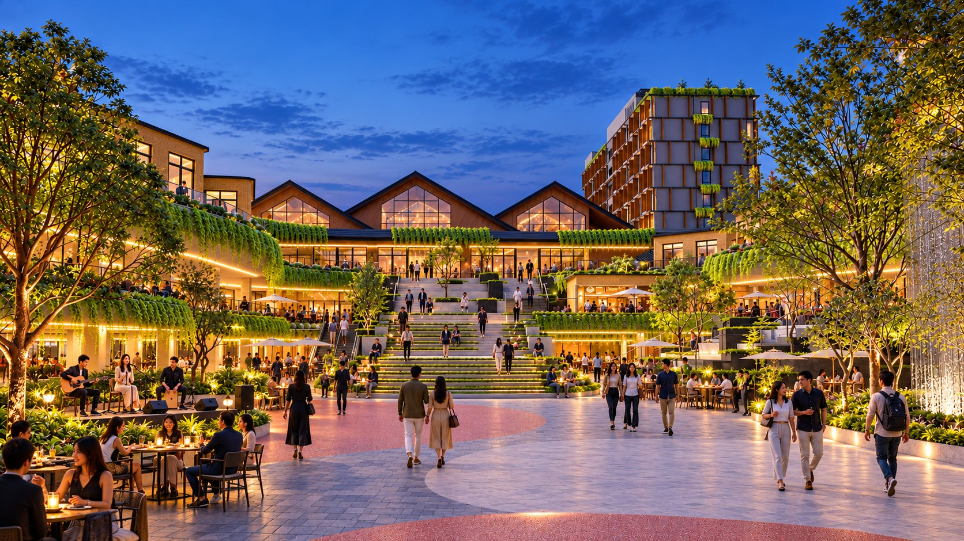
KALINDO / THE COMPLETE BRIEF
CLOSING
Closing copy
LIFE COMES TOGETHER.
THE VERANDA BRINGS IT INTO VIEW.
CLOSING
SOURCE: KALINDO PROJECT (1).PDF / 29
Notes:
Slide 29: LIFE COMES TOGETHER. THE VERANDA BRINGS IT INTO VIEW.
EDITABLE VERSION: all text, photos, tables and backgrounds are native PowerPoint objects. Click to edit, replace or delete them.
LIFE COMES TOGETHER.
THE VERANDA BRINGS IT INTO VIEW.
The source wording is retained. Only PDF line wraps, zero-width characters and bullet styling are normalised. Supplied concept imagery is not verified as built. Market evidence is reproduced from the supplied brief, not independently re-researched.

