Slide 1
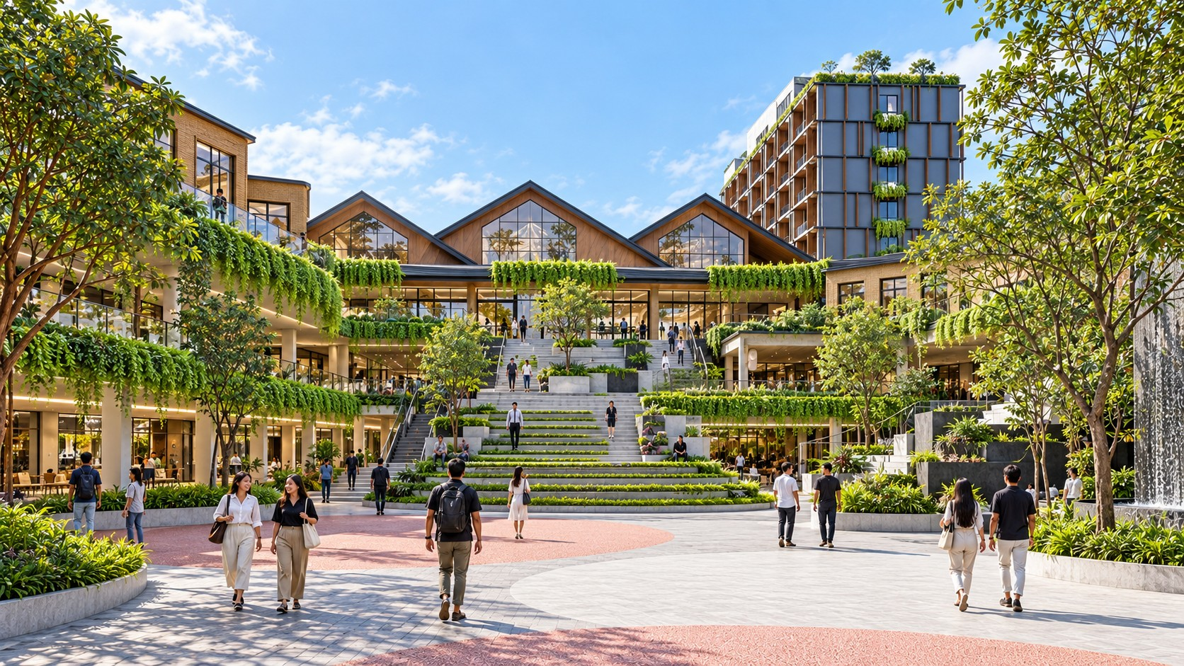
KALINDO / DESTINATION IDENTITY
DESTINATION AMBITION
KALINDO PROJECT
K
／
A new address
for life in Batam.
Concept, Brand Positioning & Destination Naming
BATAM, INDONESIA
DESTINATION CONCEPT / 01
CONCEPT, BRAND POSITIONING & DESTINATION NAMING
SUPPLIED CONCEPT IMAGERY · NOT VERIFIED AS BUILT / 01
Notes:
Slide 1: A new address for life in Batam.
EDITABLE VERSION: text, photos, rules, diagrams and backgrounds are native PowerPoint objects. Click an element to edit, replace or delete it. All assets are embedded. Fonts use Georgia and Arial for portability.
Concept, Brand Positioning & Destination Naming
Source: KALINDO PROJECT.pdf. Concepts, programmes and naming recommendations are not approvals. See presentation/CONTENT-REVIEW.md.

Slide 2
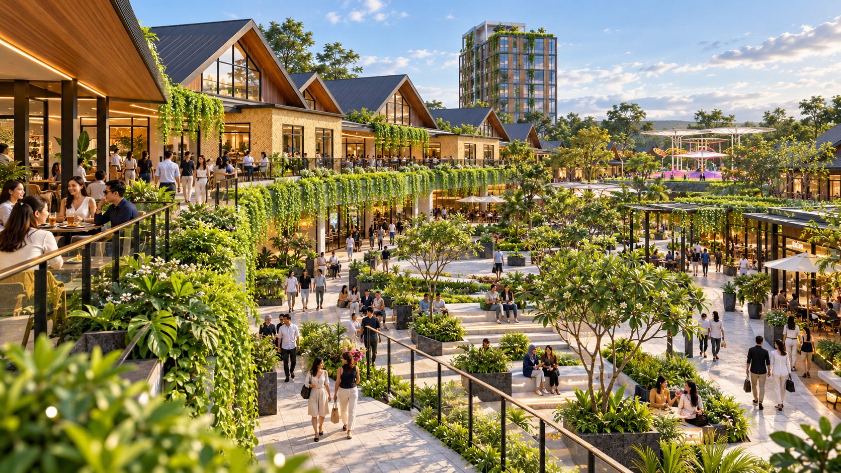
KALINDO / DESTINATION IDENTITY
DESTINATION AMBITION
Destination ambition
A place Batam returns to.
A destination the region discovers.
Everyday life, with a wider horizon.
Local belonging
Everyday convenience creates familiarity. A district that becomes part of life in Batam.
Regional discovery
Culinary discovery, shared experiences and hospitality give visitors more reasons to stay.
EVERYDAY LIFE ↔ REGIONAL LEISURE
DESTINATION AMBITION
SUPPLIED CONCEPT IMAGERY · NOT VERIFIED AS BUILT / 02
Notes:
Slide 2: A place Batam returns to. A destination the region discovers.
EDITABLE VERSION: text, photos, rules, diagrams and backgrounds are native PowerPoint objects. Click an element to edit, replace or delete it. All assets are embedded. Fonts use Georgia and Arial for portability.
Everyday life, with a wider horizon.
Local belonging / Everyday convenience creates familiarity. A district that becomes part of life in Batam.
Regional discovery / Culinary discovery, shared experiences and hospitality give visitors more reasons to stay.
Source: KALINDO PROJECT.pdf. Concepts, programmes and naming recommendations are not approvals. See presentation/CONTENT-REVIEW.md.

Slide 3
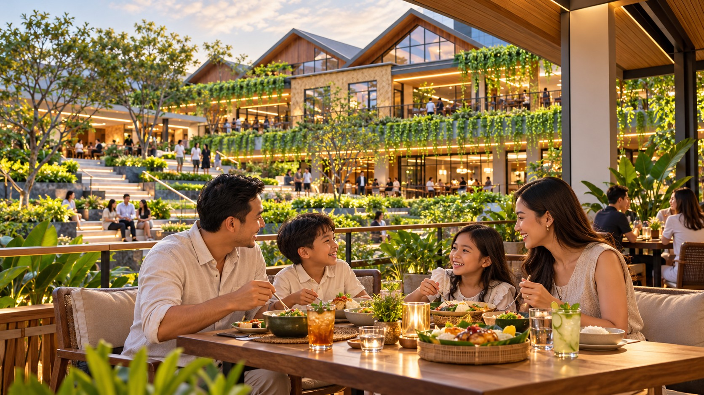
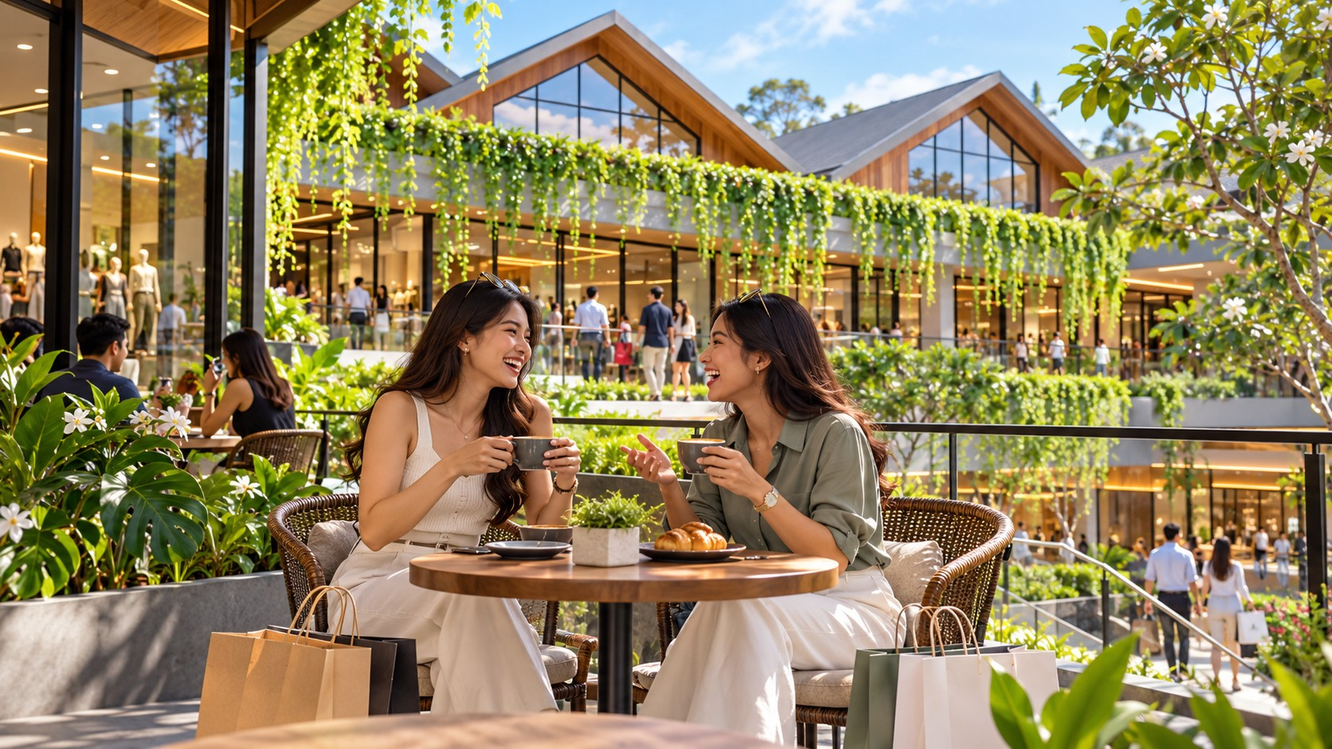
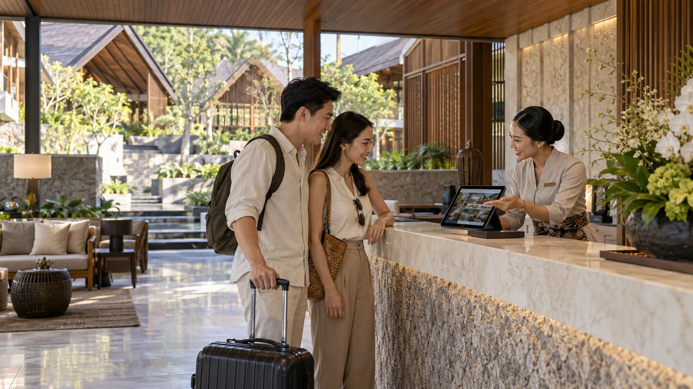
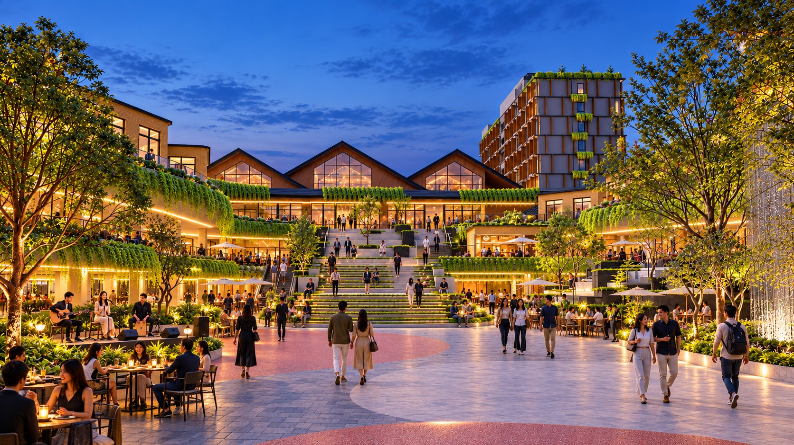
KALINDO / DESTINATION IDENTITY
DESTINATION AMBITION
Destination ambition
Life comes together.
One visit opens into another experience.
01
02
03
04
A family afternoon
A shopping visit
A hotel stay
An ordinary evening
becomes dinner.
becomes a catch-up.
becomes a discovery of Batam.
becomes a shared celebration.
Connected places. Connected experiences.
DESTINATION AMBITION
SUPPLIED CONCEPT IMAGERY · NOT VERIFIED AS BUILT / 03
Notes:
Slide 3: Life comes together.
EDITABLE VERSION: text, photos, rules, diagrams and backgrounds are native PowerPoint objects. Click an element to edit, replace or delete it. All assets are embedded. Fonts use Georgia and Arial for portability.
One visit opens into another experience.
family / A family afternoon / becomes dinner.
friends / A shopping visit / becomes a catch-up.
hotel / A hotel stay / becomes a discovery of Batam.
night / An ordinary evening / becomes a shared celebration.
Source: KALINDO PROJECT.pdf. Concepts, programmes and naming recommendations are not approvals. See presentation/CONTENT-REVIEW.md.

Slide 4
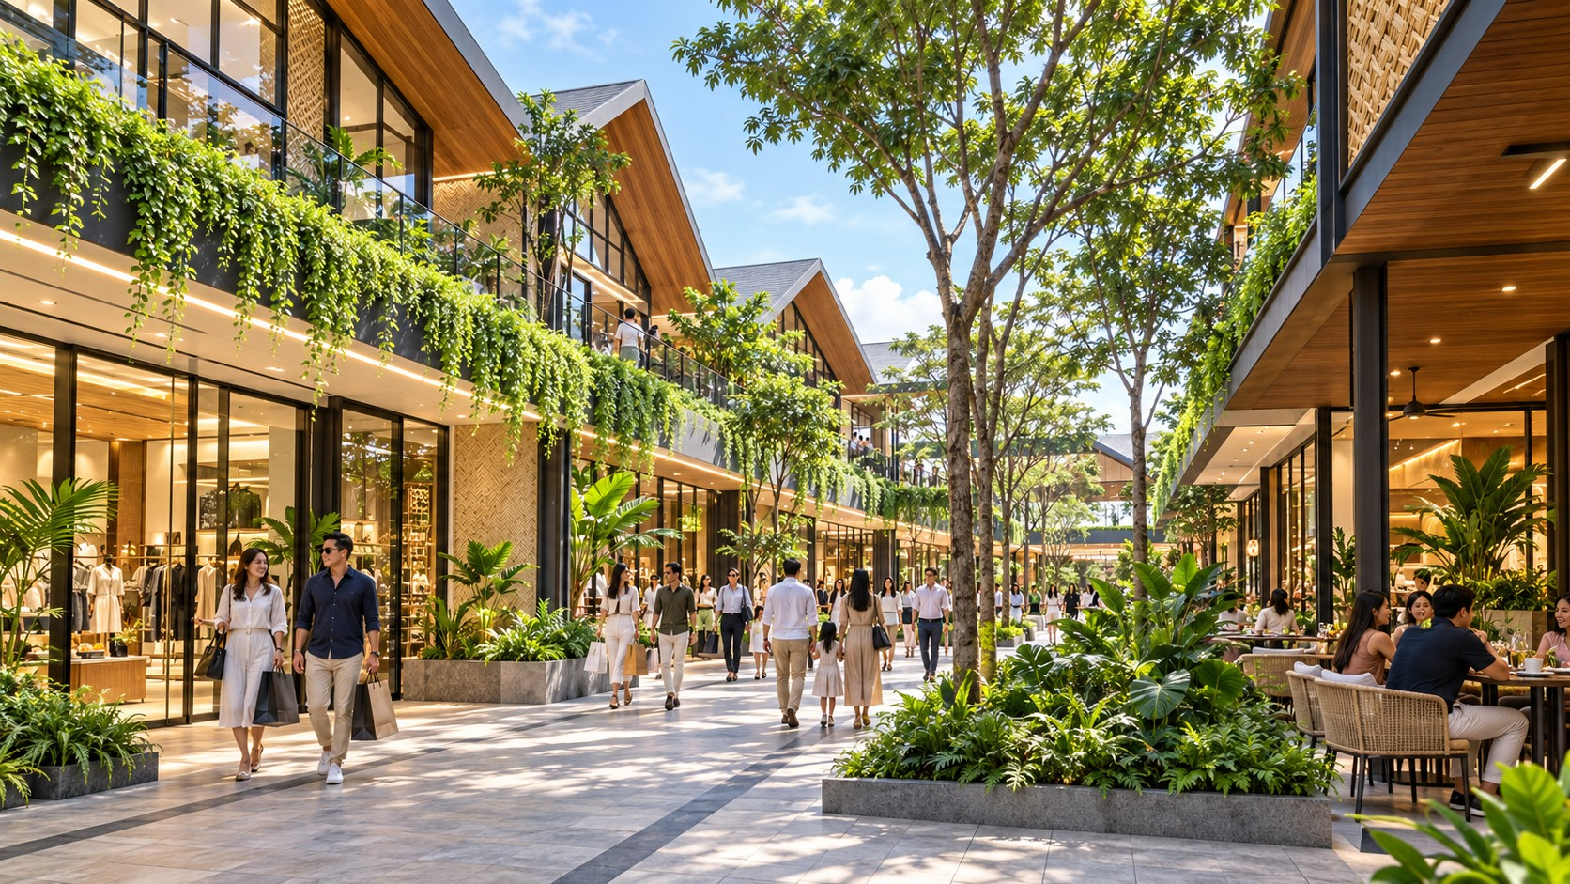
KALINDO / DESTINATION IDENTITY
DESTINATION AMBITION
Destination ambition
Batam’s tropical
lifestyle district.
For whom
Batam residents and regional leisure visitors.
Our proposition
Indonesian culinary discovery, curated retail, family experiences and hospitality in a walkable tropical setting, centred on The Veranda.
Our position
Middle-to-upper lifestyle: quality spaces, welcoming service and a considered range of prices.
BRAND PROMISE
More to discover.
More reasons to stay.
DESTINATION AMBITION
SUPPLIED CONCEPT IMAGERY · NOT VERIFIED AS BUILT / 04
Notes:
Slide 4: Batam’s tropical lifestyle district.
EDITABLE VERSION: text, photos, rules, diagrams and backgrounds are native PowerPoint objects. Click an element to edit, replace or delete it. All assets are embedded. Fonts use Georgia and Arial for portability.
More to discover.
More reasons to stay.
For whom / Batam residents and regional leisure visitors.
Our proposition / Indonesian culinary discovery, curated retail, family experiences and hospitality in a walkable tropical setting, centred on The Veranda.
Our position / Middle-to-upper lifestyle: quality spaces, welcoming service and a considered range of prices.
Source: KALINDO PROJECT.pdf. Concepts, programmes and naming recommendations are not approvals. See presentation/CONTENT-REVIEW.md.

Slide 5
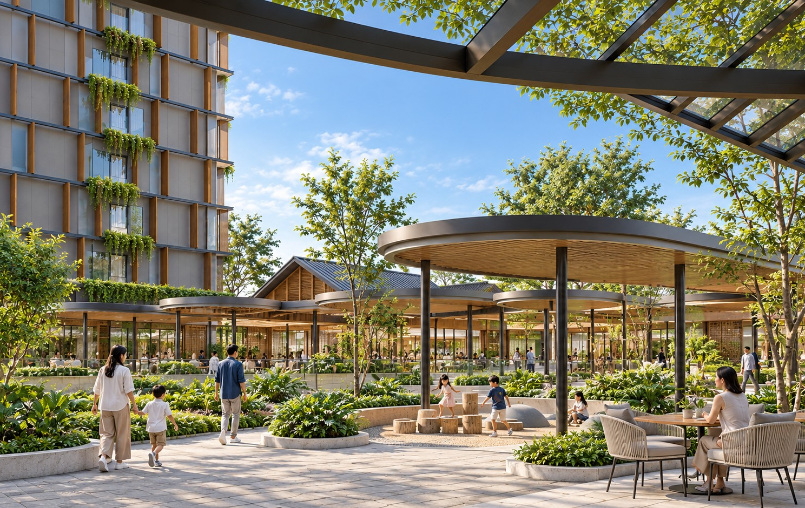
KALINDO / DESTINATION IDENTITY
DESTINATION AMBITION
Destination ambition
Everyday ease.
A day worth spending.
Take care of an everyday need. Enjoy the time around it.
Everyday convenience
Useful tenants that encourage repeat visits.
Culinary discovery
Food experiences that reward curiosity.
Gardens and terraces
Places to pause, dine and linger.
A central gathering place
Shared space with a changing calendar.
Hospitality
An invitation to extend a visit into a stay.
DESTINATION AMBITION
SUPPLIED CONCEPT IMAGERY · NOT VERIFIED AS BUILT / 05
Notes:
Slide 5: Everyday ease. A day worth spending.
EDITABLE VERSION: text, photos, rules, diagrams and backgrounds are native PowerPoint objects. Click an element to edit, replace or delete it. All assets are embedded. Fonts use Georgia and Arial for portability.
Take care of an everyday need. Enjoy the time around it.
bag / Everyday convenience / Useful tenants that encourage repeat visits.
dish / Culinary discovery / Food experiences that reward curiosity.
leaf / Gardens and terraces / Places to pause, dine and linger.
people / A central gathering place / Shared space with a changing calendar.
door / Hospitality / An invitation to extend a visit into a stay.
Source: KALINDO PROJECT.pdf. Concepts, programmes and naming recommendations are not approvals. See presentation/CONTENT-REVIEW.md.

Slide 6
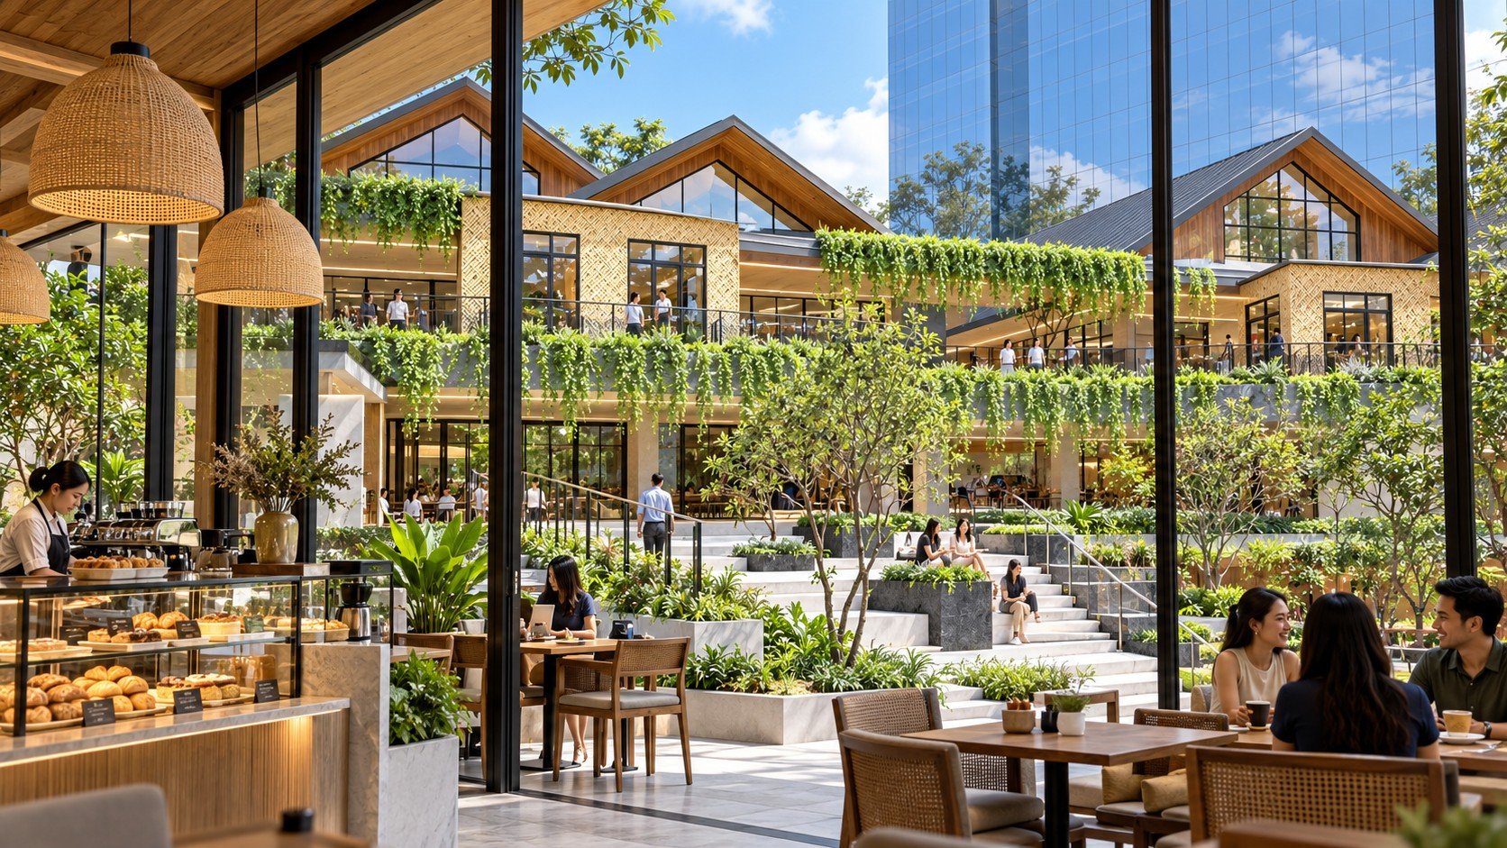
KALINDO / DESTINATION IDENTITY
BRAND PLATFORM
Brand platform
The life between.
Life is rarely about just one thing.
We meet for coffee, but stay for lunch. We come to shop, but end up meeting friends. We bring our children to play, then sit down for dinner.
Batam is shaped by movement: between Indonesia and the region, work and leisure, local life and new experiences. The district brings those different sides of life together.
One place. Many ways
to spend the day.
BRAND PLATFORM
SUPPLIED CONCEPT IMAGERY · NOT VERIFIED AS BUILT / 06
Notes:
Slide 6: The life between.
EDITABLE VERSION: text, photos, rules, diagrams and backgrounds are native PowerPoint objects. Click an element to edit, replace or delete it. All assets are embedded. Fonts use Georgia and Arial for portability.
Life is rarely about just one thing.
We meet for coffee, but stay for lunch. We come to shop, but end up meeting friends. We bring our children to play, then sit down for dinner.
Batam is shaped by movement: between Indonesia and the region, work and leisure, local life and new experiences. The district brings those different sides of life together.
One place. Many ways
to spend the day.
Source: KALINDO PROJECT.pdf. Concepts, programmes and naming recommendations are not approvals. See presentation/CONTENT-REVIEW.md.

Slide 7
KALINDO / DESTINATION IDENTITY
BRAND PLATFORM
Brand platform
The brand in one frame.
01 / PURPOSE
02 / PROMISE
03 / PHILOSOPHY
To enrich everyday life in Batam through places and experiences people share.
More to discover. More reasons to stay.
The Life Between
04 / EMOTIONAL BENEFIT
05 / PERSONALITY
06 / EXPERIENCE LINE
The freedom to spend time your way, with the people who matter.
Warm. Contemporary. Confident. Sociable. Curious.
One Place. Many Ways to Spend the Day.
BRAND PLATFORM
STRATEGIC PROPOSAL / 07
Notes:
Slide 7: The brand in one frame.
EDITABLE VERSION: text, photos, rules, diagrams and backgrounds are native PowerPoint objects. Click an element to edit, replace or delete it. All assets are embedded. Fonts use Georgia and Arial for portability.
Purpose / To enrich everyday life in Batam through places and experiences people share.
Promise / More to discover. More reasons to stay.
Philosophy / The Life Between
Emotional benefit / The freedom to spend time your way, with the people who matter.
Personality / Warm. Contemporary. Confident. Sociable. Curious.
Experience line / One Place. Many Ways to Spend the Day.
Source: KALINDO PROJECT.pdf. Concepts, programmes and naming recommendations are not approvals. See presentation/CONTENT-REVIEW.md.

Slide 8
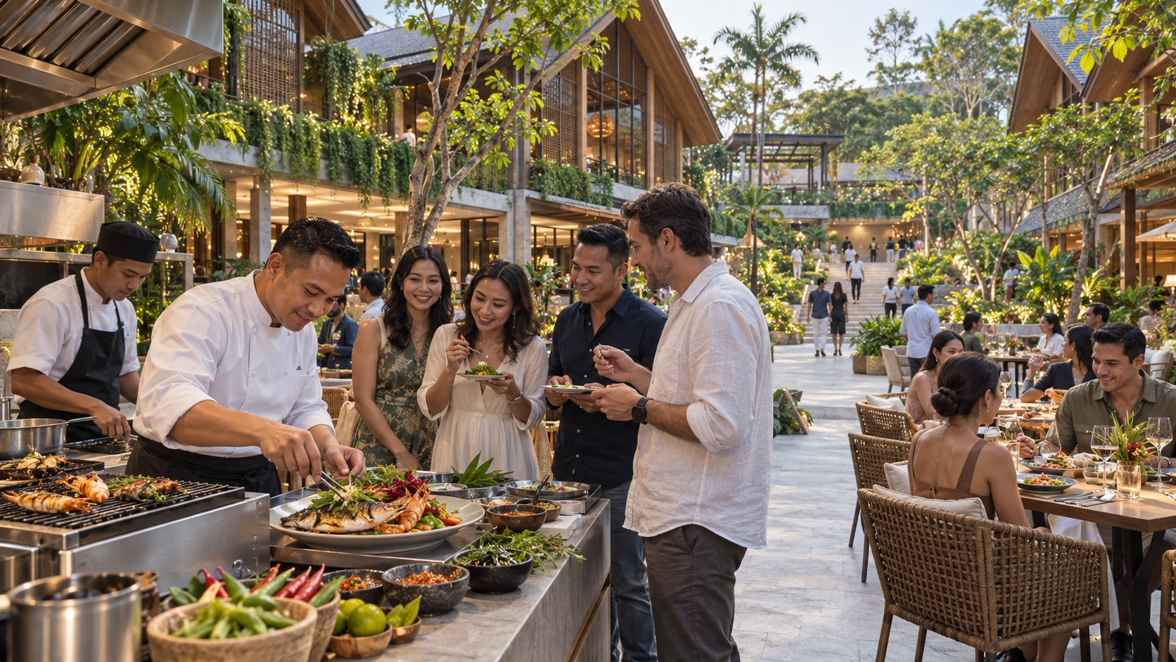
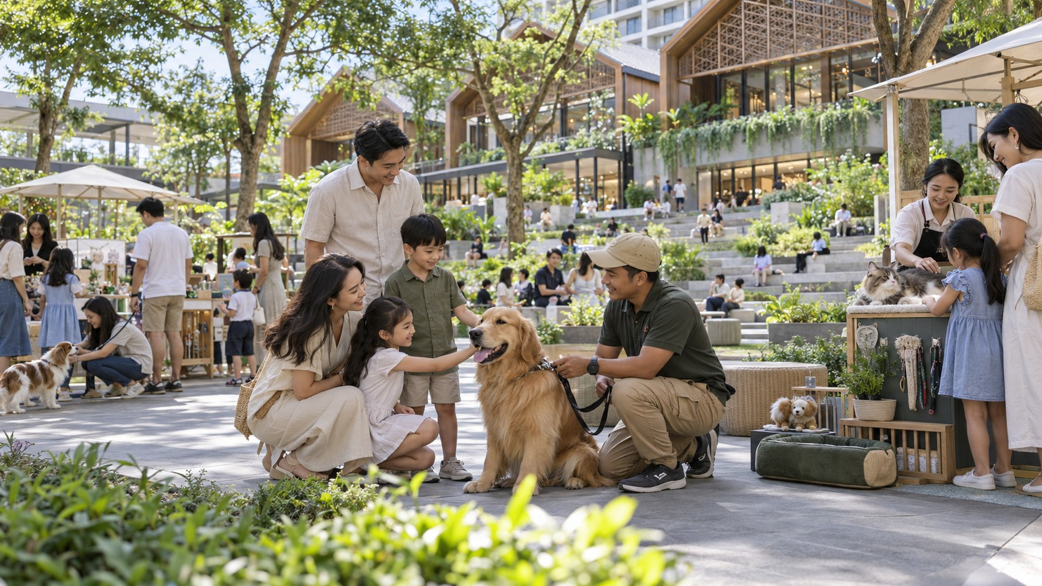
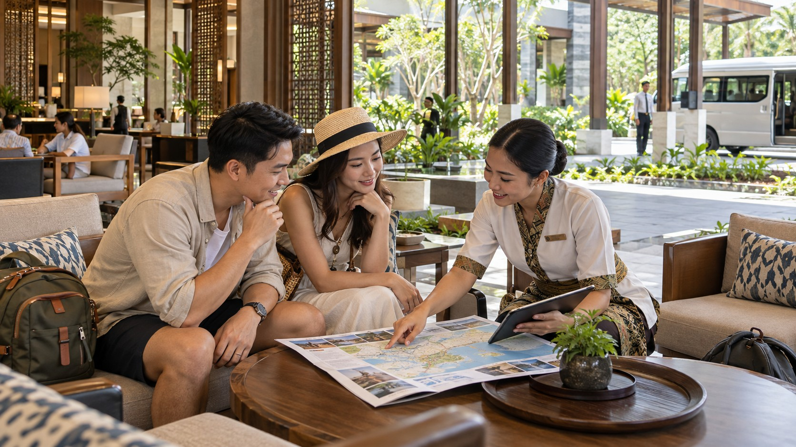
KALINDO / DESTINATION IDENTITY
BRAND PLATFORM
Brand platform
Four reasons to belong.
01
02
03
04
Everyday Ease
Culinary Discovery
Shared Experiences
Time to Stay
A convenient place that fits real routines.
Something worth tasting and sharing.
Time together with more possibilities.
The comfort to extend a visit.
Grocery · services · cafés · fitness · useful retail
Nusantara food · seafood · producers · chef collaborations
The Veranda · families · markets · culture · events
Hotel · garden dining · leisure · spa · quieter spaces
Brand pillars organise the experience story; zoning follows architectural requirements.
BRAND PLATFORM
SUPPLIED CONCEPT IMAGERY · NOT VERIFIED AS BUILT / 08
Notes:
Slide 8: Four reasons to belong.
EDITABLE VERSION: text, photos, rules, diagrams and backgrounds are native PowerPoint objects. Click an element to edit, replace or delete it. All assets are embedded. Fonts use Georgia and Arial for portability.
Brand pillars organise the experience story; zoning follows architectural requirements.
retail / Everyday Ease / A convenient place that fits real routines. / Grocery · services · cafés · fitness · useful retail
table / Culinary Discovery / Something worth tasting and sharing. / Nusantara food · seafood · producers · chef collaborations
pets / Shared Experiences / Time together with more possibilities. / The Veranda · families · markets · culture · events
leisure / Time to Stay / The comfort to extend a visit. / Hotel · garden dining · leisure · spa · quieter spaces
Source: KALINDO PROJECT.pdf. Concepts, programmes and naming recommendations are not approvals. See presentation/CONTENT-REVIEW.md.

Slide 9
KALINDO / DESTINATION IDENTITY
DESTINATION EXPERIENCE
THE PROMENIDE
Where the
district connects.
Everyday interactions become shared experiences.
Community activities. Markets. Performances. Celebrations. A connected district gives each encounter room to grow.
“The Promenide” retained from the brief; spelling to be confirmed.
DESTINATION EXPERIENCE
SUPPLIED CONCEPT IMAGERY · NOT VERIFIED AS BUILT / 09
Notes:
Slide 9: Where the district connects.
EDITABLE VERSION: text, photos, rules, diagrams and backgrounds are native PowerPoint objects. Click an element to edit, replace or delete it. All assets are embedded. Fonts use Georgia and Arial for portability.
Everyday interactions become shared experiences.
Community activities. Markets. Performances. Celebrations. A connected district gives each encounter room to grow.
“The Promenide” retained from the brief; spelling to be confirmed.
Source: KALINDO PROJECT.pdf. Concepts, programmes and naming recommendations are not approvals. See presentation/CONTENT-REVIEW.md.

Slide 10
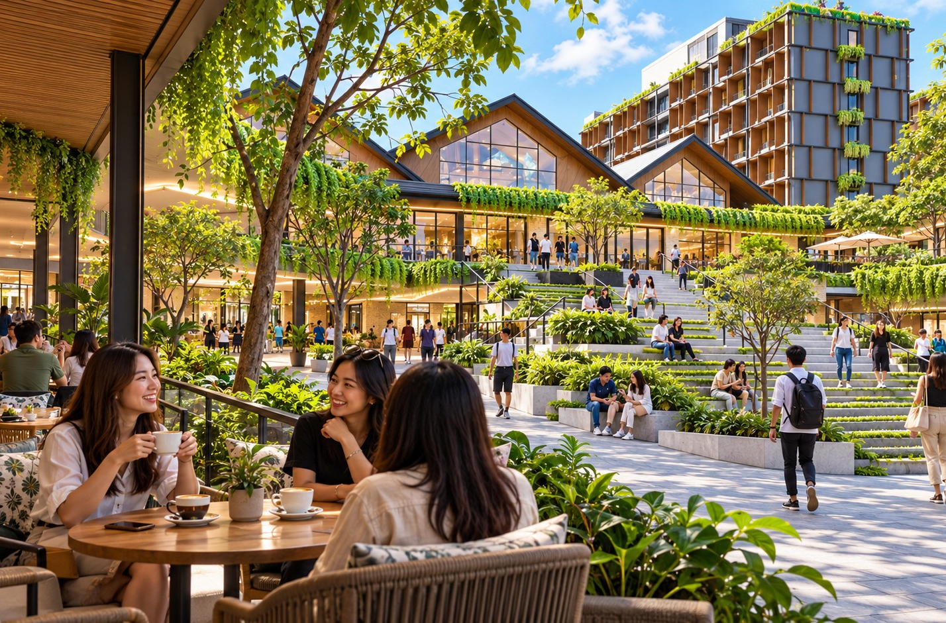
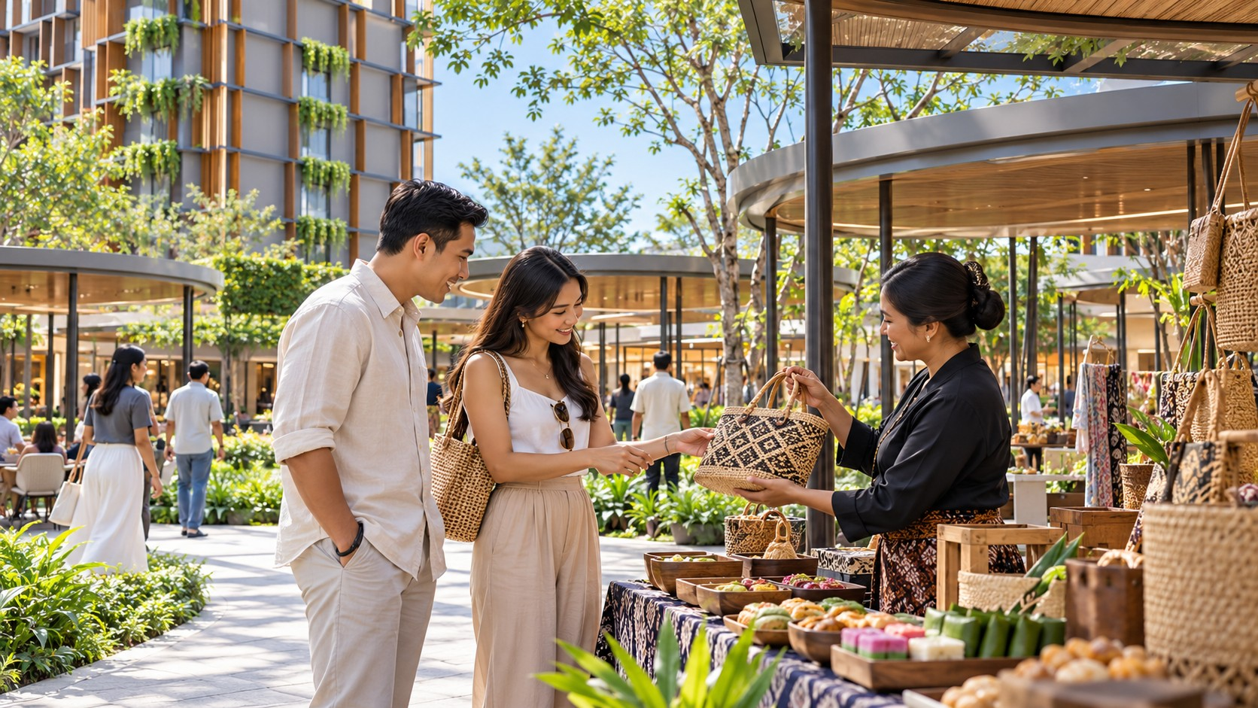
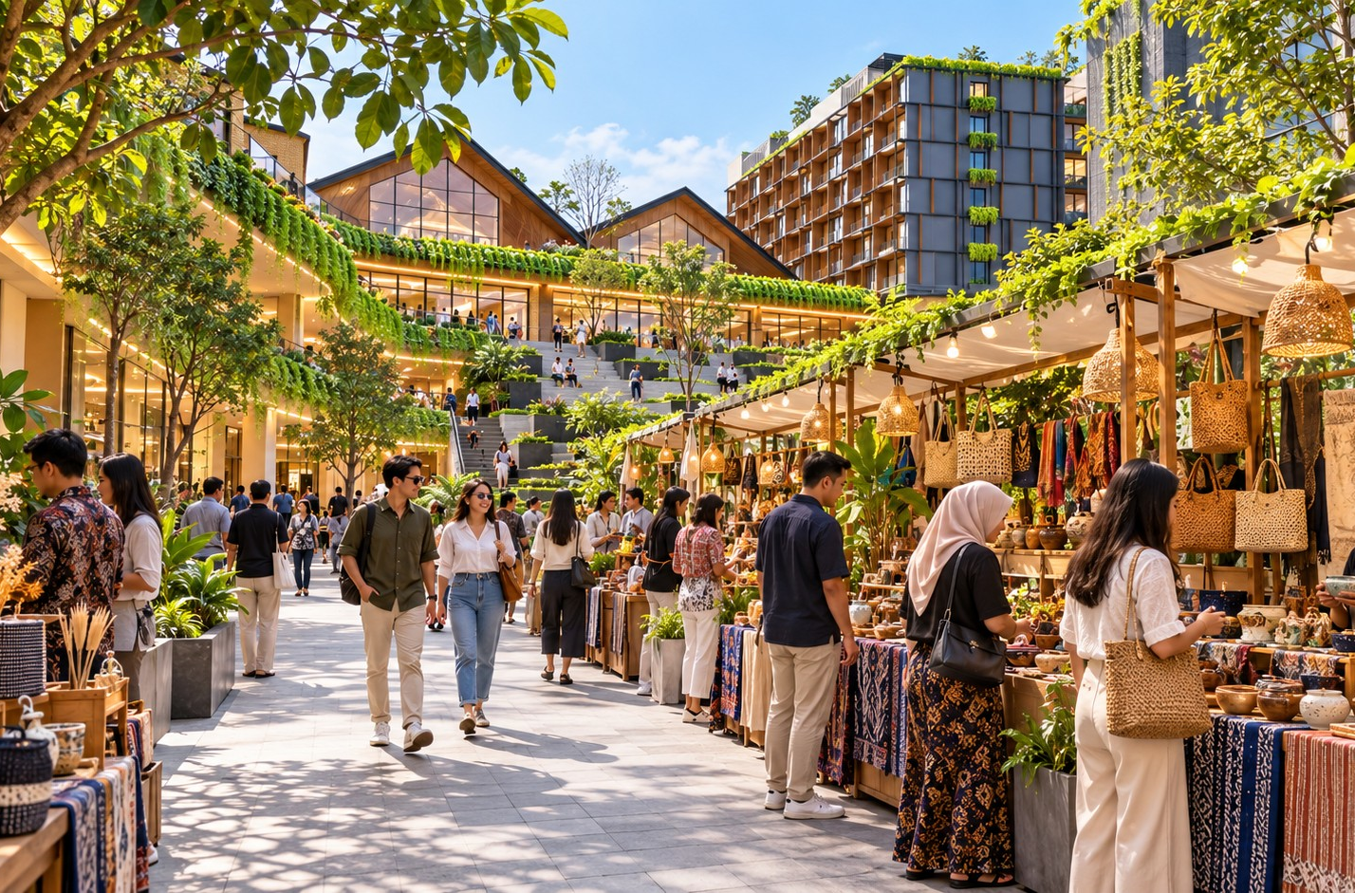
KALINDO / DESTINATION IDENTITY
DESTINATION EXPERIENCE
THE VERANDA
The heart of
the destination.
The flexible social heart of the district, supporting everyday gatherings and programmed occasions.
One shared place. Four ways to come together.
01
02
03
04
Everyday Veranda
Market Veranda
Evening Veranda
Celebration Veranda
Casual meetings, comfortable seating and cafés.
Curated food, local makers and lifestyle markets.
Dining, intimate performances and social gatherings.
Cultural occasions, seasonal events and destination programming.
Proposed modes of use. Keep circulation and surrounding tenants accessible; the court is not a permanent event venue.
DESTINATION EXPERIENCE
SUPPLIED CONCEPT IMAGERY · NOT VERIFIED AS BUILT / 10
Notes:
Slide 10: The heart of the destination.
EDITABLE VERSION: text, photos, rules, diagrams and backgrounds are native PowerPoint objects. Click an element to edit, replace or delete it. All assets are embedded. Fonts use Georgia and Arial for portability.
One shared place. Four ways to come together.
Proposed modes of use. Keep circulation and surrounding tenants accessible; the court is not a permanent event venue.
brunch / Everyday Veranda / Casual meetings, comfortable seating and cafés.
market / Market Veranda / Curated food, local makers and lifestyle markets.
night / Evening Veranda / Dining, intimate performances and social gatherings.
veranda / Celebration Veranda / Cultural occasions, seasonal events and destination programming.
Source: KALINDO PROJECT.pdf. Concepts, programmes and naming recommendations are not approvals. See presentation/CONTENT-REVIEW.md.

Slide 11
KALINDO / DESTINATION IDENTITY
DESTINATION EXPERIENCE
Destination experience
Connected places.
Different rhythms.
The spatial experience
Arrival Garden
Hospitality & Retreat Spaces
A welcoming entrance with clear orientation.
THE QUIETER LAYER
Pedestrian Promenades
↔
Comfortable connections between tenants, activities and levels.
PEDESTRIAN PROMENADES
Garden Terraces
Places to pause, dine and observe district life.
Arrival
The Veranda
Garden
The Veranda
Garden
Terraces
The shared gathering place and event setting.
THE SHARED HEART
Hospitality & Retreat Spaces
A quieter layer for guests to stay and unwind.
CONNECTED EXPERIENCES · NOT A GEOGRAPHIC ROUTE
Conceptual relationship diagram, not a site plan or to scale. Based on the brief and supplied spatial overlay; routes and privacy buffers require architectural coordination.
DESTINATION EXPERIENCE
CONCEPTUAL DIAGRAM / 11
Notes:
Slide 11: Connected places. Different rhythms.
EDITABLE VERSION: text, photos, rules, diagrams and backgrounds are native PowerPoint objects. Click an element to edit, replace or delete it. All assets are embedded. Fonts use Georgia and Arial for portability.
The spatial experience
Conceptual relationship diagram, not a site plan or to scale. Based on the brief and supplied spatial overlay; routes and privacy buffers require architectural coordination.
Arrival Garden / A welcoming entrance with clear orientation.
Pedestrian Promenades / Comfortable connections between tenants, activities and levels.
Garden Terraces / Places to pause, dine and observe district life.
The Veranda / The shared gathering place and event setting.
Hospitality & Retreat Spaces / A quieter layer for guests to stay and unwind.
Source: KALINDO PROJECT.pdf. Concepts, programmes and naming recommendations are not approvals. See presentation/CONTENT-REVIEW.md.

Slide 12
KALINDO / DESTINATION IDENTITY
DESTINATION EXPERIENCE
Destination experience
Comfort makes the
experience possible.
The tropical character comes from how a visit feels.
01
02
Covered connections
Shade & air movement
Protect essential journeys.
Support comfortable walking and seating.
03
04
Vertical access
Family facilities
Connect the different levels clearly.
Make longer visits easier.
05
06
Evening lighting
Rain alternatives
Create an inviting atmosphere.
Give events a workable wet-weather plan.
Design requirements for architectural validation. Building comfort and performance are not verified.
DESTINATION EXPERIENCE
SUPPLIED CONCEPT IMAGERY · NOT VERIFIED AS BUILT / 12
Notes:
Slide 12: Comfort makes the experience possible.
EDITABLE VERSION: text, photos, rules, diagrams and backgrounds are native PowerPoint objects. Click an element to edit, replace or delete it. All assets are embedded. Fonts use Georgia and Arial for portability.
The tropical character comes from how a visit feels.
Design requirements for architectural validation. Building comfort and performance are not verified.
Covered connections / Protect essential journeys.
Shade & air movement / Support comfortable walking and seating.
Vertical access / Connect the different levels clearly.
Family facilities / Make longer visits easier.
Evening lighting / Create an inviting atmosphere.
Rain alternatives / Give events a workable wet-weather plan.
Source: KALINDO PROJECT.pdf. Concepts, programmes and naming recommendations are not approvals. See presentation/CONTENT-REVIEW.md.

Slide 13
KALINDO / DESTINATION IDENTITY
AUDIENCE & VISITOR JOURNEYS
Audience & visitor journeys
Local life builds the foundation.
Regional leisure extends the opportunity.
01
02
03
04
Batam families
Professionals & social groups
Local communities
Regional visitors & hotel guests
Easy, enjoyable time together.
Places to meet and unwind.
A welcoming place to return to.
Family activities, dining, grocery and events.
Cafés, lunch, fitness and evening dining.
Workshops, markets, gatherings and performances.
A worthwhile short stay.
Culinary discovery, hospitality and signature programmes.
AUDIENCE & VISITOR JOURNEYS
SUPPLIED CONCEPT IMAGERY · NOT VERIFIED AS BUILT / 13
Notes:
Slide 13: Local life builds the foundation. Regional leisure extends the opportunity.
EDITABLE VERSION: text, photos, rules, diagrams and backgrounds are native PowerPoint objects. Click an element to edit, replace or delete it. All assets are embedded. Fonts use Georgia and Arial for portability.
family / Batam families / Easy, enjoyable time together. / Family activities, dining, grocery and events.
friends / Professionals & social groups / Places to meet and unwind. / Cafés, lunch, fitness and evening dining.
pets / Local communities / A welcoming place to return to. / Workshops, markets, gatherings and performances.
hotel / Regional visitors & hotel guests / A worthwhile short stay. / Culinary discovery, hospitality and signature programmes.
Source: KALINDO PROJECT.pdf. Concepts, programmes and naming recommendations are not approvals. See presentation/CONTENT-REVIEW.md.

Slide 14
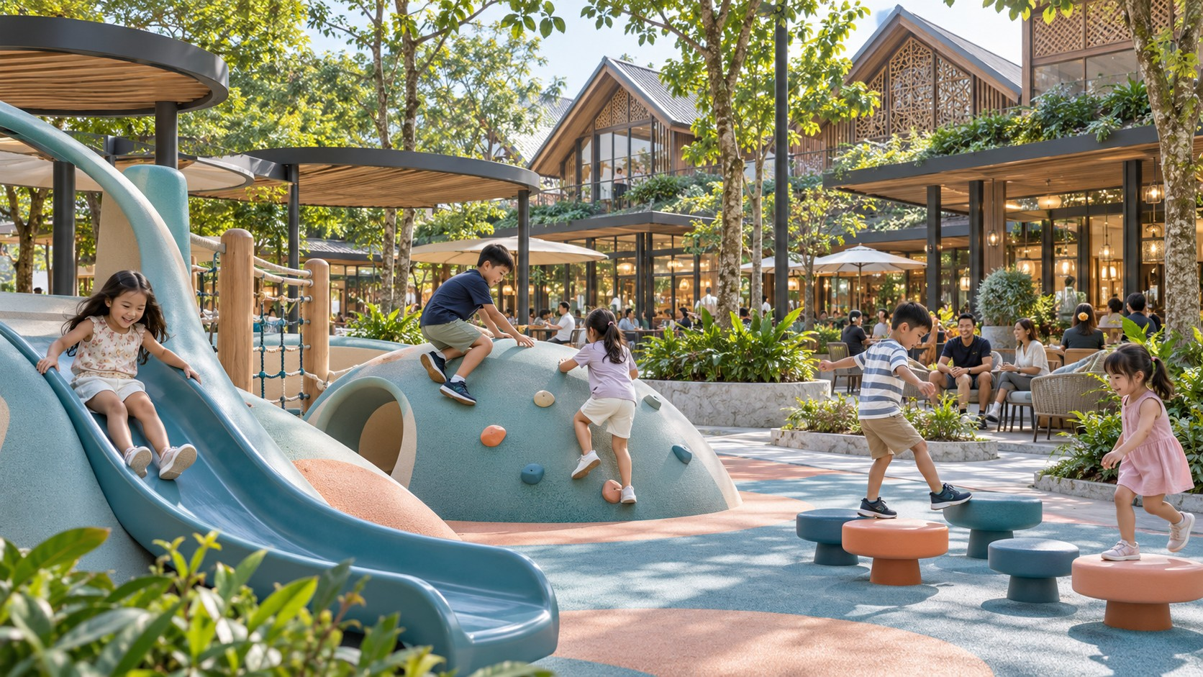
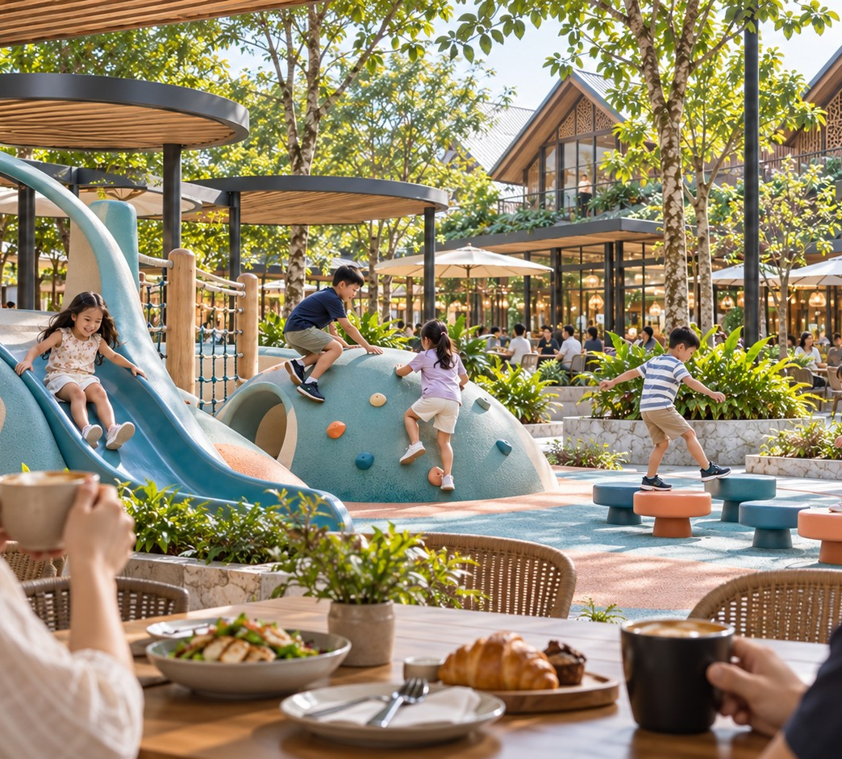
KALINDO / DESTINATION IDENTITY
AUDIENCE & VISITOR JOURNEYS
THE LOCAL FAMILY JOURNEY
A family afternoon
that grows into an evening.
01
02
03
04
05
→
→
→
→
Arrival
Activity
Time Nearby
Reunion
Shared Moment
Clear parking access and an easy route in.
Appropriate play or learning experiences.
Parents enjoy a café or browse nearby retail.
Meet again for a meal.
A programme at The Veranda extends the day.
Proposed journey. Distinguish shared family activities from children’s activities requiring managed supervision.
AUDIENCE & VISITOR JOURNEYS
SUPPLIED CONCEPT IMAGERY · NOT VERIFIED AS BUILT / 14
Notes:
Slide 14: A family afternoon that grows into an evening.
EDITABLE VERSION: text, photos, rules, diagrams and backgrounds are native PowerPoint objects. Click an element to edit, replace or delete it. All assets are embedded. Fonts use Georgia and Arial for portability.
Proposed journey. Distinguish shared family activities from children’s activities requiring managed supervision.
cover / Arrival / Clear parking access and an easy route in.
kids / Activity / Appropriate play or learning experiences.
parents / Time Nearby / Parents enjoy a café or browse nearby retail.
family / Reunion / Meet again for a meal.
pets / Shared Moment / A programme at The Veranda extends the day.
Source: KALINDO PROJECT.pdf. Concepts, programmes and naming recommendations are not approvals. See presentation/CONTENT-REVIEW.md.

Slide 15
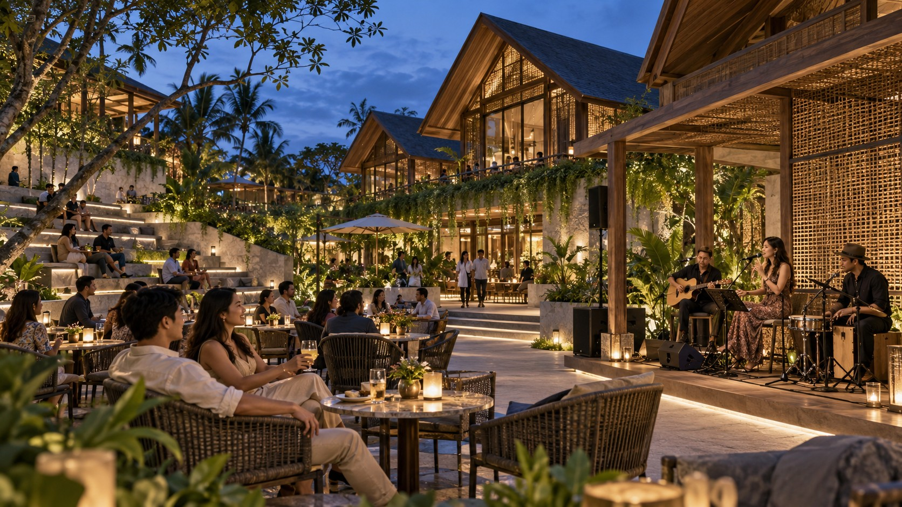
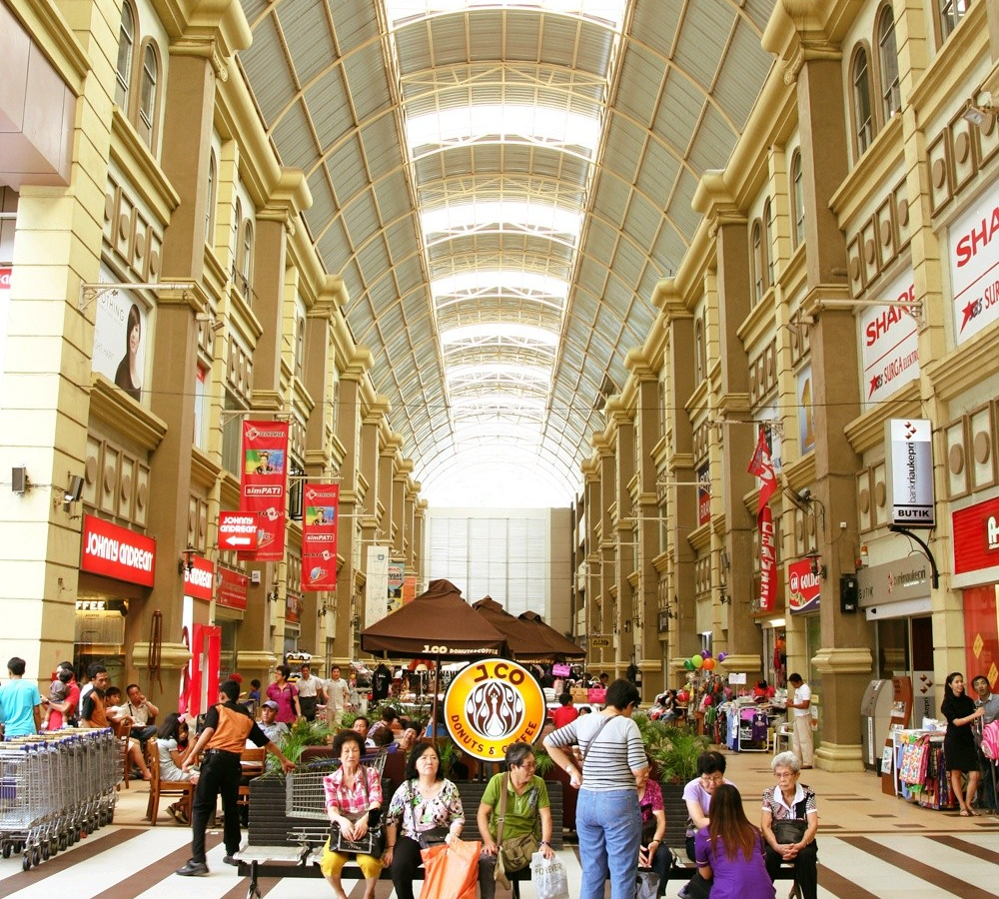
KALINDO / DESTINATION IDENTITY
AUDIENCE & VISITOR JOURNEYS
THE REGIONAL GUEST JOURNEY
A stay with more
of Batam in it.
01
02
03
04
05
→
→
→
→
Check In
Taste
Gather
Unwind
Discover Further
Settle in and discover the district programme.
Explore Indonesian food and seafood.
Enjoy an evening at The Veranda.
Choose quieter leisure or wellness.
Explore a curated Batam itinerary.
Proposed journey; tourism partner arrangements remain to be developed. Final image is a supplied city reference, not a KALINDO facility.
AUDIENCE & VISITOR JOURNEYS
SUPPLIED CONCEPT IMAGERY · NOT VERIFIED AS BUILT / 15
Notes:
Slide 15: A stay with more of Batam in it.
EDITABLE VERSION: text, photos, rules, diagrams and backgrounds are native PowerPoint objects. Click an element to edit, replace or delete it. All assets are embedded. Fonts use Georgia and Arial for portability.
Proposed journey; tourism partner arrangements remain to be developed. Final image is a supplied city reference, not a KALINDO facility.
hotel / Check In / Settle in and discover the district programme.
table / Taste / Explore Indonesian food and seafood.
evening / Gather / Enjoy an evening at The Veranda.
leisure / Unwind / Choose quieter leisure or wellness.
context2 / Discover Further / Explore a curated Batam itinerary.
Source: KALINDO PROJECT.pdf. Concepts, programmes and naming recommendations are not approvals. See presentation/CONTENT-REVIEW.md.

Slide 16
KALINDO / DESTINATION IDENTITY
AUDIENCE & VISITOR JOURNEYS
Audience & visitor journeys
Different reasons to visit
throughout the day.
01
02
03
04
05
Morning
Midday
Afternoon
Evening
Selected weekends
Breakfast · coffee · fitness · everyday shopping
Lunch · retail · hotel guest activity
Families · cafés · workshops
Dinner · The Veranda programmes
Markets · collaborations · visitor packages
Encourage longer visits.
Build recurring routines.
Support daytime transactions.
Strengthen social and culinary appeal.
Attract leisure visits.
Strategic dayparts, not approved operating hours. Timing follows tenant and operator readiness.
AUDIENCE & VISITOR JOURNEYS
SUPPLIED CONCEPT IMAGERY · NOT VERIFIED AS BUILT / 16
Notes:
Slide 16: Different reasons to visit throughout the day.
EDITABLE VERSION: text, photos, rules, diagrams and backgrounds are native PowerPoint objects. Click an element to edit, replace or delete it. All assets are embedded. Fonts use Georgia and Arial for portability.
Strategic dayparts, not approved operating hours. Timing follows tenant and operator readiness.
cafe / Morning / Breakfast · coffee · fitness · everyday shopping / Build recurring routines.
retail / Midday / Lunch · retail · hotel guest activity / Support daytime transactions.
kids / Afternoon / Families · cafés · workshops / Encourage longer visits.
night / Evening / Dinner · The Veranda programmes / Strengthen social and culinary appeal.
market / Selected weekends / Markets · collaborations · visitor packages / Attract leisure visits.
Source: KALINDO PROJECT.pdf. Concepts, programmes and naming recommendations are not approvals. See presentation/CONTENT-REVIEW.md.

Slide 17
KALINDO / DESTINATION IDENTITY
TENANT STRATEGY & PROGRAMMING
Tenant strategy & programming
Anchors attract.
The district extends the visit.
A considered mix, connected by shared experiences.
01
Everyday anchors
Establish dependable repeat visitation.
SHARED DESTINATION SPACE
02
Destination anchors
The Veranda
Give people a clear reason to choose the district.
03
Experience tenants
Gathering, discovery
Extend time through activities, dining and leisure.
and time together.
04
Discovery tenants
Add distinctive products and changing content.
Eat / Shop / Play / Move / Stay
05
Hospitality partners
Connect overnight guests with the wider district.
Strategic tenant roles; no confirmed tenants. Selection considers customer fit, price range, hours, frontage and neighbouring experiences.
TENANT STRATEGY & PROGRAMMING
STRATEGIC PROPOSAL / 17
Notes:
Slide 17: Anchors attract. The district extends the visit.
EDITABLE VERSION: text, photos, rules, diagrams and backgrounds are native PowerPoint objects. Click an element to edit, replace or delete it. All assets are embedded. Fonts use Georgia and Arial for portability.
A considered mix, connected by shared experiences.
Strategic tenant roles; no confirmed tenants. Selection considers customer fit, price range, hours, frontage and neighbouring experiences.
Everyday anchors / Establish dependable repeat visitation.
Destination anchors / Give people a clear reason to choose the district.
Experience tenants / Extend time through activities, dining and leisure.
Discovery tenants / Add distinctive products and changing content.
Hospitality partners / Connect overnight guests with the wider district.
Source: KALINDO PROJECT.pdf. Concepts, programmes and naming recommendations are not approvals. See presentation/CONTENT-REVIEW.md.

Slide 18
KALINDO / DESTINATION IDENTITY
TENANT STRATEGY & PROGRAMMING
Tenant strategy & programming
The Veranda calendar.
Proposed programming concepts
01
02
03
04
Veranda Sessions
The Weekend Edit
Batam Table
The Family Social
Selected music and performance, paired with dining.
A curated market of food, makers and rotating brands.
Indonesian chefs and local producers, with opportunities for regional exchange.
Creative activities and shared family experiences.
Frequency, scale, capacity, cost and operational plans remain to be developed and approved.
TENANT STRATEGY & PROGRAMMING
SUPPLIED CONCEPT IMAGERY · NOT VERIFIED AS BUILT / 18
Notes:
Slide 18: The Veranda calendar.
EDITABLE VERSION: text, photos, rules, diagrams and backgrounds are native PowerPoint objects. Click an element to edit, replace or delete it. All assets are embedded. Fonts use Georgia and Arial for portability.
Proposed programming concepts
Frequency, scale, capacity, cost and operational plans remain to be developed and approved.
evening / Veranda Sessions / Selected music and performance, paired with dining.
market / The Weekend Edit / A curated market of food, makers and rotating brands.
table / Batam Table / Indonesian chefs and local producers, with opportunities for regional exchange.
kids / The Family Social / Creative activities and shared family experiences.
Source: KALINDO PROJECT.pdf. Concepts, programmes and naming recommendations are not approvals. See presentation/CONTENT-REVIEW.md.

Slide 19
KALINDO / DESTINATION IDENTITY
TENANT STRATEGY & PROGRAMMING
THE FLAGSHIP EXPERIENCE
Batam Table
A shared table at The Veranda.
A changing edition can spotlight an Indonesian region, a local ingredient, a chef collaboration or a regional exchange. Bookable dining is complemented by activities neighbouring tenants can join.
01
02
Shared dinner
Tasting market
03
04
Chef demonstration
Producer showcase
Proposed culinary concept. Potential collaborators and regional exchanges are not confirmed partnerships.
TENANT STRATEGY & PROGRAMMING
SUPPLIED CONCEPT IMAGERY · NOT VERIFIED AS BUILT / 19
Notes:
Slide 19: Batam Table
EDITABLE VERSION: text, photos, rules, diagrams and backgrounds are native PowerPoint objects. Click an element to edit, replace or delete it. All assets are embedded. Fonts use Georgia and Arial for portability.
A shared table at The Veranda.
A changing edition can spotlight an Indonesian region, a local ingredient, a chef collaboration or a regional exchange. Bookable dining is complemented by activities neighbouring tenants can join.
Proposed culinary concept. Potential collaborators and regional exchanges are not confirmed partnerships.
01 / Shared dinner
02 / Tasting market
03 / Chef demonstration
04 / Producer showcase
Source: KALINDO PROJECT.pdf. Concepts, programmes and naming recommendations are not approvals. See presentation/CONTENT-REVIEW.md.

Slide 20
KALINDO / DESTINATION IDENTITY
BRAND IDENTITY
Brand identity
Contemporary tropical.
Warm and confident.
Visual identity
Architectural proportions, generous spacing, a recognisable graphic system.
Photography
Real interactions, food, discovery and the changing atmosphere of the district.
Tone of voice
Inviting and clear, with specific reasons to visit.
Service character
Approachable hospitality at arrival, information, family support and events.
EDITORIAL SERIF × CONTEMPORARY SANS
Life comes together.
Forest
Garden
Sage
Ivory
Stone
#183D32
#6D8767
#DCE4D5
#F4F1E8
#D8D1C4
BRAND IDENTITY
SUPPLIED CONCEPT IMAGERY · NOT VERIFIED AS BUILT / 20
Notes:
Slide 20: Contemporary tropical. Warm and confident.
EDITABLE VERSION: text, photos, rules, diagrams and backgrounds are native PowerPoint objects. Click an element to edit, replace or delete it. All assets are embedded. Fonts use Georgia and Arial for portability.
Visual identity / Architectural proportions, generous spacing, a recognisable graphic system.
Photography / Real interactions, food, discovery and the changing atmosphere of the district.
Tone of voice / Inviting and clear, with specific reasons to visit.
Service character / Approachable hospitality at arrival, information, family support and events.
Source: KALINDO PROJECT.pdf. Concepts, programmes and naming recommendations are not approvals. See presentation/CONTENT-REVIEW.md.

Slide 21
KALINDO / DESTINATION IDENTITY
BRAND IDENTITY
Brand identity
One destination.
A recognisable heart.
MASTER DESTINATION
[Selected Masterbrand]
Batam’s Tropical Lifestyle District
APPLICATION EXAMPLES
The Veranda at [Masterbrand]
SIGNATURE GATHERING & EVENT EXPERIENCE
The Veranda
Batam Table at The Veranda
Discover what’s on at [Masterbrand]
PROGRAMMING
Veranda Sessions · Batam Table · The Weekend Edit · The Family Social
EXPERIENCE CATEGORIES
Eat · Shop · Play · Move · Stay · Explore · Unwind
Masterbrand remains unselected. The Veranda names the central gathering and event experience, not the whole destination.
BRAND IDENTITY
STRATEGIC PROPOSAL / 21
Notes:
Slide 21: One destination. A recognisable heart.
EDITABLE VERSION: text, photos, rules, diagrams and backgrounds are native PowerPoint objects. Click an element to edit, replace or delete it. All assets are embedded. Fonts use Georgia and Arial for portability.
Masterbrand remains unselected. The Veranda names the central gathering and event experience, not the whole destination.
Source: KALINDO PROJECT.pdf. Concepts, programmes and naming recommendations are not approvals. See presentation/CONTENT-REVIEW.md.

Slide 22
KALINDO / DESTINATION IDENTITY
BRAND IDENTITY
Brand identity
A name with the
01
Broad enough
presence of a destination.
Represent the entire district.
02
Memorable
Easy to speak and write.
Established enough for hospitality and regional appeal. Welcoming enough for everyday life.
03
Locally & regionally relevant
A place.
Work across local and regional communication.
A presence.
04
Flexible
Span retail, dining, events and hospitality.
A belonging.
05
Distinctive
Support a recognisable identity.
BRAND IDENTITY
STRATEGIC PROPOSAL / 22
Notes:
Slide 22: A name with the presence of a destination.
EDITABLE VERSION: text, photos, rules, diagrams and backgrounds are native PowerPoint objects. Click an element to edit, replace or delete it. All assets are embedded. Fonts use Georgia and Arial for portability.
Established enough for hospitality and regional appeal. Welcoming enough for everyday life.
01 / Broad enough / Represent the entire district.
02 / Memorable / Easy to speak and write.
03 / Locally & regionally relevant / Work across local and regional communication.
04 / Flexible / Span retail, dining, events and hospitality.
05 / Distinctive / Support a recognisable identity.
Source: KALINDO PROJECT.pdf. Concepts, programmes and naming recommendations are not approvals. See presentation/CONTENT-REVIEW.md.

Slide 23
KALINDO / DESTINATION IDENTITY
BRAND IDENTITY
Brand identity
Four routes.
One shared ambition.
ROUTE 01
ROUTE 02
Canopy Quarter
Garden Quarter
Tropical architecture and destination presence.
Landscape, hospitality and relaxed lifestyle.
ROUTE 03
ROUTE 04 / CREATIVE RECOMMENDATION
The Courtyard
Batam Commons
A central place for dining, community and social interaction.
City belonging and shared experiences.
Belonging to Batam. Open to everyone.
Creative recommendation from the brief, not an approved final name. Availability, legal and linguistic checks remain required.
BRAND IDENTITY
STRATEGIC PROPOSAL / 23
Notes:
Slide 23: Four routes. One shared ambition.
EDITABLE VERSION: text, photos, rules, diagrams and backgrounds are native PowerPoint objects. Click an element to edit, replace or delete it. All assets are embedded. Fonts use Georgia and Arial for portability.
Creative recommendation from the brief, not an approved final name. Availability, legal and linguistic checks remain required.
Canopy Quarter / Tropical architecture and destination presence.
Garden Quarter / Landscape, hospitality and relaxed lifestyle.
The Courtyard / A central place for dining, community and social interaction.
Batam Commons / City belonging and shared experiences.
Source: KALINDO PROJECT.pdf. Concepts, programmes and naming recommendations are not approvals. See presentation/CONTENT-REVIEW.md.

Slide 24
KALINDO / DESTINATION IDENTITY
BRAND IDENTITY
KALINDO PROJECT
Life comes together.
Across the district.
One Place. Many Ways to Spend the Day.
CONCEPT, BRAND POSITIONING & DESTINATION NAMING
SUPPLIED CONCEPT IMAGERY · NOT VERIFIED AS BUILT / 24
Notes:
Slide 24: Life comes together. Across the district.
EDITABLE VERSION: text, photos, rules, diagrams and backgrounds are native PowerPoint objects. Click an element to edit, replace or delete it. All assets are embedded. Fonts use Georgia and Arial for portability.
One Place. Many Ways to Spend the Day.
Source: KALINDO PROJECT.pdf. Concepts, programmes and naming recommendations are not approvals. See presentation/CONTENT-REVIEW.md.

