Slide 1
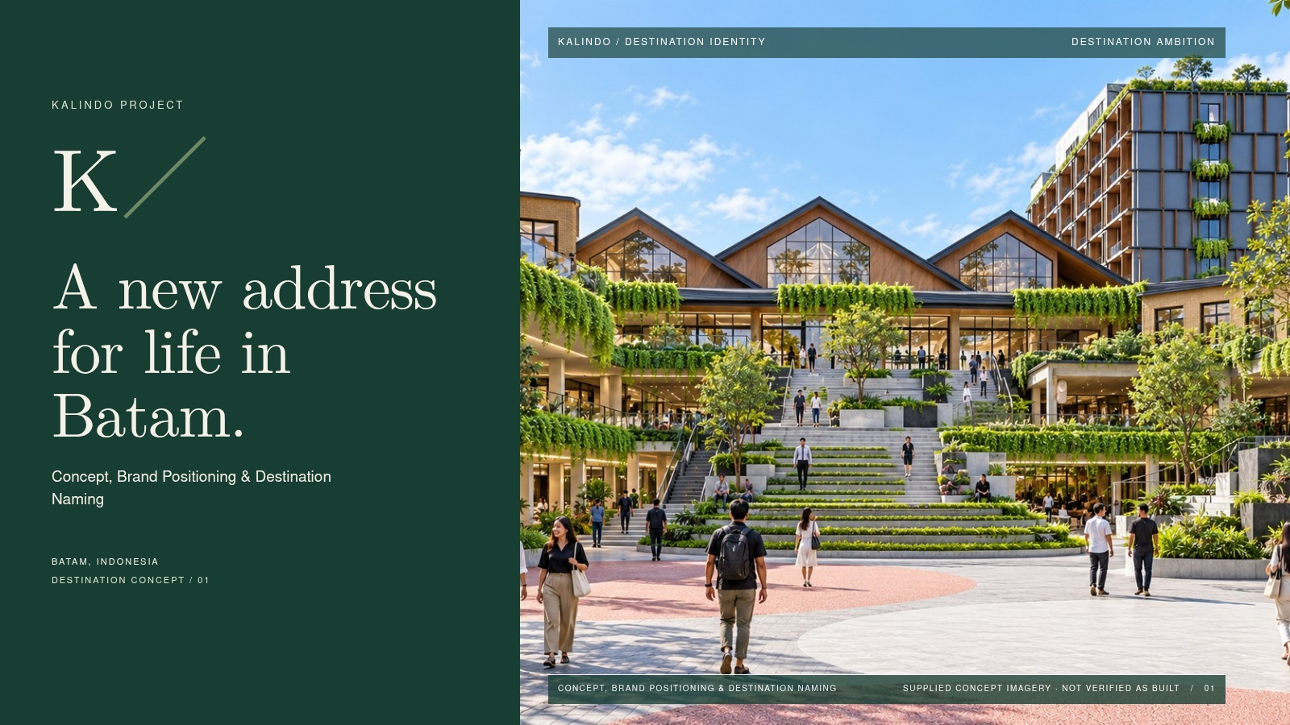
Notes:
SLIDE 01 / Destination ambition
A new address
for life in Batam.
Visual-fidelity version. The slide is a flattened image; edit source content/layout and regenerate to change it.
KALINDO PROJECT
Concept, Brand Positioning & Destination Naming
Authority: KALINDO PROJECT.pdf. Supplied concept imagery is not verified as built. See presentation/CONTENT-REVIEW.md.

Slide 2
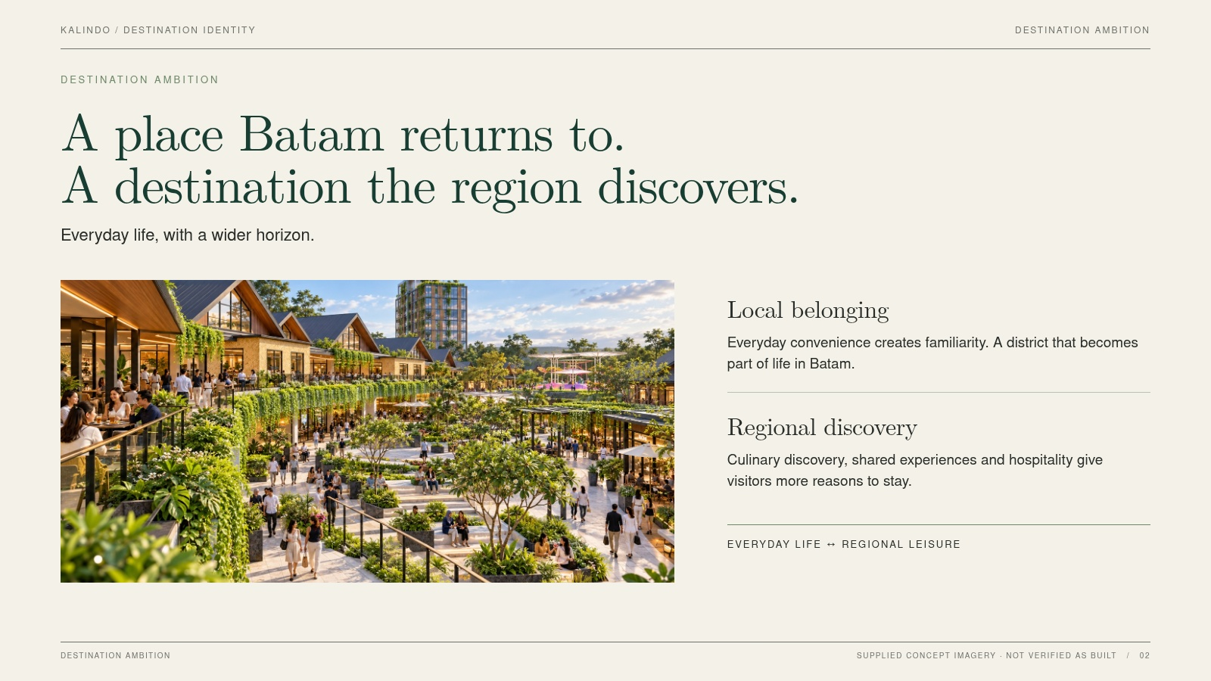
Notes:
SLIDE 02 / Destination ambition
A place Batam returns to.
A destination the region discovers.
Visual-fidelity version. The slide is a flattened image; edit source content/layout and regenerate to change it.
Everyday life, with a wider horizon.
Local belonging / Everyday convenience creates familiarity. A district that becomes part of life in Batam.
Regional discovery / Culinary discovery, shared experiences and hospitality give visitors more reasons to stay.
Authority: KALINDO PROJECT.pdf. Supplied concept imagery is not verified as built. See presentation/CONTENT-REVIEW.md.

Slide 3
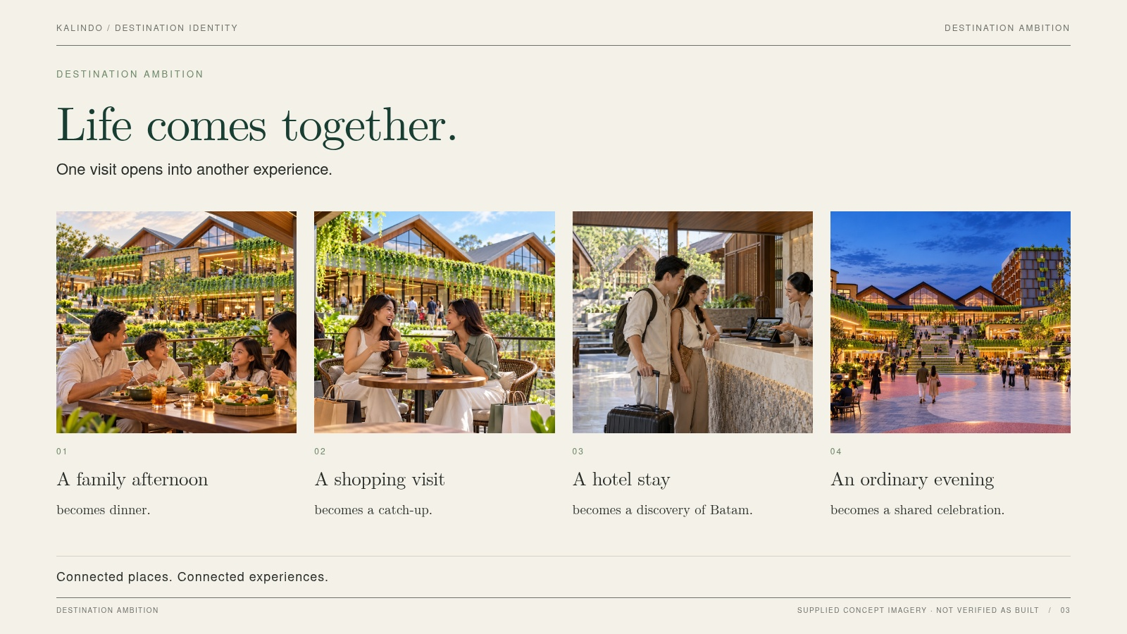
Notes:
SLIDE 03 / Destination ambition
Life comes together.
Visual-fidelity version. The slide is a flattened image; edit source content/layout and regenerate to change it.
One visit opens into another experience.
family / A family afternoon / becomes dinner.
friends / A shopping visit / becomes a catch-up.
hotel / A hotel stay / becomes a discovery of Batam.
night / An ordinary evening / becomes a shared celebration.
Authority: KALINDO PROJECT.pdf. Supplied concept imagery is not verified as built. See presentation/CONTENT-REVIEW.md.

Slide 4
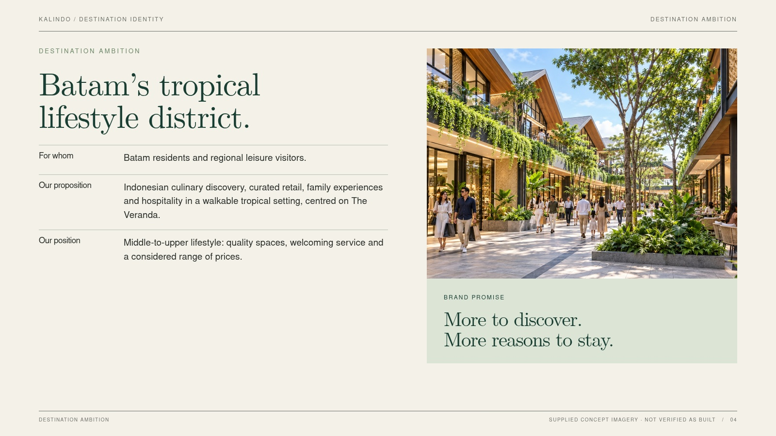
Notes:
SLIDE 04 / Destination ambition
Batam’s tropical
lifestyle district.
Visual-fidelity version. The slide is a flattened image; edit source content/layout and regenerate to change it.
More to discover.
More reasons to stay.
For whom / Batam residents and regional leisure visitors.
Our proposition / Indonesian culinary discovery, curated retail, family experiences and hospitality in a walkable tropical setting, centred on The Veranda.
Our position / Middle-to-upper lifestyle: quality spaces, welcoming service and a considered range of prices.
Authority: KALINDO PROJECT.pdf. Supplied concept imagery is not verified as built. See presentation/CONTENT-REVIEW.md.

Slide 5
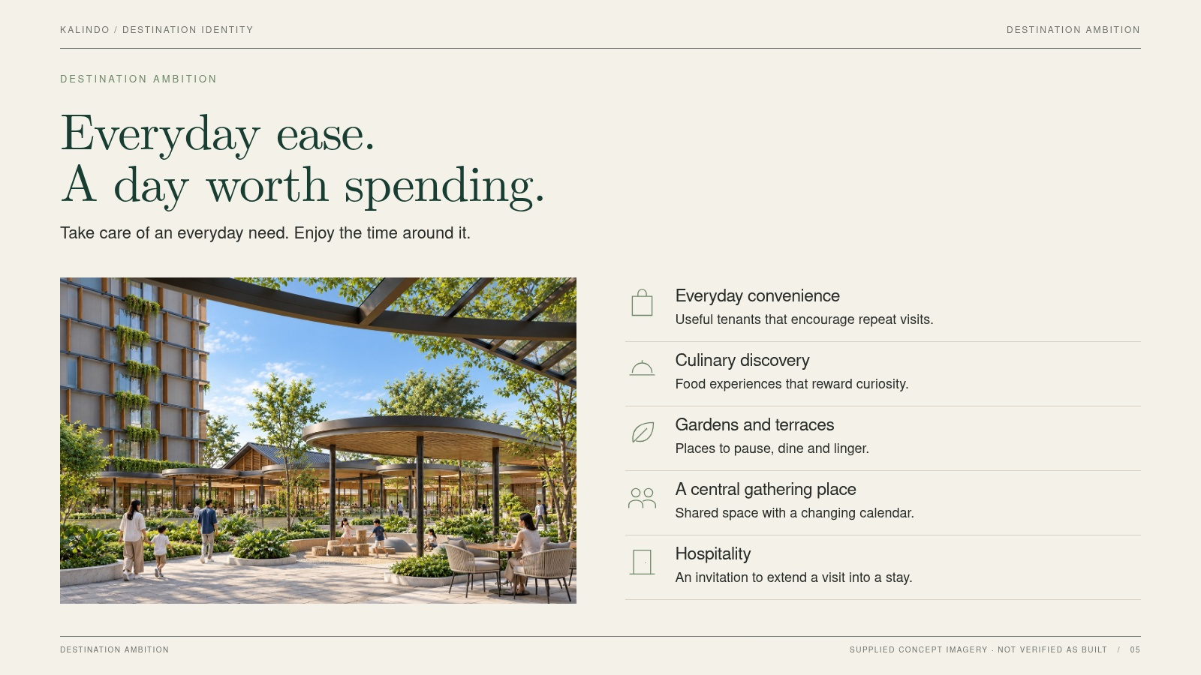
Notes:
SLIDE 05 / Destination ambition
Everyday ease.
A day worth spending.
Visual-fidelity version. The slide is a flattened image; edit source content/layout and regenerate to change it.
Take care of an everyday need. Enjoy the time around it.
bag / Everyday convenience / Useful tenants that encourage repeat visits.
dish / Culinary discovery / Food experiences that reward curiosity.
leaf / Gardens and terraces / Places to pause, dine and linger.
people / A central gathering place / Shared space with a changing calendar.
door / Hospitality / An invitation to extend a visit into a stay.
Authority: KALINDO PROJECT.pdf. Supplied concept imagery is not verified as built. See presentation/CONTENT-REVIEW.md.

Slide 6
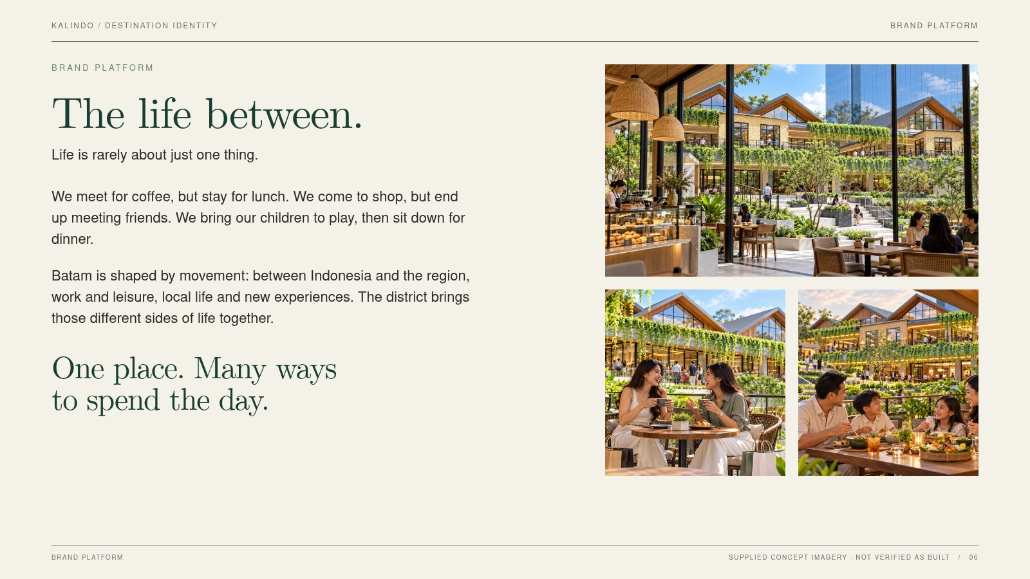
Notes:
SLIDE 06 / Brand platform
The life between.
Visual-fidelity version. The slide is a flattened image; edit source content/layout and regenerate to change it.
Life is rarely about just one thing.
We meet for coffee, but stay for lunch. We come to shop, but end up meeting friends. We bring our children to play, then sit down for dinner.
Batam is shaped by movement: between Indonesia and the region, work and leisure, local life and new experiences. The district brings those different sides of life together.
One place. Many ways
to spend the day.
Authority: KALINDO PROJECT.pdf. Supplied concept imagery is not verified as built. See presentation/CONTENT-REVIEW.md.

Slide 7
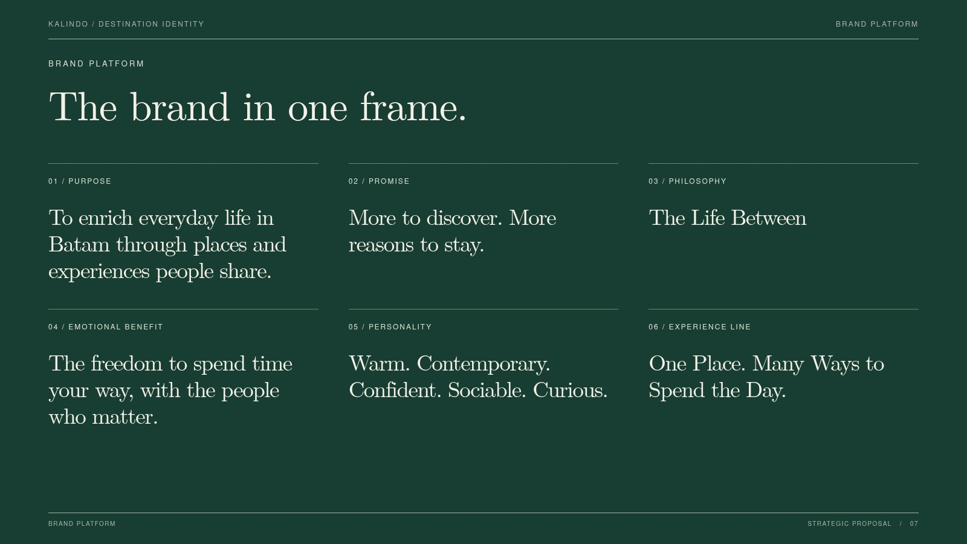
Notes:
SLIDE 07 / Brand platform
The brand in one frame.
Visual-fidelity version. The slide is a flattened image; edit source content/layout and regenerate to change it.
Purpose / To enrich everyday life in Batam through places and experiences people share.
Promise / More to discover. More reasons to stay.
Philosophy / The Life Between
Emotional benefit / The freedom to spend time your way, with the people who matter.
Personality / Warm. Contemporary. Confident. Sociable. Curious.
Experience line / One Place. Many Ways to Spend the Day.
Authority: KALINDO PROJECT.pdf. Supplied concept imagery is not verified as built. See presentation/CONTENT-REVIEW.md.

Slide 8
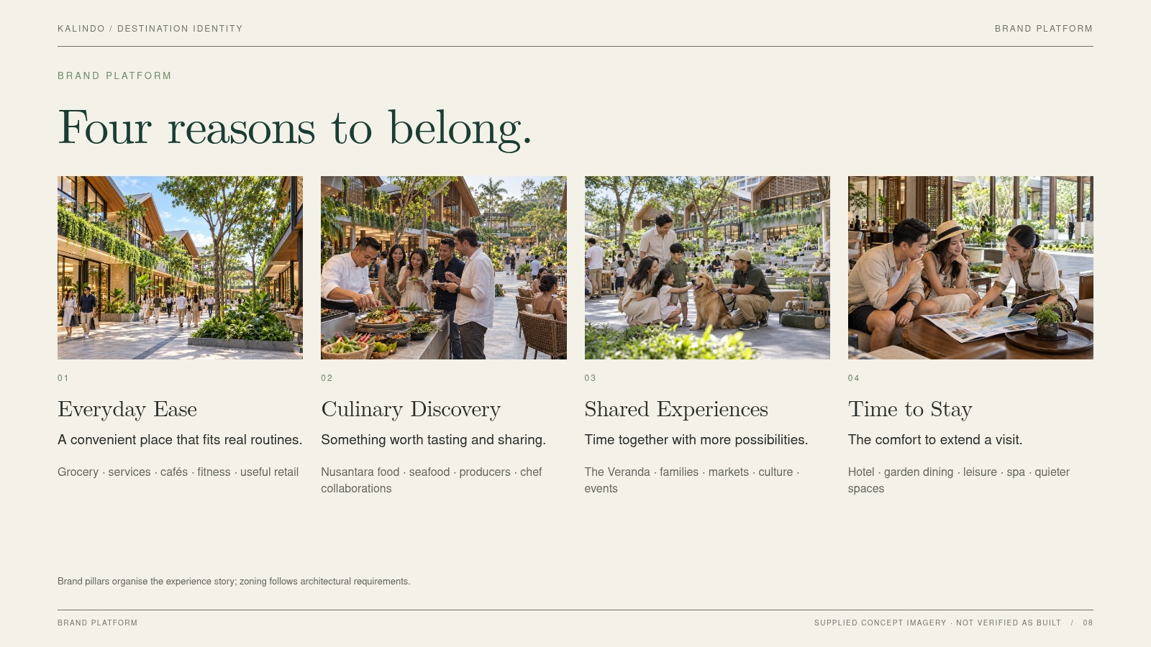
Notes:
SLIDE 08 / Brand platform
Four reasons to belong.
Visual-fidelity version. The slide is a flattened image; edit source content/layout and regenerate to change it.
retail / Everyday Ease / A convenient place that fits real routines. / Grocery · services · cafés · fitness · useful retail
table / Culinary Discovery / Something worth tasting and sharing. / Nusantara food · seafood · producers · chef collaborations
pets / Shared Experiences / Time together with more possibilities. / The Veranda · families · markets · culture · events
leisure / Time to Stay / The comfort to extend a visit. / Hotel · garden dining · leisure · spa · quieter spaces
REVIEW NOTE: Brand pillars organise the experience story; zoning follows architectural requirements.
Authority: KALINDO PROJECT.pdf. Supplied concept imagery is not verified as built. See presentation/CONTENT-REVIEW.md.

Slide 9
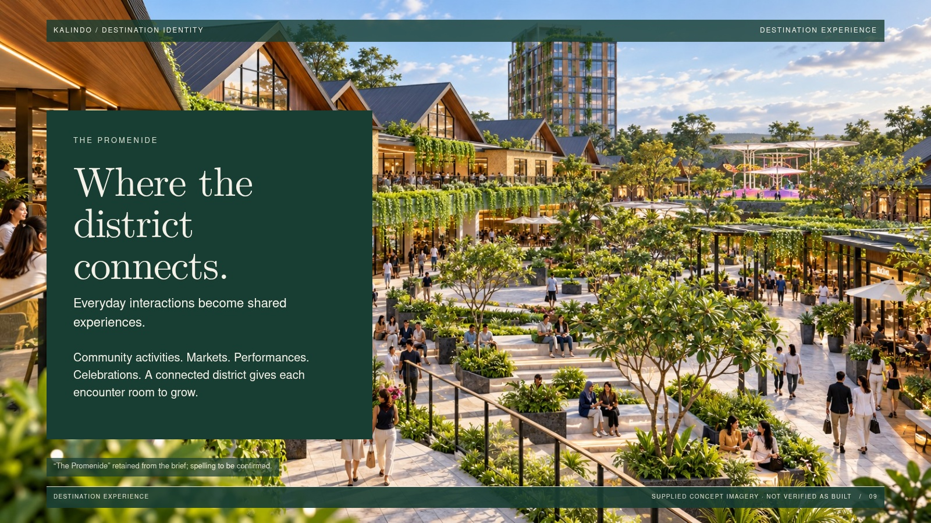
Notes:
SLIDE 09 / Destination experience
Where the
district connects.
Visual-fidelity version. The slide is a flattened image; edit source content/layout and regenerate to change it.
THE PROMENIDE
Everyday interactions become shared experiences.
Community activities. Markets. Performances. Celebrations. A connected district gives each encounter room to grow.
REVIEW NOTE: “The Promenide” retained from the brief; spelling to be confirmed.
Authority: KALINDO PROJECT.pdf. Supplied concept imagery is not verified as built. See presentation/CONTENT-REVIEW.md.

Slide 10
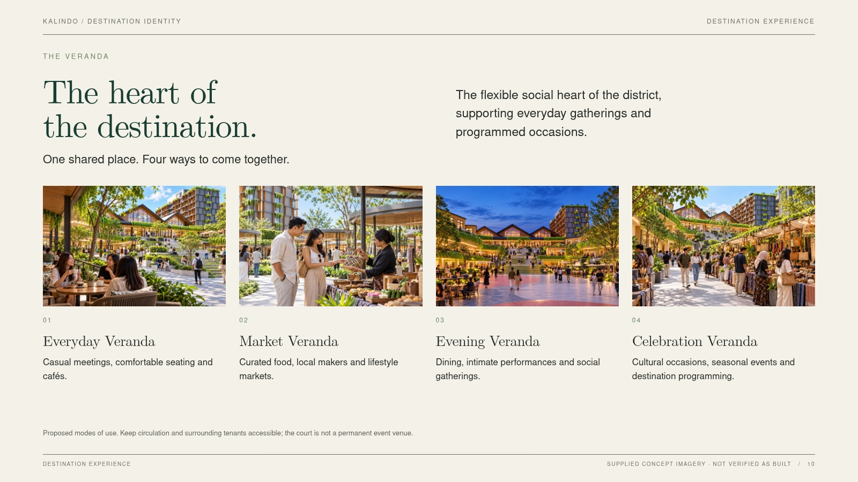
Notes:
SLIDE 10 / Destination experience
The heart of
the destination.
Visual-fidelity version. The slide is a flattened image; edit source content/layout and regenerate to change it.
THE VERANDA
One shared place. Four ways to come together.
brunch / Everyday Veranda / Casual meetings, comfortable seating and cafés.
market / Market Veranda / Curated food, local makers and lifestyle markets.
night / Evening Veranda / Dining, intimate performances and social gatherings.
veranda / Celebration Veranda / Cultural occasions, seasonal events and destination programming.
REVIEW NOTE: Proposed modes of use. Keep circulation and surrounding tenants accessible; the court is not a permanent event venue.
Authority: KALINDO PROJECT.pdf. Supplied concept imagery is not verified as built. See presentation/CONTENT-REVIEW.md.

Slide 11
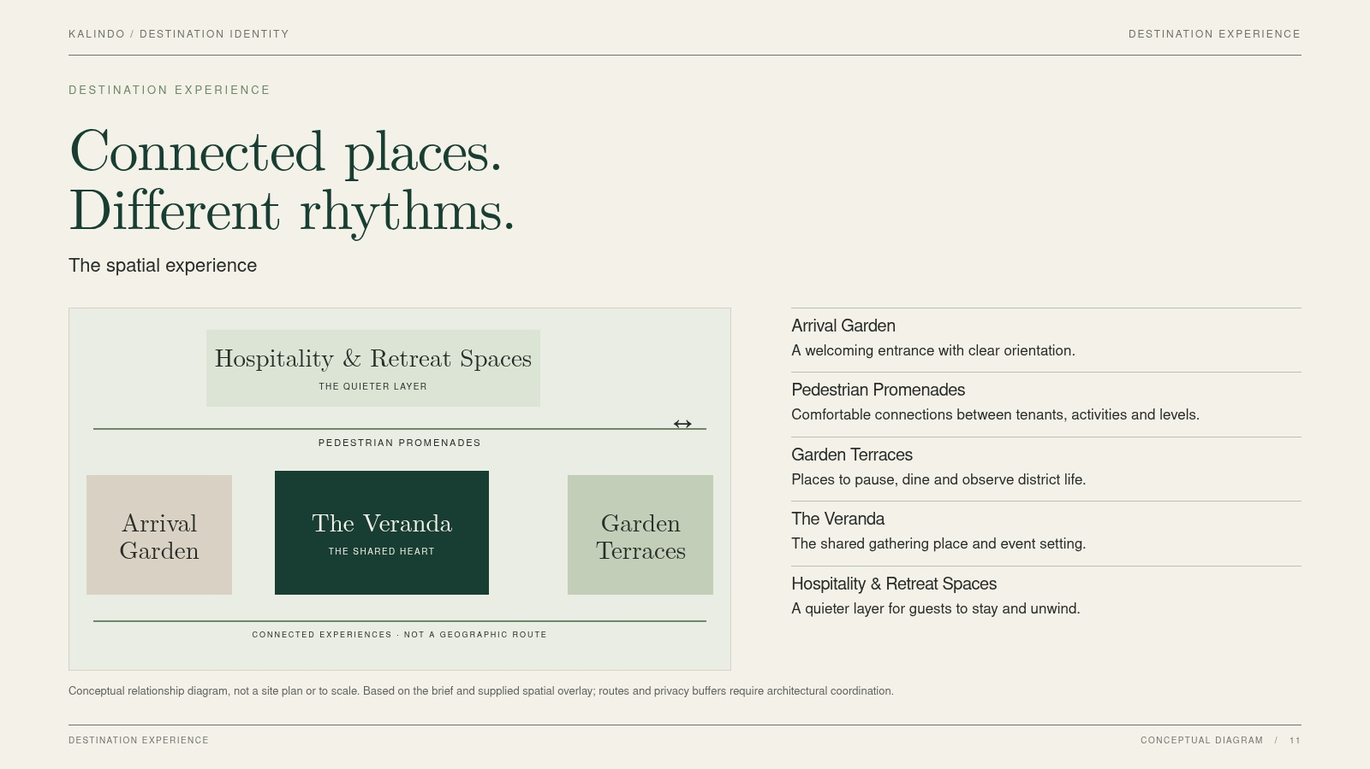
Notes:
SLIDE 11 / Destination experience
Connected places.
Different rhythms.
Visual-fidelity version. The slide is a flattened image; edit source content/layout and regenerate to change it.
The spatial experience
Arrival Garden / A welcoming entrance with clear orientation.
Pedestrian Promenades / Comfortable connections between tenants, activities and levels.
Garden Terraces / Places to pause, dine and observe district life.
The Veranda / The shared gathering place and event setting.
Hospitality & Retreat Spaces / A quieter layer for guests to stay and unwind.
REVIEW NOTE: Conceptual relationship diagram, not a site plan or to scale. Based on the brief and supplied spatial overlay; routes and privacy buffers require architectural coordination.
Authority: KALINDO PROJECT.pdf. Supplied concept imagery is not verified as built. See presentation/CONTENT-REVIEW.md.

Slide 12
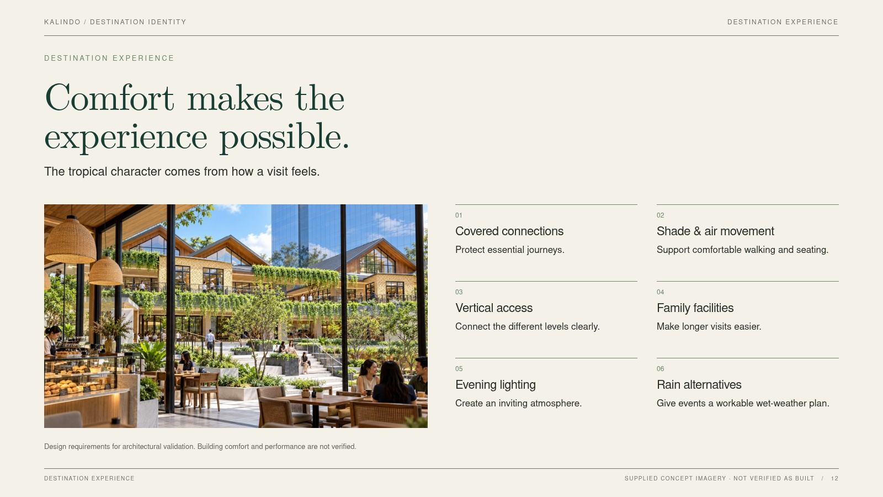
Notes:
SLIDE 12 / Destination experience
Comfort makes the
experience possible.
Visual-fidelity version. The slide is a flattened image; edit source content/layout and regenerate to change it.
The tropical character comes from how a visit feels.
Covered connections / Protect essential journeys.
Shade & air movement / Support comfortable walking and seating.
Vertical access / Connect the different levels clearly.
Family facilities / Make longer visits easier.
Evening lighting / Create an inviting atmosphere.
Rain alternatives / Give events a workable wet-weather plan.
REVIEW NOTE: Design requirements for architectural validation. Building comfort and performance are not verified.
Authority: KALINDO PROJECT.pdf. Supplied concept imagery is not verified as built. See presentation/CONTENT-REVIEW.md.

Slide 13
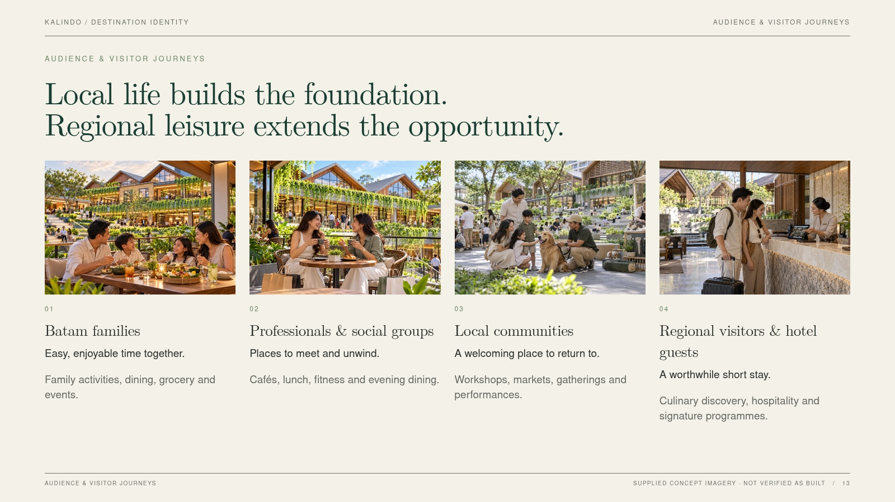
Notes:
SLIDE 13 / Audience & visitor journeys
Local life builds the foundation.
Regional leisure extends the opportunity.
Visual-fidelity version. The slide is a flattened image; edit source content/layout and regenerate to change it.
family / Batam families / Easy, enjoyable time together. / Family activities, dining, grocery and events.
friends / Professionals & social groups / Places to meet and unwind. / Cafés, lunch, fitness and evening dining.
pets / Local communities / A welcoming place to return to. / Workshops, markets, gatherings and performances.
hotel / Regional visitors & hotel guests / A worthwhile short stay. / Culinary discovery, hospitality and signature programmes.
Authority: KALINDO PROJECT.pdf. Supplied concept imagery is not verified as built. See presentation/CONTENT-REVIEW.md.

Slide 14
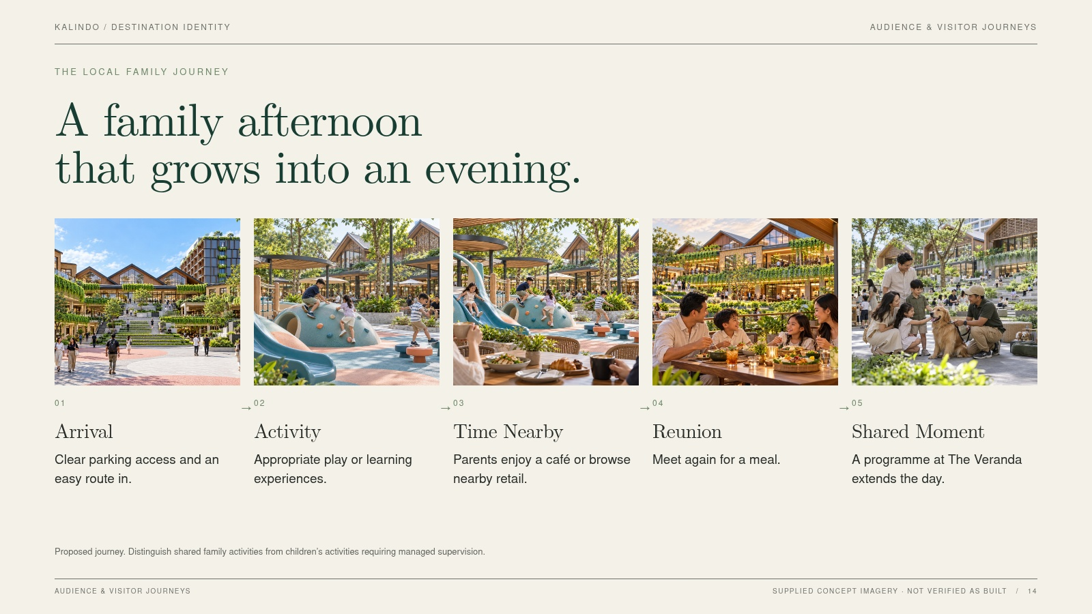
Notes:
SLIDE 14 / Audience & visitor journeys
A family afternoon
that grows into an evening.
Visual-fidelity version. The slide is a flattened image; edit source content/layout and regenerate to change it.
THE LOCAL FAMILY JOURNEY
cover / Arrival / Clear parking access and an easy route in.
kids / Activity / Appropriate play or learning experiences.
parents / Time Nearby / Parents enjoy a café or browse nearby retail.
family / Reunion / Meet again for a meal.
pets / Shared Moment / A programme at The Veranda extends the day.
REVIEW NOTE: Proposed journey. Distinguish shared family activities from children’s activities requiring managed supervision.
Authority: KALINDO PROJECT.pdf. Supplied concept imagery is not verified as built. See presentation/CONTENT-REVIEW.md.

Slide 15
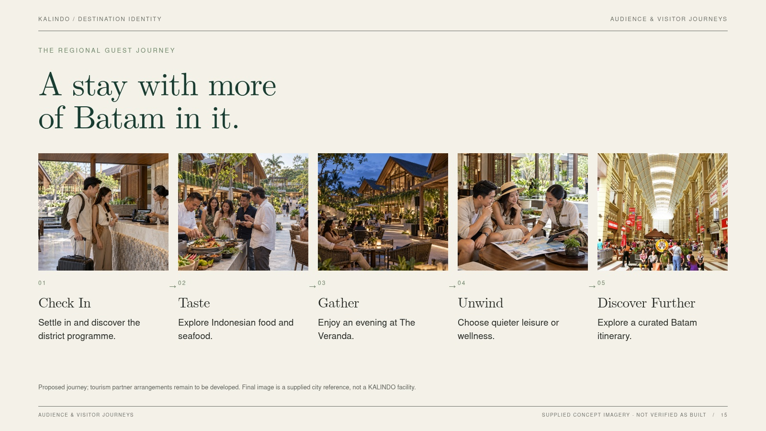
Notes:
SLIDE 15 / Audience & visitor journeys
A stay with more
of Batam in it.
Visual-fidelity version. The slide is a flattened image; edit source content/layout and regenerate to change it.
THE REGIONAL GUEST JOURNEY
hotel / Check In / Settle in and discover the district programme.
table / Taste / Explore Indonesian food and seafood.
evening / Gather / Enjoy an evening at The Veranda.
leisure / Unwind / Choose quieter leisure or wellness.
context2 / Discover Further / Explore a curated Batam itinerary.
REVIEW NOTE: Proposed journey; tourism partner arrangements remain to be developed. Final image is a supplied city reference, not a KALINDO facility.
Authority: KALINDO PROJECT.pdf. Supplied concept imagery is not verified as built. See presentation/CONTENT-REVIEW.md.

Slide 16
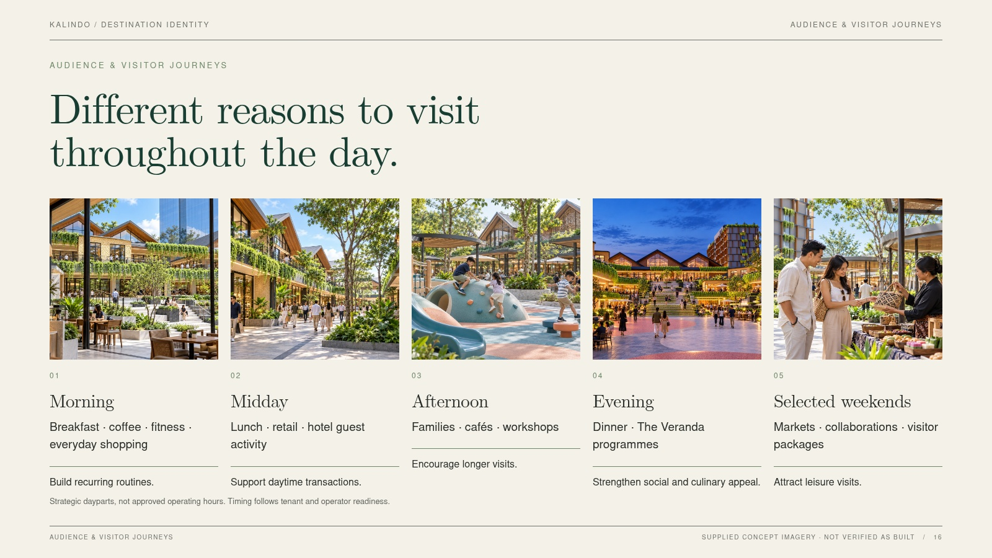
Notes:
SLIDE 16 / Audience & visitor journeys
Different reasons to visit
throughout the day.
Visual-fidelity version. The slide is a flattened image; edit source content/layout and regenerate to change it.
cafe / Morning / Breakfast · coffee · fitness · everyday shopping / Build recurring routines.
retail / Midday / Lunch · retail · hotel guest activity / Support daytime transactions.
kids / Afternoon / Families · cafés · workshops / Encourage longer visits.
night / Evening / Dinner · The Veranda programmes / Strengthen social and culinary appeal.
market / Selected weekends / Markets · collaborations · visitor packages / Attract leisure visits.
REVIEW NOTE: Strategic dayparts, not approved operating hours. Timing follows tenant and operator readiness.
Authority: KALINDO PROJECT.pdf. Supplied concept imagery is not verified as built. See presentation/CONTENT-REVIEW.md.

Slide 17
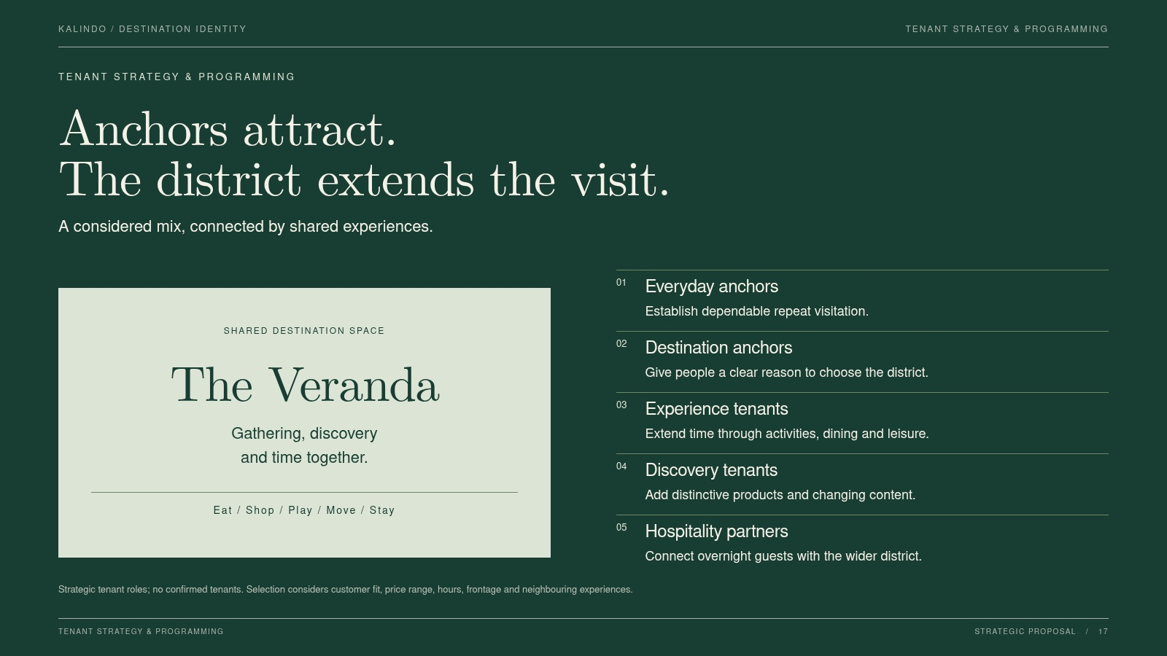
Notes:
SLIDE 17 / Tenant strategy & programming
Anchors attract.
The district extends the visit.
Visual-fidelity version. The slide is a flattened image; edit source content/layout and regenerate to change it.
A considered mix, connected by shared experiences.
Everyday anchors / Establish dependable repeat visitation.
Destination anchors / Give people a clear reason to choose the district.
Experience tenants / Extend time through activities, dining and leisure.
Discovery tenants / Add distinctive products and changing content.
Hospitality partners / Connect overnight guests with the wider district.
REVIEW NOTE: Strategic tenant roles; no confirmed tenants. Selection considers customer fit, price range, hours, frontage and neighbouring experiences.
Authority: KALINDO PROJECT.pdf. Supplied concept imagery is not verified as built. See presentation/CONTENT-REVIEW.md.

Slide 18
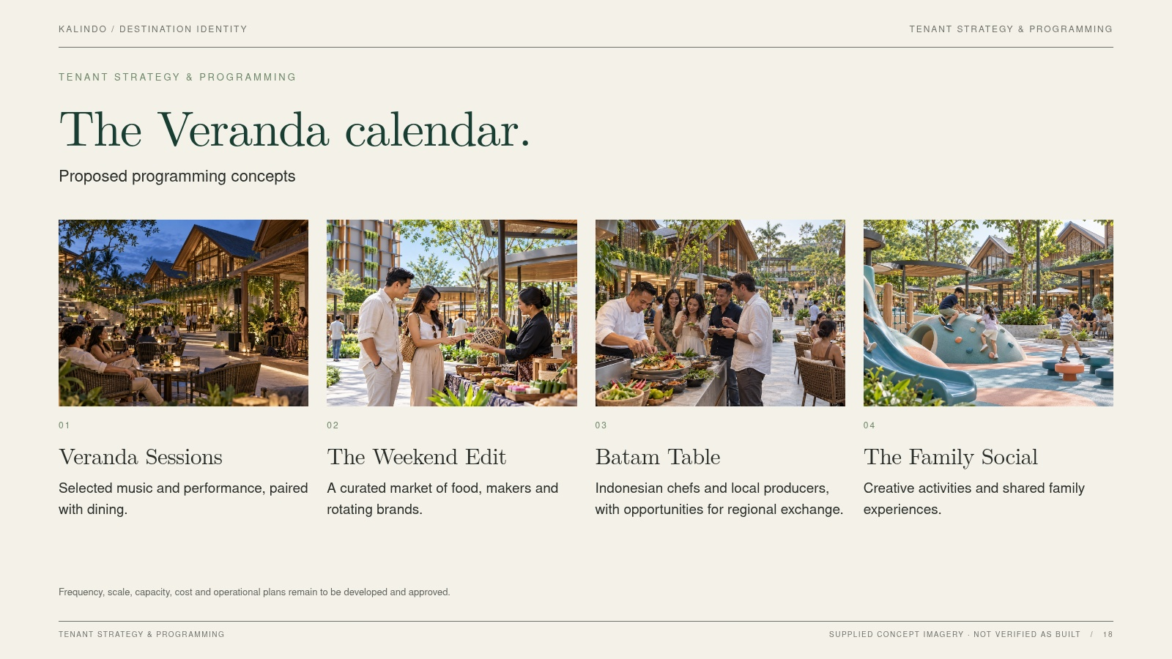
Notes:
SLIDE 18 / Tenant strategy & programming
The Veranda calendar.
Visual-fidelity version. The slide is a flattened image; edit source content/layout and regenerate to change it.
Proposed programming concepts
evening / Veranda Sessions / Selected music and performance, paired with dining.
market / The Weekend Edit / A curated market of food, makers and rotating brands.
table / Batam Table / Indonesian chefs and local producers, with opportunities for regional exchange.
kids / The Family Social / Creative activities and shared family experiences.
REVIEW NOTE: Frequency, scale, capacity, cost and operational plans remain to be developed and approved.
Authority: KALINDO PROJECT.pdf. Supplied concept imagery is not verified as built. See presentation/CONTENT-REVIEW.md.

Slide 19
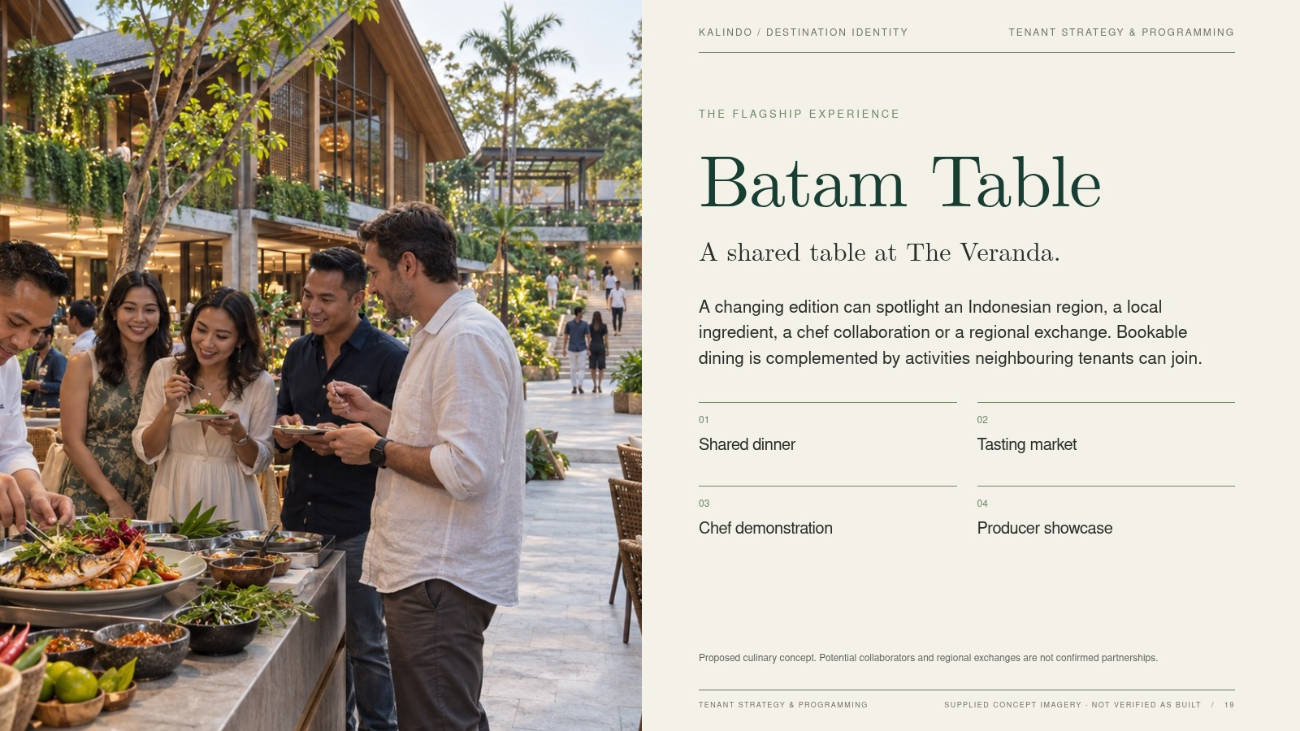
Notes:
SLIDE 19 / Tenant strategy & programming
Batam Table
Visual-fidelity version. The slide is a flattened image; edit source content/layout and regenerate to change it.
THE FLAGSHIP EXPERIENCE
A shared table at The Veranda.
A changing edition can spotlight an Indonesian region, a local ingredient, a chef collaboration or a regional exchange. Bookable dining is complemented by activities neighbouring tenants can join.
01 / Shared dinner
02 / Tasting market
03 / Chef demonstration
04 / Producer showcase
REVIEW NOTE: Proposed culinary concept. Potential collaborators and regional exchanges are not confirmed partnerships.
Authority: KALINDO PROJECT.pdf. Supplied concept imagery is not verified as built. See presentation/CONTENT-REVIEW.md.

Slide 20
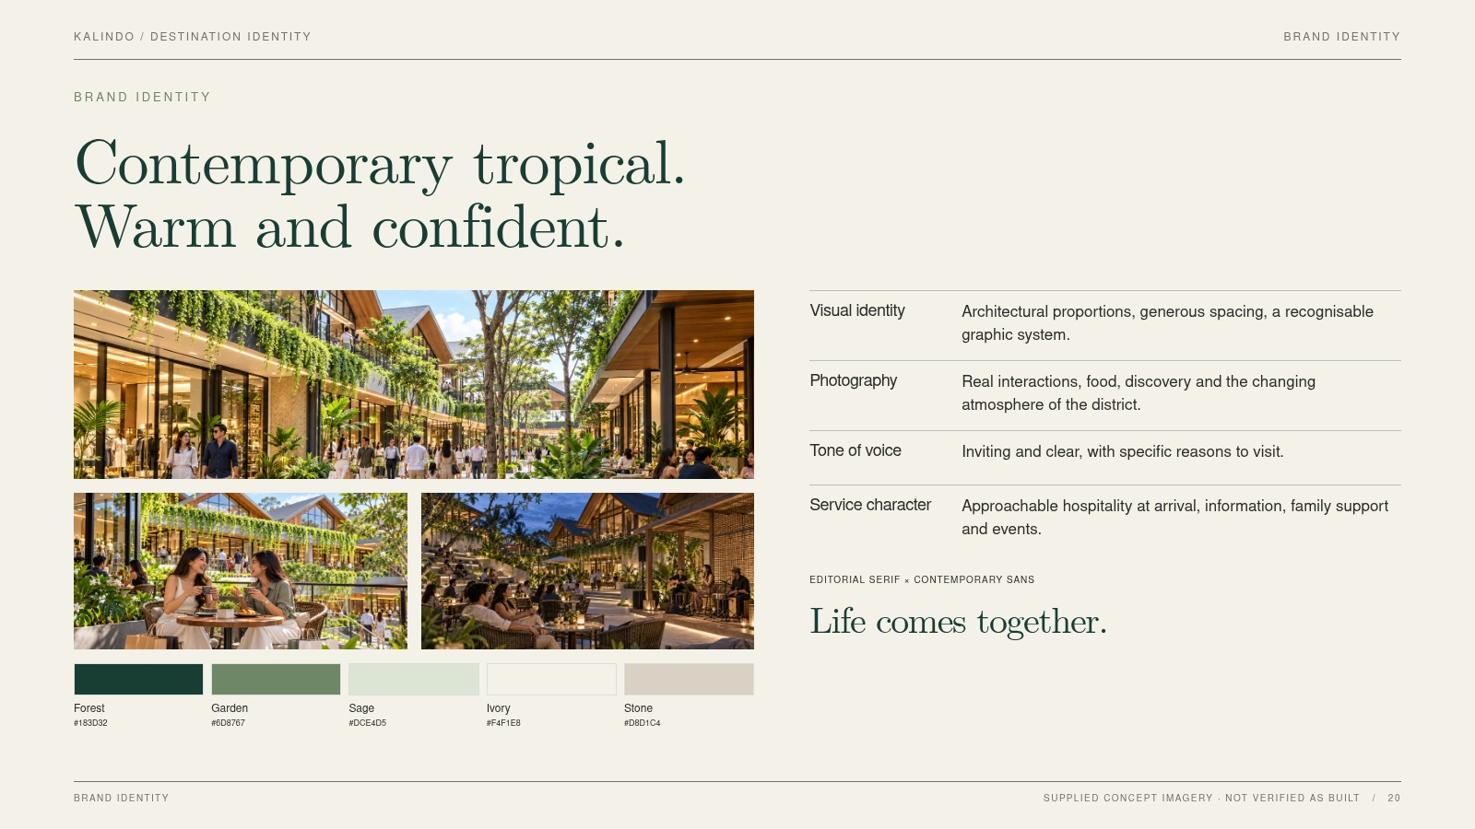
Notes:
SLIDE 20 / Brand identity
Contemporary tropical.
Warm and confident.
Visual-fidelity version. The slide is a flattened image; edit source content/layout and regenerate to change it.
Visual identity / Architectural proportions, generous spacing, a recognisable graphic system.
Photography / Real interactions, food, discovery and the changing atmosphere of the district.
Tone of voice / Inviting and clear, with specific reasons to visit.
Service character / Approachable hospitality at arrival, information, family support and events.
Authority: KALINDO PROJECT.pdf. Supplied concept imagery is not verified as built. See presentation/CONTENT-REVIEW.md.

Slide 21
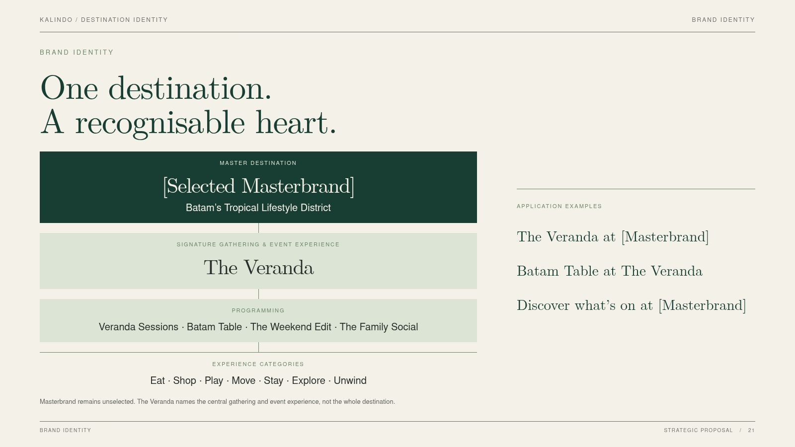
Notes:
SLIDE 21 / Brand identity
One destination.
A recognisable heart.
Visual-fidelity version. The slide is a flattened image; edit source content/layout and regenerate to change it.
REVIEW NOTE: Masterbrand remains unselected. The Veranda names the central gathering and event experience, not the whole destination.
Master Destination: [Selected Masterbrand]
Category Descriptor: Batam’s Tropical Lifestyle District
Signature gathering & event experience: The Veranda
Programming: Veranda Sessions / Batam Table / The Weekend Edit / The Family Social
Experience categories: Eat / Shop / Play / Move / Stay / Explore / Unwind
Authority: KALINDO PROJECT.pdf. Supplied concept imagery is not verified as built. See presentation/CONTENT-REVIEW.md.

Slide 22
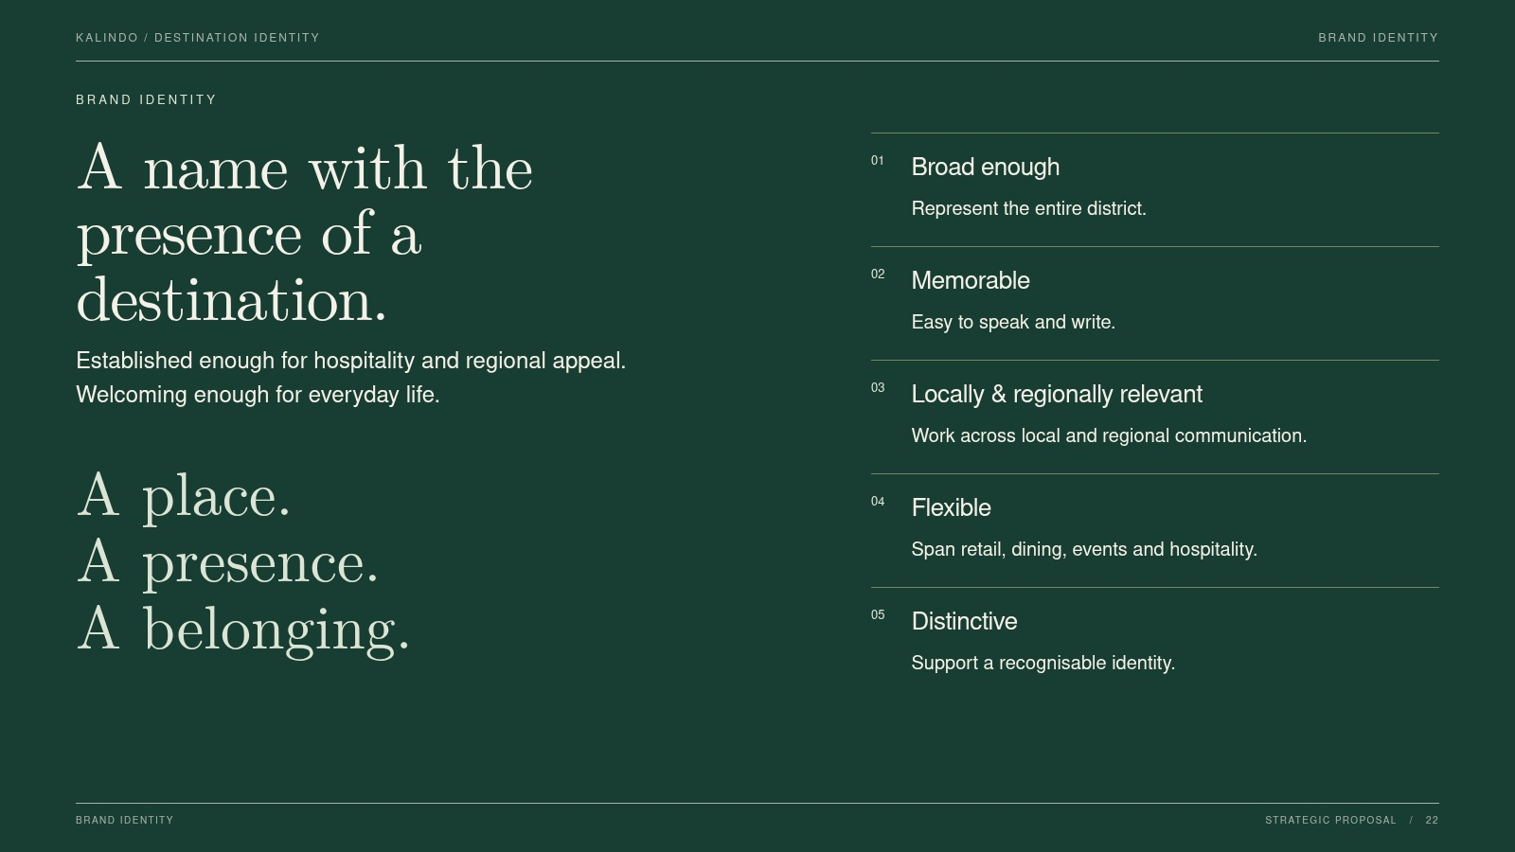
Notes:
SLIDE 22 / Brand identity
A name with the
presence of a destination.
Visual-fidelity version. The slide is a flattened image; edit source content/layout and regenerate to change it.
Established enough for hospitality and regional appeal. Welcoming enough for everyday life.
01 / Broad enough / Represent the entire district.
02 / Memorable / Easy to speak and write.
03 / Locally & regionally relevant / Work across local and regional communication.
04 / Flexible / Span retail, dining, events and hospitality.
05 / Distinctive / Support a recognisable identity.
Authority: KALINDO PROJECT.pdf. Supplied concept imagery is not verified as built. See presentation/CONTENT-REVIEW.md.

Slide 23
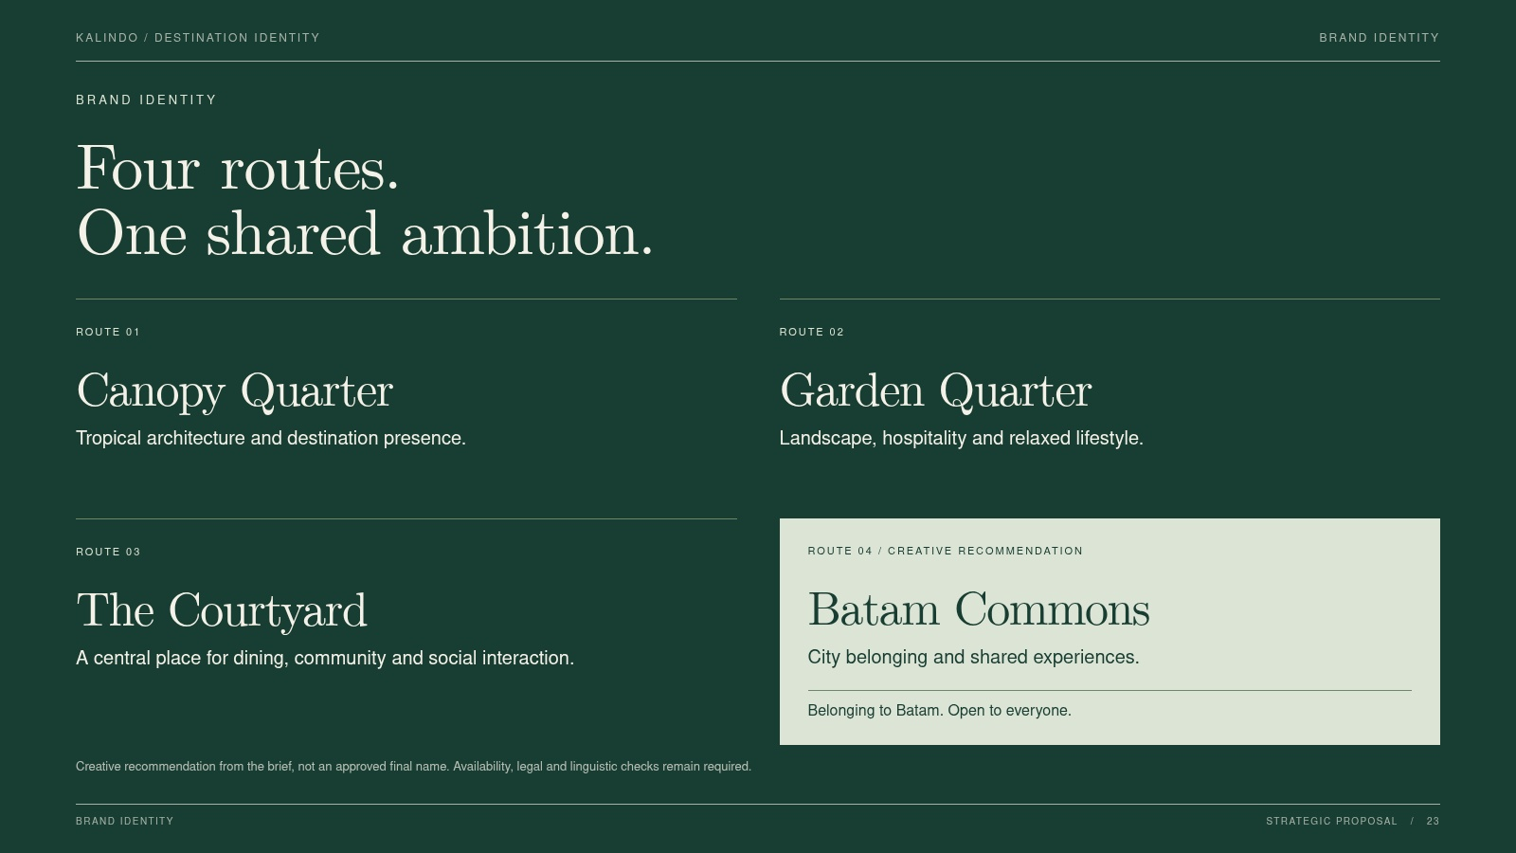
Notes:
SLIDE 23 / Brand identity
Four routes.
One shared ambition.
Visual-fidelity version. The slide is a flattened image; edit source content/layout and regenerate to change it.
Canopy Quarter / Tropical architecture and destination presence.
Garden Quarter / Landscape, hospitality and relaxed lifestyle.
The Courtyard / A central place for dining, community and social interaction.
Batam Commons / City belonging and shared experiences.
REVIEW NOTE: Creative recommendation from the brief, not an approved final name. Availability, legal and linguistic checks remain required.
Authority: KALINDO PROJECT.pdf. Supplied concept imagery is not verified as built. See presentation/CONTENT-REVIEW.md.

Slide 24
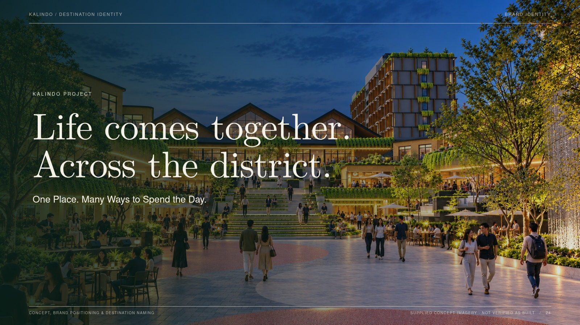
Notes:
SLIDE 24 / Brand identity
Life comes together.
Across the district.
Visual-fidelity version. The slide is a flattened image; edit source content/layout and regenerate to change it.
One Place. Many Ways to Spend the Day.
Authority: KALINDO PROJECT.pdf. Supplied concept imagery is not verified as built. See presentation/CONTENT-REVIEW.md.

