Slide 1

GIMP 2.10 Plugin Primer
Feb. 5th, 2019
Dr. Michelle Boyce

Slide 2
Annotated Hello World Plugin Code: hello_world.py
#!/usr/bin/env python
# This is a hello world plugin-in using gimpfu, a python interface package [1-3].
# [1] A good primer on python-plugins: https://www.gimp.org/docs/python/index.html
# NB: Example code on-line are extremely GIMP version dependent; this script uses
# GIMP-2.10. But not to worry, you can lookup the correct syntax by searching
# through GIMP's procedure browser (Help -> Procedure Bowser), and adjust the examples
# accordingly.
# [2] Mac OS X Notes:
# a) Installing.
# To run this on make Mac OS X, place this script_name.py in
# /Users/<USERNAME>/Library/Application Support/GIMP/2.10/plug-ins
# and make it executable (i.e., chmod 755 it).
# b) Debugging.
# To debug start gimp on the command line, i.e.,
# $ /Applications/GIMP-2.10.app/Contents/MacOS/gimp --verbose --console-messages
# assuming you did a standard GIMP install.
# c) Executing.
# In GIMP do,
# File -> Create -> "Hello world..."
# d) Notes on Mac OS X and other platforms.
# https://en.wikibooks.org/wiki/GIMP/Installing_Plugins
# [3] Cheat Sheet: http://gimpbook.com/scripting/
#
NB: Header and Notes

Slide 3
Annotated Hello World Plugin Code: hello_world.py
from gimpfu import *
# hello world plugin source code
def hello_world(initstr,font,size,color):
img = gimp.Image(1,1,RGB)
gimp.set_foreground(color)
# note: this is a gimp procedure-database (pdb) function, as in, you can use the
# procedure browser in gimp to get its definition information.
layer = pdb.gimp_text_fontname(img,None,0,0,initstr,10,True,size,PIXELS,font)
img.resize(layer.width, layer.height, 0, 0)
# print to the console
print "HELLO WORLD!"
# display as image
gimp.Display(img)
Hello World Script

Slide 4
Annotated Hello World Plugin Code: hello_world.py
# plugin registration
register(
# unique plugin name
"python_fu_hello_world",
# brief description.
"Hello world image",
# detail description
"Create an image with a user-provided string",
# author, copyright, date
"Bart Simpson", "That Dam Dog Inc.","2050",
# pulldown menu label
"Hello world...",
"",
# parameter-template for dialogue box mapping to function arguments.
[
(PF_STRING, "string", "String", 'Hello, world!'),
(PF_FONT, "font", "Font face", "Sans"),
(PF_SPINNER, "size", "Font size", 50, (1,3000,1)),
(PF_COLOR, "color", "Text color",(1.0,0.5,0.0))
],
[],
# the function
hello_world,
# pulldown menu location
menu="<Image>/File/Create"
)
# start/install the plugin
main()
Registration/Installing

Slide 5
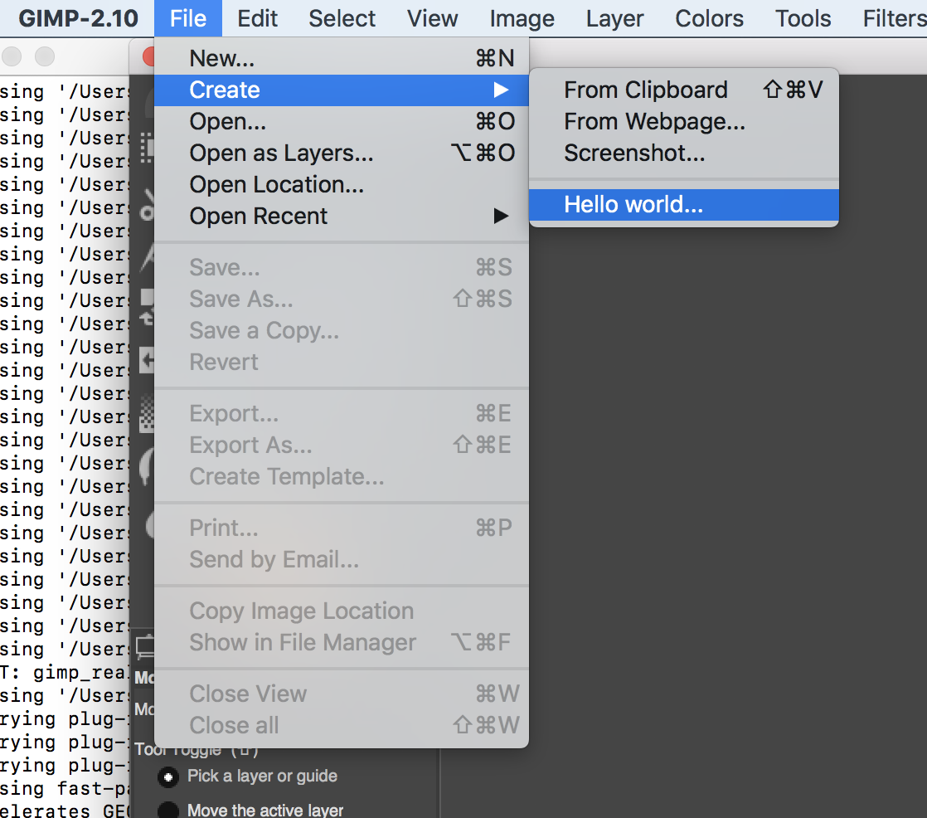
Execution

Slide 6
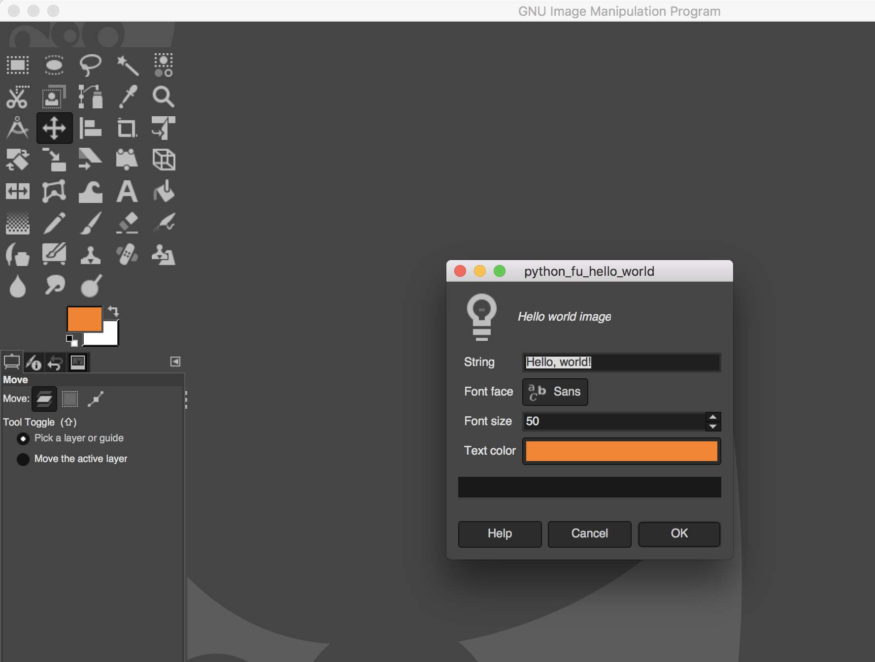
Execution

Slide 7
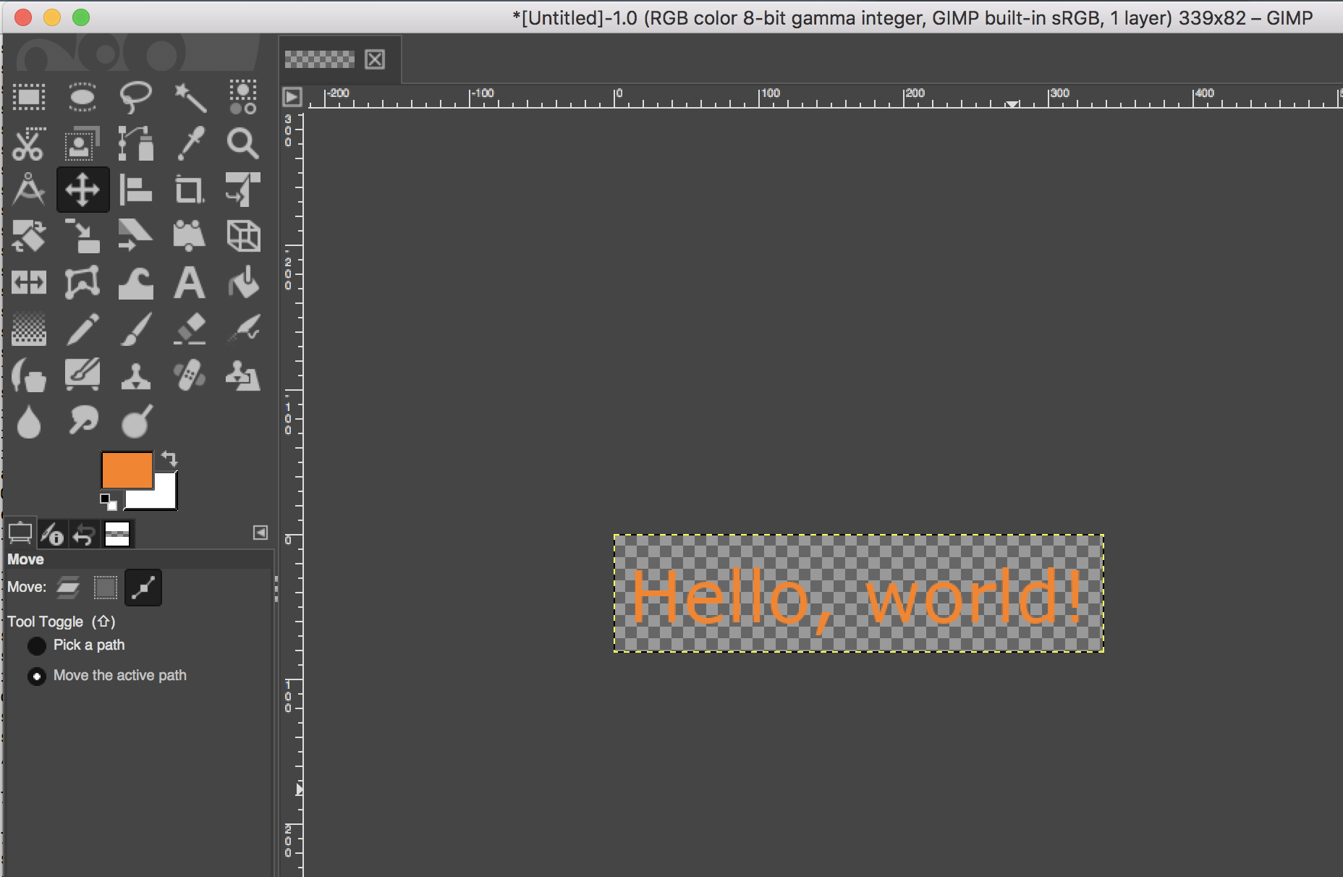
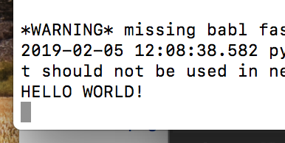
Execution
Console

