Slide 1
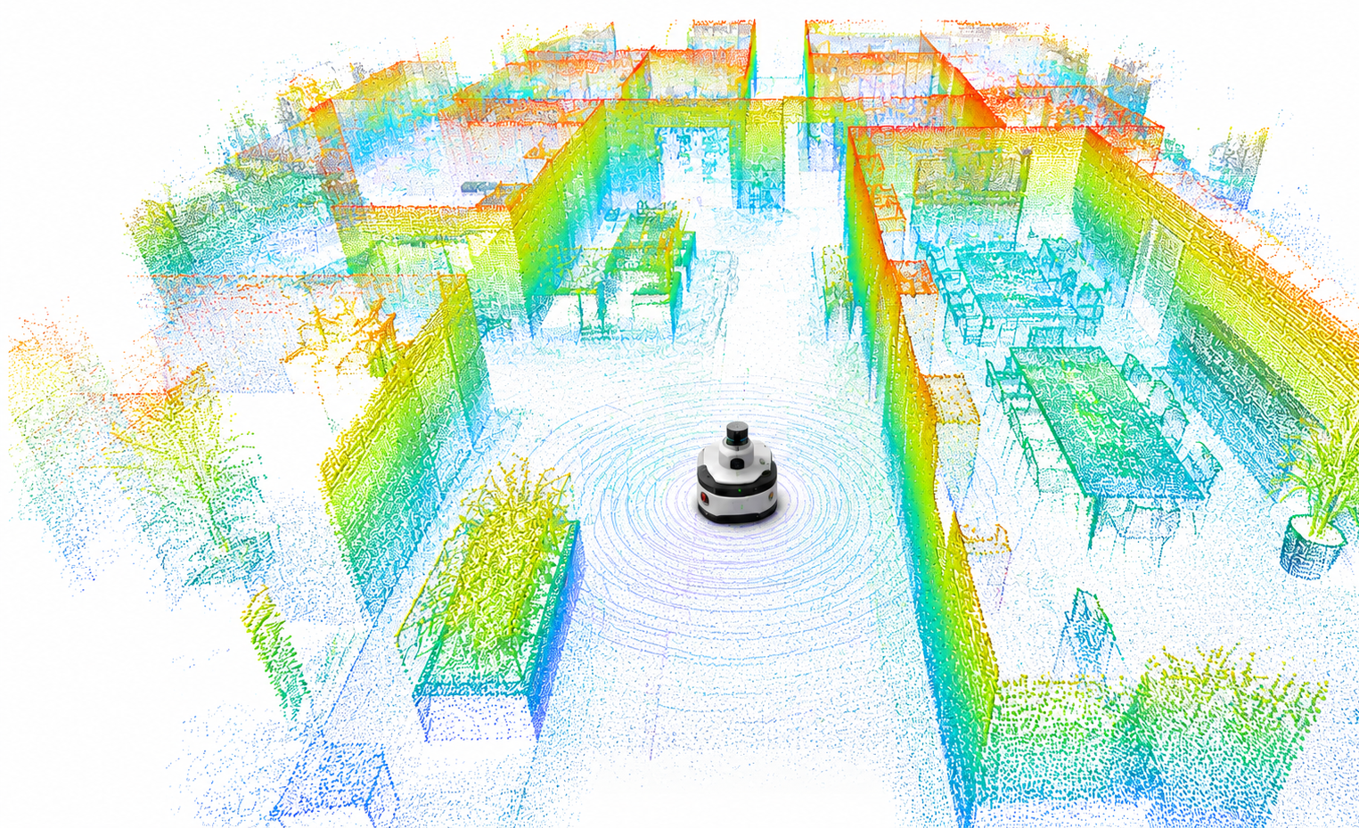
Immersive Mapping in Virtual Reality for Robot Teleoperation
Rubin Khadka Chhetri (6558048)
Sarvenaz Ashoori (6878764)
Abdul Hayee Hafiz (6029926)

Slide 2

Problem Statement
2D displays lack depth perception
Poor distance judgment
High mental workload
Inefficient navigation in tight spaces

Slide 3
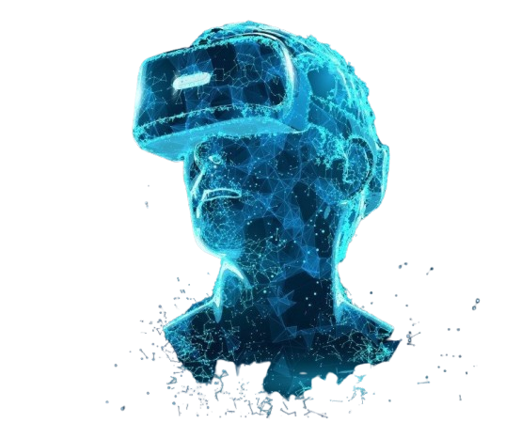
Proposed Solution
Immersive VR Visualization
Multi-camera System
Minimap and distance feedback
Cross platform Architecture

Slide 4
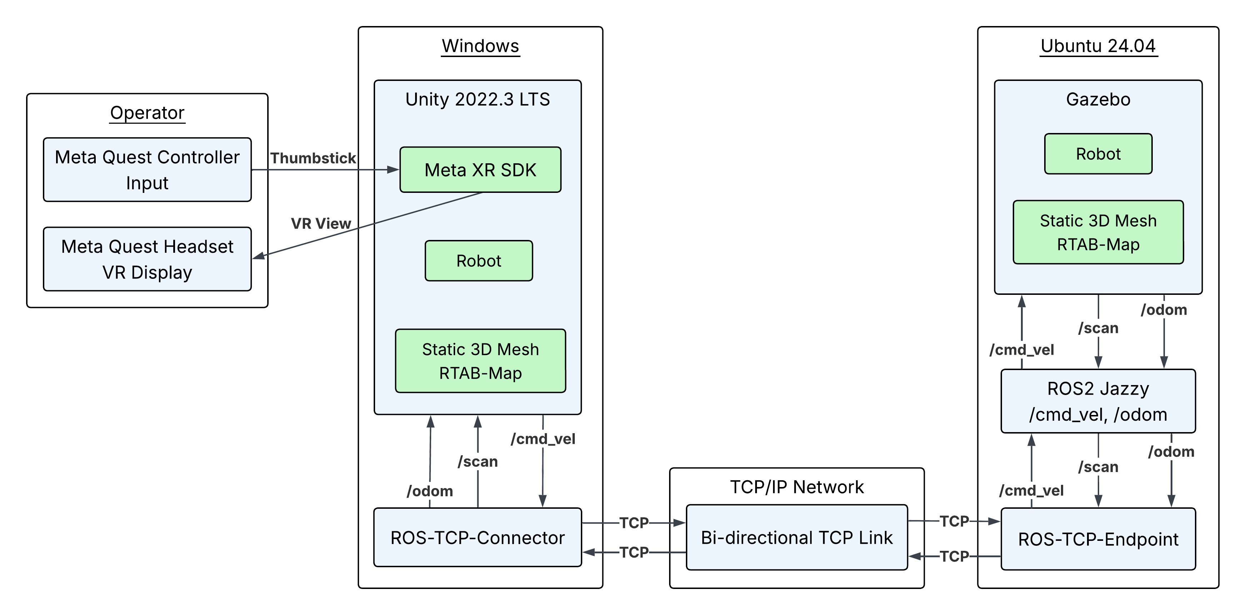
System Architecture

Slide 5
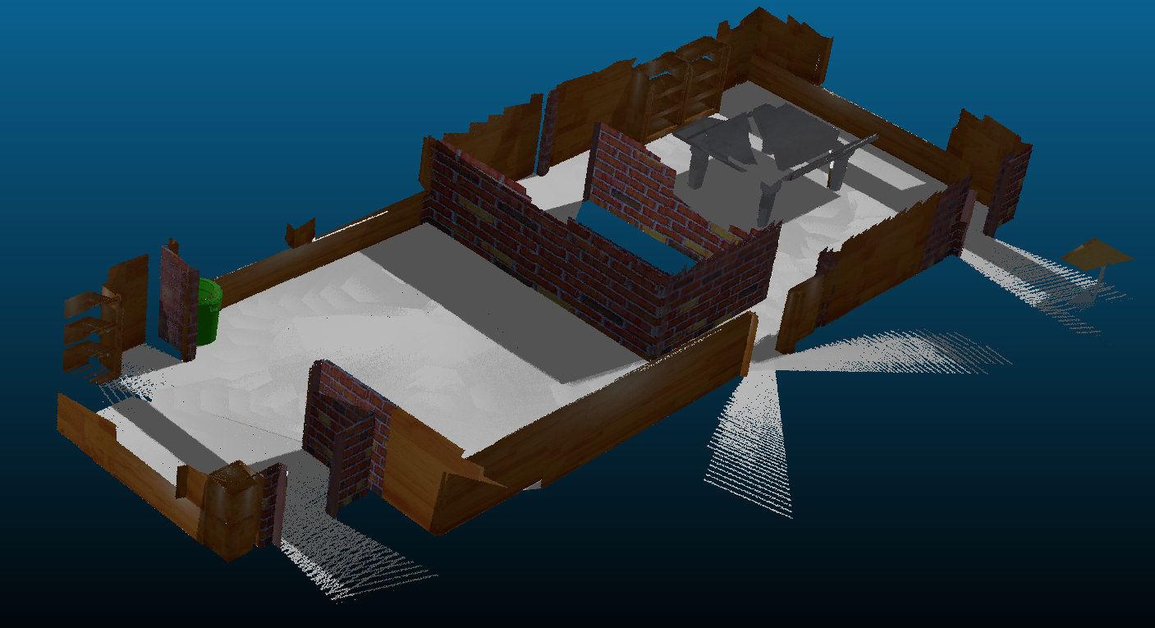
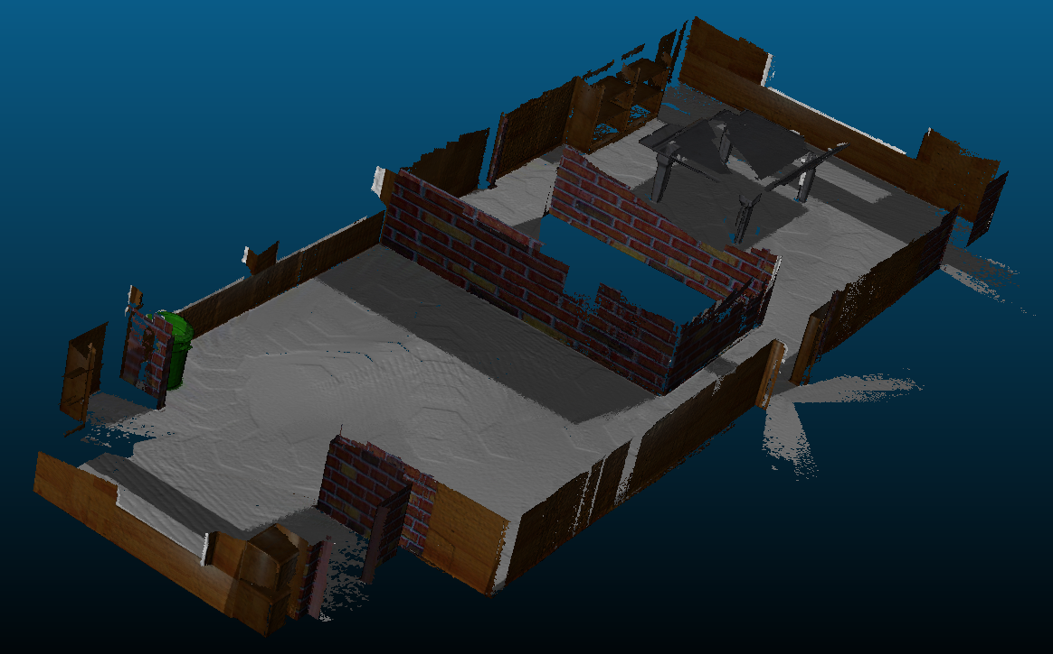
Mapping & Environment
Point Cloud
Static Mesh

Slide 6
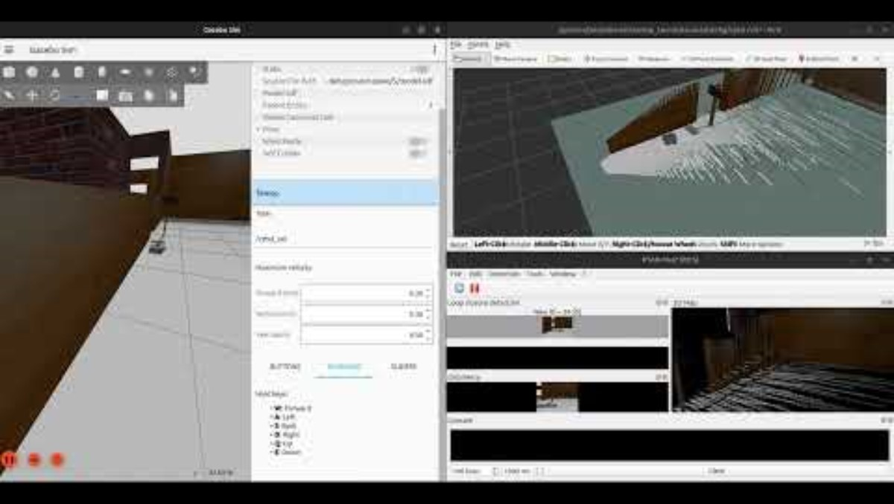

Slide 7
Robot Movement & Controller Mapping
How Robot Moves
Controller Input
Unity does not move robot directly
Input -> /cmd_vel -> Gazebo -> /odom -> Unity -> VR
Gazebo is single source of truth for physics
Primary: Meta Quest thumbstick
Challenge: Simulator thumbstick emulation unrealiable
Solution: Keyboard Fallback to validate pipeline

Slide 8
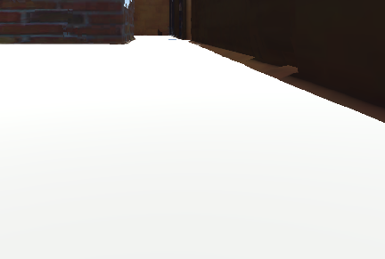
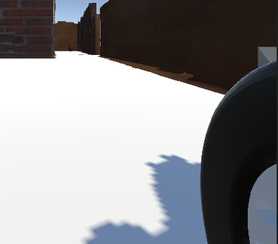
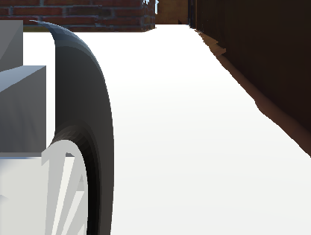
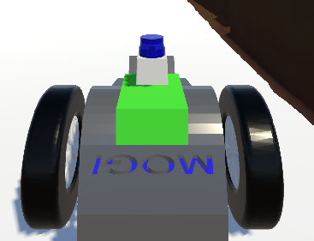
VR Interface Design
Multi Camera System
Main
Left Wheel
Right Wheel
Following

Slide 9
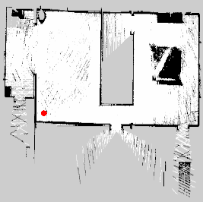
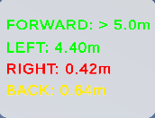




VR Interface Design
Minimap
Distance Feedback
Communication Health State

Slide 10
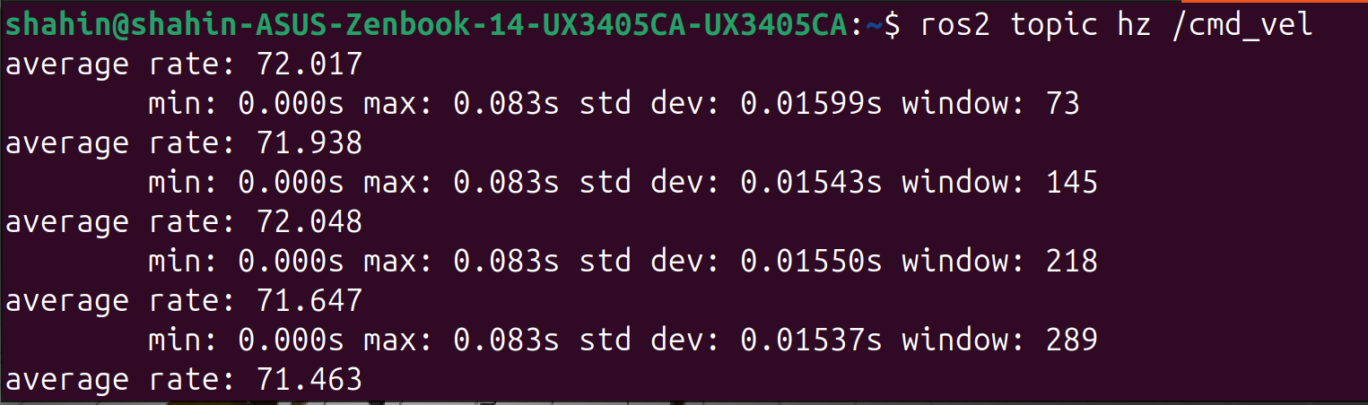
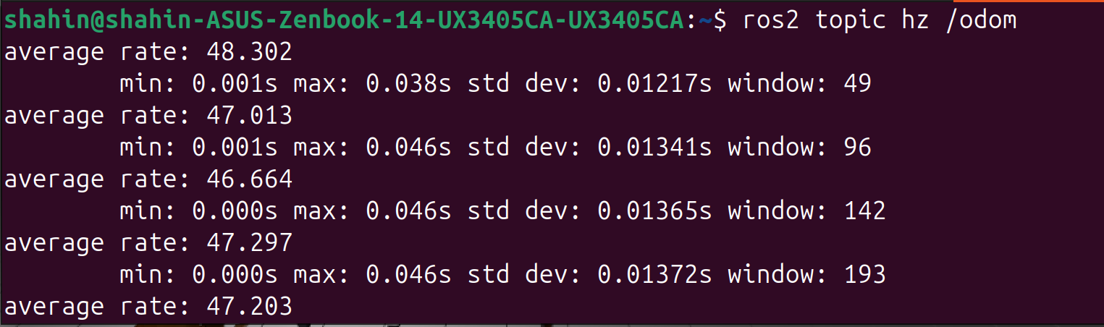
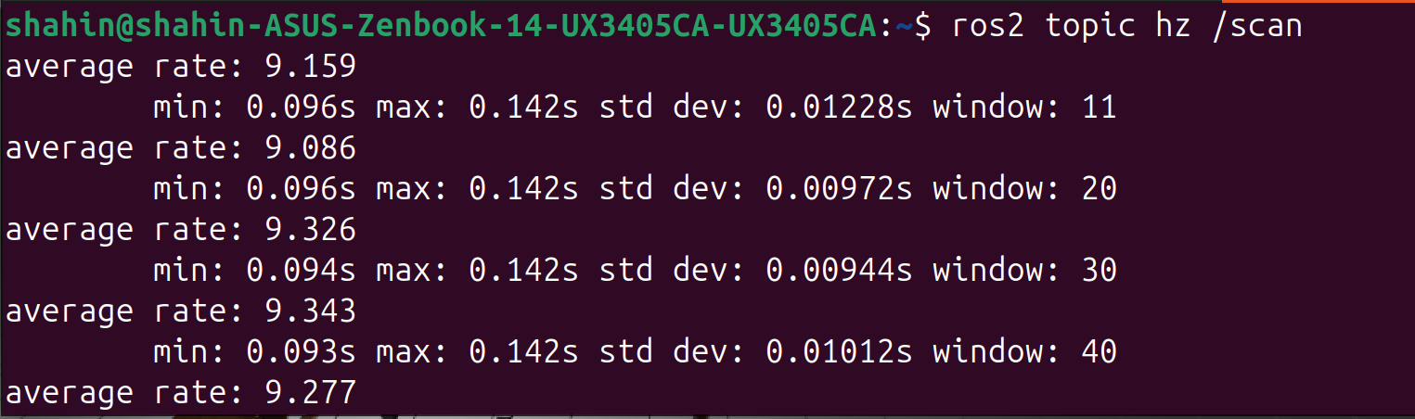
Results & Validation
Topic | Measured Rate | Expected Max
/cmd_vel | 71-72 Hz | ~72 Hz
/odom | 47-48 Hz | 50 Hz
/scan | 9-10 Hz | 10 Hz

Slide 11
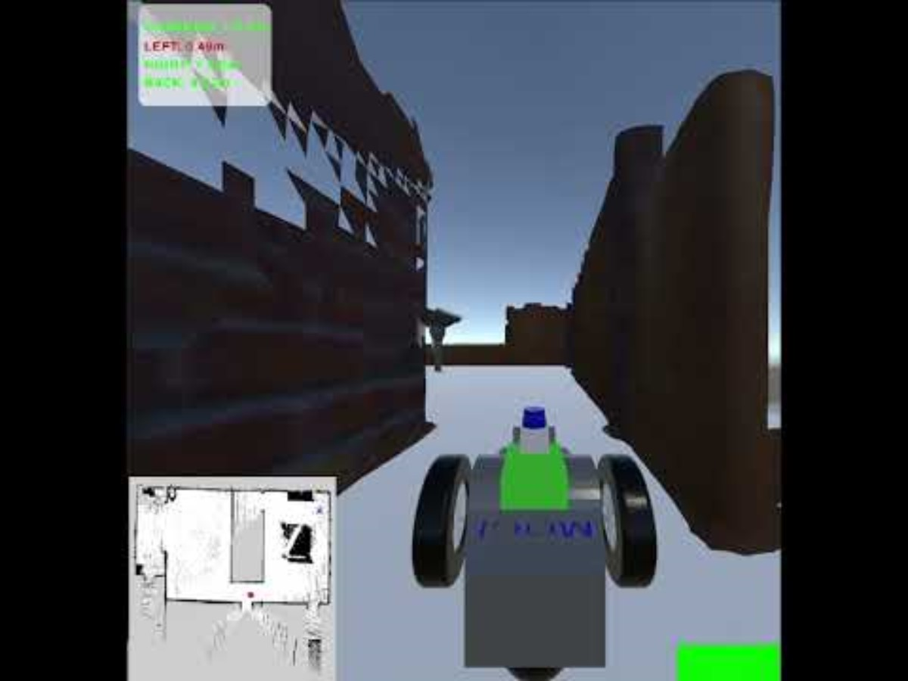
Result & Validation

Slide 12
Challenges & Future Direction
Challenges
Future Direction
WiFi unreliable -> Ethernet + static IP
DirectX11 crashes -> Switched to Vulkan
Industrial WiFi/ 5G
Physical Hardware Testing
Live SLAM for unmapped environments
🔗 All code and assets: github.com/rubin-khadka/VR_Controlled_Robot_Teleop

Slide 13


