Slide 1
Supernova Survey with the 2.4 m Mirror A more detailed presentation of the Feb 15, 2013 Survey
C.Baltay and S. Perlmutter
December 8, 2014

Slide 2
WFIRST –AFTA Baseline
Assume 6 months for Supernova Survey
2.4 m on axis mirror
Imager with
18 H4RG detectors (6x3)
0.11 “/pixl
0.28 sq degrees
Filter wheel with
4 filters.
IFU Integral Field Spectrometer
R = 80 to 110
H2RG Detector
2.0 micron λ cutoff

Slide 3
Changes from the Feb 15, 2013 Report
Minor tuning of all of the parameters
Used variable IFU resolution R = 80 to 110, used R = 80 in band 1 at 1.15μ instead of 75
Assumed H2RG detector for IFU instead of the H4RG. This meant lower read noise (1.3 sec per read instead of 5.24 per read)
All of this allowed us to keep 136 SNe per bin with FoM = 312 but now have an 8 day contingency (survey takes 175 days out of 183 days allocated)

Slide 4
Assume 4 Filter Bands
Δ λ = λ / 4.5
Filter | λ Central | Δ λ | λ Range
1 (Y) | 1.15 | 0.26 | 1.02 – 1.28
2 (J) | 1.45 | 0.32 | 1.29 – 1.61
3 (H) | 1.80 | 0.40 | 1.60 – 2.00
4 (K) | 2.25 | 0.50 | 2.00 – 2.50
These were the four filter bands for DRM1 and 2.
We planned on using bands 2,3,4 with the 2.5 micron cutoff.
For DRM A with a 2.0 micron cutoff we plan on using bands 1,2,3.
We will fine tune these when the filter bands for DRM A are chosen.

Slide 5
Supernova Survey Strategy
Use the 0.28 sq degree imager to discover supernovae in two filter bands
Use IFU spectra to type supernova and get redshift, S/N=6 per resolution element ,expect to need spectra of two candidates for one good Type 1a, plan to delay typing spectra to near peak.
Use IFU spectra to get light curves with roughly a 5 day rest frame cadence, 8 spectra on light curve (including the typing and the deep spectra) from -10 rest frame days before peak to +25 rest frame days past peak, S/N = 3 per reselement (S/N = 15 per synthetic filter band)
1 reference spectrum after supernova has faded, for galaxy subtraction with S/N = 6 per reselement
1 deep spectrum near peak to confirm Sne Ia classification,for subtyping, spectral feature ratios etc. with S/N = 10 per resel

Slide 6
Survey Cadence
Plan to run supernova survey for 6 months spread over 2 years calendar time.
Plan on supernova survey with a 5 day cadence, 30 hours per visit
(2*365/5)*30 hrs/24 = 182 days = 6 months

Slide 7
Supernova Survey Strategy
Do a 3 tier survey, scanning different areas of sky for different redshift ranges
Tier | Z max | Sky Area Sq Degrees
1 | 0.4 | 27.44
2 | 0.8 | 8.96
3 | 1.7 | 5.04

Slide 8
Survey Areas (6x3 Imager)
We want square areas so we can continuously monitor it as we go around a corner every three month with a 90 degree turn of the detector plane
For DRM A assume 18 H4RG detectors are arranged in a 6 x 3 pattern so the imager is not square
For example
Two imager footprints make a 6x6 sensor square
8 imager footprints make a 12x12 square
etc

Slide 9
Square Survey Areas for 6x3 Imager
Pattern | Sensors | Area(sq degrees) | No of shots
1 W x 2 H | 6 x 6 | 0.56 | 2
2 W x 4 H | 12 x 12 | 2.24 | 8
3 W x 6 H | 18 x 18 | 5.04 | 18
4 w x 8 H | 24 x 24 | 8.96 | 32
5 W x 10 H | 30 x 30 | 14.00 | 50
6 W x 12 H | 36 x 36 | 20.16 | 72
7 W x 14 H | 42 x 42 | 27.44 | 98
DRM A has 18 H4RG detectors with 10 micron pixels
The image plane is 6 detectors Wide and 3 detectors High
A pattern of 2W x 4 H is 8 image planes arranged 2 in the W
direction and 4 in the H direction
No of shots is number of exposures to cover the area in a filter
We should stick with these patterns for best efficiency

Slide 10
Supernova Imaging Exposure times
Started with Alex Kim’s estimates of exposure times to get S/N = 4 in two bands with a 1.1m unobstructed view mirror telescope with 50% thruput at 12 days before peak
Scaled to a 2.4 m mirror with 78% clear aperture and a 61% thruput, scale factor 0.78*(2.4/1.1)²*(0.61/0.50)
Z Range | 1.1m Exp Time | 2.4m Exp Time
< 0.4 | 60 sec | 13 sec
< 0.8 | 300 | 67
< 1.7 | 1200 | 265
Add 42 seconds for slew and settling time

Slide 11
Time for search with Imager
Z range | S/N=4 Exp Time | Read+Slew time | Exposures | Hours/visit
< 0.4 | 13 sec | 42 sec | 98x2 | 3.0 hrs
< 0.8 | 67 | 42 | 32x2 | 1.9
<1.7 | 265 | 42 | 18x2 | 3.0
7.9 hours per visit for searching times 132 visits for search
is a total of 43 days.
This leaves 183 – 43 = 140 days for spectroscopy

Slide 12
Estimation of the Supernova Signals
The supernova signal in the three filter bands in counts/sec/band was calculated by Alex Kim by transforming the observer frame filter bands to the supernova rest frame and evaluating the flux in these rest frame bands. These were done for a 1.3 m unobstructed view mirror assuming a thruput of 50%.
These were scaled to a 2.4 m telescope
with a 22% obstruction as 0.78*(2.4/1.3)²
Corrected for a 61% thruput, 0.61/0.50
Scaled by a factor of 1.2 to agree with Chris Hirata’s estimates

Slide 13
Supernova Signal - counts/sec/filter band
Z Band 1 Band 2 Band 3
0.15 59.924 45.702 28.058
0.25 28.582 20.045 15.162
0.35 15.794 11.997 9.802
0.45 9.727 8.687 6.860
0.55 7.894 6.635 4.747
0.65 6.784 5.079 3.670
0.75 6.193 3.792 3.065
0.85 5.419 2.942 2.818
0.95 4.427 2.802 2.376
1.05 3.767 2.715 2.057
1.15 3.094 2.547 1.708
1.25 2.751 2.461 1.440
1.35 2.475 2.296 1.289
1.45 2.242 2.019 1.323
1.55 2.179 1.819 1.325
1.65 2.064 1.639 1.270
For a 2.4 m dia
obstructed view mirror
Adjusted for telescope thruput of 0.61
Wavelengths < 2.0 μ
Scaled to Chris Hirata’s
Dec 12, 2012 report

Slide 14
Estimation of Exposure Times
Exposure times in each of the filter Bands for a S/N=15 in each band
Calculated Signal to Noise as:
S/N = signal/σ_{tot} = (st)/[st + n_{pix}(Zt+Dt+r²) ]^{½}
n_{pix} = no of pixels in image
S/N = 15 required signal to noise
s is SNe signal in counts/sec/band
Z is the Zodi bckgrd in cts/sec/pix
D is the dark current in cts/sec/pix
r is the read noise

Slide 15
Read Noise Estimate
Planning to use H2RG detector for IFU
Assume 1.3 sec/read, 2.6 sec/read pair
m = (exp time)/2.6, the number of read pairs
R = noise per read pair (20 for imaging, 15 for IFU)
f = read noise floor (5 for imaging, 4 for IFU)
Read Noise ={ [( R/√ m)*√3]² + f²}^{½}

Slide 16
Parameters used in the Exposure Time Calculations
Parameter | Imaging | IFU Spectra
Signal to noise per band S/N | 4 | 15
No of pixels npix | 12.6 | 36x3 wide
Zodi Bkgrd Z | 0.36 cts/pix/sec | 0.022 cts/pix/sec
Dark Current D | 0.015 e/pixel/sec | 0.010 e/pixel/sec
Read noise Single Read Floor | 20.0 e/read 5 e | 15.0 e/read 4 e
Pixel area Apix | (0.11)**2 | (0.11)**2
Wavelength λ | Center of band
Range admitted Δλ in zodi background | Width of filter band | < 0.02μ
Spectrometer Resolution |  | R = 80 near 1.15μ

Slide 17
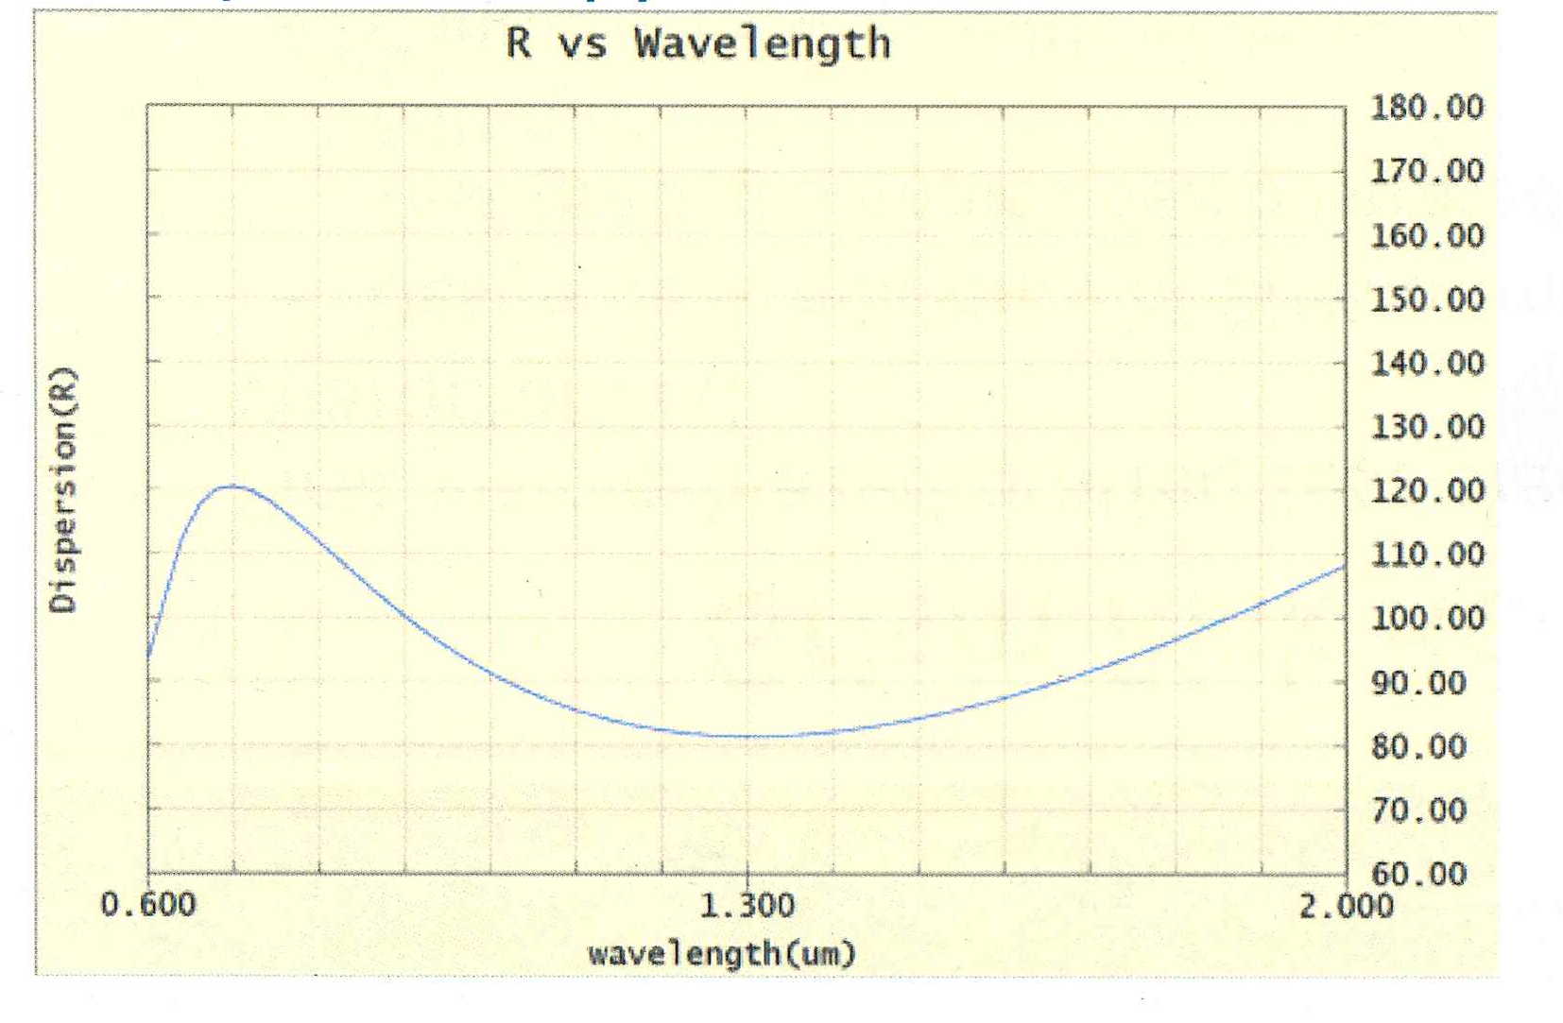
IFU Resolution varies with wavelength
R = 80 near Band 1 at 1.15 μ

Slide 18
IFU exposure Times (seconds)
Z Band 1 Band 2 Band 3
0.15 45.78 52.29 69.65
0.25 62.99 79.47 97.46
0.35 89.36 110.44 130.39
0.45 126.28 139.02 171.34
0.55 147.04 171.80 235.88
0.65 164.97 216.36 299.33
0.75 176.56 284.88 356.22
0.85 197.64 367.70 385.40
0.95 238.21 383.98 461.56
1.05 278.17 394.38 541.14
1.15 339.80 420.61 672.43
1.25 383.85 434.68 828.96
1.35 429.83 468.31 953.80
1.45 479.29 541.90 918.95
1.55 493.71 612.01 914.46
1.65 524.43 693.77 963.87
Exposure times to get S/N = 15 per synthetic filter band 1
S/N = 3.5 per pixel
Add 42 seconds to each exposure time for readout and slewing

Slide 19
IFU Exposure Times for various S/N
Used the S/N formula to estimate exposure times vs Redshift for the 1.02 to 1.28 μ Band 1
With R=80, we have 140 Å / resolution element at 1.15 μ
Will have 2600/140=18.6 resolution element in dispersion direction
S/N per resolution element = (S/N per band 1)/sqrt(18.6)
Relative Exp Time | S/N per filter Band | S/N per res el
1.0 | 15 | 3.5
2.0 | 26 | 6.0
2.4 | 30 | 7.0
4.0 | 43 | 10
5.2 | 52 | 12
6.8 | 60 | 14

Slide 20
IFU Spectra Planned for each Supernova
Spectra | No/SNe | Relative Time | S/N per resel | S/N per Filter
Typing | 2 | 2.0 | 6 | 24
Light Curve | 8 | 1.0 | 3.5 | 15
Deep at Peak | 1 | 4.0 | 10 | 40
Galaxy Ref | 1 | 2.0 | 6 | 24
Total | 12 | 18

Slide 21
IFU Spectrometer, Lightcurves from Spectra
Use imaging to discover supernovae in two filters with
S/N>4 in each
Use IFU spectrometer for Sne ID and to get points on the
lightcurve with S/N=15 per synthetic band ( S/N=3 per pixel).
Get an additional deep spectrum (S/N=10)near peak
and one reference spectrum later with S/N = 6 per pixel
Mode | Low z z < 0.4 Area Time Hours | Medium z z < 0.8 Area Time Hours | High z z < 1.7 Area Time Hours | Time per visit
Imaging Discovery | 27.44 55sec 3.0 | 8.96 109s 1.9 | 5.04 307s 3.0 | 8 hrs
Spectra for ID&Typing | 27.44 varies | 8.96 varies | 5.04 varies | 5 hrs
Spectra for lightcurves | 27.44 varies | 8.96 varies | 5.04 varies | 9 hrs
Deep Spectra | 27.44 varies | 8.96 varies | 5.04 varies | 5 hrs
Galaxy Ref | 27.44 varies | 8.96 varies | 5.04 varies | 3 hrs

Slide 22
Error Model Used
Statitical errors
Measurement error σ_{meas} = 8 % with S/N = 15 spectra per filter band 2 and one deep spectrum near peak with S/N=10 per resolution element
Intrinsic spread σ_{int} = 8 % with IFU deep spectra
Gravitational lensing error σ_{lens} = 0.07*z
Statistical σ_{stat} = [σ_{meas}² + σ_{int}² + σ_{lens}²]^{½}/√n
Systematic errors
Systematic error σ_{sys} = 0.01(1+z)/1.8
Total error per z bin
Total error σ_{tot} = [σ_{stat}² + σ_{sys}²]^{½}

Slide 23
2.4m IFU Deep, Spectro Lightcurves, FoM=312
<Z> SNe SNe SNe SNe σ_{stat} σ/√N σ_{sys} σ_{tot}
Low z Mid z Hi z Total
0.15 46 14 8 69 0.114 0.014 0.006 0.015
0.25 139 44 24 208 0.114 0.008 0.007 0.011
0.35 269 86 47 402 0.116 0.006 0.008 0.009
0.45 0 144 78 223 0.117 0.008 0.008 0.011
0.55 0 211 115 327 0.120 0.007 0.009 0.011
0.65 0 280 152 136 0.122 0.010 0.009 0.014
0.75 0 349 189 136 0.125 0.011 0.010 0.014
0.85 0 0 233 136 0.128 0.011 0.010 0.015
0.95 0 0 270 136 0.131 0.011 0.011 0.016
1.05 0 0 297 136 0.135 0.012 0.011 0.016
1.15 0 0 311 136 0.139 0.012 0.012 0.017
1.25 0 0 313 136 0.143 0.012 0.012 0.018
1.35 0 0 304 136 0.147 0.013 0.013 0.018
1.45 0 0 282 136 0.152 0.013 0.014 0.019
1.55 0 0 253 136 0.157 0.013 0.014 0.020
1.65 0 0 222 136 0.162 0.014 0.015 0.020

Slide 24
Numbers of Supernovae
3011 Supernovae Total
2725 Supernova Total
Number of Supernovae per z = 0.1 bin
Redshift

Slide 25
Error on Distance Measurement
Distance Error per z = 0.1 bin
Redshift

Slide 26
Figures of Merit
For the Supernova Survey only FoM = 312
Supernova with Stage III prior FoM = 582

