Slide 1
Medical Imaging: Final Project
Rubin Paudel

Slide 2
Table of contents
Introduction
Requirements
Loading and Visualizing DICOM Images
Coregistration & Thalamus Region

Slide 3
Introduction

Slide 4
Requirements
Loading and MIP
Study the headers
Arrange the segmentation image
Visualize the region of interest
Create a MIP
Animation with at least 16 projections
Coregistration, Thalamus region
Rigid motion
Loss function
Optimizer
Verify correctness with visualizations

Slide 5
Loading & Visualizing DICOM images

Slide 6
Data & Implementation
Data
1 Patient folder with Segmentation and multiple acquisitions
Implementation process
Visualize and study headers with 3D slicer
Find right acquisition
Load segmentation and acquisition in Python and arrange the slices
Perform alpha fusion
Create MIP projection and GIF file (16 projections)

Slide 7
Visualization

Slide 8
Coregistration & Thalamus region

Slide 9
Data & Implementation
Data
Input file, reference file, image
Implementation process
Coregistration
Thalamus region

Slide 10
Coregistration
Load the reference and atlas image.
Load the input volume data, which represents the brain image to be coregistered.
Compute the index of the central plane for each volume.
Preprocess the input and reference landmarks by normalizing and scaling them.
Perform coregistration by applying a rigid transformation to the input landmarks.
Use the coregistration result to transform the input volume to align with the reference volume.
Compute evaluation metrics, such as mean absolute error, mean squared error, and mutual information, to assess the quality of the coregistration.
Visualize the input, reference, and coregistered volumes for comparison.

Slide 11
Thalamus region
Extract thalamus indexes.
Create empty mask.
Set thalamus region in mask.
Perform alpha fusion with input image.
Perform alpha fusion with reference image.

Slide 12
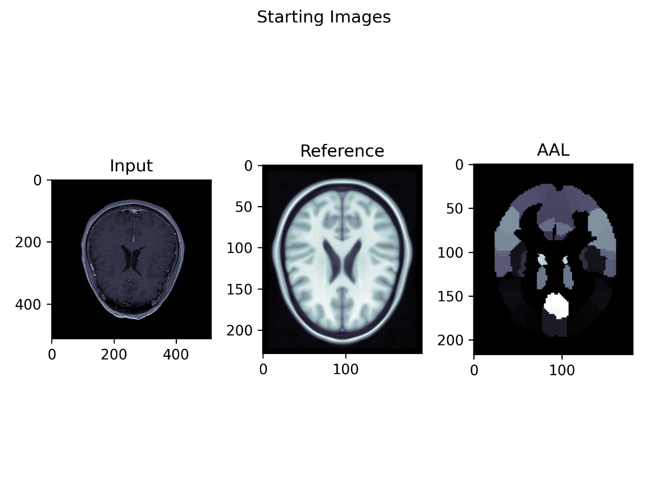
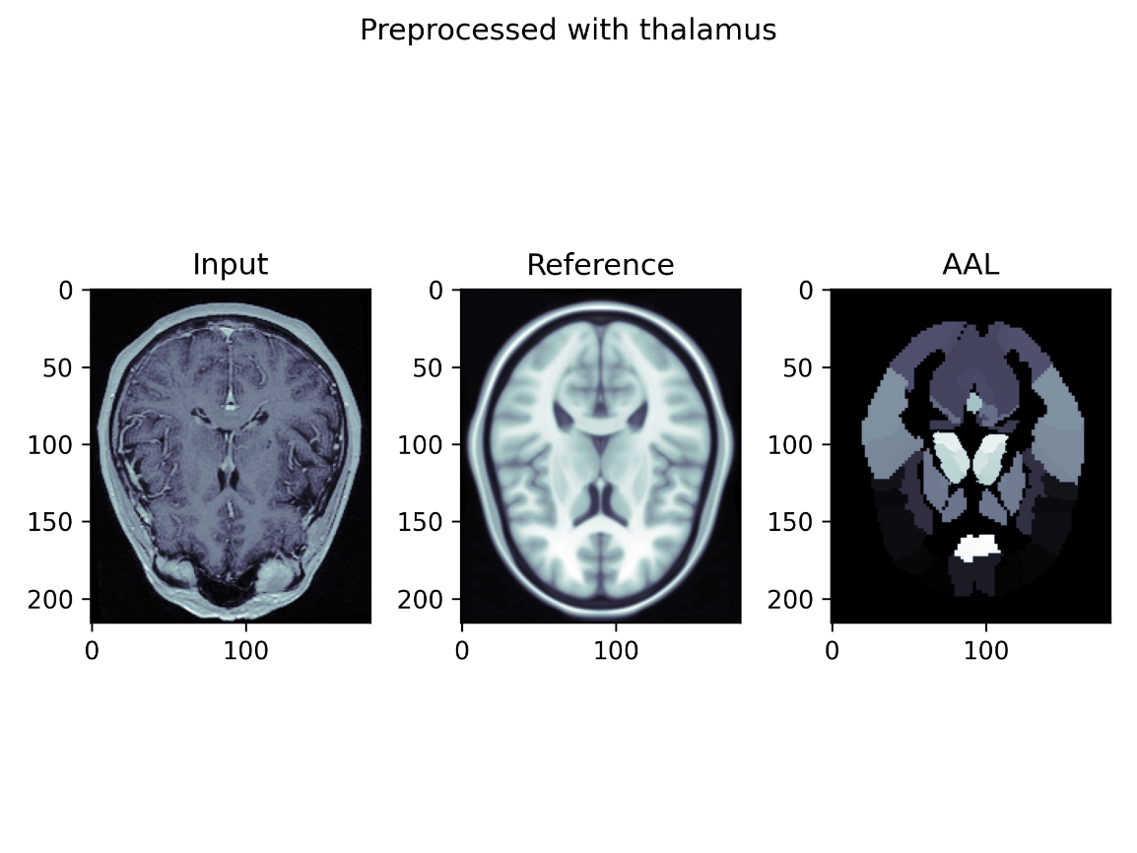
Visualizations

Slide 13
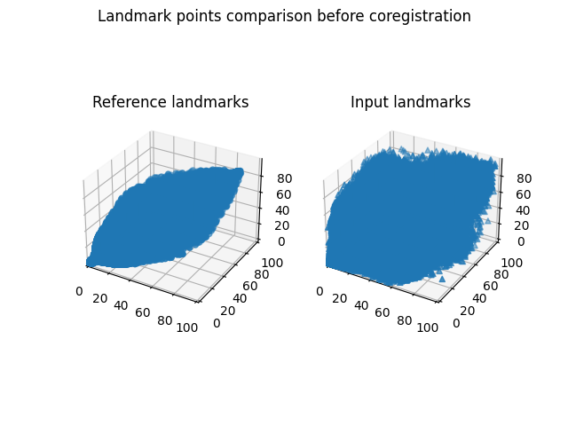

Visualizations

Slide 14
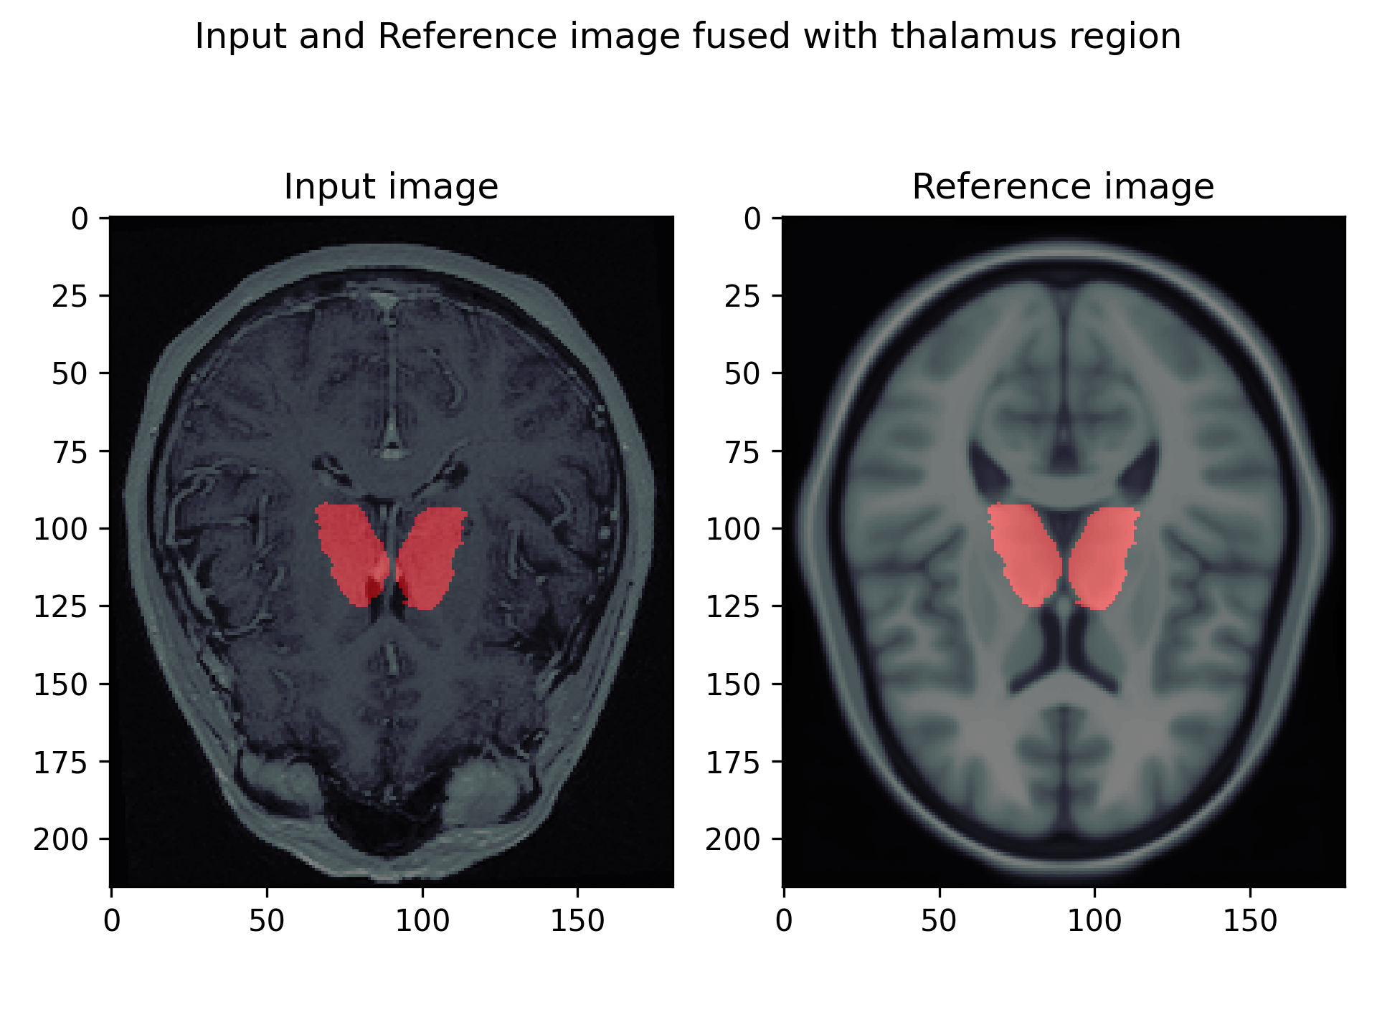
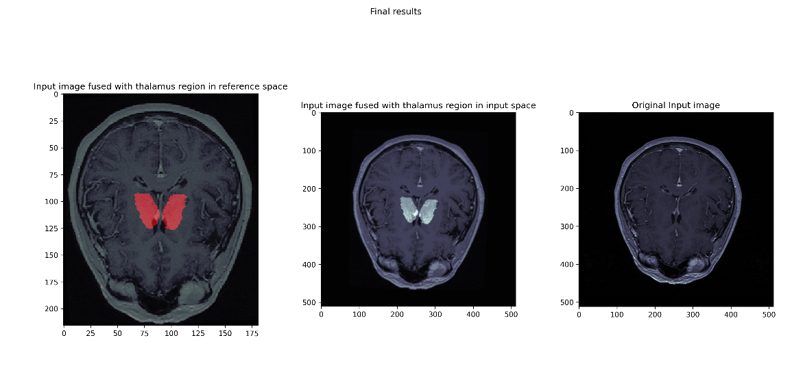
Visualizations

Slide 15
Conclusion

Slide 16
What I learned
Working with DICOM images
Using 3rd party software for medical images
Image processing
Gaining domain knowledge before starting on the project
Programming Activities

