Slide 1

OOP Final Project RPG GAME
E14056114 徐顯舜

Slide 2


motivation
Switch / XBOX game
Interesting and wondering how to make a game.
Friends
They make the games by Unity / SFML.

Slide 3
Game’s flow
Shopping Mall
User starts playing the game
Load the map from a file
User walks within the field (map)
Player Death(lose)
Determine the order of action
Yes
Encounter monsters
No
Boss Death(win)
Beat the monster

Slide 4
Techniques
Inheritance
Base class for low level role, and high levels are derived form it.
Polymorphism( virtual function )
Players special skill
Saving the game(but not finish)
Standard template library
Use vector for players’ backpack
Sound, figure
Windows.h

Slide 5
Class type
Players
The RPG game’s role.
Monsters
The role have to fight with.
Field
The map in the game.
Shop
Buying equipment , food …etc.
Mission
Ex: battle with enemy

Slide 6
Player Class
Otaku
Private data:
Attack / defense
Energy / money
Backpack / armor / weapon
Public:
SetFunction()
getFunction()
SpecialSkill()
Normal guy
Whole pack

Slide 7
Course Class
Course
Loading small
FJJ
Loading big

Slide 8
Item Class
Item
WeaponItem
ArmorItem
ConsumableItem
Calculator
Pencil
eraser
Pencil lead
food
drink

Slide 9
OTHER Class
Shop
For rest, buying equipment and upgrading
Battle
Control the battle event
Field
The map in the game and show on the screen
Game
Control the game flow

Slide 10
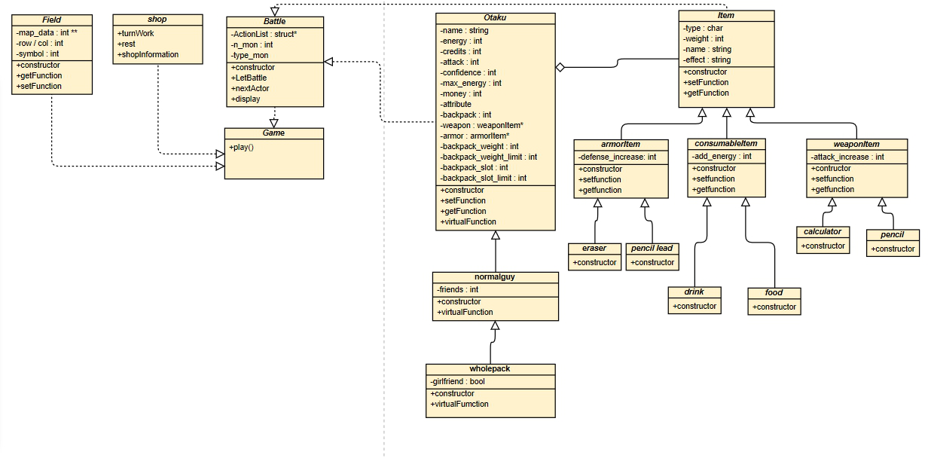
Uml diagram

Slide 11
exceptions
Null pointer
Don’t copy it into your backpack(Use vector, so you can use the function)
Role Upgrading
Remember move the weapon, armor, backpack.
delete
The memory which is not used has to delete.

Slide 12
future
Finish the function of saving file.
Try to combine with Windows form
Try to write the games by Unity or SFML

