Slide 1
Spectral clustering
Students : Pape Samba DIALLO
Van-Khoa NGUYEN

Slide 2
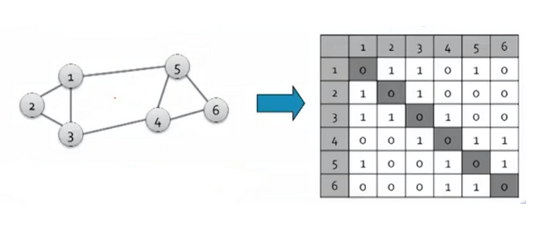
1. What is spectral clustering ? (1)
Adjacency matrix (A) :
Given a graph with n vertices and m nodes, the adjacency matrix is a square n*n matrix with the property:
A[i][j] = 1 if there is an edge between node i and node j, 0 otherwise
K-neareast neighbors

Slide 3
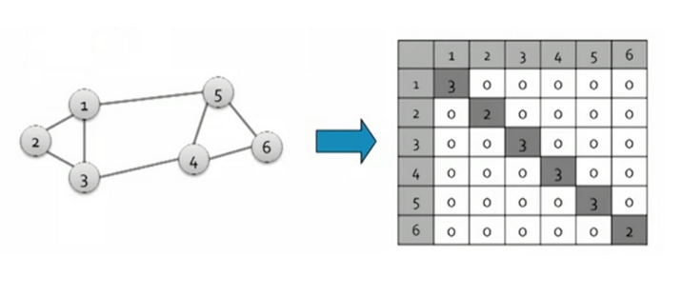
1. What is spectral clustering ? (2)
Degree matrix (D)
The degree matrix is a n*n diagonal matrix with the property
d[i][i] = the number of adjacent edges in node i or the degree of node i
d[i][j] = 0

Slide 4
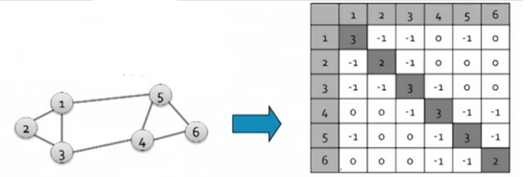
1. What is spectral clustering ? (3)
Laplacian matrix (L)
The laplacian matrix is a n*n matrix defined as: L = D -A
Its eigen values are positive real numbers and the eigen vectors are real and orthogonal (the dot product of the 2 vectors is 0)

Slide 5
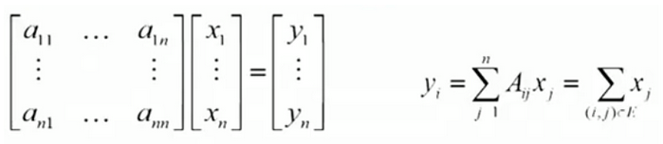
1. What is spectral clustering ? (5)
Conductance
Calculating the eigen values and eigen vectors of A with x ( n dimensional vector with the values of the nodes): A * x = lambda * x
We are ready to summarize the spectral clustering steps:
Compute the Laplacian matrix L of the input graph G
Compute the eigen values (lambda) and eigen vectors (x) such that L* x = lambda * x
Select n eigenvectors corresponding to the smallest eigenvalues and redefine the input space as a n dimensional subspace
Find clusters in this subspace using various clustering algorithms, such as k-means

Slide 6
1. Eigenvalues of the Laplacian graph
Ten eigenvalues corresponding to ten points in the graph.
Number of 0 eigenvalues corresponding to the number of connected components in the graph.
The more eigenvalues are nears to 0, the more we have the number the cluster in graph.

Slide 7
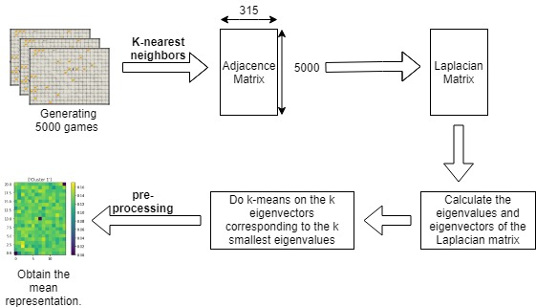
2. Applying the spectral clustering on the Pyrat DataSet
Diagram of the processus

Slide 8
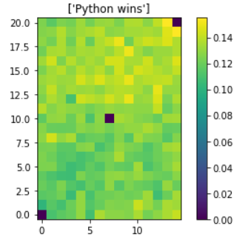
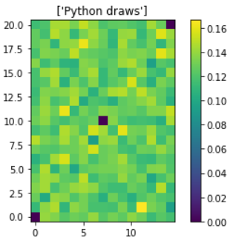
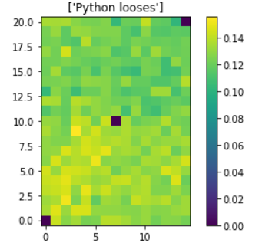
2. Applying the spectral clustering on the Pyrat DataSet
The dataset ground truth explanation
The cheese density distribution in three cases

Slide 9
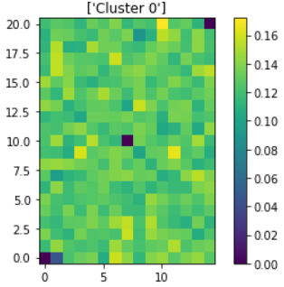
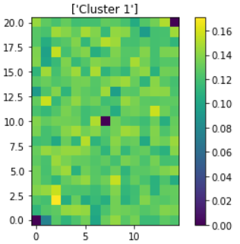
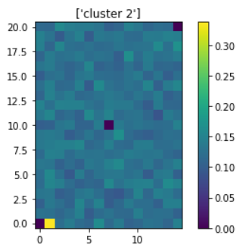
2. Applying the spectral clustering on the Pyrat DataSet
The results of implementing the spectral clustering (n_cluster = 3)
Three different clusters obtained by spectral clustering and the mean representation of them.

Slide 10
2. Applying the spectral clustering on the Pyrat DataSet
The self-tuning spectral clustering and the optimal number of clusters
The idea behind the self tuning spectral clustering is determine the optimal number of clusters and also the similarity metric σi used in the computation of the affinity matrix (Self-Tuning Spectral Clustering- Lihi Zelnik-Manor and Pietro Perona)
In the paper "a tutorial on spectral clustering — ulrike von luxburg" Eigengap heuristic suggests the number of clusters k is usually given by the value of k that maximizes the eigengap (difference between consecutive eigenvalues). The larger this eigengap is, the closer the eigenvectors of the ideal case and hence the better spectral clustering works.

Slide 11
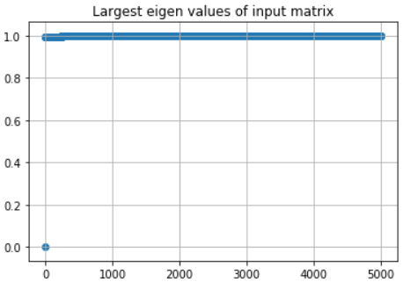
2. Applying the spectral clustering on the Pyrat DataSet
The self-tuning spectral clustering and the optimal number of clusters
Optimal number of cluster 1 (Pyrat Dataset)

Slide 12
References
Spectral graph clustering and optimal number of clusters estimation at https://towardsdatascience.com/spectral-graph-clustering-and-optimal-number-of-clusters-estimation-32704189afbe
Spectral Clustering at https://towardsdatascience.com/spectral-clustering-aba2640c0d5b

