Slide 1
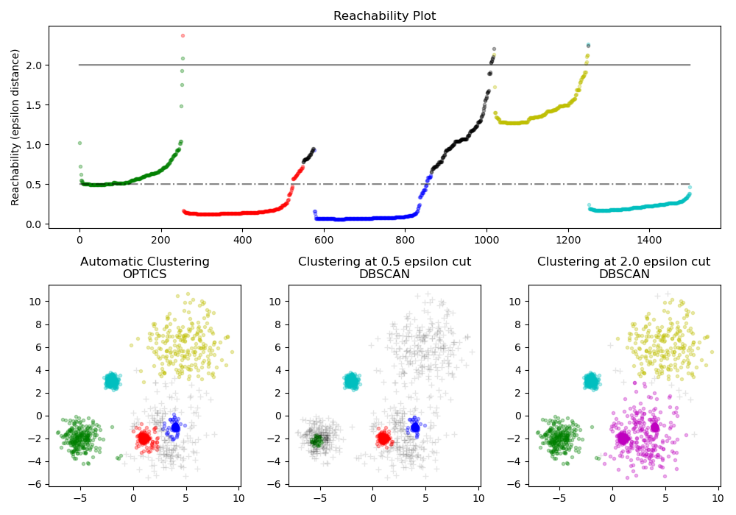
OPTICS Clustering Ordering Points To Identify the Clustering Structure
The OPTICS algorithm is a density-based clustering algorithm used for identifying clusters in spatial data.
It extends upon the DBSCAN algorithm by providing a more flexible approach for discovering clusters of arbitrary shapes and sizes, as well as revealing the hierarchical structure of the data.

Slide 2
Key components
Reachability Distance
Core Distance
Ordering of Points
Clustering Structure
How Does OPTICS Work?
Initialization
Reachability Distance Calculation
Point Ordering
Cluster Extraction
Hierarchical Clustering Structure
Parameter Tuning
Output

Slide 3
OPTICS Clustering v/s DBSCAN Clustering:
Memory Cost
The OPTICS clustering technique requires more memory as it maintains a priority queue (Min Heap) is used to find Reachability Distance. Where as DBSCAN requires less memory space.
Handling varying densities
OPTICS can identify clusters of different sizes and shapes more effectively than DBSCAN in datasets with varying densities.
Noise handling
OPTICS may be less effective when compared to DBSCAN at identifying small clusters that are surrounded by noise points, as these clusters may be merged with the noise points in the reachability distance plot.
Runtime complexity
The runtime complexity of OPTICS is generally higher than that of DBSCAN
Fewer Parameters
OPTICS has fewer parameters when compared to DBSCAN

Slide 4
Advantage
Ability to identify clusters of arbitrary shapes and sizes
Robustness to noise and outliers
Preservation of hierarchical clustering structure
Disadvantage
Computational complexity, especially for large datasets
Sensitivity to parameter selection
Difficulty in handling high-dimensional data
Application
Spatial data analysis
Image segmentation
Anomaly detection
Customer segmentation

