Slide 1
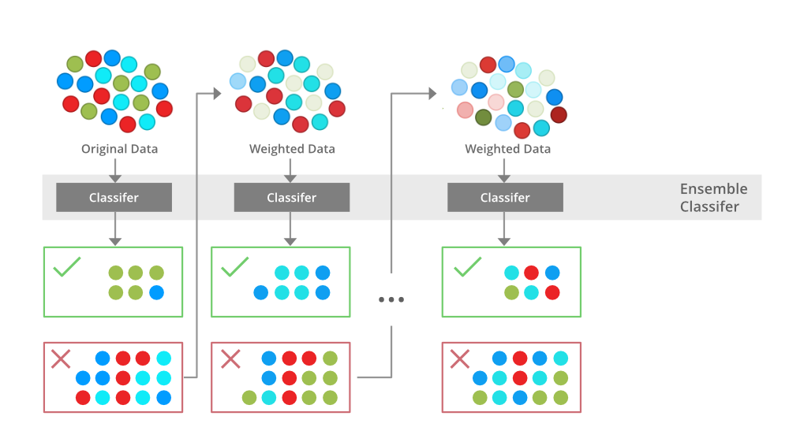
Boosting

Slide 2
Boosting Algorithm
Boosting is an ensemble learning method that combines a set of weak learners into a strong learner to minimize training errors.
In boosting, a random sample of data is selected, fitted with a model and then trained sequentially
With each iteration, the weak rules from each individual classifier are combined to form one, strong prediction rule

Slide 3
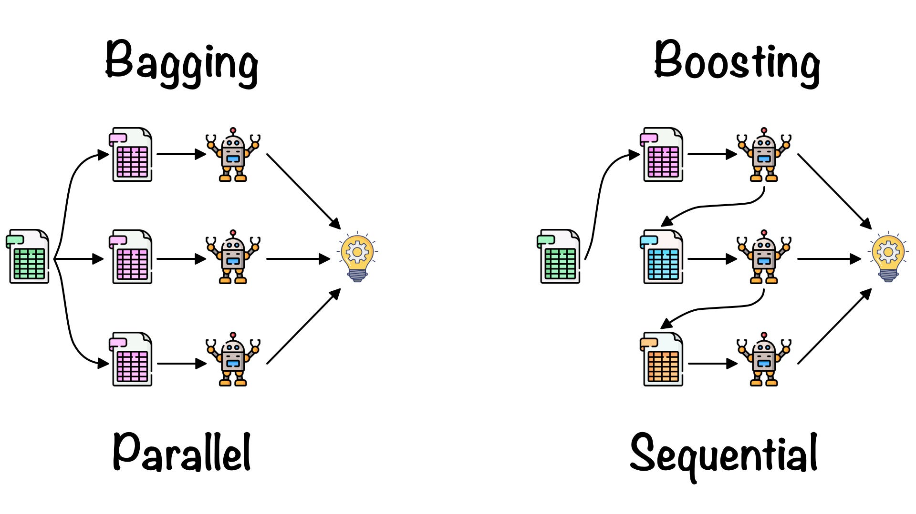
Ensemble Learning

Slide 4
Advantages of Boosting
Improved Accuracy
Combines a set of weak learners into a strong learner to minimize training errors.
Over fitting
Reduce the risk of over fitting by reweighting the inputs that are classified wrongly
Better Handling of imbalanced data
Handle the imbalance data by focusing more on the data points that are misclassified
Better Interpretability
increase the interpretability of the model by breaking the model decision process into multiple processes.

Slide 5
Types of Boosting Algorithms
Ada Boost
Gradient Boosting (GBM)
Light GBM
XGBoost
CatBoost

Slide 6
Adaboost Regressor
An Ada Boost regressor is a meta-estimator that begins by fitting a regressor on the original dataset and then fits additional copies of the regressor on the same dataset but where the weights of instances are adjusted according to the error of the current prediction.
Syntax :
class sklearn.ensemble.AdaBoostRegressor(estimator=None, *, n_estimators=50, learning_rate=1.0, loss='linear', random_state=None, base_estimator='deprecated')

Slide 7
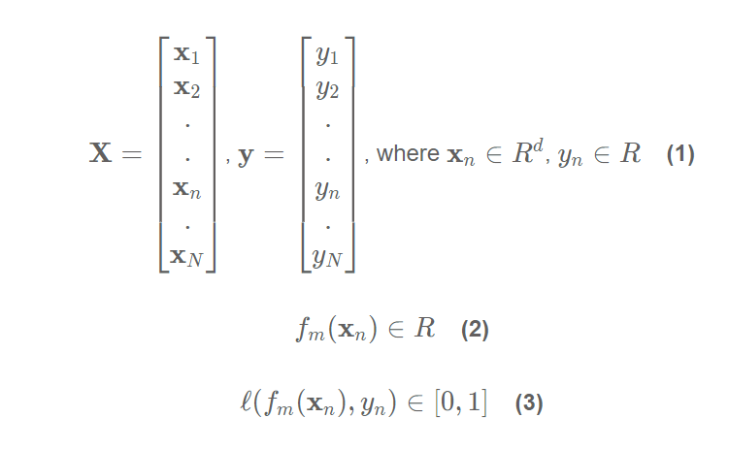
Derivation of a Adaboost Regression Algorithm
Equations (1), (2), and (3) describe the data, weak learner model, and loss function, respectively. Note x_{n} are the rows of matrix X, and contain d features. Similarly, y_{n} are the scalar values of the column vector y.
Adaboost Regression is a sequential algorithm
Combines a set of weak learners into a strong learner to minimize training errors

Slide 8
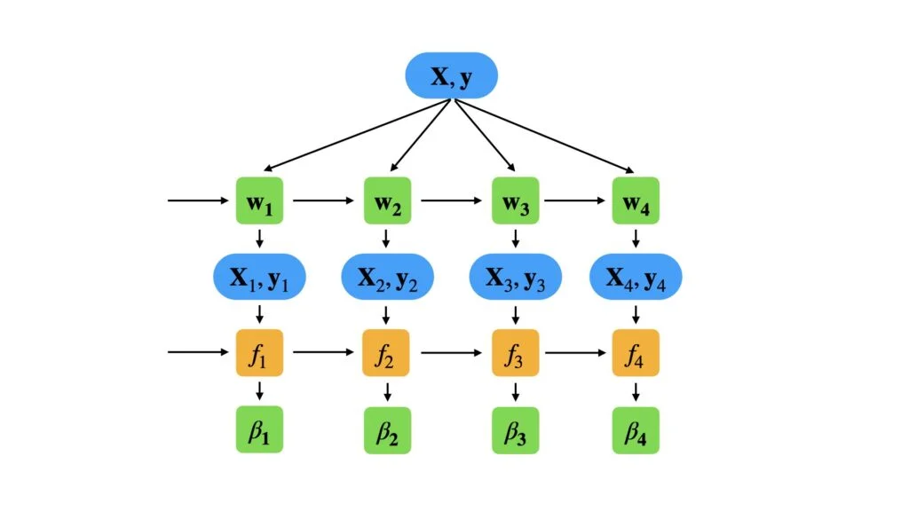
Adaboost Regressor

Slide 9
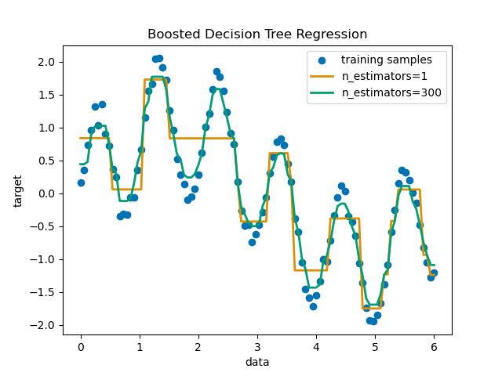
Decision Tree Regression with AdaBoost

Slide 10
XG Boost
XG Boost means eXtreme Gradient Boosting.
It is one of the advanced implementations of the gradient boosting algorithm.
XG Boost is nearly 10 times faster compared to others, and it has high predictive power.
It also helps in reducing over fitting issues and improves the overall accuracy of the model.
It is also called the ‘Regularized Boosting’ technique

Slide 11
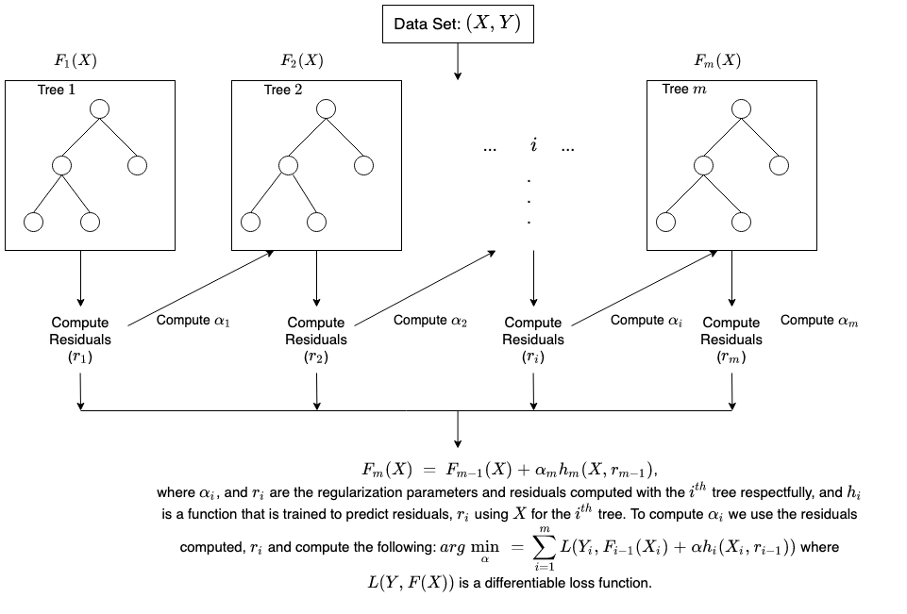
How XG Boost Works

Slide 12
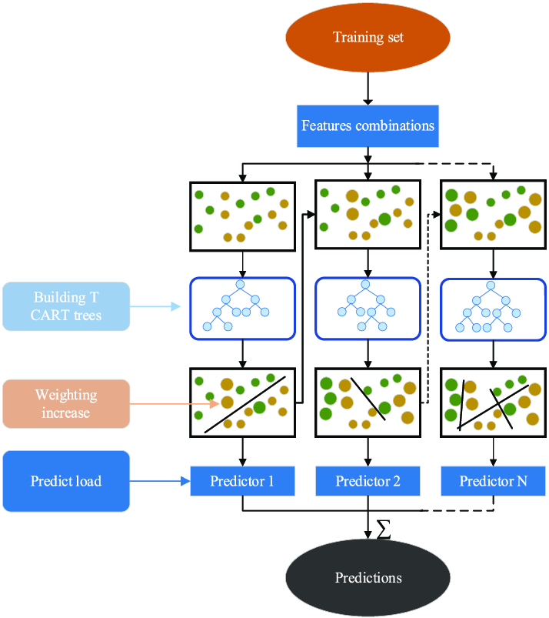
XG Boost

Slide 13
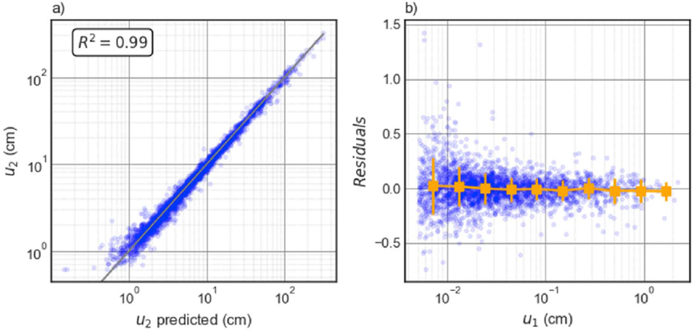
Predicted R² value in XG Boost

Slide 14
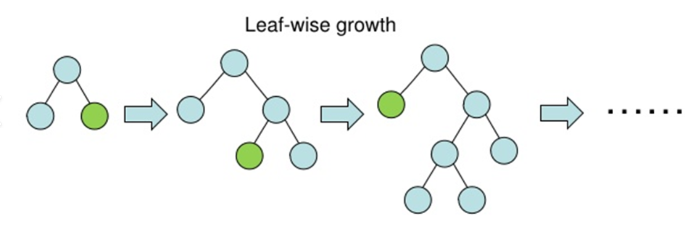
Light GBM
Light GBM creates a decision tree that develops leaf-wise, which implies that given a condition, just one leaf is split, depending on the benefit. Sometimes, especially with smaller datasets, leaf-wise trees might overfit
Light GBM is the most useful in the large dataset. This technique is faster in terms of running huge data, compared to the other algorithms.

Slide 15
Gradient Boosting (GBM)
Gradient Boosting or GBM is an ensemble machine learning algorithm which works on both regression and classification problems.
In GBM, a number of weak learners are combined to form a strong algorithm.
Here also each succeeding tree is built on the error calculation basis from the preceding trees.
Here regression trees are used as a base learner

Slide 16
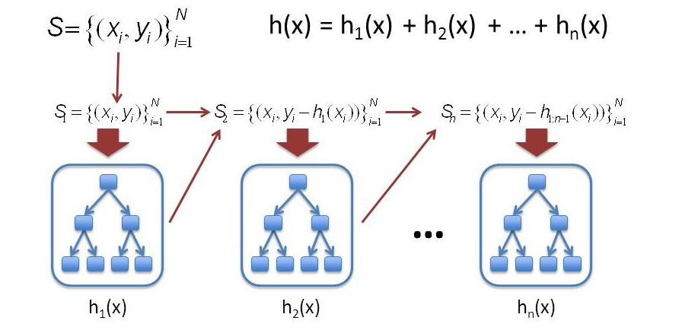
Gradient Boosting

Slide 17
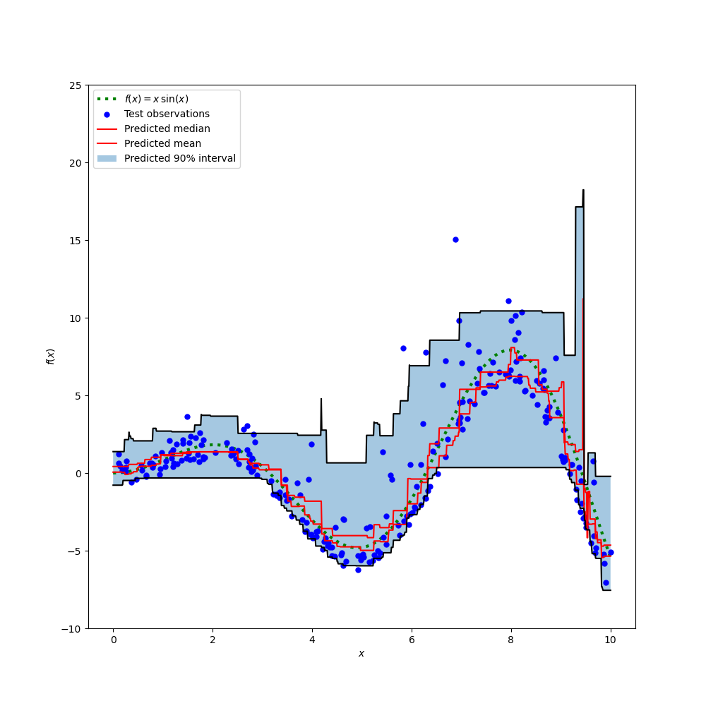
Prediction Intervals for Gradient Boosting Regression

Slide 18
Cat(Categorial) Boosting
Cat Boost is a Gradient boosting algorithm that is designed to handle categorical data without requiring the data to be converted into numerical values.
It is based on the same principles as other Gradient boosting algorithms, but it has additional features that make it well-suited to handle categorical data.
Benefits: Immune to over fitting, good with high-dimensional data with many features.
Where to use: Customer segmentation, fraud detection, recommendation systems

