Slide 1
INVESTMENT ASSIGNMENT SUBMISSION
Name: Jesal Patel

Slide 2
SparkFunds Business Objective
Understanding the global trends in Investments for making investments in a few companies.
To make an investment where most investers are investing by identifying the best sectors, countries and suitable investment type.
Key Constraints for making investments:
To invest between 5 to 15 million USD per round of investment
Investment in English speaking countries for ease of communication.

Slide 3
How to solve small analytical milestones and reach to the expected result after analysis ?
- A flow chart showing a blend of technical approach and concepts of analysis for achieving SparkFunds Objectives.
- The flow chart is sectioned in to 2 parts.

Slide 4
. Flow Chart part-1
Importing required libraries for working
Data Collection
Data understanding
Data visualisation
Cleaning the data
. Flow Chart part-2
Merging the Dataframes as per requirement
Cleaning the dataframes
Creating a master frame
Goal-wise analysis
Investment type analysis
Country analysis
Sector analysis

Slide 5
Flow chart part-1
Start
Plots for Data Understanding
# Plotting the Data from Dataframe helps visualize the data in more physically.
# using bar plots, histograms, box plots helps understand the wideness and type of data
Importing the required Libraries
# pandas for working on DataFrames
# matplotlib for graph plots
Importing csv as DataFrames
#pd.read_csv(“../filename_ext”,encoding=xx)
Cleaning the Data
# Identifying the Outliers and if not required clean the data
# dropna(), del column_name, refill the data with mean, median
Data Understanding
# Using functions : info(),describe(),head()
# getting the size, nature and information binded in the DataFrame
continued

Slide 6
Flow chart part-2
continued
Plots for Data Understanding
# Plotting the Data from Dataframe helps visualize the data in more physically.
# using bar plots, histograms, box plots helps understand the wideness and type of data
Merging the DataFrames
# Identifying the primary key / unique id from the set for merging
# merging the imported csv to dataframes and clubbing it to mainframe
# pd.merge(df1,df2,how= ‘ ‘,on=’ ‘)
Cleaning the Data
# Identifying the Outliers and if not required clean the data
# dropna(), del column_name, refill the data with mean, median
Data Understanding
# Using functions : info(),describe(),head()
# getting the size, nature and information binded in the DataFrame
Creating Master Frames for further goal oriented analysis
Flow Chart Part-2 continued

Slide 7
Flow chart part-2 (continued)
Flow Chart Part-2 continued
Sector Analysis
# Identifying the top three sectors based on the eight main sectors provided .
Investment Type Analysis
# Seggregating the Investment companies with investment type venture, seed,angel,private equity
# Finding type that has heavy investments
Plotting the analysed Data for better # Plotting fraction of total investments(globally) in selected funding types
# Plotting top 9 countries against investment amounts of selected fund type
# Plot showing number of investments in top 3 sectors of top 3 countries
Country Analysis
# Seggregating companies based on countries which are heavily invested.
End of Analysis

Slide 8
Investment type analysis
Among the dataframe of companies obtained by merging and mapping the sectors we need to find the most representative value of the investment types.
Here the funding types Venture, Angel, Seed and Private Equity is more prefered.
Grouping the compnies based on funding types and summing the investment amount and the variation of data by calculating the average. And filtering with condition of investment amount 5-15 million USD.
Further by sorting the values of investment amount in ascending we get a list of top to bottom investment type.
From this we can easily select the likely funding type by most of the investors.

Slide 9
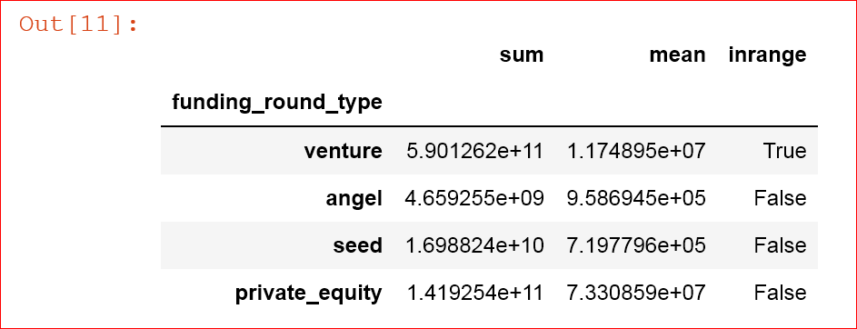
Investment type analysis
We get the following Data :
From the below data observing the inrange column which says True based on all the filtering conditions by SparkFunds.
Venture is the investment funding type likely globally.

Slide 10
Country analysis
Determining the countries of the given invested companies requires two different tasks to be performed.
Identifying and sorting the countries that speak English language (Countries having English as primary and official language).
And further filtering with condition of investment amount 5-15 million USD.
Now by arranging the list of countries in higher to lower order based on the raised amount invested in each countries, we get a list of top 9 countries

Slide 11
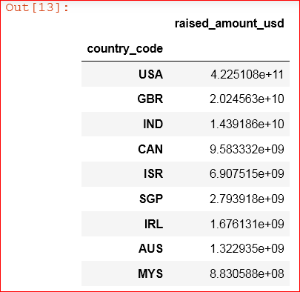
Country analysis
We get the following Data :
From the below data observing the column raised_amount_usd
Top 3 countries comes out to be : USA , Great Britain, India

Slide 12
Sector analysis
Sector anaysis is very important as it helps SparkFunds to invest in which sector among the top countries.
Also it lists out companies which boom in the perticular sector in perticular selected county.
Helps narrow down the options from a big pool of companies, countriesa and sectors.
This can be achieved by mapping the sub-categories sector of the companies provided with the eight main categories given by SparkFunds as their investment interests.

Slide 13
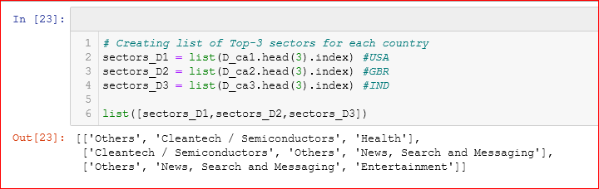
Sector analysis
After Sector analysis we get:
A list of top 3 sectors from top 3 countries

Slide 14
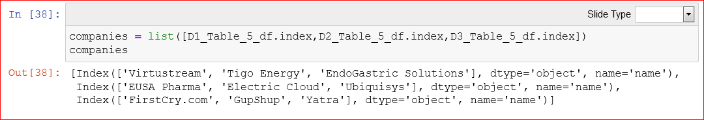
Sector analysis
After Sector analysis we get:
Also we can further determine the top 3 companies of these respective sectors in respective countries.
Output format : | Companies(USA) | Companies(GBR) | Companies (IND)

Slide 15
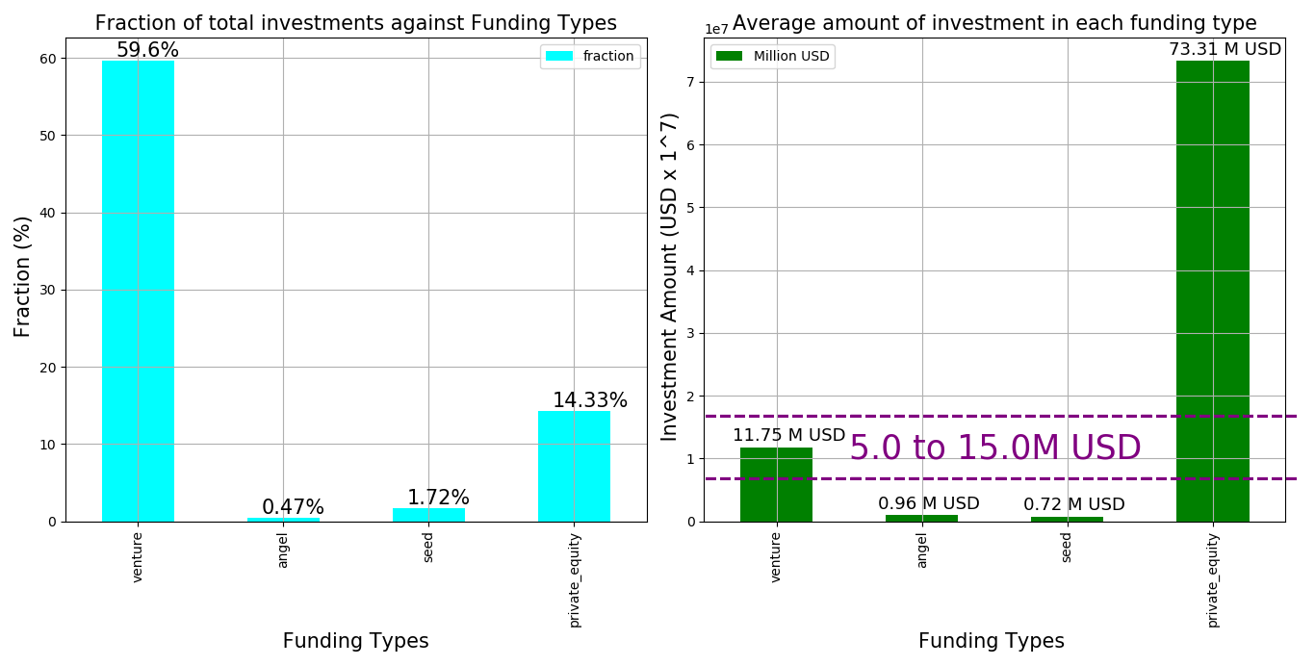
The Fraction of total investments (globally) in Angel, Venture, Seed and Private Equity, and the average of investment in each funding type.
Plot 1

Slide 16
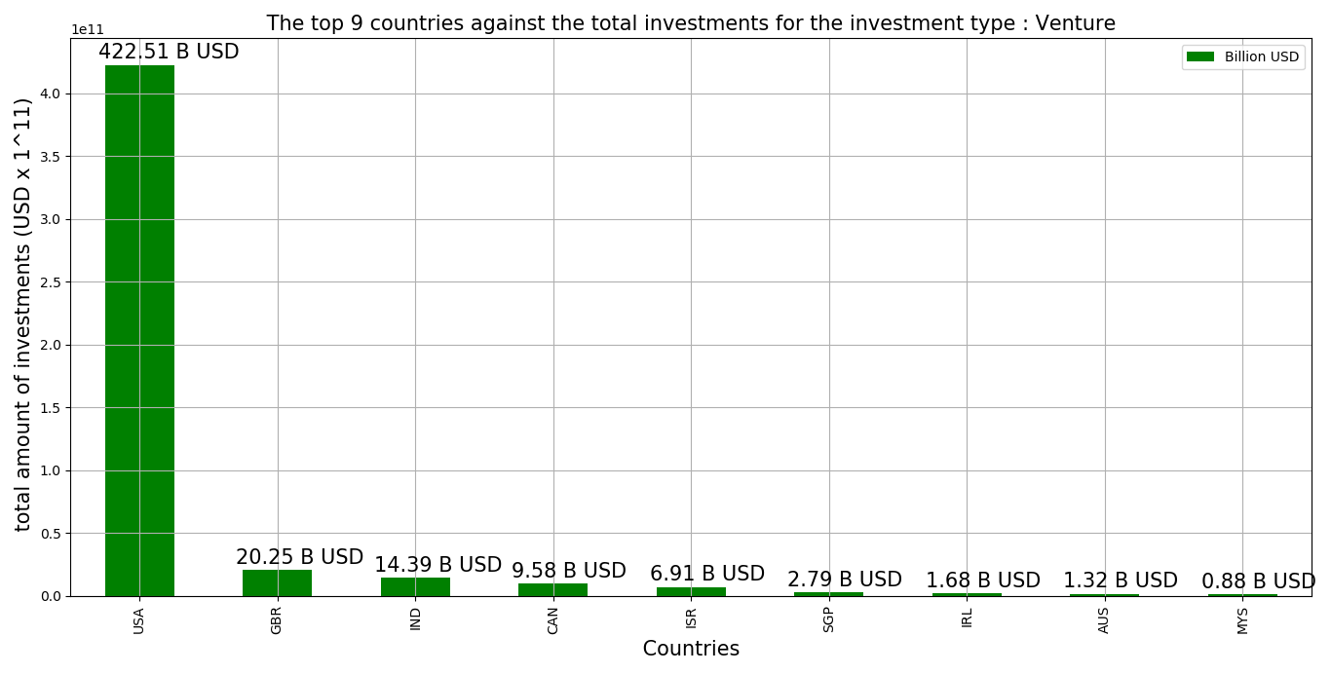
The top 9 countries against the total investments for the investment type : Venture
Plot 2

Slide 17
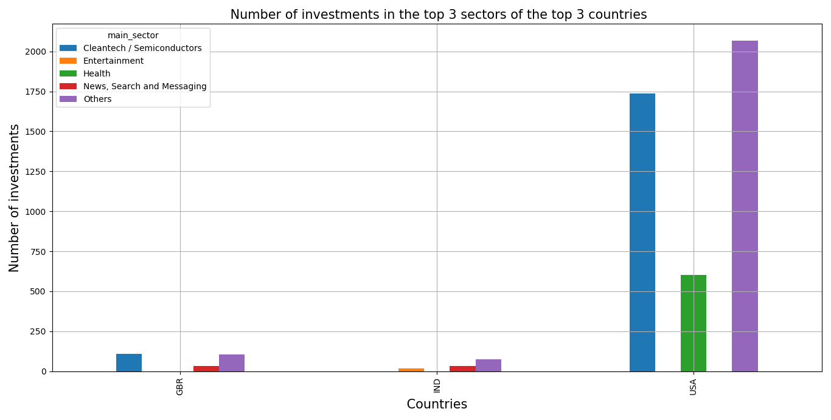
The number of investments in the top 3 sectors of the top 3 countries for the investment type : Venture
Plot 3

Slide 18
Proposed Conclusions
With the analysis done on the historical data of the investments provided and with the SparkFunds constraints being considered.
Two points can be concluded:
SparkFunds can go on with the Venture funding round type which is 59.6% among the given and chosen funding investment types.
The top 3 countries that can be invested in with ease of communication are USA , Great Britain and India
The common booming sectors which can be invested in respective selected countries in number of investments are:
Others & Cleantech/Semiconductors

