Slide 1
Migrations
Database Schema Versioning

Slide 2
Ways to do it
RedGate
  SqlCompare
  SqlSourceControl
Microsoft
  SQL Server Data tools
Custom
Migrations
  Flyway - Sql Script based
  DbUp – Sql Script based
  RoundhousE – Sql Script based
  EF/EF Core – Code first
  FluentMigrator – Fluent syntax based

Slide 3
EF Core vs FluentMigrator
Models
Convention based
CLI
Easier to use
Fluent Syntax
User Defined
CLI & Console
Simple but not as easy as EF Core

Slide 4
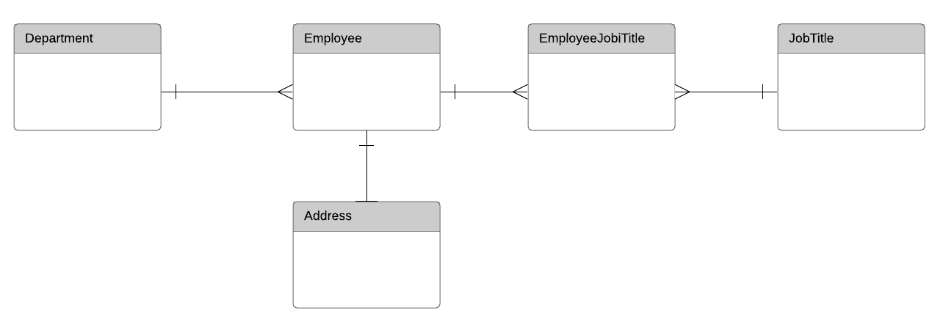
Schema

