Slide 1
Approximate Bayesian Computation for Household Influenza Outbreaks
Tony and Stumpf, “Simulation-based model selection for dynamical systems in systems and population biology”, Bioinformatics (2010)
INDIANA UNIVERSITY BLOOMINGTON
Rubiga Kim

Slide 2
Real-World Question:
Project Objectives
When influenza outbreaks occur, do they spread the same way?
  Two H3N2 outbreaks in Michigan (1977-78, 1980-81) and different strains in Seattle (Influenza B vs H1N1)
  Key question: Are transmission dynamics strain-specific or outbreak-specific
Why this matters?
  Public health planning: Different strains need different interventions
  Resource allocation: Where to focus prevention efforts
Notes:
Can they be described by the same model

Slide 3
Project Overview & Objectives
  Goals of the project:
Estimate transmission parameters:
qh: household transmission probability escape
qc: community transmission probability escape
Compare two competing models:
Model 1: both outbreaks share the same parameters
Model 2: each outbreak has separate parameters
Reproduce figures from the paper
Accepted ABC samples forms clusters
Tecumseh outbreaks should overlap
Seattle outbreaks should form two distinct clusters
Notes:
Primary aim of ABC is to infer the parameters that best explain the observed household outbreak data. ABC allows us to approximate posterior distribution. In other words, is to learn which transmission parameters produce simulated outbreaks that best match the observed data, so that we can see whether different influenza outbreaks share the same disease-spread dynamics.

Slide 4


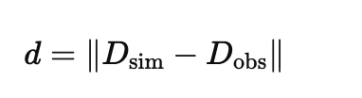
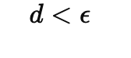
ABC Logic and Algorithm
  The likelihood of Longini-Koopman household model is intractable so we cannot compute:
  Draw parameters from prior
  Simulate outbreak data using:
      wjs_matrix() and simulate counts()
  Compute distance measure
  Accept or Reject
Notes:
The likelihood for the Longini–Koopman model requires summing over all possible unobserved infection pathways within households, which grows combinatorially and has no closed-form solution—so traditional Bayesian inference is impossible, and ABC is required

Slide 5
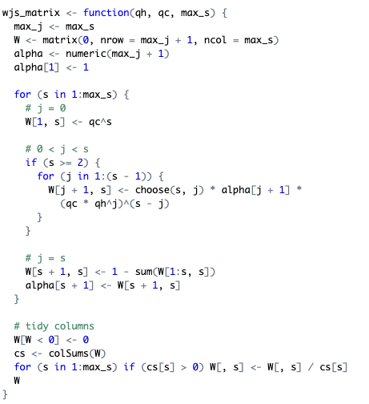
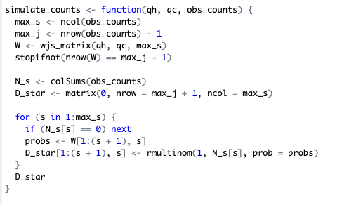
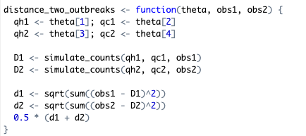
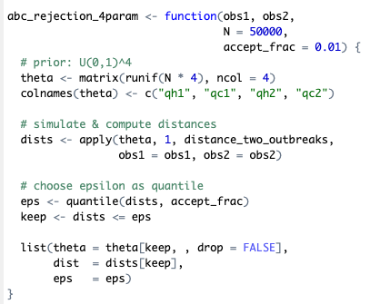
Code Design & Key Functions
  Draws Parameters
  Simulates outbreaks
  Calculates distances
  Returns accepted samples
Notes:
1. wjs_matrix(qh, qc)
Builds household infection probability matrix
Ensures each column sums to 1
2. simulate_counts(qh, qc, obs)
Generates infection count tables
Uses multinomial sampling
3. distance_two_outbreaks(theta)
Computes Frobenius distance between simulated and observed tables
4. abc_rejection_4param()
Draws parameters
Simulates outbreaks
Calculates distances
Returns accepted samples
Design Decisions
Modular functions for easy debugging
Vectorized distance computation for speed
Returns both parameters and epsilon threshold

Slide 6
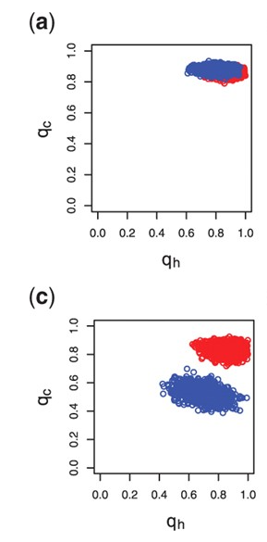
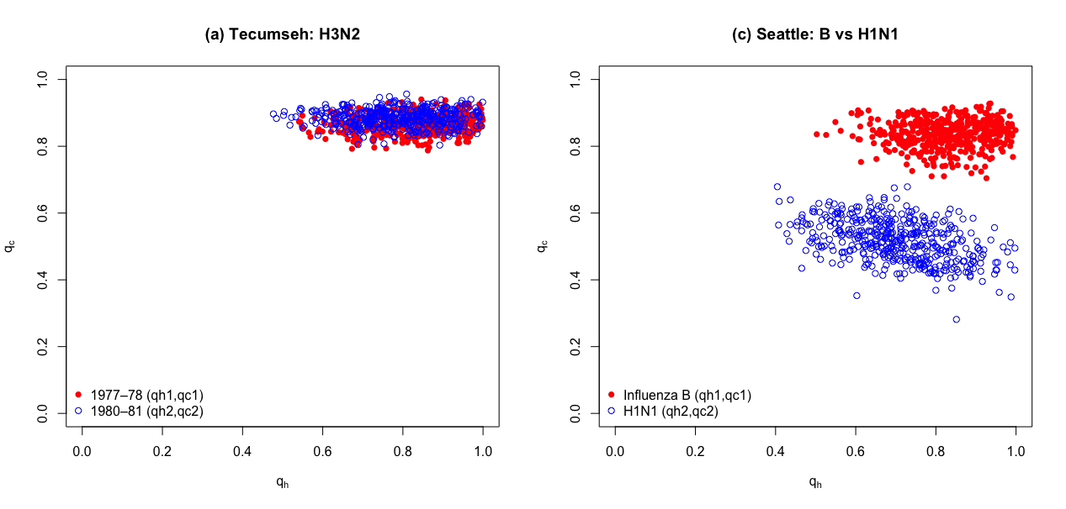
Conclusions
Posterior cluster
Notes:
1. Column sums of W normalized to 1
“First, in wjs_matrix(), every column is automatically normalized so the probabilities sum to 1.
This guarantees that the infection probability distribution for each household size is mathematically valid.”
2. Simulator preserves household totals
“Next, our simulator uses a multinomial draw, which always returns counts summing to the number of households of that size.
This ensures the simulation never creates or loses households.”
3. Distance = 0 when simulated matches observed
“Our distance function computes the Frobenius norm between two outbreak tables.
If we compare a simulated table to itself, the distance is exactly zero, which confirms the metric is implemented correctly.”
4. Lower epsilon → tighter posterior cluster
“Finally, in the ABC rejection step, decreasing epsilon makes the acceptance threshold stricter.
As expected, this produces much tighter posterior clusters, indicating the algorithm is behaving correctly.”

Slide 7
Conclusions
  ABC infers transmission parameters for influenza outbreaks
  Code reproduces the qualitative patterns as in the paper
  Tecumseh outbreaks → Similar behavior
  Seattle outbreaks → Distinct behavior

