Slide 1

MIDS W200
A Game of Solitaire
Ruby Han
PROJECT_1
Oct 30th, 2020

Slide 2
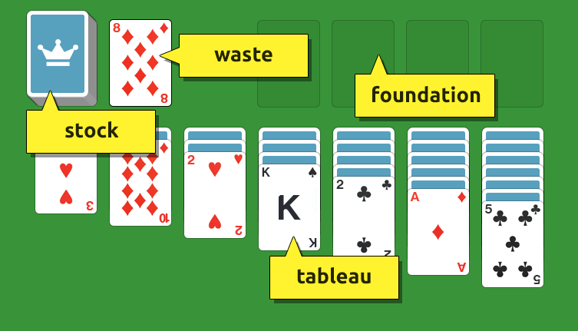
Overview - Solitaire
Popular card game that you can play alone to kill time
Follows the official rules of Solitaire
Eight classes (PlayingCard, Deck, Tableau, StockAndWaste, Foundation, Help, Solitaire, Engine)
Two libraries (Random, Colorama)

Slide 3
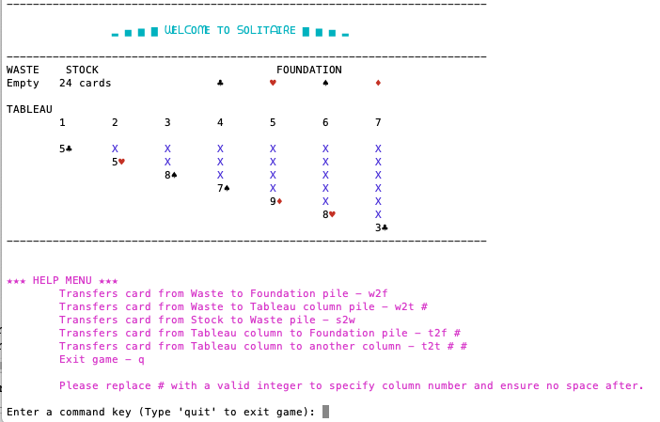

Slide 4
Future Improvement Opportunities
No fancy graphical images
No scoring/timer/undo features
No option to display three cards simultaneously in the Waste pile
No command shortcuts
Consider PyGame to make better UX/UI

