Slide 1

NLP Applications
Ruby Amyeen
Institute for Computing in Research

Slide 2

Natural Language Processing (NLP)
NLP involves…
computers learning the natural language we use to communicate- text, speech
The intersection between linguistics and AI

Slide 3

https://media.wired.com/photos/5daa22180da2b80009c7fad8/4:3/w_1683,h_1262,c_limit/Science_Quantalead_Testing-AI_2880x1820_Lede.jpg

Slide 4
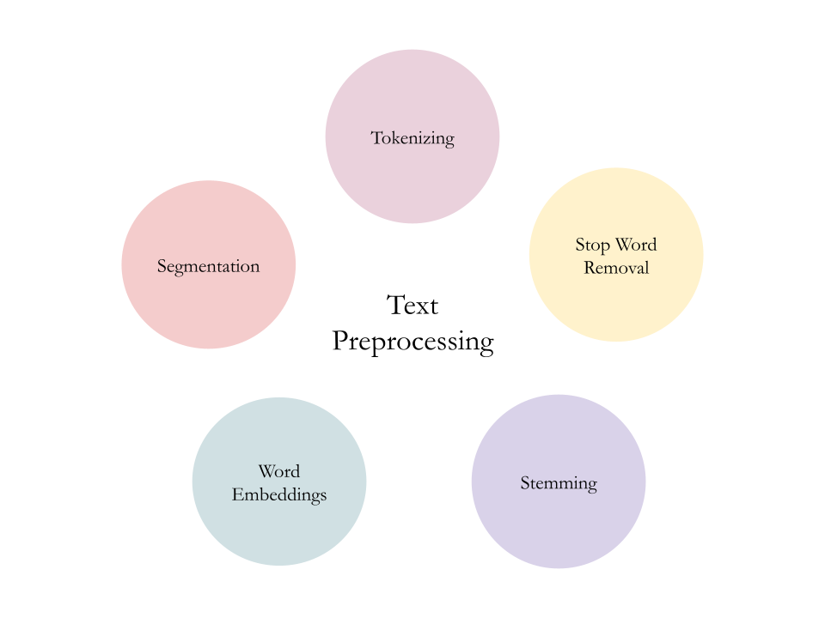
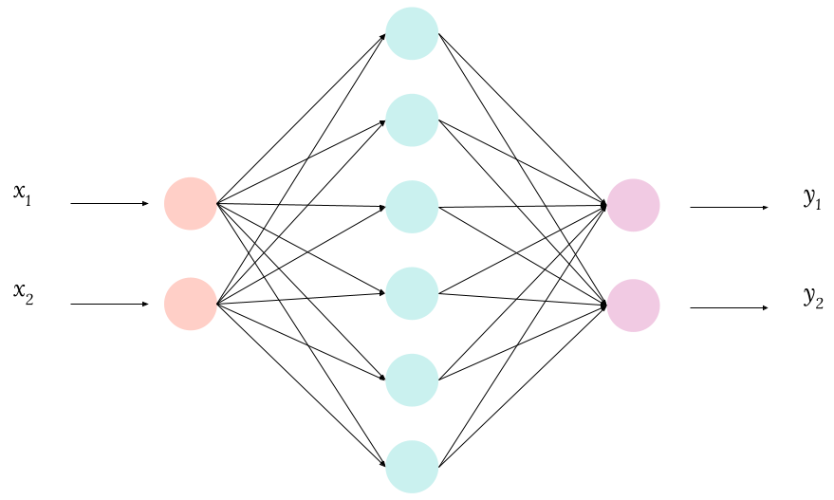
NLP Process
Data Preprocessing
Neural Networks

Slide 5
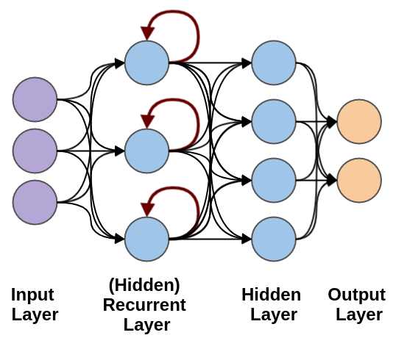
Recurrent Neural Networks (RNNs)
How do we fix long-term dependencies?
Gated Recurrent Unit (GRU)
Long Short Term Memory (LSTM)

Slide 6
NLP Applications
Health
Misinformation Detection
Politics
Translation
Scoring
Automated Essay Grading

Slide 7
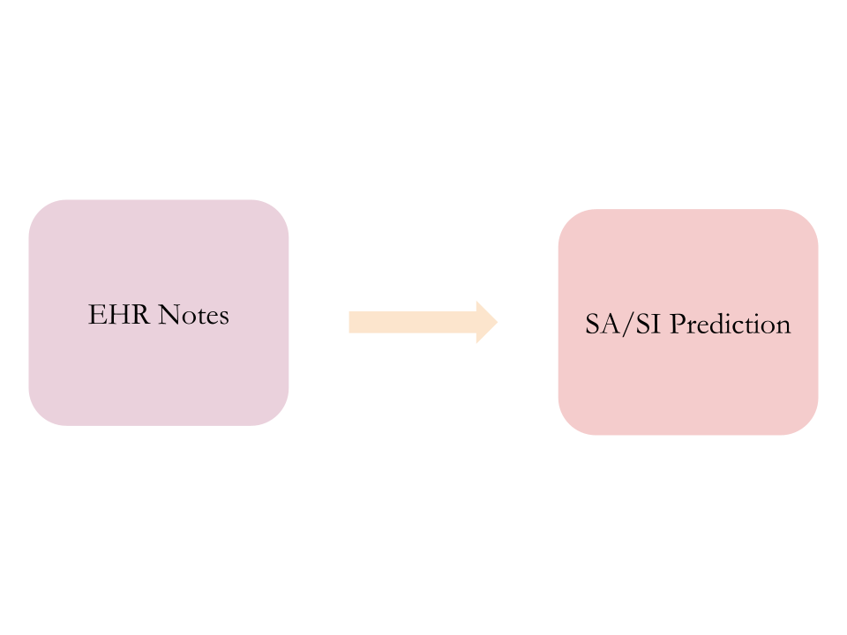
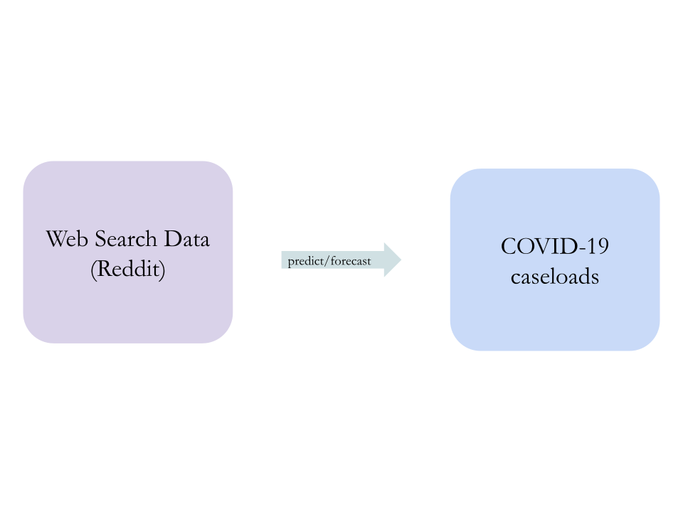
Health Applications
Suicide Early Intervention/Prevention
Motivation: One of the leading causes of death
COVID-19 Forecasting
Motivation: Ongoing global pandemic

Slide 8
Misinformation Detection
with multiple approaches
1.
2.
3.
4.
User and Comment Trees
Early Rumor Detection
For Chinese Datasets
Text & Tables

Slide 9

NLP in Politics...
Political Perspective Detection in News Media
Motivation: Combating political polarization
Identify political perspectives from media (left wing or right wing)
Political Conflict and Violence
Be able to recognize conflict and political violence
Pre-trained model → helps future research understand and study conflict/armed violence

Slide 10
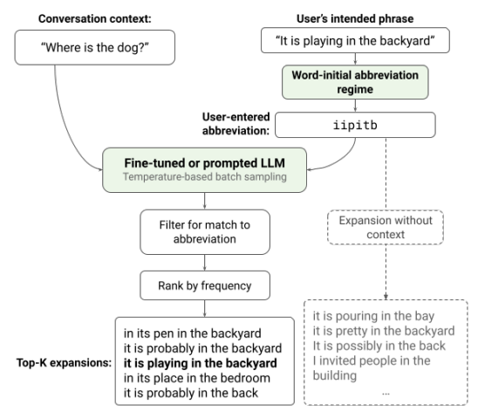
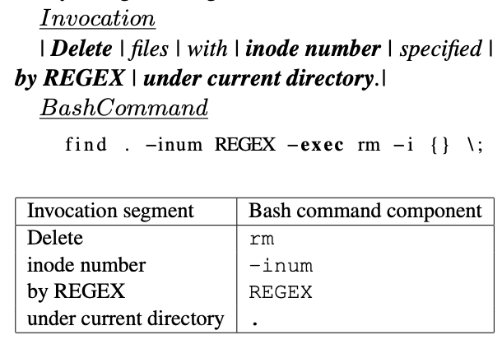
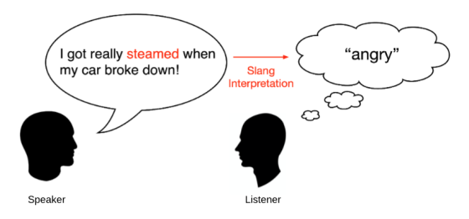
Translation
Abbreviation Expansion
AAC for people with severe limited motor capabilities
Natural language to Bash Commands
Making computing more accessible
Slang Interpretation
Common use of informal language that’s hard for computers to interpret

Slide 11
Scoring
Automatic Essay Grading (AEG)
Motivation: Alleviate burden of grading off of teachers
Approach: Multi Task Learning
  Splitting tasks into a primary task & auxiliary tasks
Automatic Short Answer Grading
Motivation: …
Approach: comparing a student’s answer against the given correct answer

Slide 12

Closer Look into AEG
Sungho Jeon & Michael Strube, Countering the Influence of Essay Length in Neural Essay Scoring
Goals
  Asses content quality and writing skills
Motivations
  Save time
  Save money
  Consistency

Slide 13
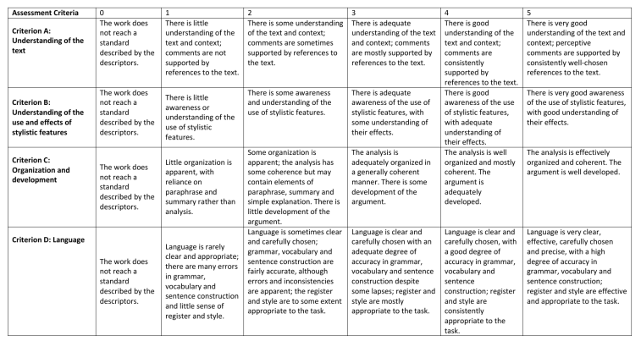
How do Humans Grade?

Slide 14
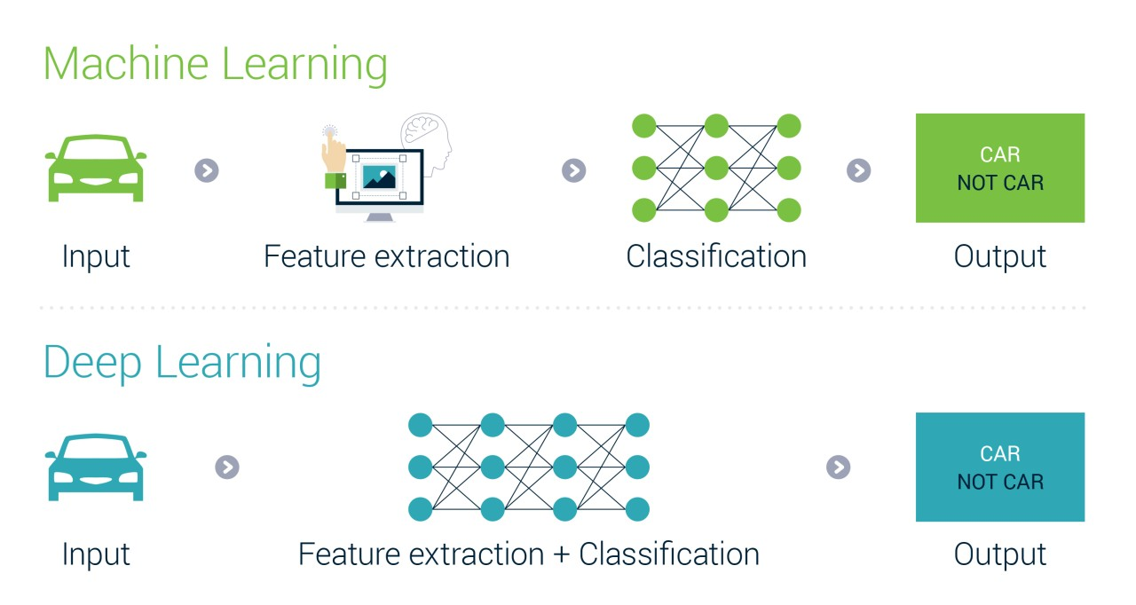
How do Machines Learn to Grade?

Slide 15
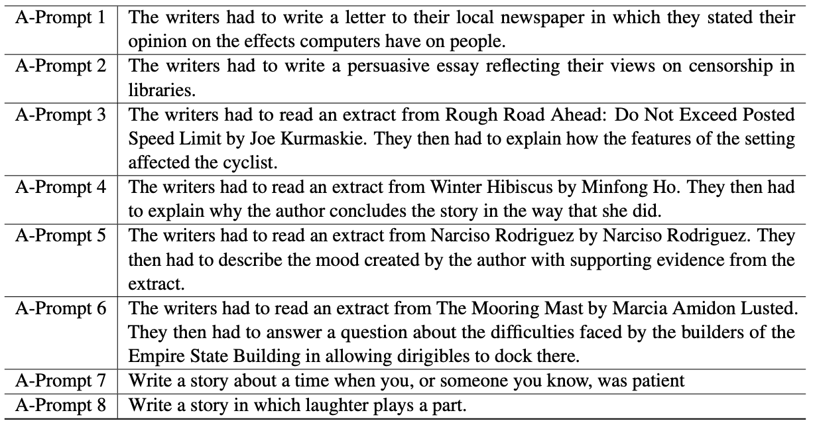
Kaggle ASAP Dataset

Slide 16
Replicating the Code
1.
2.
3.
4.
Clone & create Conda environment
Download & split data in 5 folds
Change commands/paths in repo to configure for CPU instead of GPU
Run results

Slide 17
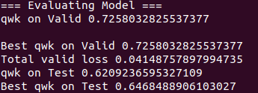

Results
with Quadratic Weighted Kappa (QWK) Scoring
Evaluating the model with QWK
Best QWK test score for fold 1

Slide 18
Conclusion & Future Work
Examining a dataset’s natural characteristics → does it need to be countered?
Providing text feedback to the writer
Cheating
Branching out in other languages

Slide 19

Sources
https://2022.naacl.org/program/schedule/
https://www.lexalytics.com/blog/machine-learning-natural-language-processing/
https://towardsdatascience.com/a-gentle-introduction-to-natural-language-processing-e716ed3c0863
https://media-exp2.licdn.com/dms/image/C5112AQHRvcnd9AXC4Q/article-cover_image-shrink_720_1280/0/1568627686923?e=1661990400&v=beta&t=0Dx1KVIt_sdsp-0BqHBV8we1jlxila81Cdqc0ngTaLw
https://www.youtube.com/watch?v=hWxOTR6h0yY
https://miro.medium.com/max/553/0*xs3Dya3qQBx6IU7C.png
https://arxiv.org/abs/1807.10854
https://www.mcgregorboyall.digital/rails/active_storage/blobs/eyJfcmFpbHMiOnsibWVzc2FnZSI6IkJBaHBBNG5zQ0E9PSIsImV4cCI6bnVsbCwicHVyIjoiYmxvYl9pZCJ9fQ==--a68180fb95f13e1cb7fc9ee44d6189f53639b38a/AI2.jpg

